Slide 1
Financial Fitness for Life, Chapter 14: All About Interest Rates Theresa Fischer October 2020 ecofisch@gmail.com

Slide 2
EconEdLink Membership
You can now access CEE’s professional development webinars directly on EconEdLink.org! To receive these new professional development benefits, become an EconEdLink member. As a member, you will now be able to:
Automatically receive a professional development certificate via e-mail within 24 hours after viewing any webinar for a minimum of 45 minutes
Register for upcoming webinars with a simple one-click process
Easily download presentations, lesson plan materials and activities for each webinar
Search and view all webinars at your convenience
Save webinars to your EconEdLink dashboard for easy access to the event
You may access our new Professional Development page here

Slide 3
Professional Development Certificate
To earn your professional development certificate for this webinar, you must:
Watch a minimum of 45-minutes and you will automatically receive a professional development certificate via e-mail within 24 hours.
Accessing resources:
You can now easily download presentations, lesson plan materials, and activities for each webinar from EconEdLink.org/professional-development/

Slide 4
https://store.councilforeconed.org/

Slide 5
Agenda
Understand the meaning of Interest Rates
How are interest rates established?
What is the difference between interest added on and APR?
Nominal Interest Rates v. Real Interest Rates
Interest rates’ effect on economic growth

Slide 6
Objectives
1. Demystify interest rates
2. Determine who is responsible for setting interest rates and why
3. Help students to understand how to calculate their interest rate for their bank accounts, credit cards and various loans
4. Understand that low interest rates can generate economic growth for a nation.
5. Distinguish between nominal interest rates or real interest rates, as an investor

Slide 7
National Standards
Standard 4 Using Credit, Grade 12 Benchmark 1
Consumers can compare the cost of credit using the annual percentage rate (APR), initial fees charged, and fees charged for late payments or missed payments.

Slide 8
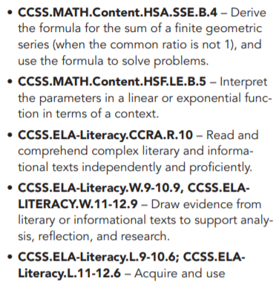
State Standards

Slide 9
Assessment Questions
What determines an interest rate?
How is an interest rate established?
Should you look at the nominal interest rate or the real interest rate when making an investment decision?
How important is the interest rate and an educated consumer?
How can an interest affect economic growth?

Slide 10
References
St Louis Federal Reserve Bank
Financial Fitness for Life, 3rd Edition by CEE
Federal Reserve Bank publications
Economics, 21st Edition by McConnell and Brue
Advanced Placement Instructional Program I: Macroeconomics by CEE
Visit https://econedlink.org/resources/collection/fffl-9-12/ to find presentations, interactives and other great technology tools to enhance your teaching of this lesson

Slide 11
What are Interest Rates?
Interest rates are the price you pay to borrow money (or on the flip side, the payment you receive when you lend money).
They’re generally framed as percentages. Each year you either pay (if you’re borrowing) or receive (if you’re lending) this percentage of the total amount of the loan.

Slide 12
How Important are Interest Rates ?
Interest rates are one of the most important numbers in the economy, because they influence how likely people are to borrow money.
If interest rates are high, it’s expensive to borrow money.
When they’re low, it’s much cheaper. Many more people will borrow!
When people borrow money, they’re usually using it to invest in big things like a house or a new business.

Slide 13
Ripple Effect of Interest Rates
These investments ripple to the rest of the economy and can boost job growth or even wages and economic growth!

Slide 14
How are Interest Rates Established?

Slide 15
Money Market Model
Nominal ir
MS MS1
Used to target the Fed Funds Rate through monetary policy
Nominal interest rates
Should be used in conjunction with AD/AS and Investment Demand models
ir
ir1
MD
QM QM1
Quantity of Money

Slide 16
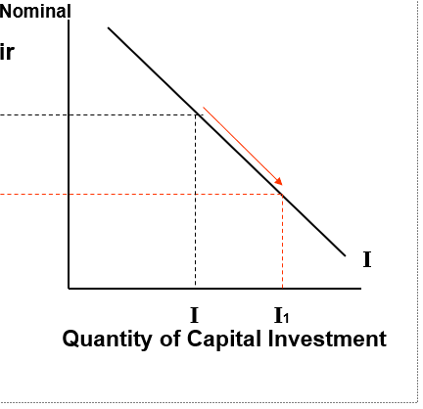
MONEY MARKET = Linked to Capital Investment (Buying Bonds)

Slide 17
Investment Linked to AD/AS
Price level
SRAS
Nom-inal ir
Investment in Capital
PL1
PL
ir
ir1
AD1
(C+I1+G)
I
AD (C+I+G)
0 I I1
Y Y1
Quantity of Capital Investment
Real Gross Domestic Product
Expansionary Policy

Slide 18
Loanable Funds + Theory of Interest
The supply of loanable funds comes from savers who deposit money in banks.
Supply is positively-sloped because people need an incentive to delay current spending.
Demand is negatively-sloped since higher interest rates discourage borrowing and spending.
Government borrows money from this market when taxes don’t cover the bills. This could create crowding out.

Slide 19
Control of Interest Rates
The majority of influence on interest rates comes from the private sector.
Rates react to changes in the individual desire of private citizens to consume or invest in capital (or to save…)
Investment spending and the interest sensitive components of consumption spending are inversely related to interest rates.
The desire to save is positively related to interest rates.

Slide 20
Calculating Simple Interest Rates
FC = P x R x T
FC: Finance Change or total Interest
P: Principal
R: Interest Rate (an add on rate, expressed in decimal form)
T: Time in years
For example, you borrow $10,000 at 8% What is the finance charge for 4 years?
$10,000 x .08 x 4 = $3,200

Slide 21
Calculate Some Finance Charges!
Gabrielle Daily borrows $1,000 at 6 % add on rate for 1 year. What is the finance charge?
Jessica Candelaria borrows $2,000 at a 10% add on rate for 3 years. What is the finance charge?

Slide 22
Answers
Gabrielle Daily borrows $1,000 at 6 % add on rate for 1 year. What is the finance charge?
$60
Jessica Candelaria borrows $2,000 at a 10% add on rate for 3 years. What is the finance charge ?
$600

Slide 23
Repayment Questions
If you want to lower the finance charge, should you shop for a higher or lower interest rate? Why?
If you want to reduce the finance charges should you pay back the loan more quickly or less quickly? Why?

Slide 24
Answers
If you want to lower the finance charge, should you shop for a higher or lower interest rate? Why?
Lower, because the interest will be lower, and you will pay less.
If you want to reduce the finance charges, should you pay back the loan more quickly or less quickly? Why?
More quickly. The more quickly you pay back your loan, the shorter your borrowing period and the lower finance charges.

Slide 25
Let’s Calculate Monthly Payments
MP = (PFC)N
MP: Monthly Payment
P: Principal of the loan
FC: Finance charge or total interest
N: Number of months for the loan
You borrow $10,000 at an 8% add on rate for 4 years. What is your monthly payment?
FC = $10,000 x .08 x 4 = $3,000
MP =$10,000 + $3,2000 = $275 a month
48

Slide 26
Borrowing Questions
Maria Torres borrows $8,000 at an 8 % add on rate for 4 years
What is the finance charge?
What is the monthly payment?

Slide 27
Answers
Maria Torres borrows $8,000 at an 8 % add on rate for 4 years
What is the finance charge?
$2,560
What is the monthly payment?
$220

Slide 28
Borrowing Questions
David Kim borrows $8,000 at 8% for 2 years.
What is the finance charge?
What is the monthly payment?

Slide 29
Answers
David Kim borrows $8,000 at 8% for 2 years.
What is the finance charge?
($8,000 x 08 x 2) = $1,280
What is the monthly payment?
($8,000 + $1,280)/ 24 = $386.67

Slide 30
Truth and Lending Law 1968
The Truth in Lending Act (TILA) protects you against inaccurate and unfair credit billing and credit card practices. It requires lenders to provide you with loan cost information so that you can comparison shop for certain types of loans.
www.occ.treas.gov

Slide 31
Dodd Frank Act and the Consumer Protection Act 2008
This was as a result of the 2008 Financial Crisis
In the past, lenders advertised interest rates in various ways
Historical outcomes:
some people end up paying a much higher rate than they thought
lenders would compute the rates differently for different products
consumers had difficulty shopping for credit

Slide 32
APR Video

Slide 33
“Zero %” APR Financing
…What does it mean for the consumer?
What does this mean for the consumer?
Notes:
Typical offers from auto companies are "Zero Percent APR financing available or $1,000 rebate". The consumer who elects "zero percent" financing gives up a $1,000 rebate (reduction in car price). Effectively, he or she pays $1,000 to get the "interest free" loan. Since only auto makers can do this type of bundling, banks, credit unions and other competitors are left at a disadvantage. They must disclose true APR rates while the auto makers can claim no interest costs.

Slide 34
Determining APR
APR = 2 x M x FC
P x (N+1)
M: Number of payments
(Monthly Payments is always 12 per calendar year)
FC: Finance charges or total interest
P: Principal
N: Number of payments
The APR is the total yearly cost of borrowing. The interest rate is equal to the APR minus the portion of that cost that comes from fees. Both the APR and interest rate are expressed as percentage rates, but the APR is always higher unless the loan includes no fees.

Slide 35
Comparing Finance Charges with APR
George secured a loan $1,200 at 10% and he will pay off the loan at the end of the year. He will pay $1,320 at the end of the year.
Sheila secured a loan $1,200 at 10% paying $110 a month. Part of this repayment of the loan is the principal and the interest rate and service charges.
Each month she has less of the loan.
Now let’s see annual percentage rate using the APR formula
APR = 2 x 12 x $120 = $2,880 = 0.1846 = 18.46 %
$1,200 x 13 $15,600

Slide 36
Why the difference between an add on finance charge and APR?
George has the loan for the entire year and he then pays it back in ONE sum at the end of the time period.
Sheila pays a monthly amount which goes toward the repayment of the loan.
Sheila has less of a loan each month because of her monthly payments. She is paying for a service fee along with the interest rate.
George has no other service fee but the Interest rate on the loan.

Slide 37
APR & Financing Questions
Lisa Rios borrows $5,000 at 5% add on rate for one year
What is her finance charge?
What is her APR?

Slide 38
Answers
Lisa Rios borrows $5,000 at 5% add on rate for one year…
What is her finance charge? $250
What is her APR? 9.2%

Slide 39
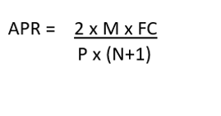
APR & Financing Questions
Brett Olson borrows $6,000 for three years at a 7% add on rate…
What is the finance charge?
What is the APR?

Slide 40
Answers
Brett Olson borrows $6,000 for three years at a 7% add on rate…
What is the finance charge? $1,260
What is the APR? 13.6%

Slide 41
Nominal Interest Rate
The nominal interest rate is the stated interest rate of a bond or loan, which signifies the actual monetary price borrowers pay lenders to use their money.
Ex.: If the nominal rate on a loan is 5%, borrowers can expect to pay $5 of interest for every $100 loaned to them. This is often referred to as the coupon rate, because it was traditionally stamped on the coupons redeemed by bondholders.
Investopia.com

Slide 42
Real Interest Rate
The real interest rate is so named because, unlike the nominal rate, it factors inflation into the equation to give investors a more accurate measure of their buying power after they redeem their positions.
Ex.: If an annually compounding bond lists a 6% nominal yield and the inflation rate is 4%, then the real rate of interest is actually only 2%.
Investotopia.com

Slide 43
What’s the Difference?
The nominal interest rate is the rate you pay on a loan.
The real interest rate is the nominal interest rate adjusted for inflation. A higher real interest rate reduces a borrowing firm's profit and hence its willingness to borrow.

Slide 44
Here is the formula…
RR = Real Rate of Return​
RR = Nominal Interest Rate − Inflation Rate
If nominal interest rate is 6% and inflation is 5%, what is the real rate of Interest rate? ____________
If the Real rate of interest is 10% and inflation is 5%, what is the nominal rate of interest?_____________
As an investor in a business, which interest rate would concern you? _______

Slide 45
Answers
If nominal interest rate is 6% and inflation is 5%, what is the real rate of Interest rate? ____________
1%
If the Real rate of interest is 10% and inflation is 5%, what is the nominal rate of interest?_____________
5%
As an investor in a business, which interest rate would concern you? REAL INTEREST RATE

Slide 46
Assessment Questions & Answers
What determines an interest rate? How is an interest rate established?
Supply and Demand. The Federal reserve Bank and the Open market Operation of buying selling securities.
Should you look at the nominal interest rate or the real interest rate when making an investment decision?
You want to look at the real interest rate with inflation removed.
How important is the interest rate and an educated consumer?
Interest rates determine the cost of your loan and whether you are able to afford the loan.
How can an interest affect economic growth?
A low interest rate incentives your ability to afford to buy a home, buy capital equipment and therefore create growth in the economy.

Slide 47
Sum Up Questions
1. What is the principal of a loan?
2. What is considered the finance charge?
3. Why is APR important to know when you take out a loan?
4. How can a borrower reduce the finance charge on a loan?
5. What is more important real or nominal interest rates?
6. How can interest rates affect growth in an economy?

Slide 48
Sum Up Answers
1. What is the principal of a loan?—Original mount of $ borrowed, not including fees.
2. What is considered the finance charge?--Amount of interest need to be paid.
3. Why is APR important to know when you take out a loan?--It is the best figure to use when comparing the cost of loans.
4. How can a borrower reduce the finance charge on a loan?--Shop for low APR and pay back quickly.
5. What is more important, real or nominal interest rates?---Real interest rates because it gives investors a more accurate measure of their buying power, after they redeem their positions.
6. How can interest rates affect growth in an economy?--People are willing to borrow at low rates and buy homes, business and capital equipment.

Slide 49
Lessons on Interest Rates
State of New Jersey resources for teachers
https://www.state.nj.us/education/aps/cccs/career/resources/mclesson11.pdf
Next Generation Personal Finance
https://www.ngpf.org/curriculum/?gclid=CjwKCAjwzvX7BRAeEiwAsXExo7YGoiGgcPB1g4year5M7QP9TUB1Bd-t-6Vwd4Kc6WoRoeYkawKZ3ImBoCeooQAvD_BwE
High School Financial Planning Program
https://www.hsfpp.org/instructors/instructor-overview.aspx?gclid=CjwKCAjwzvX7BRAeEiwAsXExo0aJDW6d2_wsOZqk-mdUhhwg0XLleHBncOurN0qRAV_E0f9g6_- owBoCm8UQAvD_BwE
Money Instructor
https://www.moneyinstructor.com/lesson/understandinterest.asp
PBS learning website
https://ny.pbslearningmedia.org/resource/fin10.socst.personfin.interest.lpinterest/the-business-of-interest/

Slide 50
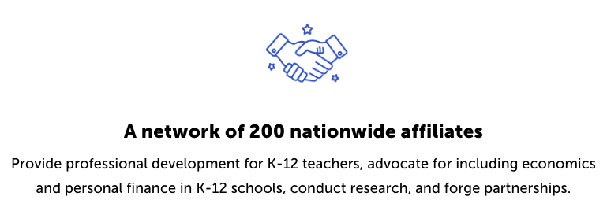
CEE Affiliates
https://www.councilforeconed.org/resources/local-affiliates/

Slide 51
Thank You to Our Sponsors!

