Slide 1
Tic Tac Taxes
Presented by
Dr. Julie Heath, University of Cincinnati
October 5, 2020 julia.heath@uc.edu

Slide 2
EconEdLink Membership
You can now access CEE’s professional development webinars directly on EconEdLink.org! To receive these new professional development benefits, become an EconEdLink member. As a member, you will now be able to:
Automatically receive a professional development certificate via e-mail within 24 hours after viewing any webinar for a minimum of 45 minutes
Register for upcoming webinars with a simple one-click process
Easily download presentations, lesson plan materials and activities for each webinar
Search and view all webinars at your convenience
Save webinars to your EconEdLink dashboard for easy access to the event
You may access our new Professional Development page here

Slide 3
Professional Development Certificate
To earn your professional development certificate for this webinar, you must:
Watch a minimum of 45-minutes and you will automatically receive a professional development certificate via e-mail within 24 hours.
Accessing resources:
You can now easily download presentations, lesson plan materials, and activities for each webinar from EconEdLink.org/professional-development/

Slide 4
Agenda
Warm-up
Kinds of taxes
Purpose of taxes
Levels of government
Matching game
Individual activity

Slide 5
Objectives
Understand several kinds of taxes
Explore the connection between taxes and public goods
Analyze why different govts (federal, state, local) collect different taxes
Illustrate why govts provide public goods

Slide 6
National Standards--Economics
Name: Government Failure
Standard: 17
Students will understand that: Costs of government policies sometimes exceed benefits. This may occur because of incentives facing voters, government officials, and government employees, because of actions by special interest groups that can impose costs on the general public, or because social goals other than economic efficiency are being pursued.

Slide 7
National Standards--Economics
Name: Government Failure
Standard: 17
Students will be able to use this knowledge to: Identify some public policies that may cost more than the benefits they generate, and assess who enjoys the benefits and who bears the costs. Explain why the policies exist.

Slide 8
National Standards—Fin. Lit.
Name: Earning an Income
Students will understand that: Income for most people is determined by the market value of their labor, paid as wages and salaries. People can increase their income and job opportunities by choosing to acquire more education, work experience, and job skills. The decision to undertake an activity that increases income or job opportunities is affected by the expected benefits and costs of such an activity. Income also is obtained from other sources such as interest, rents, capital gains, dividends, and profits.

Slide 9
Lesson Overview
Students learn about taxes: different types of taxes, and why we have them.
Time: 45-60 minutes
Materials:
Receipt
Goods and Services Cards/Gov’t or Business Cards
Taxing Activity
Where Does Your $1 Go?
Fun Tax Facts
Tic-Tac-Taxes Game

Slide 10
Lesson Demo

Slide 11
We Need a New School!
A new middle school costs about $26 million.
How can we get the money to build it?
Will we be able to raise enough?

Slide 12
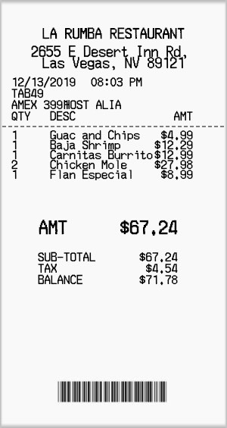
Kinds of Taxes

Slide 13
Sales Tax—What Is It?
Tax levied by local/state governments on purchases of goods and some services
A percentage of purchases—flat rate
Example, in Cincinnati:
    City sales tax 0%
    County sales tax 1.25%
    State sales tax 5.75%
    Total 7.00%

Slide 14
Sales Tax—Who Collects It?
Local (city and/or county) and state governments
More important for state governments
US has no federal sales tax, but other countries do

Slide 15
Income Tax—What Is It?
Not a fixed percentage in U.S.—increases as income increases (progressive)
  Ex: Federal marginal tax rate on $50,000 = 22%
    Federal marginal tax rate on $200,000 = 32%

Slide 16
Income Tax—Who Collects It?
Income taxes can be collected by one, two, or all three levels of government
Usually all income tax payments for previous year’s income are due on April 15

Slide 17
Excise Tax—What Is It?
Tax on particular goods and services like gasoline, alcohol, airplane tickets, and tobacco
Can be either a percentage or per unit
Consumers often don’t see how much an excise tax is because it is a part of the price

Slide 18
Excise Tax—Who Collects It?
Any or all of the three levels: local, state, federal
Ex: federal excise tax on gasoline = 18.4 cents/gallon
  States add additional excise tax; CA is highest at 61.2 cents/gallon
  Many states do not charge an additional sales tax on gasoline

Slide 19
Property Tax—What Is It?
Tax on things we own, like a house, or in some states, personal property like a car and other belongings.
Percentage of value

Slide 20
Property Tax—Who Collects It?
Any of the three levels: local, state, or federal, but primarily local

Slide 21
What Do Taxes Pay For?
Ask students to name the things they think taxes pay for
Local: schools, roads, police/fire, libraries, parks
State: roads, state parks, bridges, education, social services
National: military, interstate highways, education, national parks, social services
What is common among these…? They benefit everyone

Slide 22
Tax Distribution
Students probably have an easier time naming things provided by local/state governments than the federal government
Ask students to guess how much of each $1 collected in taxes goes to each of the three levels
Refer to Where Does Your $1 Go?
Point out that most of each $1 in taxes goes to the federal government, including that the two portions of federal taxes make up 65 cents of every dollar collected in taxes

Slide 23
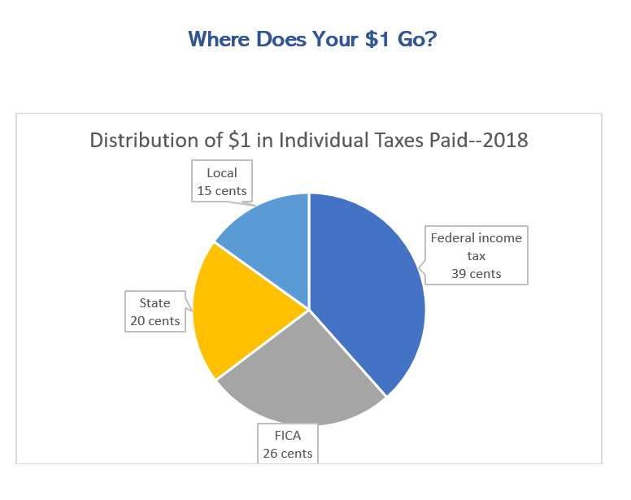

Slide 24
Why Not Business?
Businesses exist to make a profit
They do that by selling goods and services for more than it costs them to make/provide them.
Ex. What is the market for fire protection?
  Your house is on fire, and you call the fire department. They say, we’ll come and put the fire out for $800, pay by cash or credit. You don’t have $800. What do you do?

Slide 25
Why Taxes?
Imagine you earn $5,000 every month or $60,000/yr.
Think about what the federal government provides.
How much of that $60,000 are you willing to contribute to federal taxes?
Solicit answers from class and add up total contributions and get average for class.

Slide 26
Why Taxes? Cont’d
Tell students that the federal govt spent $13,415 per person in 2019.
Compute the difference between $13,415 and the class average, pointing out the shortfall.
Point out that if we leave funding of federally-provided goods and services to contributions, we have to choose: fewer goods and services or find the money elsewhere. And what if people change their minds?

Slide 27
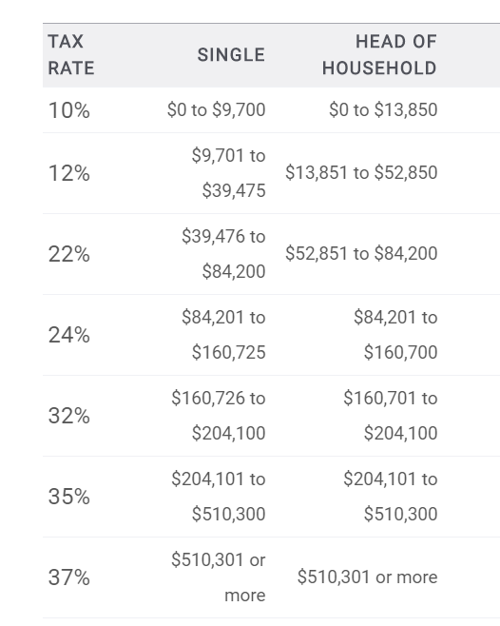
Federal taxes on $60,000 = $9,059
Tax on $9,701 $970
Tax on $29,774
($39,475-$9,701) $3,573
Tax on $20,525
($60,000-$39,475) $4,516
Total $9,059
Point out that the contribution of someone making $60,000 is still shy of the average that is needed. What’s the solution?
Notes:
Two solutions: $13, 415 is what is needed, on average, but some people pay a lot more than this (and some people pay a lot less). Also, the federal government can run a deficit.

Slide 28
Concentration Game

Slide 29


Slide 30
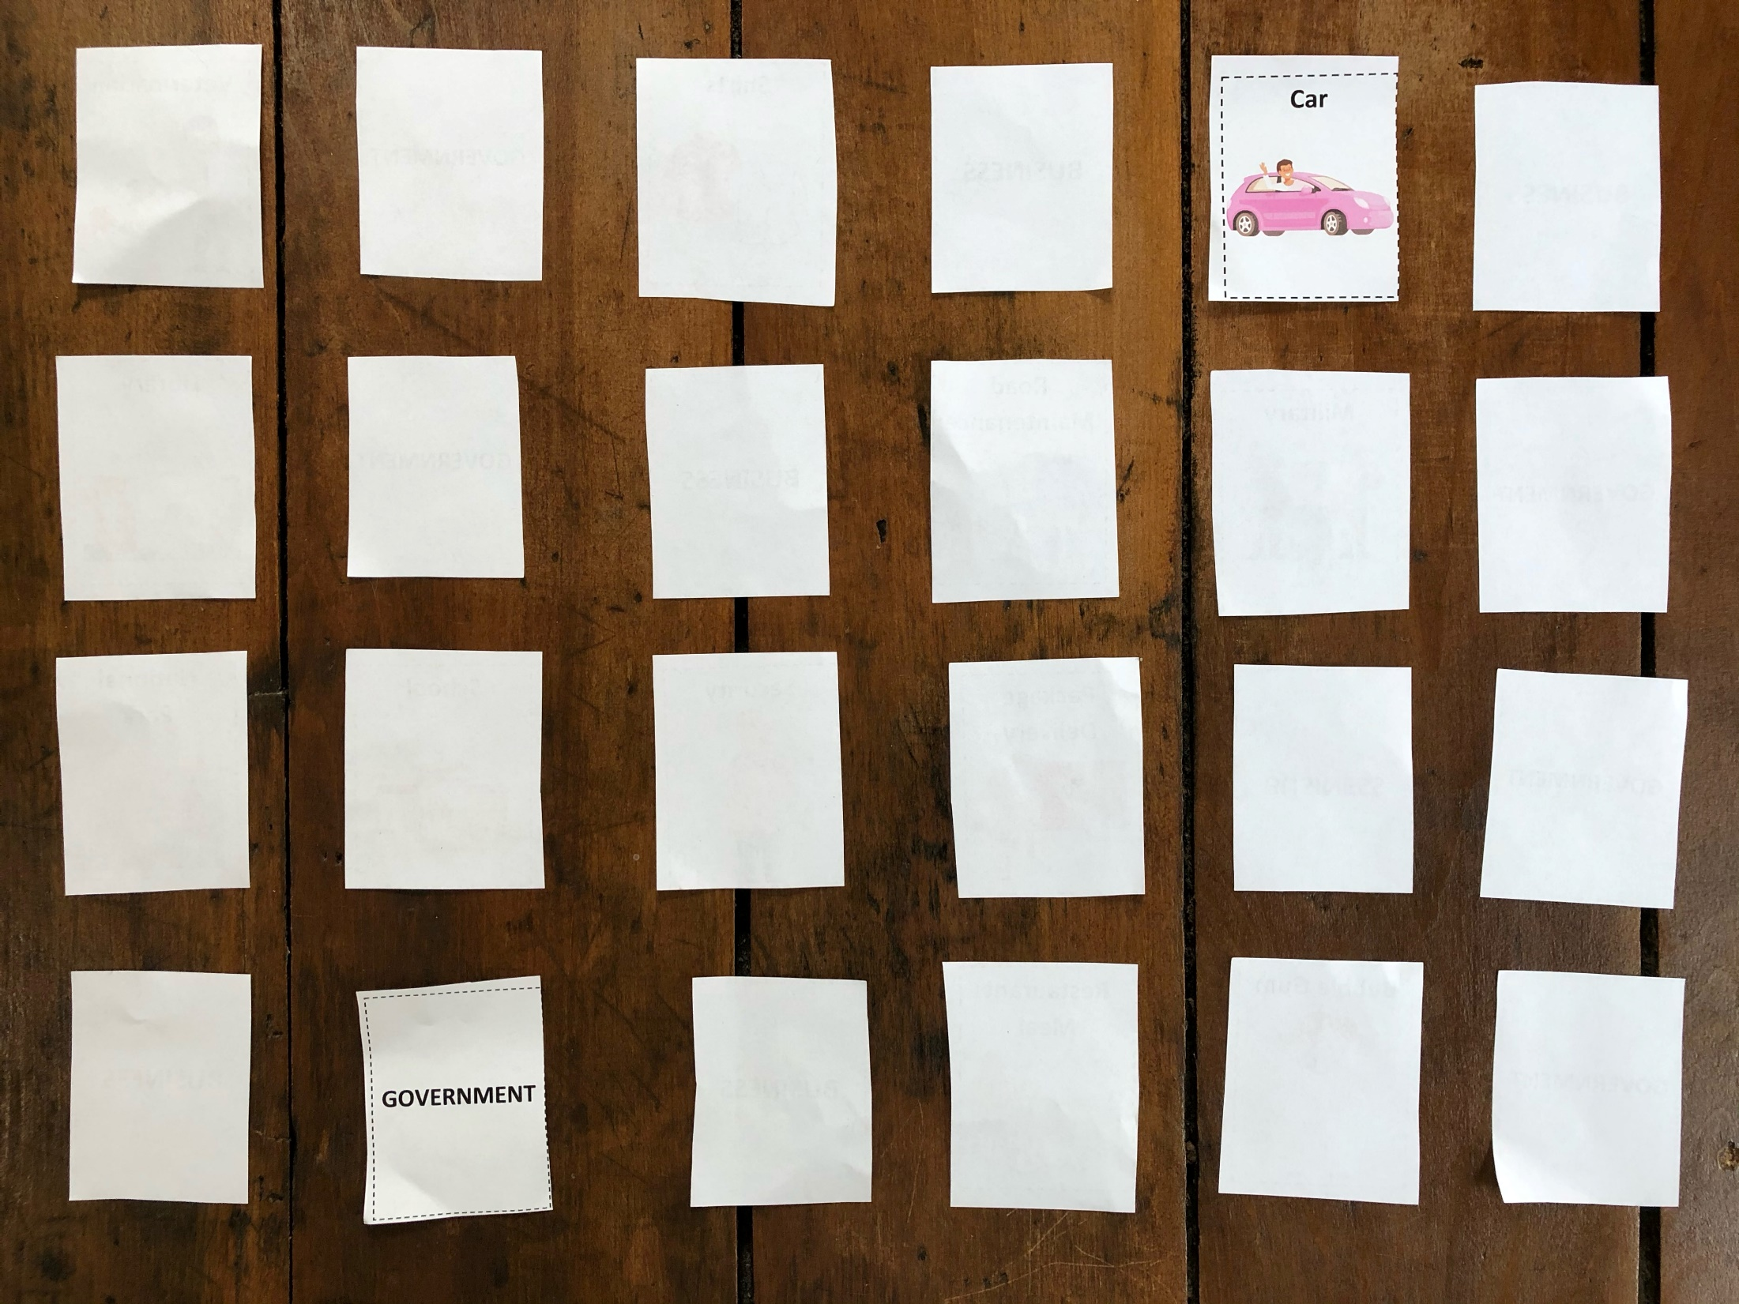

This Photo by Unknown Author is licensed under CC BY-SA

Slide 31
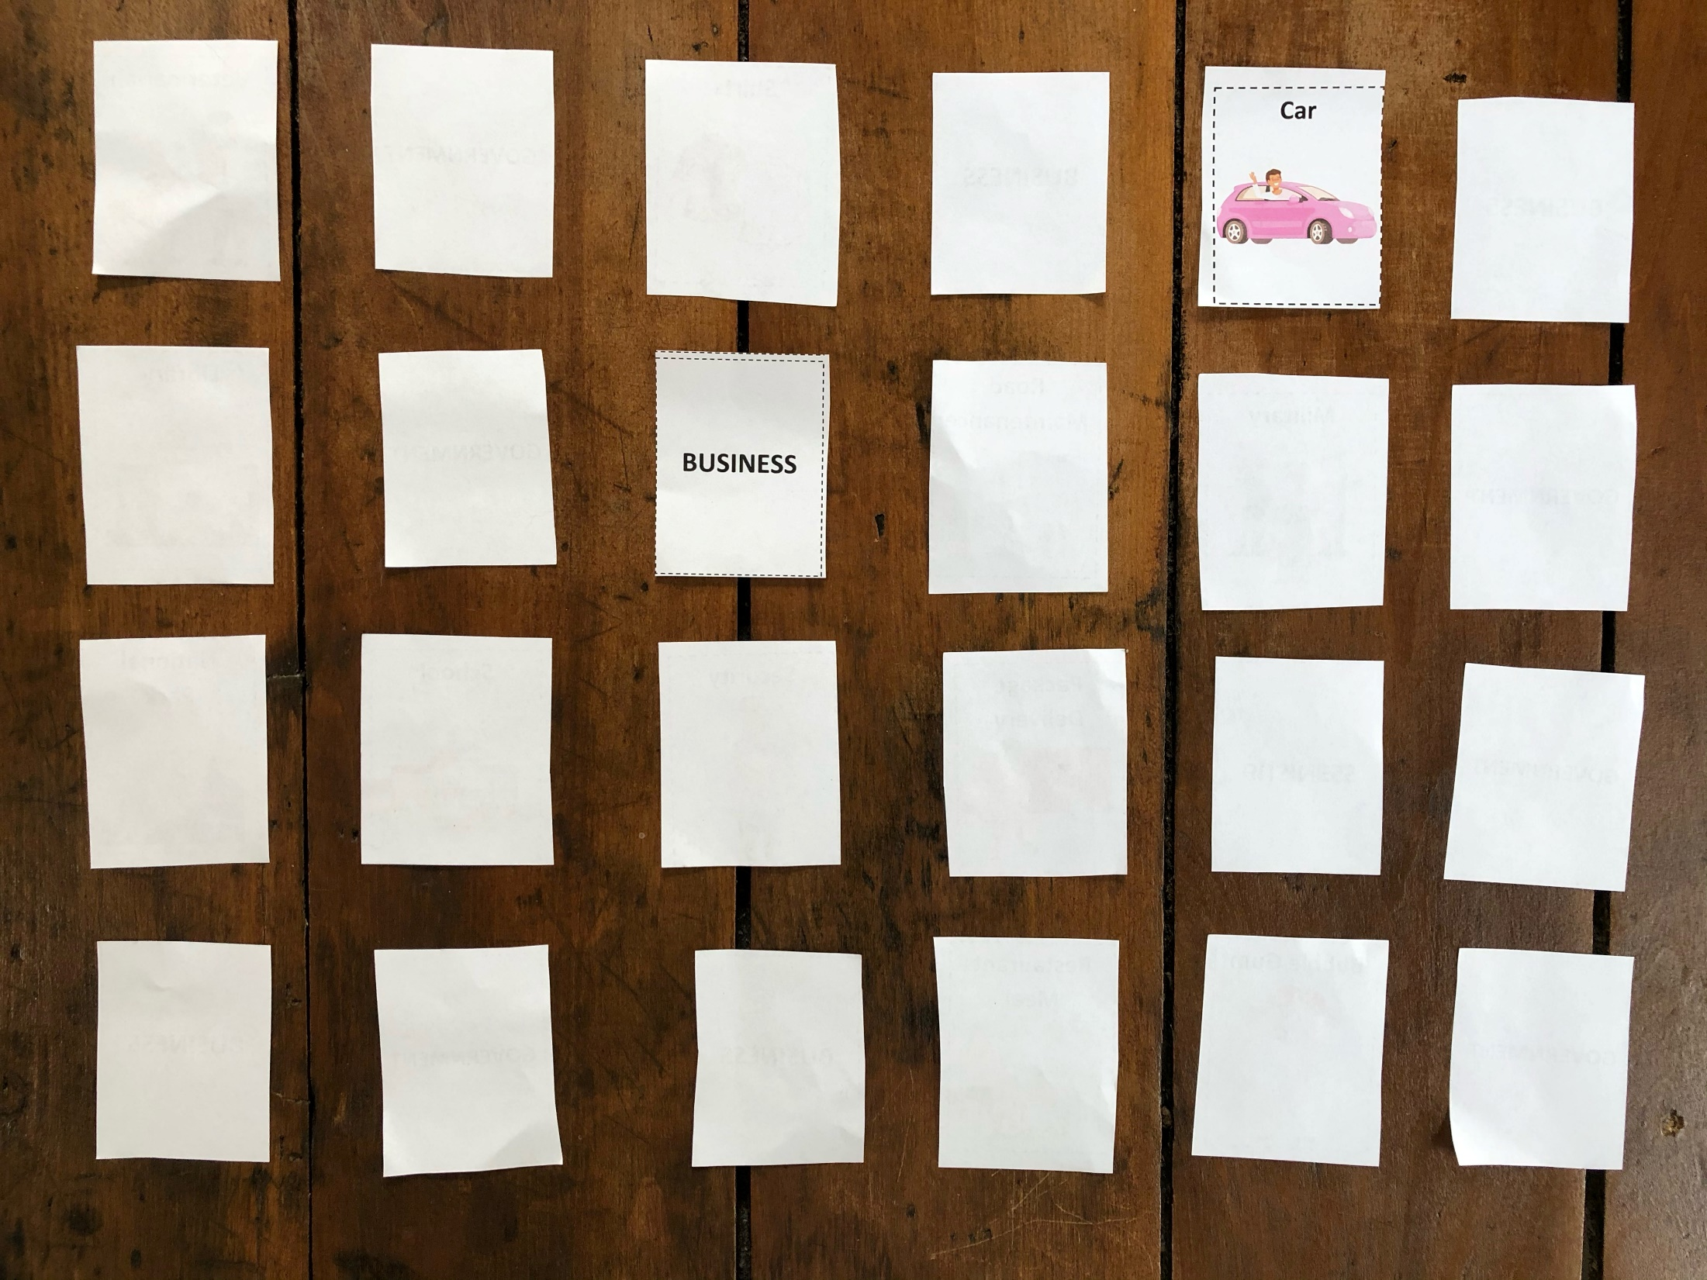


Slide 32
Math Connection
Percentages
Generate charts, graphs
Compute “effective” (or average) tax rate
Ex. Effective tax rate on $60,000 =
$9059/$60,000 = 15%

Slide 33
Paired Activity
In pairs, students complete a Tic-Tac-Toe activity

Slide 34
Reflection Activity
The average contribution needed from each person to fully meet federal government spending is $13,415. Some people pay more than that, and some people pay less than that (as in our example)
Is this “fair”? That some pay more and some pay less? In what cases is it fair or not?

Slide 35
Fun Tax Facts
See accompanying sheet

Slide 36

CEE Affiliates
https://www.councilforeconed.org/resources/local-affiliates/

Slide 37




Thank You to Our Sponsors!

Slide 38

The Conference is your pathway to learn about the opportunities to incorporate personal finance and economics into your K-12 classroom and to exchange ideas with hundreds of peers.
Register by August 15, 2020 to receive the early bird special discount:
$79 Early Bird ($99 thereafter)
Register Today >>>
https://www.councilforeconed.org/events/conference

