Slide 1
The Mystery of Voters Who Don’t Vote

Slide 2
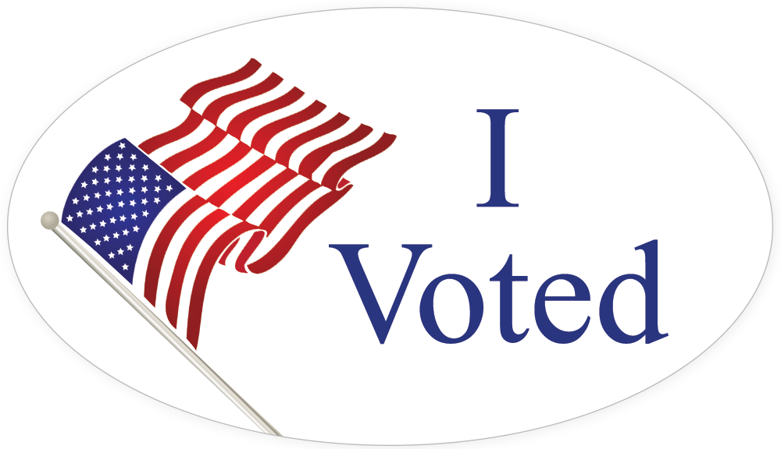

Slide 3
Match Countries with Percentages
Countries
Australia
Belgium
Canada
France
Germany
Israel
South Korea
Sweden
Switzerland
United States
Percentage of Voters
87%
83%
79%
78%
76%
69%
68%
62%
56%
39%

Slide 4
Countries with Voting Percentages
Australia 79%
Belgium 87%
Canada 62%
France 68%
Germany 69%
Israel 76%
South Korea 78%
Sweden 83%
Switzerland 39%
United States 56%
https://www.pewresearch.org/fact-tank/2018/05/21/u-s-voter-turnout-trails-most-developed-countries/

Slide 5
Handy Dandy Guide to Economic Thinking
People choose. People choose the alternative which seems best to them because it involves the least cost and greatest benefit.
People's choices involve costs. Cost is the second best choice people give up when they make their best choice.
People respond to incentives in predictable ways. Incentives are actions or rewards that encourage people to act. When incentives change, people's behavior changes in predictable ways.
People create economic systems that influence individual choices and incentives. How people cooperate is governed by written and unwritten rules. As rules change, incentives change and behavior changes.
People gain when they trade voluntarily. People can produce more in less time by concentrating on what they do best. The surplus goods or services they produce can be traded to obtain other valuable goods or services.
People's choices have consequences that lie in the future. The important costs and benefits in economic decision making are those which will appear in the future. Economics stresses making decisions about the future because it is only the future that we can influence. We cannot influence things that have happened in the past.

Slide 6
Group Assignment
The Economic Mystery…
Having the right to vote is a major component to the success of a healthy democracy and many Americans consider the right to vote to be one of the most important rights they have as citizens. Despite these strong beliefs, only 56% of eligible voters voted in the most recent presidential election.
Why???

Slide 7
Solving the Mystery of Why People Don’t Vote Clue 1.
Motor Voter Legislation. Because of “Motor Voter” legislation and other innovations, it is relatively easy for most Americans to register to vote.
https://www.justice.gov/crt/about-national-voter-registration-act

Slide 8
Solving the Mystery of Why People Don’t Vote Clue 2.
How Many Elections Each Year? At the federal, state and local levels, there are many elections in the United States. An American who voted in all the elections for which he or she was eligible would do a lot of voting.
https://ballotpedia.org/Elections_by_state_and_year

Slide 9
Solving the Mystery of Why People Don’t Vote Clue 3.
Long Lines. In presidential elections, long lines of voters often form at the polls.
https://www.usatoday.com/story/news/politics/elections/2016/11/08/voting-polls-election-day/93201770/

Slide 10
Solving the Mystery of Why People Don’t Vote Clue 4.
Finding Issues. It can be difficult for voters to find reliable information about candidates and issues — especially local candidates and state or local issues addressed in referenda.
http://www.ontheissues.org/default.htm

Slide 11
Solving the Mystery of Why People Don’t Vote Clue 5.
Two Senators. Each state elects two United States Senators.
www.senate.gov/pagelayout/reference/e_one_section_no_teasers/org_chart.htm

Slide 12
Solving the Mystery of Why People Don’t Vote Clue 6.
Slim Margins. Few elections in the United States are ever decided by one or two votes. (Although the 2000 Presidential election came very close!)
www.infoplease.com/ipa/A0876793.html

Slide 13
Solving the Mystery of Why People Don’t Vote Clue 7.
Primary and General. There are two kinds of elections — primary and general.
http://www.magazineusa.com/us/info/show.aspx?unit=elections&doc=1,002&dsc=Primary_and_General_Elections

Slide 14
Solving the Mystery of Why People Don’t Vote Clue 8.
26th Amendment. The 26th Amendment to the Constitution made 18 the legal voting age.
https://legal-dictionary.thefreedictionary.com/26th+Amendment

Slide 15
Solving the Mystery of Why People Don’t Vote Clue 9.
At the Polls. Voting takes place in polling places.
www.vote411.org/

Slide 16
Which clues helped solve the mystery?
How Many Elections Each Year? At the federal, state and local levels, there are many elections in the United States. An American who voted in all the elections for which he or she was eligible would do a lot of voting.
Long Lines. In presidential elections, long lines of voters often form at the polls.
Finding Issues. It can be difficult for voters to find reliable information about candidates and issues — especially local candidates and state or local issues addressed in referenda.
Slim Margins. Few elections in the United States are ever decided by one or two votes. (Although the 2000 Presidential election came very close!)

