Slide 1
Read Aloud Ready 2
Economics in Children’s Literature
Presented by Amanda Stiglbauer
September 28, 2020 amanda.stiglbauer@moore.sc.edu

Slide 2
EconEdLink Membership
You can now access CEE’s professional development webinars directly on EconEdLink.org! To receive these new professional development benefits, become an EconEdLink member. As a member, you will now be able to:
Automatically receive a professional development certificate via e-mail within 24 hours after viewing any webinar for a minimum of 45 minutes
Register for upcoming webinars with a simple one-click process
Easily download presentations, lesson plan materials and activities for each webinar
Search and view all webinars at your convenience
Save webinars to your EconEdLink dashboard for easy access to the event
You may access our new Professional Development page here

Slide 3
Professional Development Certificate
To earn your professional development certificate for this webinar, you must:
Watch a minimum of 45-minutes and you will automatically receive a professional development certificate via e-mail within 24 hours.
Accessing resources:
You can now easily download presentations, lesson plan materials, and activities for each webinar from EconEdLink.org/professional-development/

Slide 4
Agenda
NearPod Matching Pairs Activity
Economic Concepts for the Early Grades
Intro to A New Coat for Anna – (Read Aloud Ready #1)
Time to Climb!
Collaboration Board Bartered Items
Debrief A New Coat for Anna
Intro to The Little Red Hen – (Read Aloud Ready #2)
Mentimeter Economic Concepts within the book
Padlet Productive Resources
Debrief The Little Red Hen

Slide 5

Objectives
I can:
Identify key economic concepts for the early grades.
List productive resources in A New Coat for Anna and The Little Red Hen.
Explain the difference between barter and trade.

Slide 6
National Standards
Standard 1: Students will understand that productive resources are limited. Therefore, people cannot have all the goods and services they want; as a result, they must choose some things and give up others.
STANDARD 5: TRADE Voluntary exchange occurs only when all participating parties expect to gain. This is true for trade among individuals or organizations within a nation, and among individuals or organizations in different nations.

Slide 7
Economic Concepts for Early Grades
Scarcity
Needs and wants
Productive resources
  Natural resources
  Capital resources
  Human resources
  Entrepreneurship
Goods and services
Opportunity Cost
Producers and consumers
Budgeting
Investing
Spending and Savings
Interdependence and trade

Slide 8

Read Aloud 1
A New Coat for Anna
by Harriet Ziefert

Slide 9



Slide 10
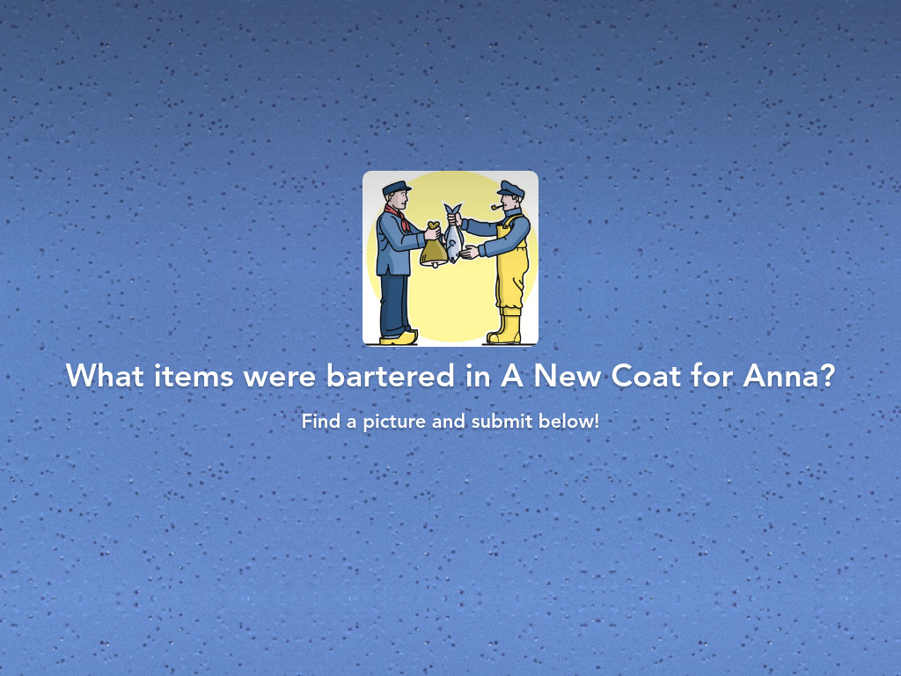


Slide 11
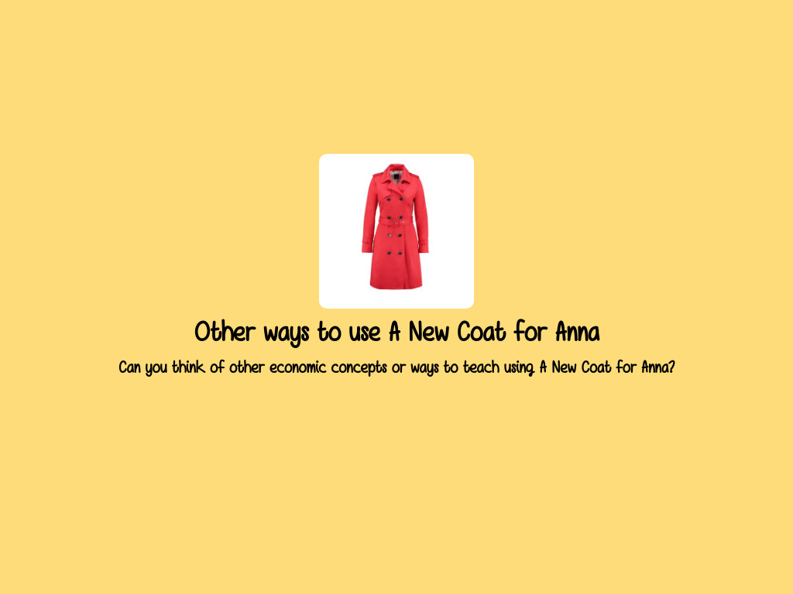

Slide 12
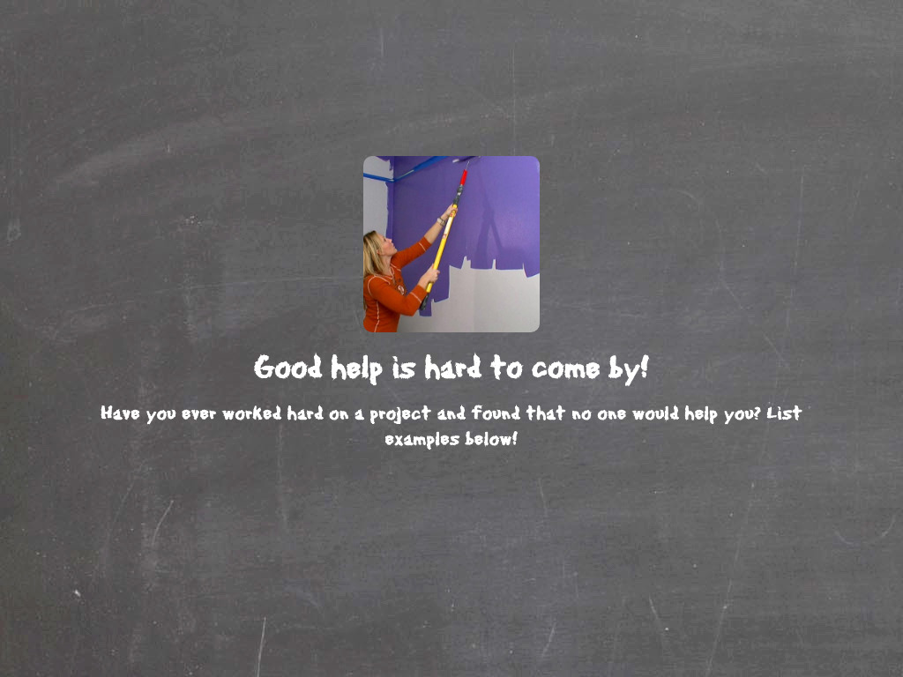

Slide 13

The Little Red Hen

Slide 14

Mentimeter
Economic Concepts in The Little Red Hen

Slide 15
Productive Resources
Natural Resources (Land) | Capital Resources (Capital) | Human Resources (Labor)

Slide 16
Assessment Questions
What is an example of a human resource used in A New Coat for Anna? (farmer)
What is an example of a natural resource used in the book? (wool, lingonberries)
In what time period did the story take place? (post-World War II)
Trade without money is known as (barter)
What do Anna and her mother do when the coat is finished? (invited the craftspeople who helped make Anna’s coat to celebrate)

Slide 17

CEE Affiliates
https://www.councilforeconed.org/resources/local-affiliates/

Slide 18




Thank You to Our Sponsors!

Slide 19

The Conference is your pathway to learn about the opportunities to incorporate personal finance and economics into your K-12 classroom and to exchange ideas with hundreds of peers.
Register by August 15, 2020 to receive the early bird special discount:
$79 Early Bird ($99 thereafter)
Register Today >>>
https://www.councilforeconed.org/events/conference

