Slide 1
Read Aloud Ready
Economics in Children’s Literature
Presented by Amanda Stiglbauer
September 14, 2020 amanda.stiglbauer@moore.sc.edu

Slide 2
EconEdLink Membership
You can now access CEE’s professional development webinars directly on EconEdLink.org! To receive these new professional development benefits, become an EconEdLink member. As a member, you will now be able to:
Automatically receive a professional development certificate via e-mail within 24 hours after viewing any webinar for a minimum of 45 minutes
Register for upcoming webinars with a simple one-click process
Easily download presentations, lesson plan materials and activities for each webinar
Search and view all webinars at your convenience
Save webinars to your EconEdLink dashboard for easy access to the event
You may access our new Professional Development page here

Slide 3
Professional Development Certificate
To earn your professional development certificate for this webinar, you must:
Watch a minimum of 45-minutes and you will automatically receive a professional development certificate via e-mail within 24 hours.
Accessing resources:
You can now easily download presentations, lesson plan materials, and activities for each webinar from EconEdLink.org/professional-development/

Slide 4
Agenda
NearPod Matching Pairs Activity
Economic Concepts for the Early Grades
Intro to A Chair for My Mother - Read Aloud #1
Savings Goals - Draw It!
Debrief A Chair for My Mother
Intro to Uncle Jed’s Barbershop - Read Aloud #2
Mentimeter - Economic Concepts within the Book
Padlet - Productive Resources
Time to Climb

Slide 5

Objectives
I can:
identify key economic concepts for the early grades.
list examples of human resources.
explain that people must make spending and saving choices to meet goals

Slide 6
National Standards
Standard 1: Students will understand that productive resources are limited. Therefore, people cannot have all the goods and services they want; as a result, they must choose some things and give up others.
Standard 10: Students will understand that institutions are created to help individuals and groups accomplish their goals. Banks, labor unions, corporations, legal systems, and not-for profit organizations are examples of important institutions. A different kind of institution, clearly defined and well enforced property rights, is essential to a market economy.
Standard 13: Income for most people is determined by the market value of the productive resources they sell. What workers earn primarily depends on the market value of what they produce.

Slide 7
Economic Concepts for Early Grades
Scarcity
Needs and wants
Productive resources
  Natural resources
  Capital resources
  Human resources
  Entrepreneurship
Goods and services
Opportunity Cost
Producers and consumers
Budgeting
Investing
Spending and Savings
Interdependence and trade

Slide 8

Read Aloud 1
A Chair for My Mother
by Vera B. Williams

Slide 9
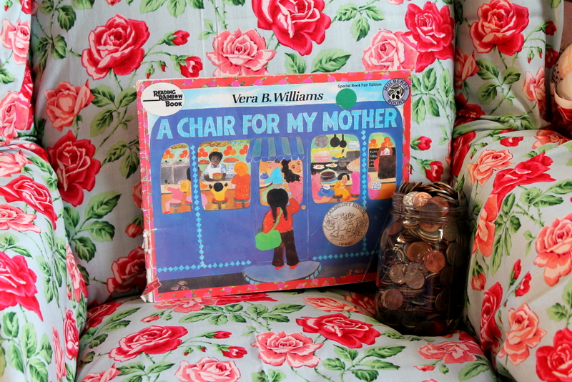
Collaborate Board
Why were the mother and little girl saving money in the book?
Why did they have to save?

Slide 10

Savings Goal
Draw It!

Slide 11
Debrief
Human Resources in A Chair for My Mother
Collaboration Board

Slide 12

Uncle Jed’s Barbershop

Slide 13

Mentimeter
Economic Concepts in Uncle Jed’s Barbershop

Slide 14
Productive Resources
Natural Resources (Land) | Capital Resources (Capital) | Human Resources (Labor)

Slide 15

Time to Climb

Slide 16
Assessment Questions
What did Uncle Jed do with the money he was saving for his barbershop? (Paid for Sarah Jean’s surgery)
What did Uncle Jed do during the Great Depression? (He continued to cut people’s hair even though they couldn’t pay him with money.)
What did Uncle Jed receive in exchange for his haircuts? (Uncle Jed took as payment whatever his customers had—a hot meal, fresh eggs, vegetables from the garden, etc.)
What event led to bank failures and contributed to Uncle Jed losing over $3,000 of his savings? (The Great Depression)
If you want to reach a savings goal more quickly, what should you do? (You need to spend less so that you can save more)

Slide 17

CEE Affiliates
https://www.councilforeconed.org/resources/local-affiliates/

Slide 18




Thank You to Our Sponsors!

Slide 19

The Conference is your pathway to learn about the opportunities to incorporate personal finance and economics into your K-12 classroom and to exchange ideas with hundreds of peers.
Register by August 15, 2020 to receive the early bird special discount:
$79 Early Bird ($99 thereafter)
Register Today >>>
https://www.councilforeconed.org/events/conference

