Slide 1
Did You Get the Message? Advertising Strategies

Slide 2
Famous People
Advertisers use famous people to grab your attention. Advertisers also think you will want to buy a product because it is associated with or recommended by a famous person.
Winning athletes are often used to promote sports clothing and equipment.
A movie star might be shown driving a new car.
Popular musicians are common in soft drink commercials.

Slide 3
Experts
You have probably seen an ad where a dentist or an actor playing a dentist tells you which toothpaste to use.
Other commercials claim most doctors prefer one medicine to other medicines.
Advertisers think you are more likely to trust a message delivered by an expert.

Slide 4
Ordinary People
Have you ever seen an ad in which ordinary people tell why they liked a movie as they were leaving the theater?
Or an ad featuring a mom who tells how clean a laundry detergent got her family's dirty clothes?
Advertisers know that some people are more likely to believe a message when “regular” people are the messengers.

Slide 5
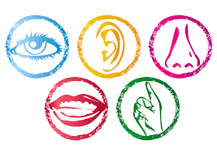
Appealing to Your Senses
Music, sound effects, color, and images
One example is the Nike “swoosh” that also serves as the company’s logo.
The color pink which is used to help promote products related to breast cancer.
Advertisers like to use something that triggers your mind to automatically think of them or their products when you see or hear it.

Slide 6
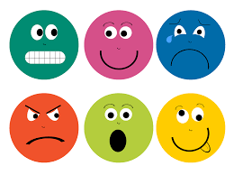
Emotional Appeal
Funny or emotional stories: Advertisers like to connect with your emotions.
If their commercial can make you laugh or feel some other emotion, it can motivate you to buy their goods or services.
Some advertisers might even use fear or a sad story as an incentive.
Focusing on your emotions can be a powerful strategy.

Slide 7
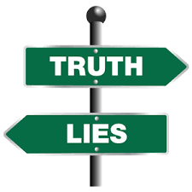
Words and Claims
The exact wording of an advertisement or the claims of what the product will do can influence you to buy certain products.
The federal government, however, requires advertisers making such claims to have proof of their results or guarantees.
Results can be monetary or non-monetary. The puffin video had non-monetary outcomes (getting to drink a Coke). An advertisement announcing a lower price or special deal that saves you money would be monetary.
Whatever words are used, advertisers are aware of their potential impact on your decision to buy their goods or service.

