Slide 1
Calculating
Simple Interest
Notes:
TEACHER: Suppose you want to get a loan to buy a car. What would you want to know about the loan? Would you want to know the amount of your monthly payments? Would you want to know how much you would have to repay including interest? In this lesson, you will learn how to calculate simple interest.
When banks use simple interest, they consider the principal, the interest rate, and the length of time of the loan. Today we will learn how banks calculate the amount in dollars to be repaid when money is borrowed.

Slide 2
Calculating Simple Interest
Oliver wants to purchase a new vehicle to get back and forth to work each day. He plans to check out a local dealership and borrow the money from his credit union.
After test-driving a few options, Oliver decided to buy a used car for $25,000.
The credit union will lend him the money. The loan is for 60 months at 4.2% APR and monthly payments of $504.17 for the duration of the loan.
Notes:
Tell students they will be using Oliver and his purchase of a new car to understand the most common terms used in lending as well as the process of calculating simple interest. Introduce (or review) the following terms: Principal (the original amount borrowed or loaned); Interest Rate (the price paid for using someone else’s money, expressed as a percentage of the amount borrowed); Duration of the loan (the number of months or years until the loan is repaid), and Monthly Payment (the amount of money required to be paid on the loan each month). Remind students that a loan is a contract between the borrower and the lender and must be repaid according to the terms of the contract or loan.

Slide 3
Calculating Simple Interest
Interest
  Money paid regularly, at a particular rate for the use of borrowed money.
Method for calculating simple interest
  Simple Interest
    Interest calculated on the principal balance only
    Formula: 𝐼=𝑃∗𝑟∗𝑡
Notes:
Tell students that understanding how interest rates are calculated will help them determine the final cost of the good or services they are financing, and it will help them compare “deals” on different products. Explain that interest is set by the lender and, unless otherwise specified, remains the same for the duration of the loan. Lenders charge interest to borrowers and pay interest to savings account holders. The interest earned by the lender serves as an incentive for them to offer loans to consumers, and as an incentive for individuals to put money into savings accounts.
Explain that simple interest is calculated only on the principal balance, and auto loans are generally calculated using the method of simple interest. To calculate simple interest, multiply the principal times the interest rate times the length (duration) of the loan.
Tell them you will use Oliver’s purchase as an example on the next slide.

Slide 4

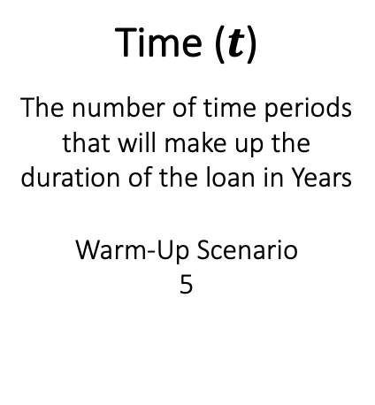
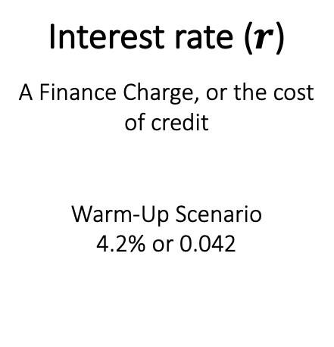
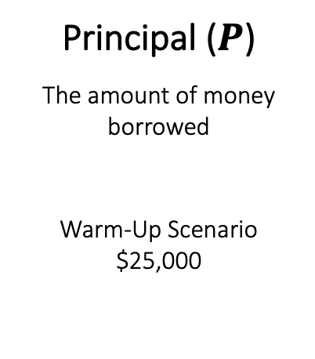
The Formula Explained
$$I=P∗r∗t$$
Principal ($P$)
The amount of money borrowed
Warm-Up Scenario
$25,000
Interest rate ($r$)
A Finance Charge, or the cost of credit
Warm-Up Scenario
4.2% or 0.042
Time ($t$)
The number of time periods that will make up the duration of the loan in Years
Warm-Up Scenario
5
Notes:
Review Oliver’s purchase. He borrowed $25,000 at an annual rate of interest rate of 4.2% for 60 months. Because you are using an annual percentage rate (APR), you need to use years, not months, in the calculations – and 60 months is 5 years.
Point out the terms and corresponding amounts in the formula. I = the amount that Oliver will pay over the life of the loan. P = the principal (the dollar amount Oliver borrowed to purchase the vehicle), which is $25,000. r = the rate of interest (the credit union set the rate as 4.2%. (Convert the percentage into a decimal to use in the formula by dividing 4.2 by 100 {4.2/100}, which means r is 0.042.) t = time (the duration of the loan is 60 months or 5 years, and 5 is used because interest is stated as APR. )

Slide 5
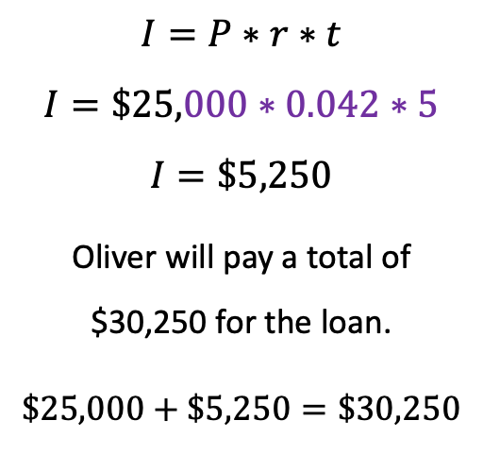
The Formula Applied
Oliver’s Purchase
What was the vehicle’s purchase price?
  $25,000
How much was the interest rate the credit union charged?
  4.2% Annual Percentage Rate (APR)
How many years does Oliver have to pay off the loan?
  5 years
$$I=P∗r∗t$$
$$I=\$25,000∗0.042∗5$$
$$I=\$5,250$$
Oliver will pay a total of $30,250 for the loan.
$$\$25,000+\$5,250=\$30,250$$
Notes:
Explain that this slide plugs the numbers for Oliver’s loan into the simple interest formula, and they can now calculate the total amount that Oliver will pay for his vehicle over the course of his loan.
Review the purchase with students before making the calculation to ensure they understand how the formula works.
What was the vehicle’s purchase price?
$25,000.00
What was the interest rate (APR) the credit union charged?
4.2% or 0.042
How many years does Oliver have to pay off the loan?
5 years
Walk students through the calculation by showing them how to find I: multiplying $25,000 * 0.042 * 5, resulting in $5,250 in simple interest that Oliver will pay on his car loan.
To find the total amount that Oliver will pay to purchase his car, add the interest to the principal ($25,000 + $5,250), which equals a grand total of $30,250.

