Slide 1
Cold War Cars
A Comparison of Economic Systems
Ian Tiedemann
8/11/2020
Ian_Tiedemann@greenwich.k12.ct.us

Slide 2
EconEdLink Membership
You can now access CEE’s professional development webinars directly on EconEdLink.org! To receive these new professional development benefits, become an EconEdLink member. As a member, you will now be able to:
Automatically receive a professional development certificate via e-mail within 24 hours after viewing any webinar for a minimum of 45 minutes
Register for upcoming webinars with a simple one-click process
Easily download presentations, lesson plan materials, and activities for each webinar
Search and view all webinars at your convenience
Save webinars to your EconEdLink dashboard for easy access to the event
You may access our new Professional Development page here

Slide 3
Professional Development Certificate
To earn your professional development certificate for this webinar, you must:
Watch a minimum of 45-minutes and you will automatically receive a professional development certificate via e-mail within 24 hours.
Accessing resources:
You can now easily download presentations, lesson plan materials, and activities for each webinar from EconEdLink.org/professional-development/

Slide 4

Agenda
Why Cars?
The assignment
Highlighting the documents
Areas of further exploration.
Databases and resources
Q and A?

Slide 5
Why Cars?
Common product that reveals much about a country’s manufacturing capabilities and overall economic development.
Easy to understand symbol of Cold War Economic Systems.
Intro Brainstorm Questions:
What is the significance of car production for individuals and society?
What is the significance of car ownership for individuals and society?
How are cars distributed in society? In other words, who makes decisions about pricing and allocation of this good within society?

Slide 6
The Task
Use the documents to evaluate the outcomes associated with command and free market economies. Your response should include...
A clear, well-stated claim/argument in response to the prompt.
At least two well-developed body paragraphs in support of your claim.
Analysis of at least seven documents to support your argument.

Slide 7
The Documents!

Slide 8
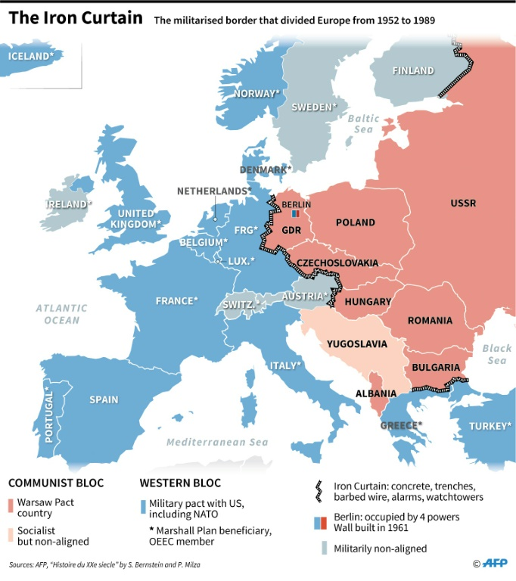
Cold War Context
West: Federal Republic of Germany (FRG)
East: German Democratic Republic (GDR)

Slide 9
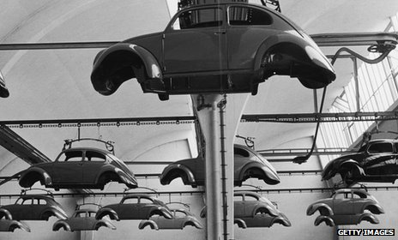
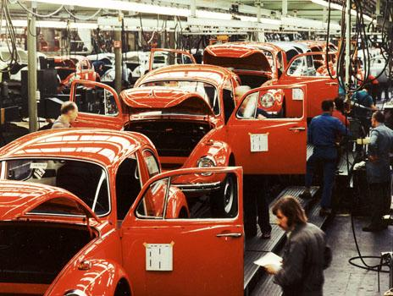
Excerpt from “How German cars beat British motors - and kept going.” BBC August, 2013
Ignoring his sceptical superiors, Hirst could see the potential amid the shattered debris of the Wolfsburg factory. Rebuilding Volkswagen, he thought, would be a step towards rehabilitating Germany as a prosperous, peaceful European ally…
In the next few years, Hirst restarted production of a car we know today as the Beetle. And from then on, VW was flying. By the late 1950s, with production up and employment buoyant, West Germany was enjoying an economic miracle. The memories of Nazism were banished, and the Germans began to rebrand themselves as a forward-thinking, hard-working and supremely modern industrial nation.
In Germany, management and unions worked closely together in the interests of the common good. Indeed, by law all major German firms are required to set up Works Councils, where the bosses and the unions must work together 'in a spirit of mutual trust'.

Slide 10
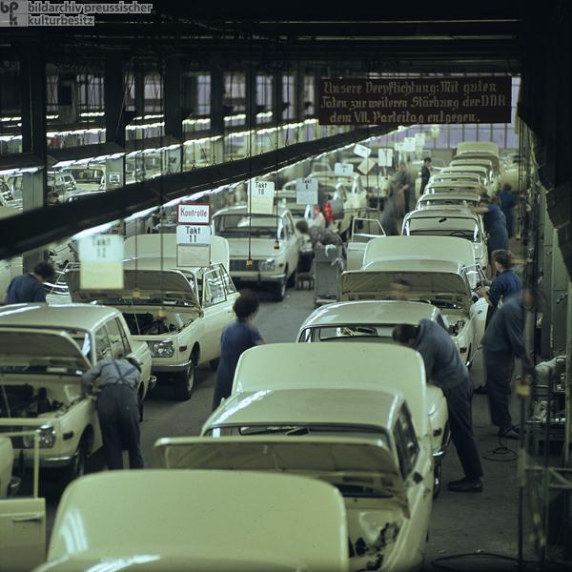
Production of the Wartburg 353 in East Germany (1966)
The Wartburg 353, designed in the mid-1960s, was an attractive car for its day. In its early years, it was even exported to the Netherlands and Great Britain. Although engineers had plans for the ongoing development of the model, the Wartburg did not undergo further modernization – this being prevented by the strained economic situation in the GDR. From the mid-1970s, the Wartburg could no longer compete with Western cars. This photograph shows the production of the Wartburg 353 in the firm's Eisenach factory. Photo by Jochen Moll.

Slide 11
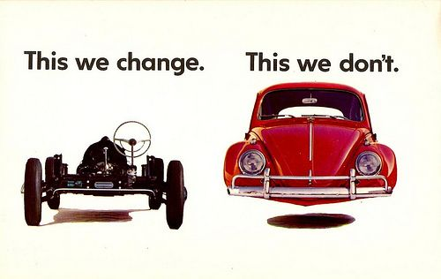
Volkswagen Advertisement, 1960

Slide 12

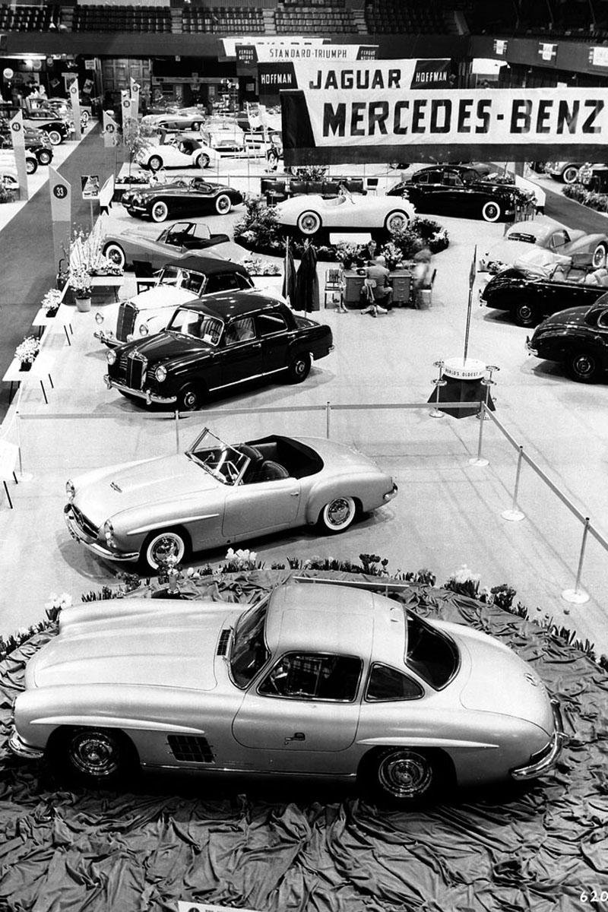


Slide 13
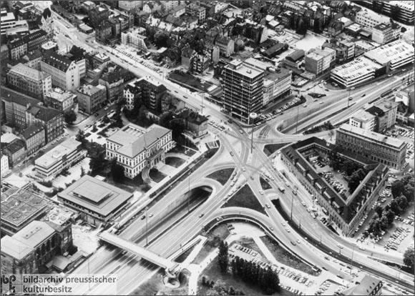

Slide 14
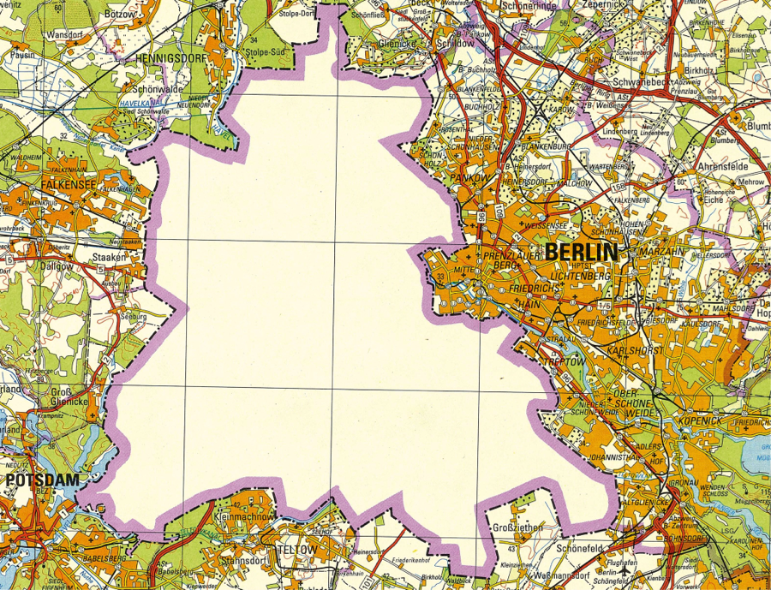
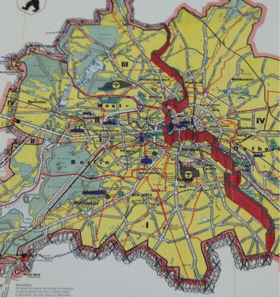
Left: East German Map of East and West Berlin (1960)
Right: West German Map of Berlin (1961)

Slide 15
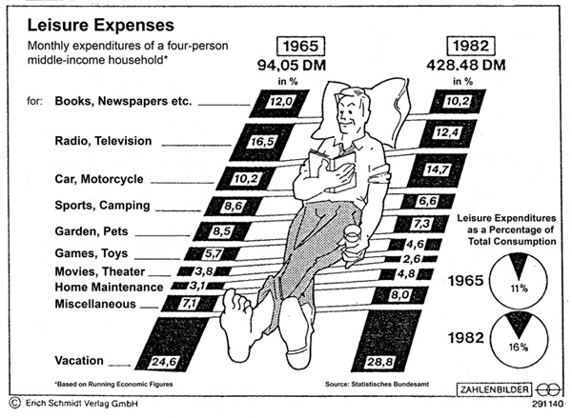

Slide 16
Excerpt from Letter by Anton S. to the “Prisma” Programming Office of GDR Television
Esteemed Prisma collective!
On February 8, 1989, my family was fortunate enough, after waiting 15 and a half years… to buy a Wartburg 1.3 Expectantly, we went… to the car dealership. After a four-hour wait, we were shown a car, a Wartburg 1.3. With the words: “This is your car; have a look. In the meantime, I’ll get the papers ready!,” the process of “purchasing a car” was over and done with. I, for my part, didn’t notice any problems with the car in the showroom…
… On the drive home… air from the side vent was blowing directly in my face… [After only a few days of driving] the battery… was almost completely drained…After a longer drive… I noticed that the transmission was making strange noises. This prompted me to visit… my authorized repair shop to have the car thoroughly inspected.… After remarking that my family and I deserved a good product for the good money we earned through our labor, I was told that this wasn’t his problem and that, after all, I didn’t have to buy this car…

Slide 17
What does the '601' in Trabant 601 stand for? 600 people will order one, but only one will get it delivered. (Or, by 1990: There are 600 cars on the lot, but only one customer.)
How do you double the value of a Trabant? Fill up the tank.
Why do East-Germans have trouble driving the Trabant? Because the wheel keeps pulling toward the west.
What do you call a Trabant on a hill? A miracle.
What do you call a Trabant with brakes? Customized.
When does the Trabant reach its top speed? When it’s towed away.
An East German driver pulled into a service station and asked, "Can I get a windshield wiper blade for this Trabi?" The mechanic looked the car over for a long time and finally said, "Okay, it's a trade!"
An East German worker's five years were up, and he went to take delivery of his Trabi. He asked the company's representative, "Can I get a car with seat belts?" "Sure," said the representative, "and while we're at it, we can give you one with two-tone paint, air-conditioning, and an AM/FM/Longwave/Shortwave radio!" Mortified, the customer mumbled, "Now you're just making fun of me." "Well," roared the representative, "who started it?"

Slide 18
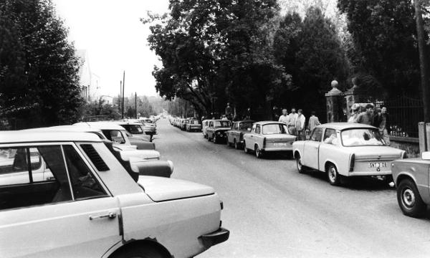
East German Cars on Budapest Roadsides (Summer 1989)

Slide 19
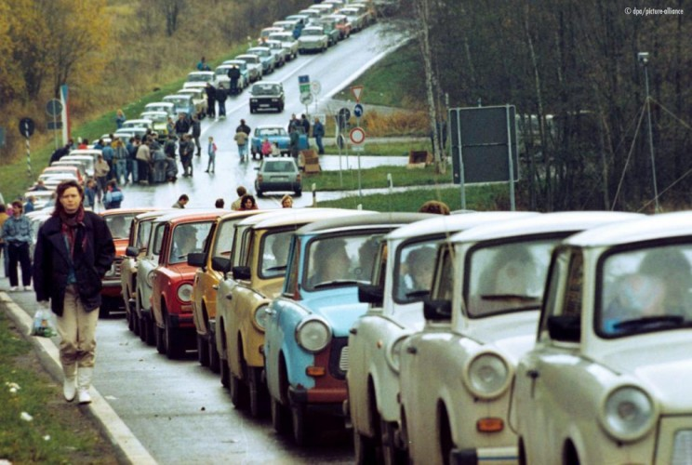
Traffic at Border Crossing Near Rasdorf in Hesse (November 19, 1989)

Slide 20
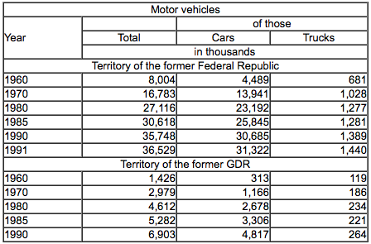
The Stock of Motor Vehicles
“Total stock” of motor vehicles includes motorcycles, cars, vans, trucks, and tractors
All numbers are in thousands, so 4,489 actually equals 4,489,000

Slide 21
“Differences between East and West” Der Spiegel (November 12, 1990)
The addiction of East German car fans – who were condemned to drive Trabis all too long – to faster and more comfortable Western automobiles is one of the most striking pan -German impressions of the year. But differences in car ownership will remain considerable over the long run. In the West, three out of four households have a car on the road or in the garage (to be more precise: at least one car, since one in five households has a second car). In the East, barely more than half of all households have a car.
Their cars are also a lot older and less powerful. Half of all cars are at least eight years old (in the West only a quarter). In the West, only four percent of private cars have less than 45 horsepower; in the East that figure is 43 percent.

Slide 22
“End Near" For E. German Car: Country's Symbol Of Failure On Road To Museum
… Now that East Germany is moving toward monetary union with West Germany, it is hardly surprising that the Trabant-known more familiarly as the Trabi-apparently is headed for the automobile industry scrap yard… no one seriously imagines East Germans will go on buying the Trabant when they have West German marks to spend…
…“This factory is a producing museum,” acknowledges Juergen Schiebert, press spokesman at the Trabant factory in Zwickau… The factory is a dark, dingy red-brick building where the work is highly labor intensive…
...Meanwhile, West Germany`s Volkswagen is planning to move into Zwickau with a $3 billion investment. The automaker will build a new plant near here that will produce Volkswagens for the East European market starting in 1994.
In the short term, there will be massive unemployment in the auto industry… about 100,000 people-70 percent of the automotive and supply workers-could lose their jobs. The Trabant factory employs 11,500. The VW plant will use robotics and other automated devices unknown in the Trabant works, and will be able to produce more cars with fewer workers.

Slide 23
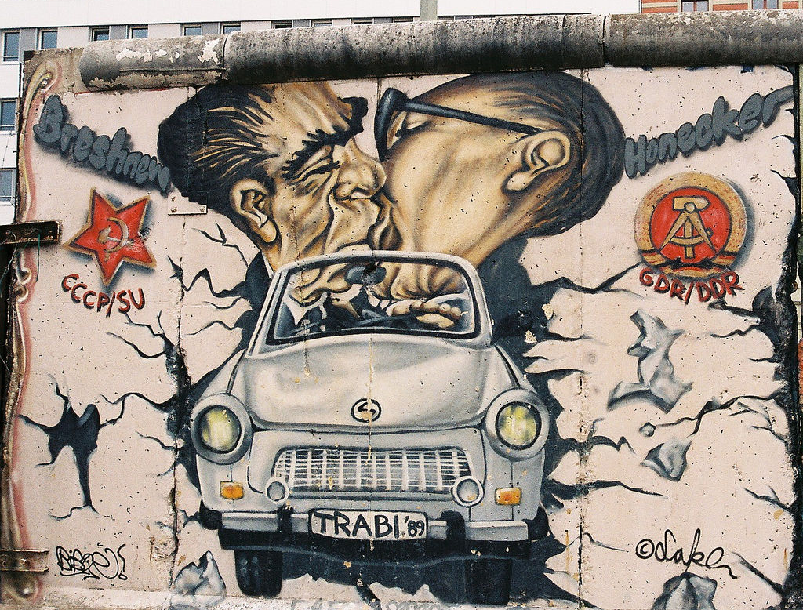
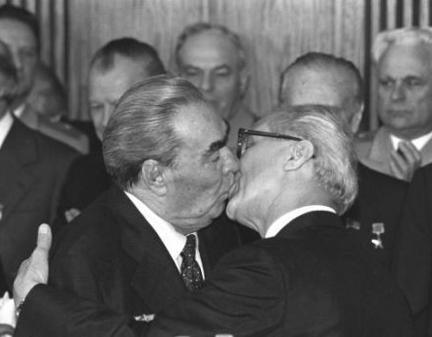

Berlin Wall Graffiti: “My God, Help Me to Survive This Deadly Love.”

Slide 24
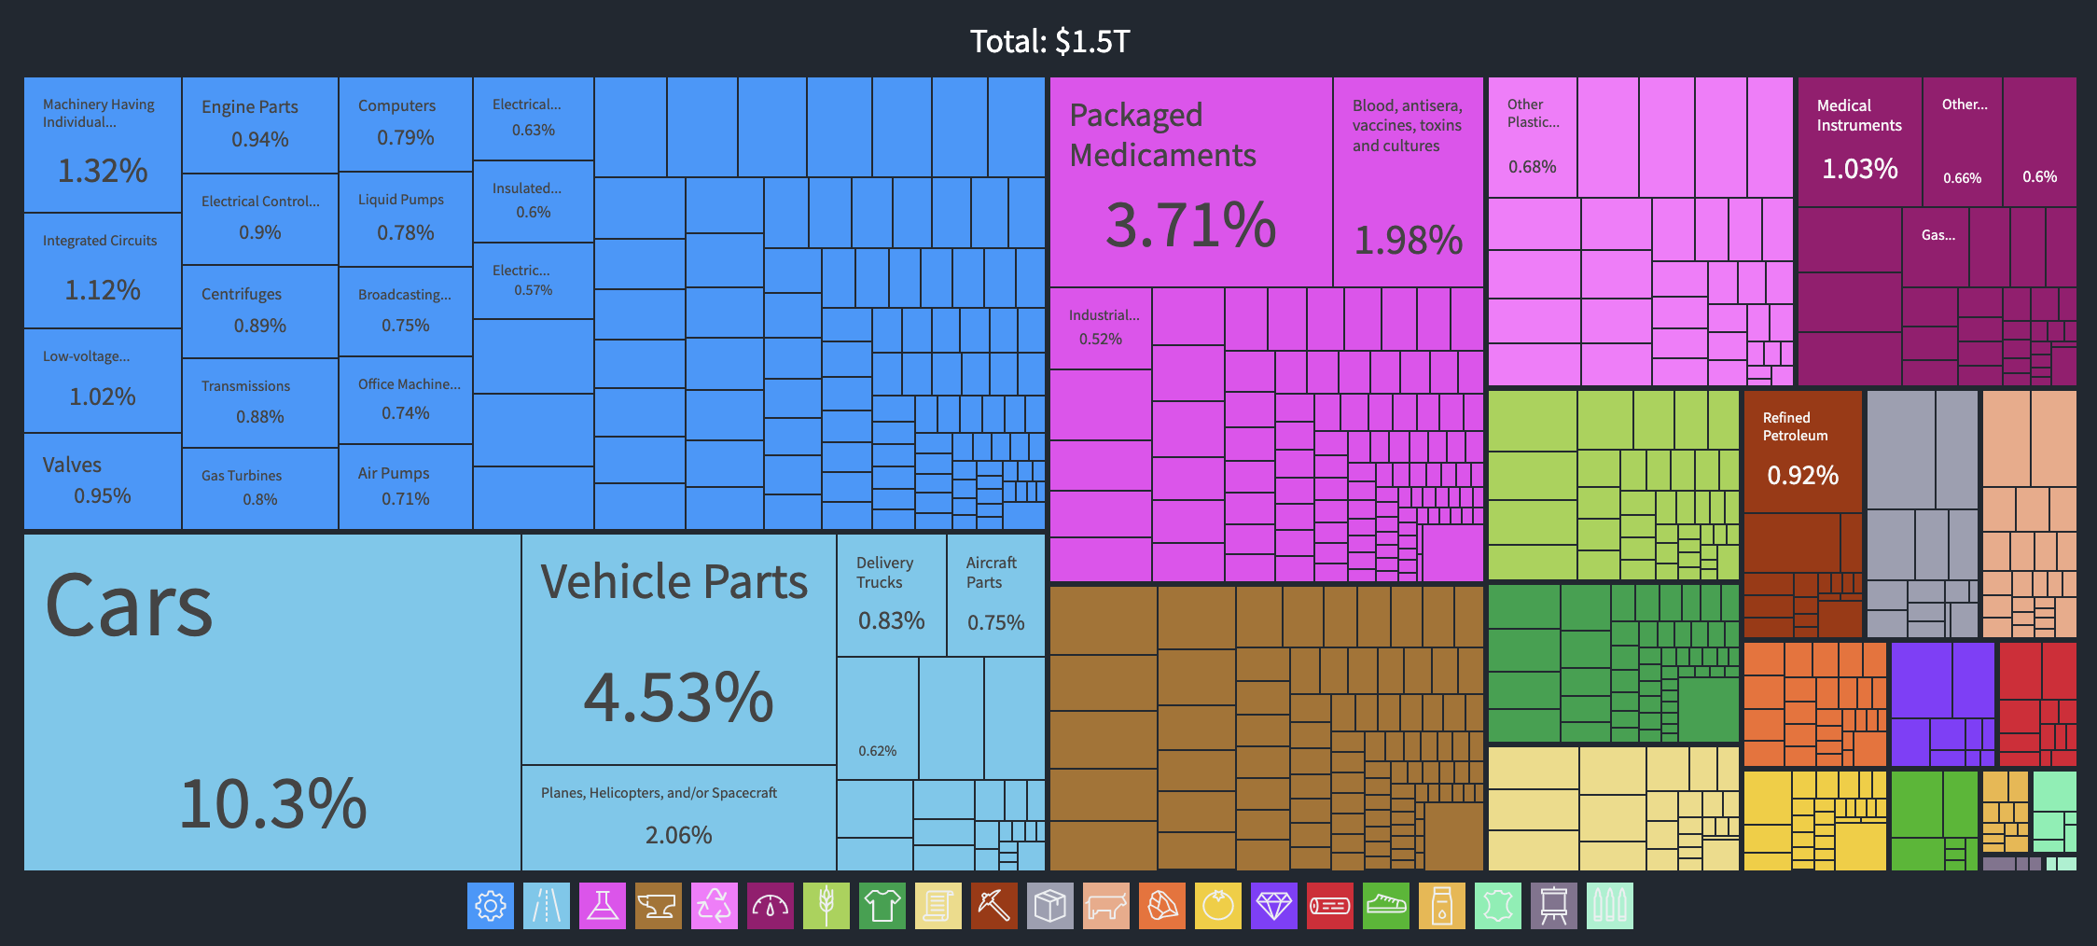
What does Germany Export? (2018)
Source: Observatory of Economic Complexity, Germany Profile

Slide 25
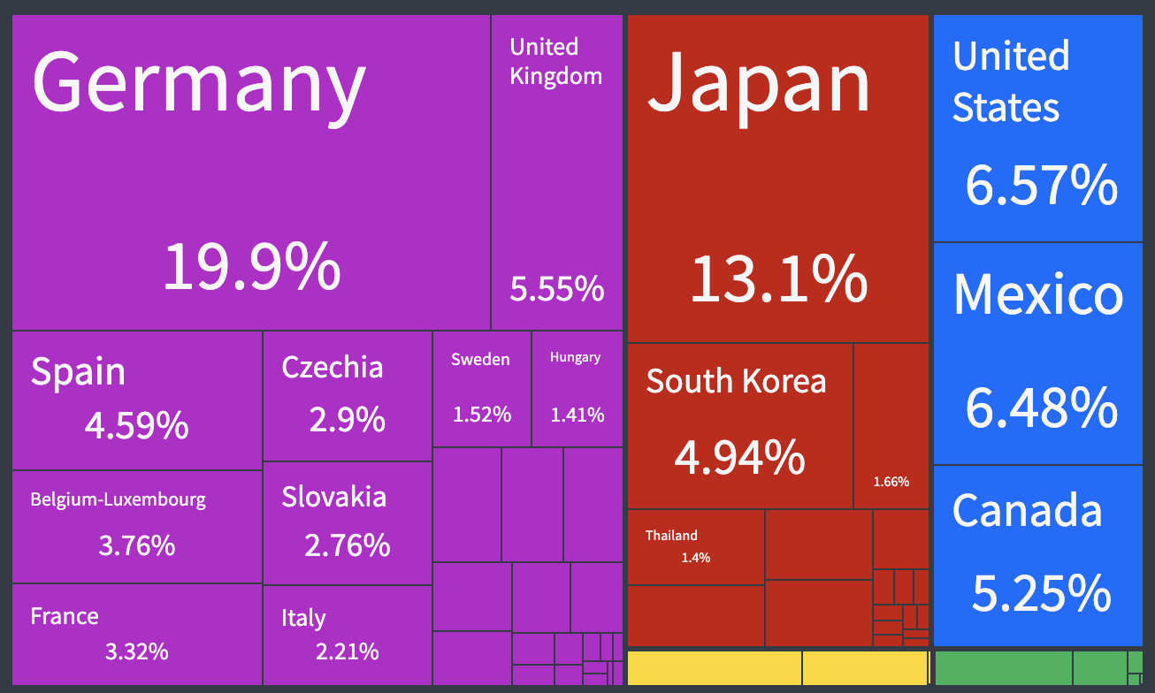
Top Exporters of Cars (2018)
Source: Observatory of Economic Complexity, Cars Profile

Slide 26
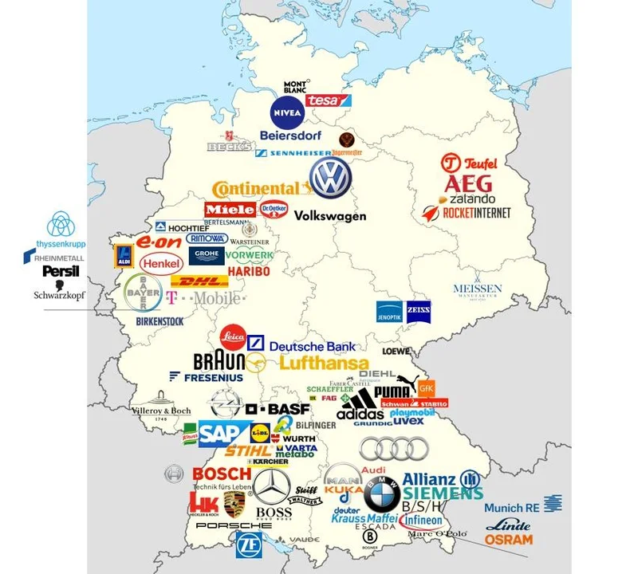
Headquarters of Major German Companies and Brands

Slide 27
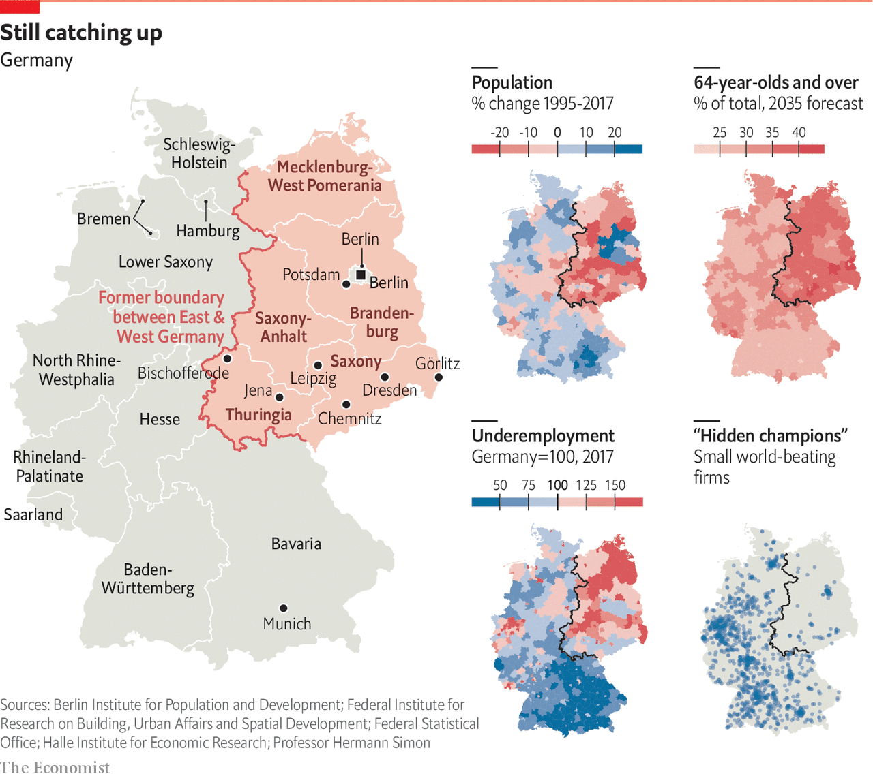
Still Catching Up, The Economist, October 31, 2019

Slide 28
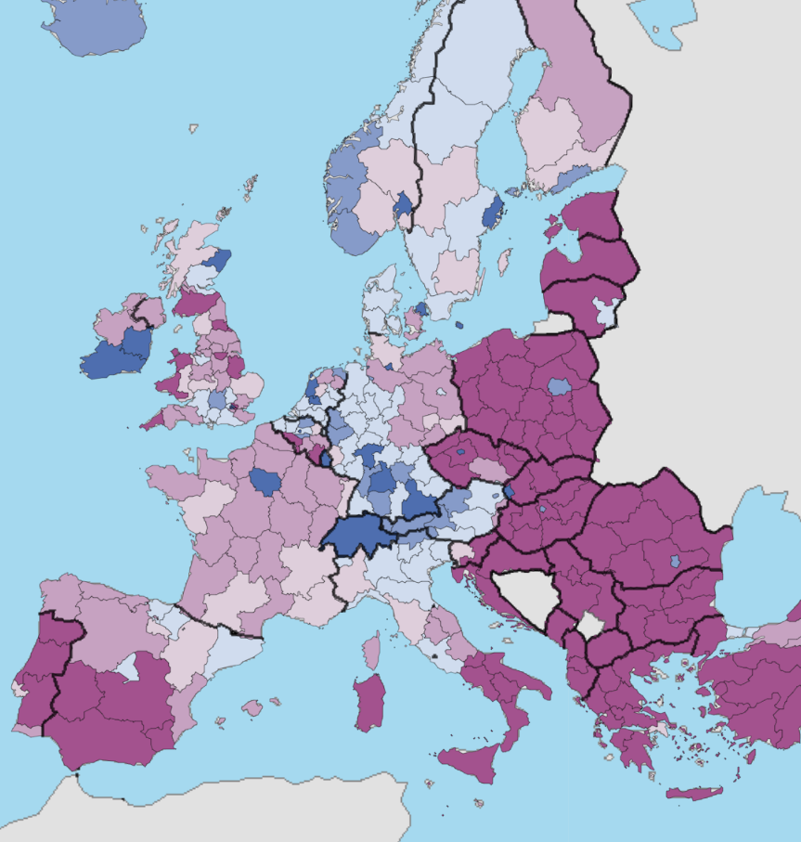
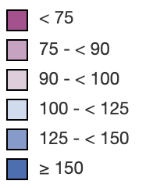
GDP/per Inhabitant in Europe, Eurostat Regional Yearbook 2018
GDP per inhabitant, 2017 in relation to the EU-28 average, EU-28 = 100

Slide 29
The Task Revisited
Use the documents to evaluate the outcomes associated with command and free market economies. Your response should include...
A clear, well-stated claim/argument in response to the prompt.
At least two well-developed body paragraphs in support of your claim.
Analysis of at least seven documents to support your argument.

Slide 30
Extension Activities!

Slide 31
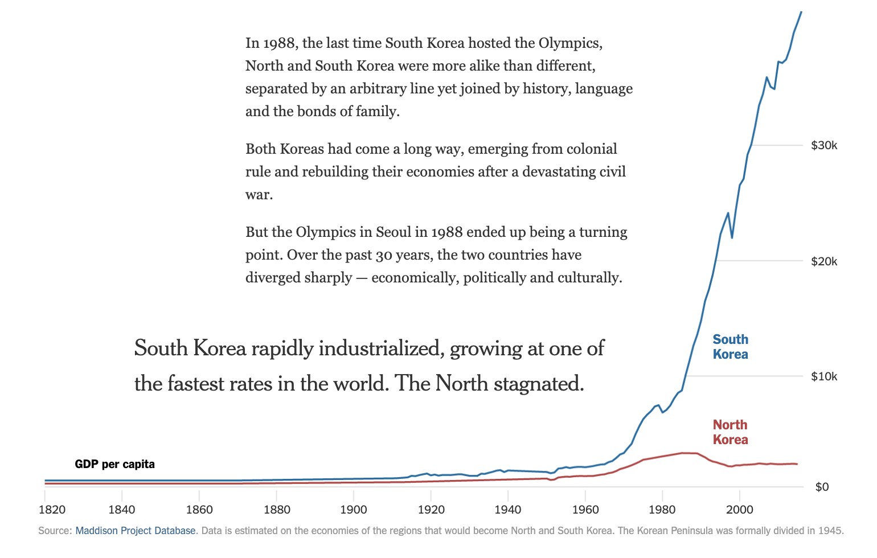
Extension Activity: Compare & contrast the East/West German example with North and South Korea’s Economic Systems.
How South Korea Left the North Behind (New York Times)

Slide 32
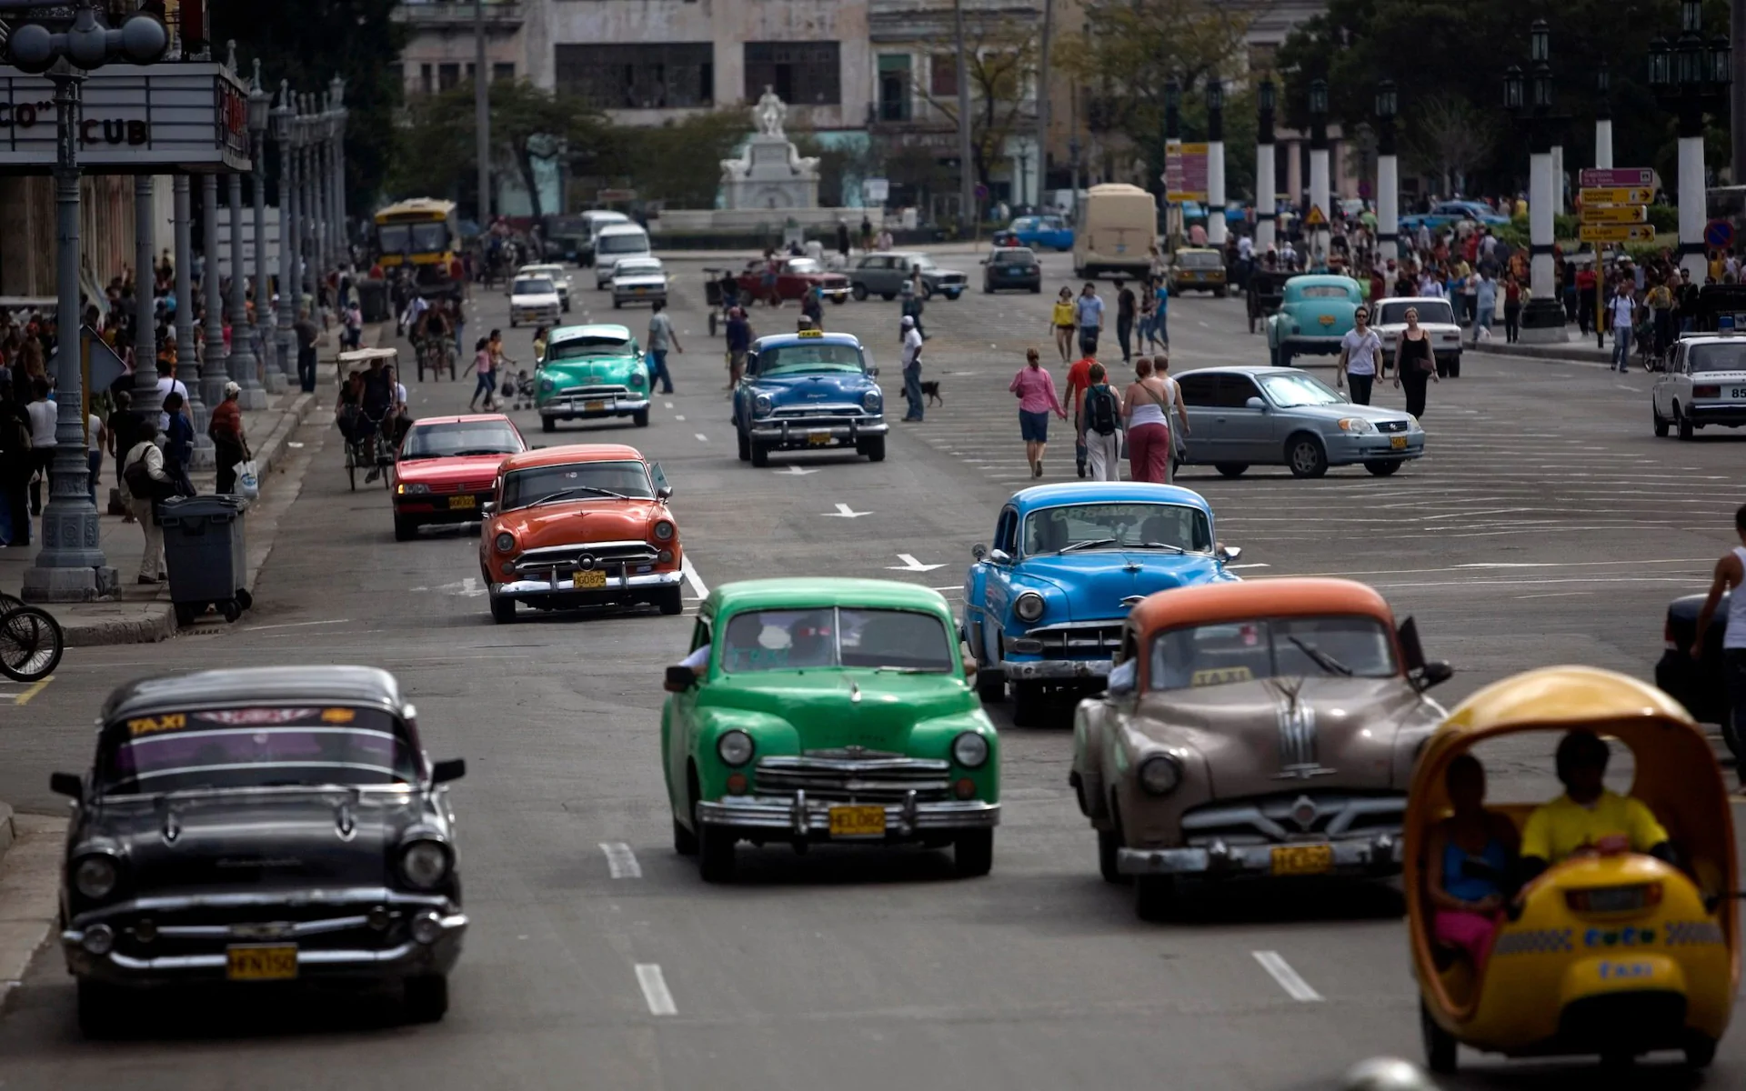
Extension Activity: Cuba’s Cars! Image from the Telegraph

Slide 33
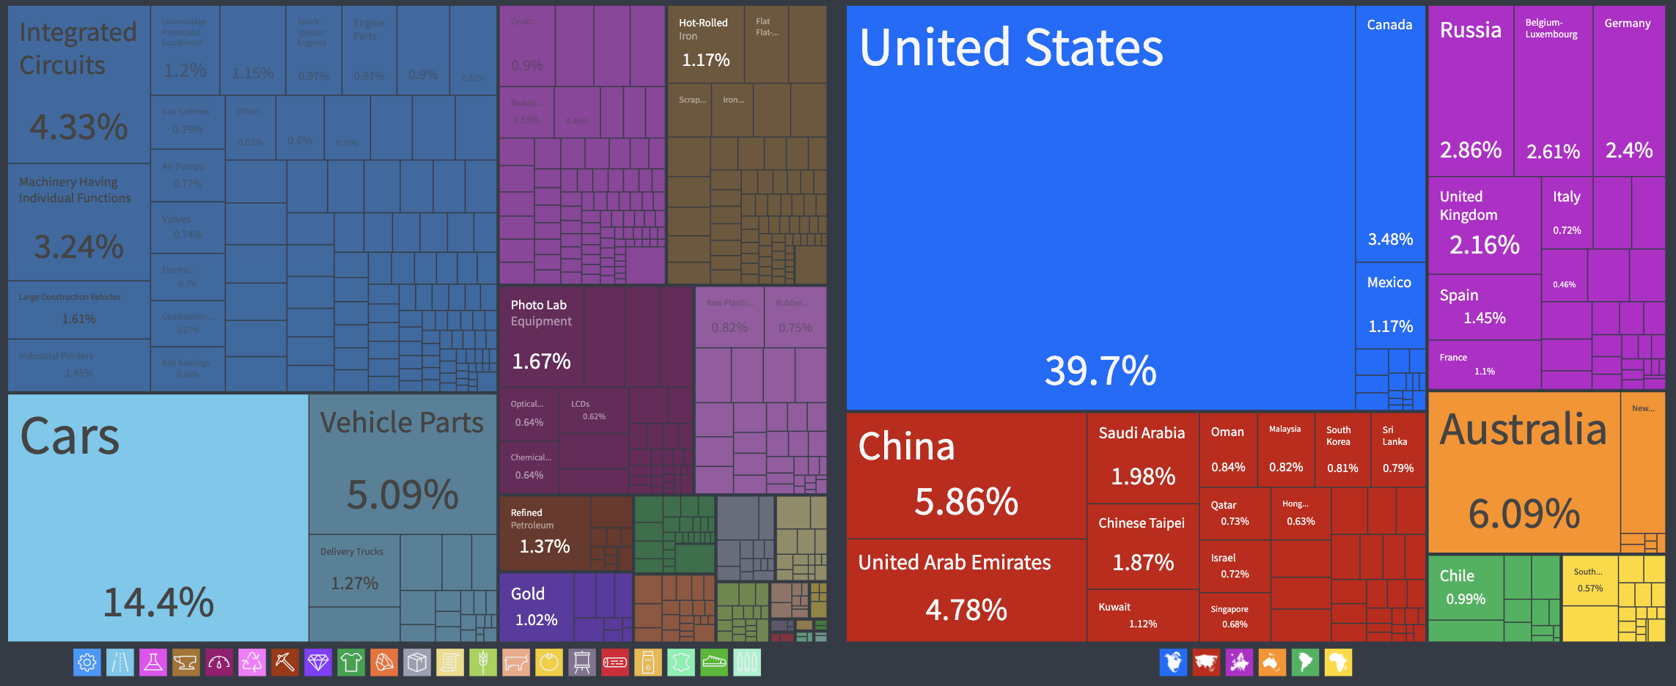
Extension Activity: Compare the historical rise of Germany’s automobile industry and exports with Japan’s post-WW2 growth.
What does Japan Export? (2018)
Car Export Destinations (2018)

Slide 34
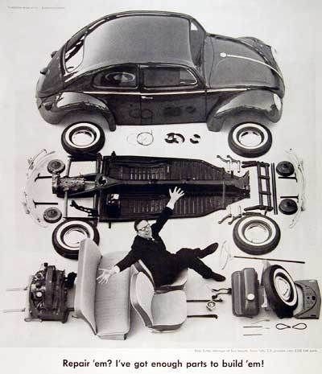
Extension Activity: Explore the supply chain of a modern automobile.
Focusing on just one part or component is illustrative of the complex, interconnected nature of production and trade.

Slide 35
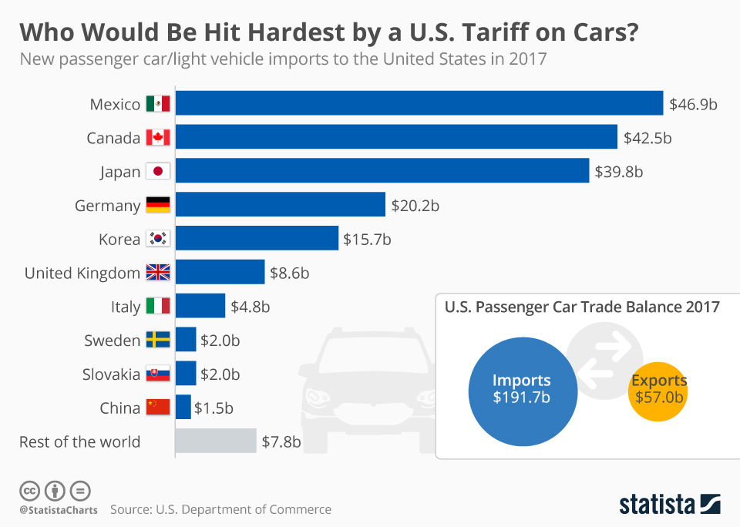
Extension Activity: Assess the winners and losers of tariff policies that target component parts or final products on this industry.

Slide 36
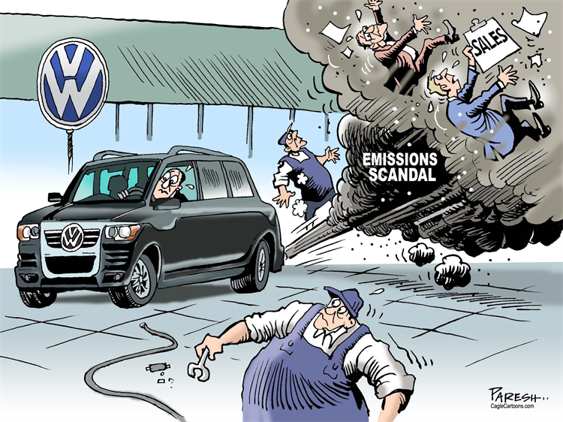
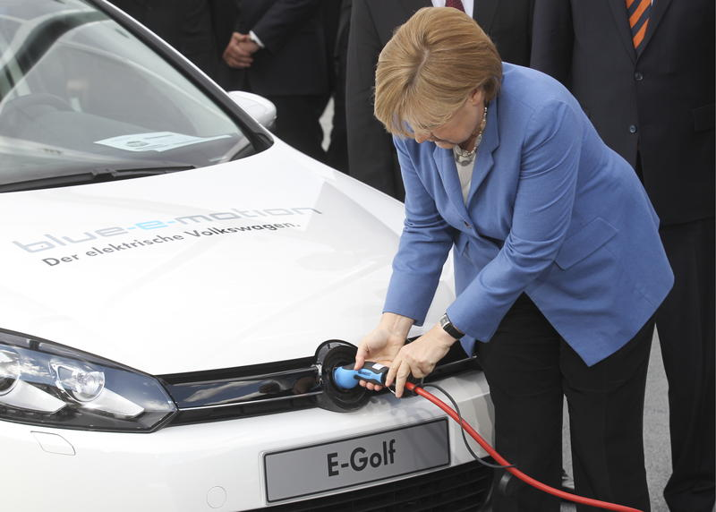
Extension Activity: Evaluate changes coming to the automobile market -- policies, energy, automation, self-driving technology.

Slide 37
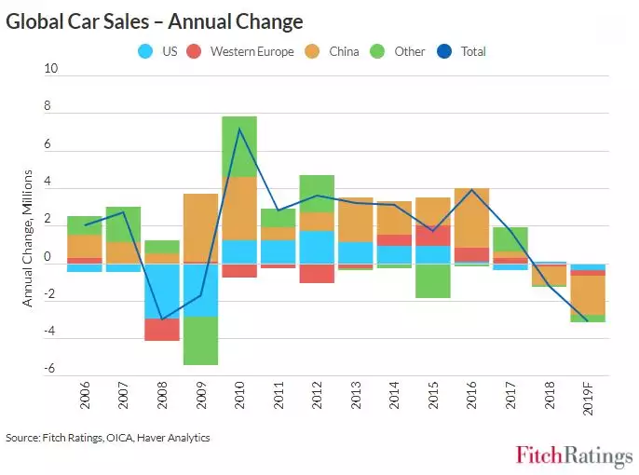
Extension Activity: What are the current trends in car purchases?

Slide 38
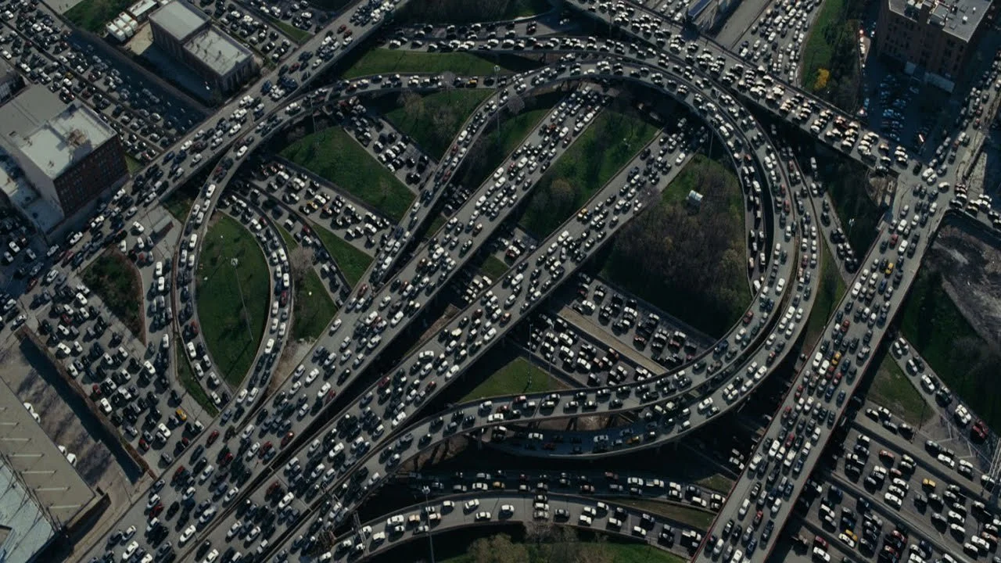
Extension Activity: Where are car markets and infrastructure growing in the years ahead?

Slide 39
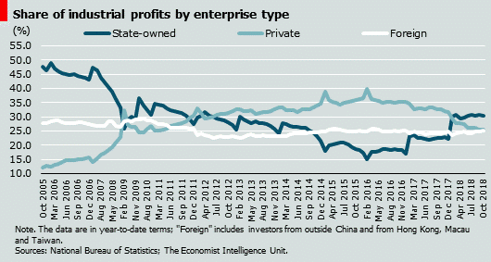
Extension Activity: What are the strengths and limitations of state owned enterprises in the 21st century?
China
Are state-owned enterprises reformable? (The Economist)

Slide 40
References
German History in Documents and Images (GHDI)
The Observatory of Economic Complexity: OEC
Statistical Atlas Eurostat regional yearbook 2019
Making the History of 1989

Slide 41
Q&A?

Slide 42
National Standards
ALLOCATION
  Different methods can be used to allocate goods and services. People acting individually or collectively must choose which methods to use to allocate different kinds of goods and services.
COMPETITION AND MARKET STRUCTURE
  Explain how changes in the level of competition in different markets can affect price and output levels
ECONOMIC GROWTH
  Investment in factories, machinery, new technology, and in the health, education, and training of people stimulates economic growth and can raise future standards of living.

Slide 43
State Standards
Social Studies Practices Grades 9-12
Gathering, Interpreting, and Using Evidence
  Identify, describe, and evaluate evidence about events from diverse sources (including written documents, works of art, photographs, charts and graphs, artifacts, oral traditions, and other primary and secondary sources).
Economics and Economics Systems
  Evaluate the extent to which competition between sellers and between buyers exists in specific markets.
  Use economic indicators to analyze the current and future state of the economy.
  Analyze government economic policies and the effects on the national and global economy
Common Core
Cite specific textual evidence to support analysis of primary and secondary sources, attending to such features as the date and origin of the information.
Determine the central ideas or information of a primary or secondary source; provide an accurate summary of how key events or ideas develop over the course of the text.

Slide 44

CEE Affiliates
https://www.councilforeconed.org/resources/local-affiliates/

Slide 45
Thank You to Our Sponsors!

