Slide 1
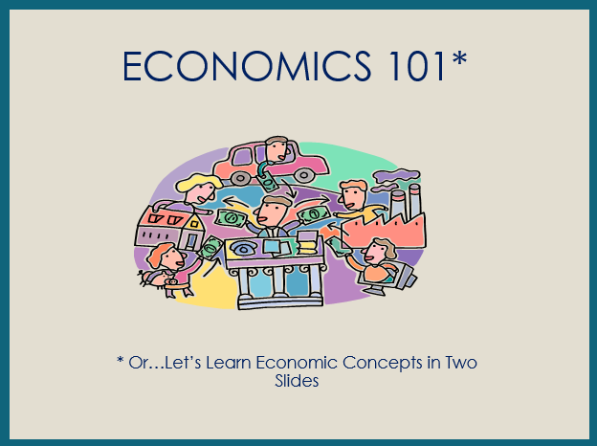

Slide 2
ECONOMICS 101
Economics is the study of _________
(as they pertain to _________, _________, and the _________).
choices
consumers
producers
government
Every nation has productive resources
__________________
Resources from the earth, unaltered by man
__________________
People’s effort, skills, and knowledge
__________________
Man-made resources
used over and over
natural
human
capital
__________________
Goods used in production to become part of a product
intermediate
which are used to produce
goods
and
services
to be __________________ or __________________ with money (savings).
bartered
purchased

Slide 3
however
Productive resources, and therefore, goods and services, are limited
Human wants (needs)
are basically unlimited
resulting in
SCARCITY
Consequently, buyers (consumers) and sellers (producers) have to make
economic __________________ (resulting in
__________________ __________________)
choices
opportunity
cost
when answering
three basic economic questions
__________ ___________
Buyers and sellers answer ?’s
___________ goods and
services will be produced?
___________ will the goods and services be produced?
___ _______ will the goods and services be distributed?
___________ ___________
Government answers ?’s
What
How
To whom
command economy
market economy
Answering these questions most efficiently creates the need for
___________________ and ___________________ resulting in trade.
specialization
interdependence
decision
making
scarcity
Economics: ___________ - __________ under ___________.

