Slide 1
Covid-19 and the National Debt
Presented by Amanda Stiglbauer
Blythewood High School, Blythewood, SC
June 21, 2020
Amanda.Stiglbauer@moore.sc.edu

Slide 2
EconEdLink Membership
You can now access CEE’s professional development webinars directly on EconEdLink.org! To receive these new professional development benefits, become an EconEdLink member. As a member, you will now be able to:
Automatically receive a professional development certificate via e-mail within 24 hours after viewing any webinar for a minimum of 45 minutes
Register for upcoming webinars with a simple one-click process
Easily download presentations, lesson plan materials, and activities for each webinar
Search and view all webinars at your convenience
Save webinars to your EconEdLink dashboard for easy access to the event
You may access our new Professional Development page here

Slide 3
Professional Development Certificate
To earn your professional development certificate for this webinar, you must:
Watch a minimum of 45-minutes and you will automatically receive a professional development certificate via e-mail within 24 hours.
Accessing resources:
You can now easily download presentations, lesson plan materials, and activities for each webinar from EconEdLink.org/professional-development/

Slide 4
Agenda
Introductions & Announcements
Poll/Interactives
Essential Content
COVID-19 and the National Debt
  Economic Performance & Outlook
  Virtual Jigsaw
  Political Cartoon Analysis
  Adding to Debt – A Good Thing?
Time to Climb
Wrap Up

Slide 5

Objectives
I can:
  Explain the difference between the government deficit and the national debt.
  I can evaluate the potential impacts of COVID-19 on the national debt.

Slide 6
National Standards
Standard 16: Role of Government and Market Failure
There is an economic role for government in a market economy whenever the benefits of a government policy outweigh its costs. Governments often provide for national defense, address environmental concerns, define and protect property rights, and attempt to make markets more competitive. Most government policies also have direct or indirect effects on peoples’ incomes.

Slide 7
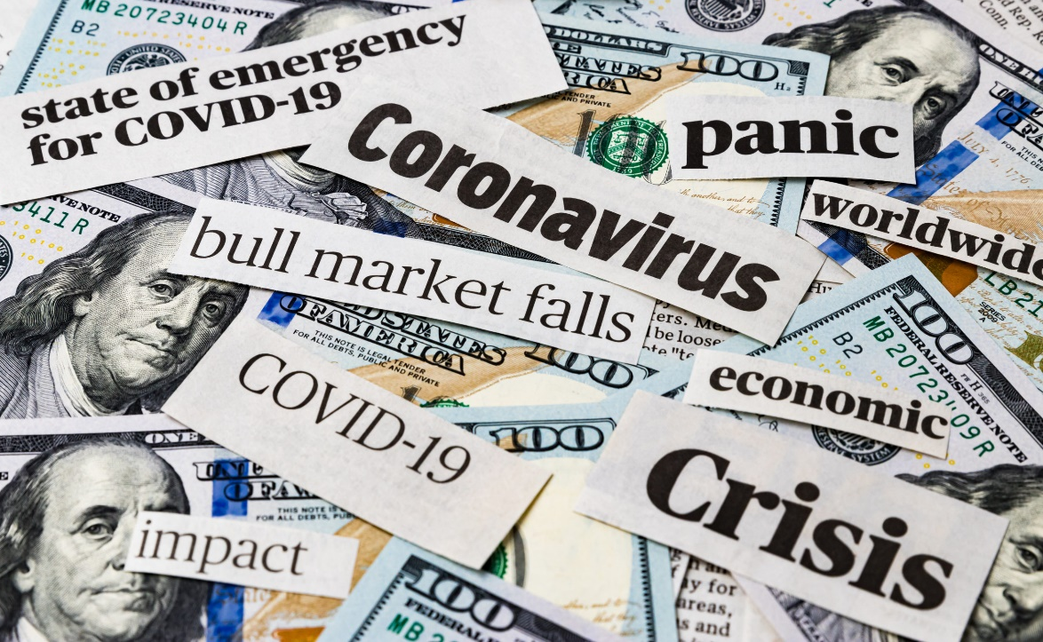
Essential Question
To what extent does COVID-19 pose a national security risk?

Slide 8
Essential Content
Cost-Benefit Analysis
Opportunity Cost
TINSTAAFL Principle
Debt vs. Deficit
Fiscal Policy
Monetary Policy

Slide 9
Key Terms
Tax Revenue
Income earned from taxes
National Deficit
When federal expenditures exceed federal revenue for one time period
National Debt
The accumulation of all past deficits and surpluses

Slide 10
Macroeconomic Indicators
From the CBO:
  GDP is expected to fall 40% (annualized) in the 2nd quarter and 5.6% for the year
  Unemployment projected to peak around 16% in the 3rd quarter and fall to 11.4% by year’s end
  Deficit: Prior to COVID expected $1.1 trillion, now expected to be $3.7 with stimulus

Slide 11
Background

Slide 12
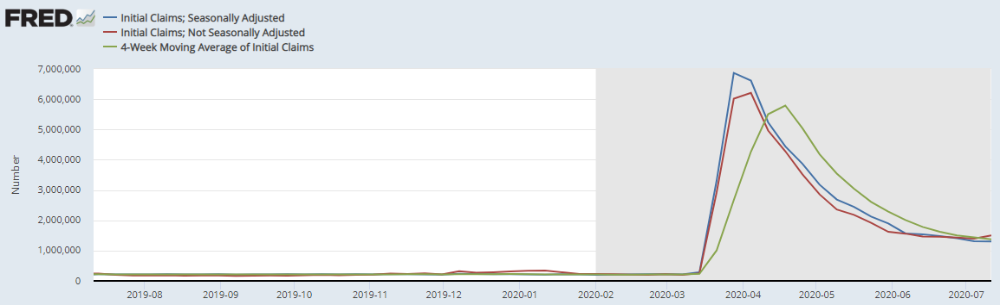
New Weekly Unemployment Claims
https://fred.stlouisfed.org/release?rid=180&t=initial%20claims&ob=pv&od=desc

Slide 13
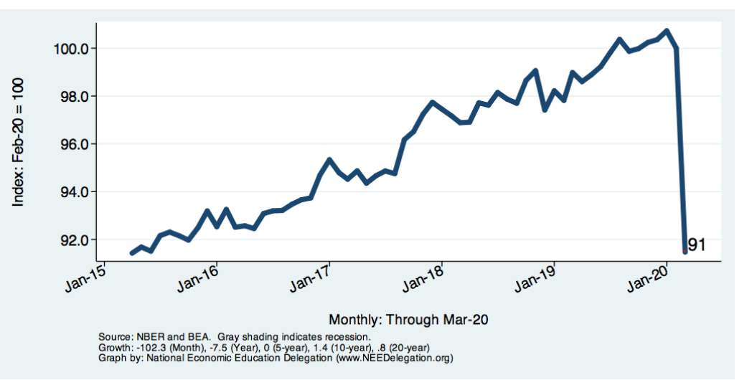
Retail since 2015

Slide 14
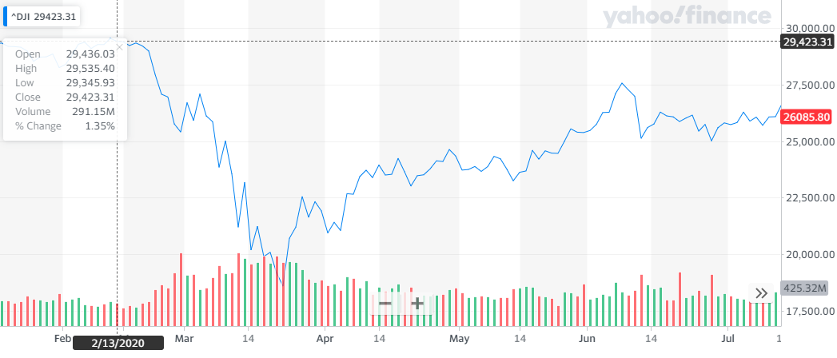
Dow Jones Industrial Average 2020

Slide 15
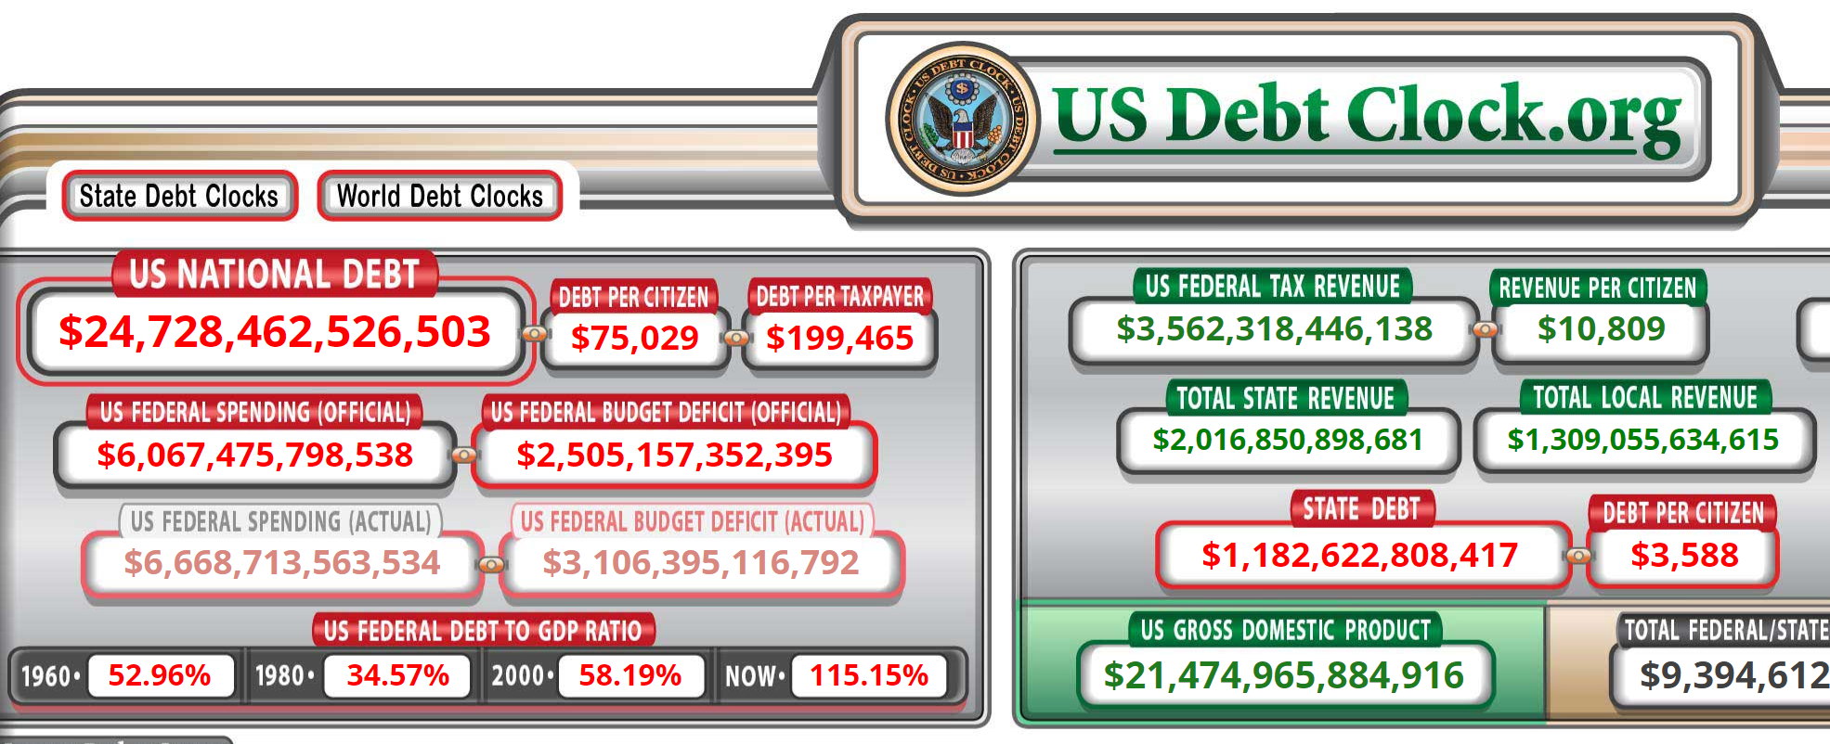
US Debt Clock

Slide 16
Policy Efforts During the Pandemic
Social
-Social distancing
-Shutdowns of some industries
-Layoffs/furloughs
-Vulnerable populations now more vulnerable
-School closures &“re-openings”
Fiscal
-CARES Act Funding
-Healthcare support
-Taxpayer and business support
-FMLA
Monetary
-Fed is back to zero interest rates
--Lowered reserve requirement to zero
-Discount window – 1.75% to 0.25%
Securities purchases

Slide 17
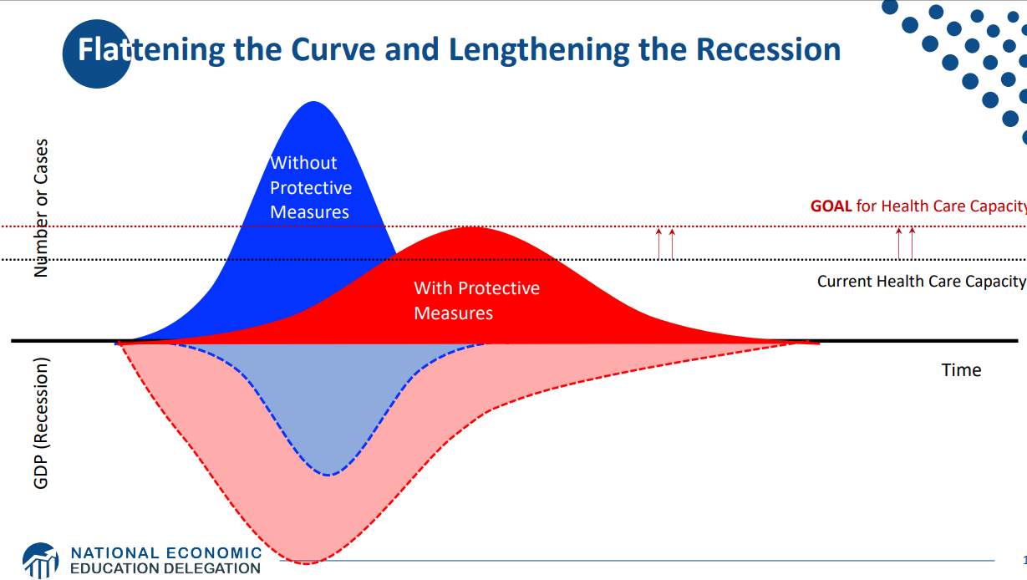
Cost-Benefit Analysis

Slide 18
Fiscal Policy Timeline
Phase IIIa: CARES HHLD Payments, Support for Small & Medium Firms, Unemployment Insurance Aid to States
Phase I: HR6074 R&D, Public Health, Medical Supplies, etc
March 6
March 18
July 31
March 14
April 24
$600 federal unemployment bonus set to expire
Phase II: Family First Paid Sick Leave, Family Medical Leave, COVID-19 Testing, Unemployment Expansion
Phase IIIb (More Support for Small Firms, COVID-19 Testing, Hospital Support

Slide 19
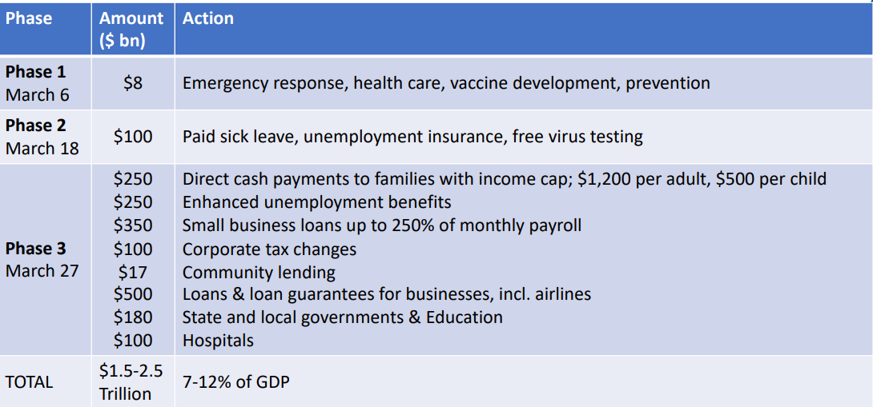
Fiscal Policy Timeline

Slide 20
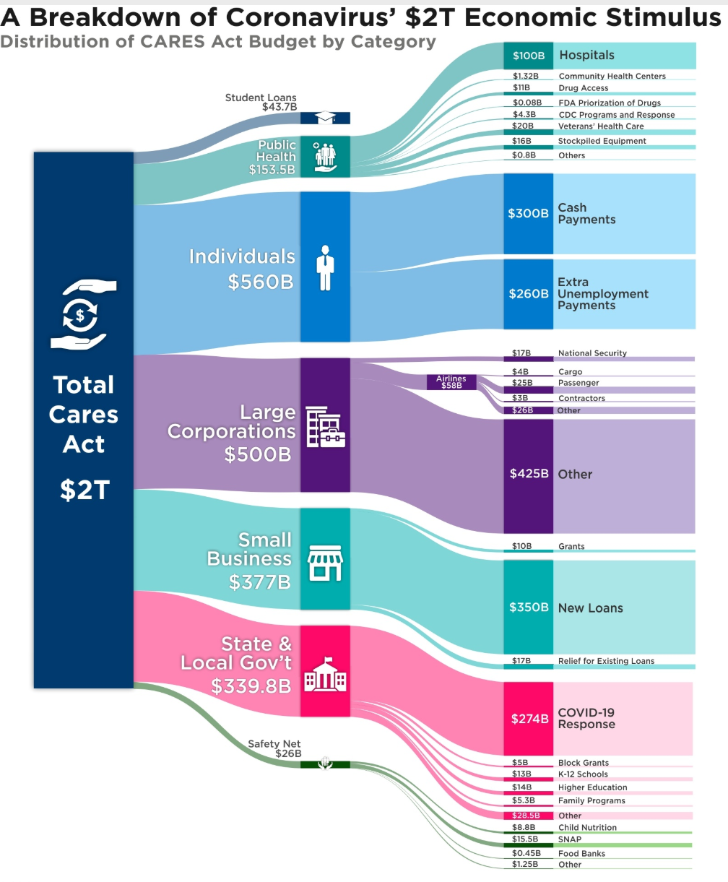

Slide 21
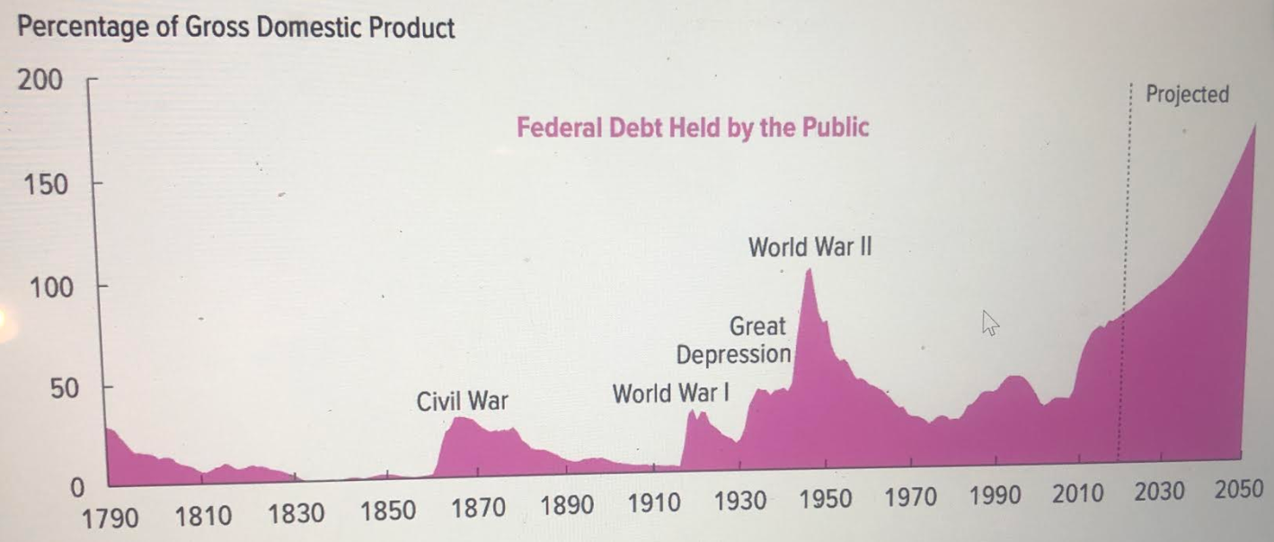
How do we pay for this?

Slide 22
Show me the money!
Problems?
  Must be paid in the future. Opportunity cost – future investment, spending, saving etc
  Higher interest payments
  May lead to large tax hikes and spending cuts
  Greater risk of fiscal crisis.
  Decreased ability to respond to problems.
  Slower economic growth
Federal government can either print money or issue debt (U.S. treasuries)
Projected debt-to-GDP ratio will reach 135% this year.

Slide 23
Article Analysis
https://www.usatoday.com/in-depth/news/2020/05/08/national-debt-how-much-could-coronavirus-cost-america/3051559001/
Key Takeaways
How might the government’s fiscal response to COVID-19 look?

Slide 24
Political Cartoon Analysis
As you view the political cartoons, consider:
  What is the author’s message?
  What are the potential outcomes of the Coronavirus pandemic, as they relate to fiscal policy?

Slide 25
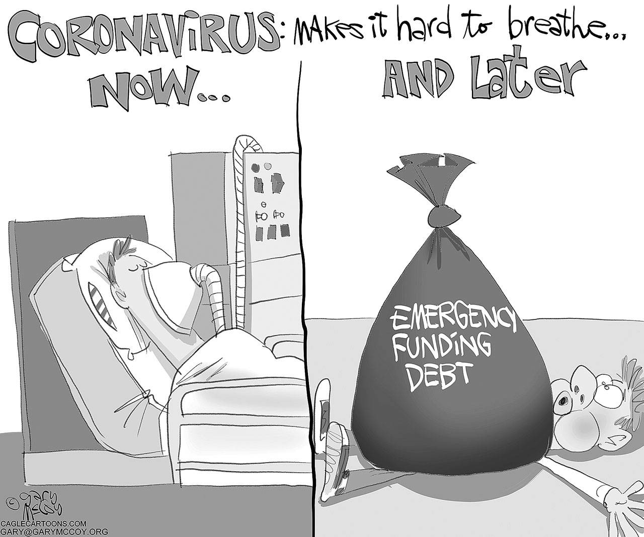

Slide 26
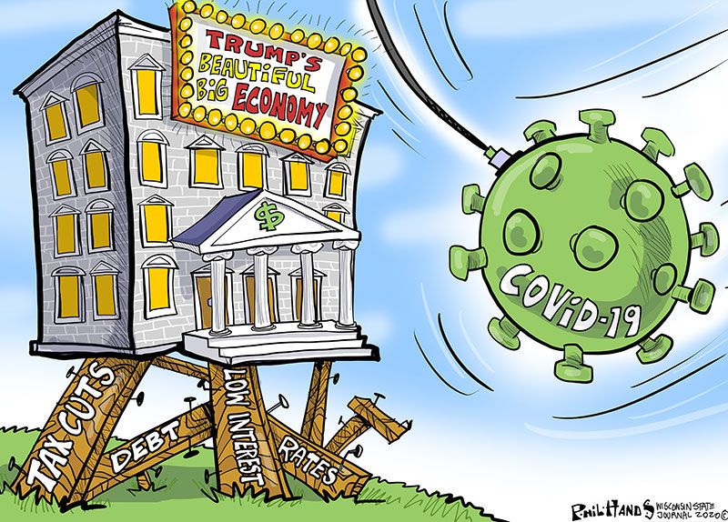

Slide 27
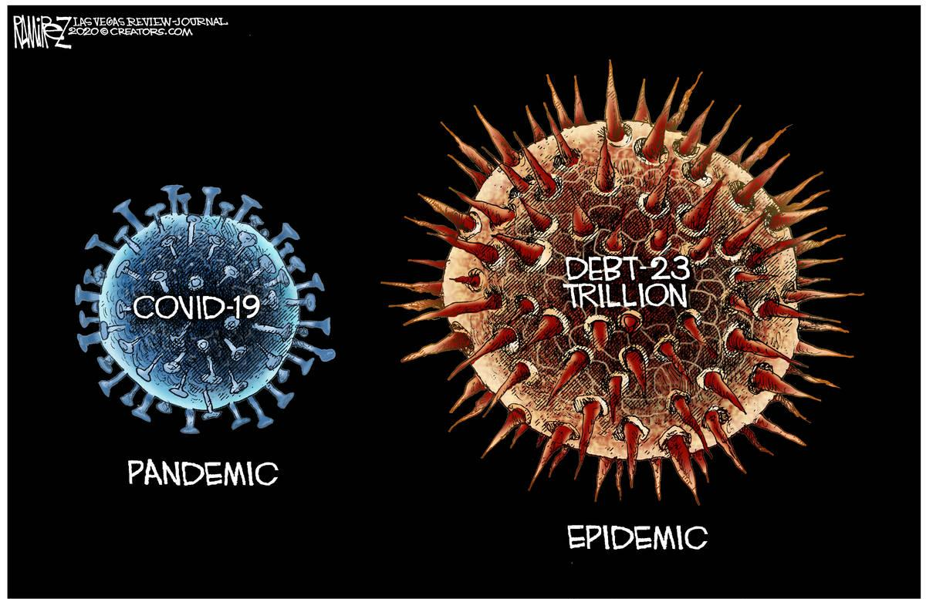

Slide 28
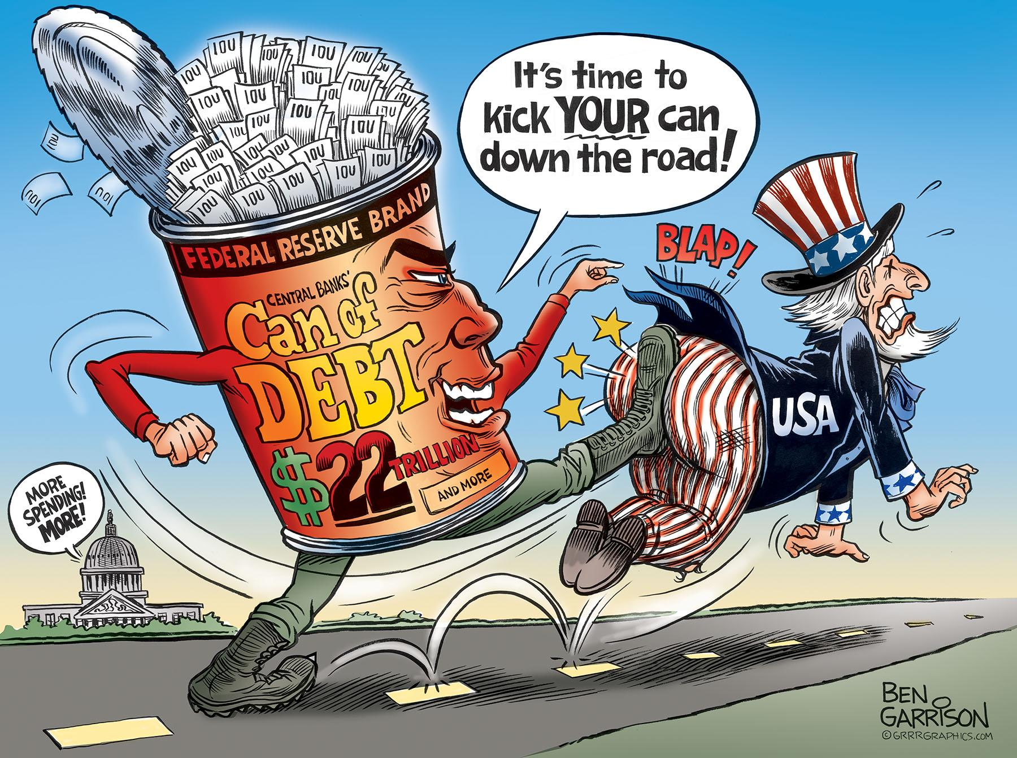

Slide 29
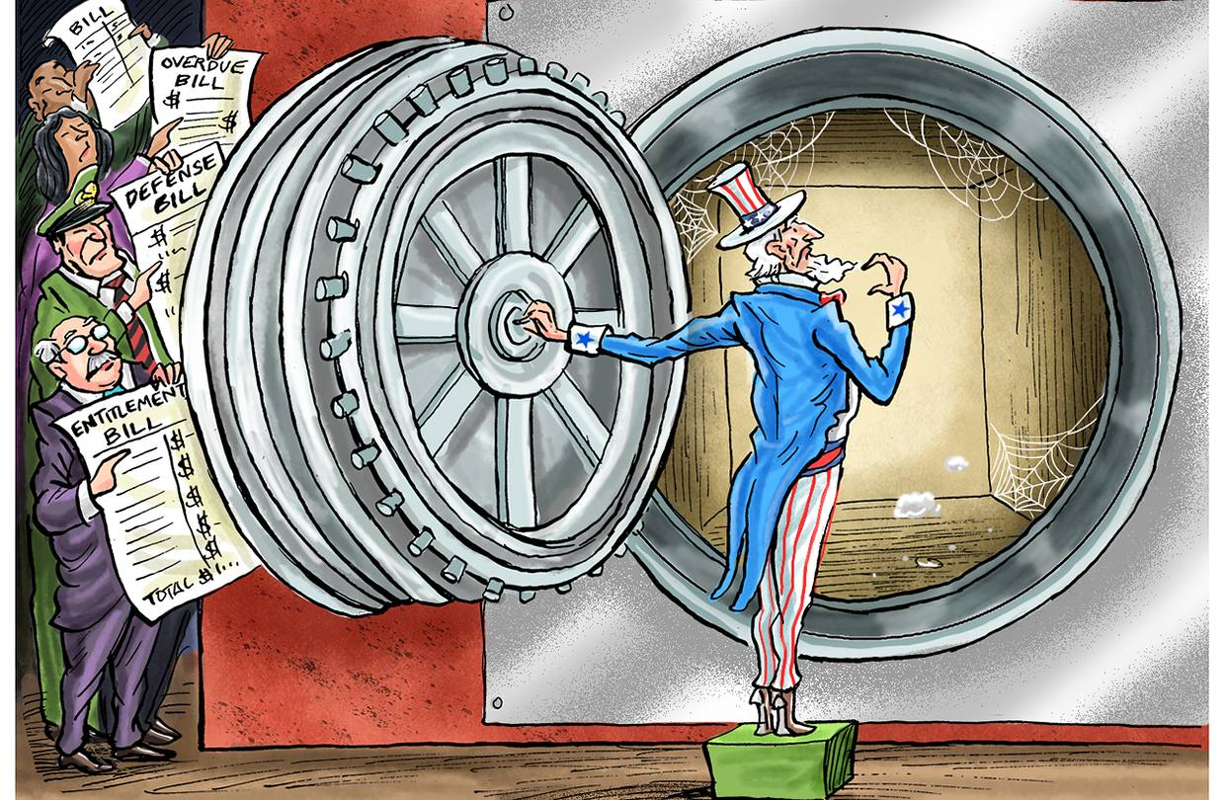

Slide 30
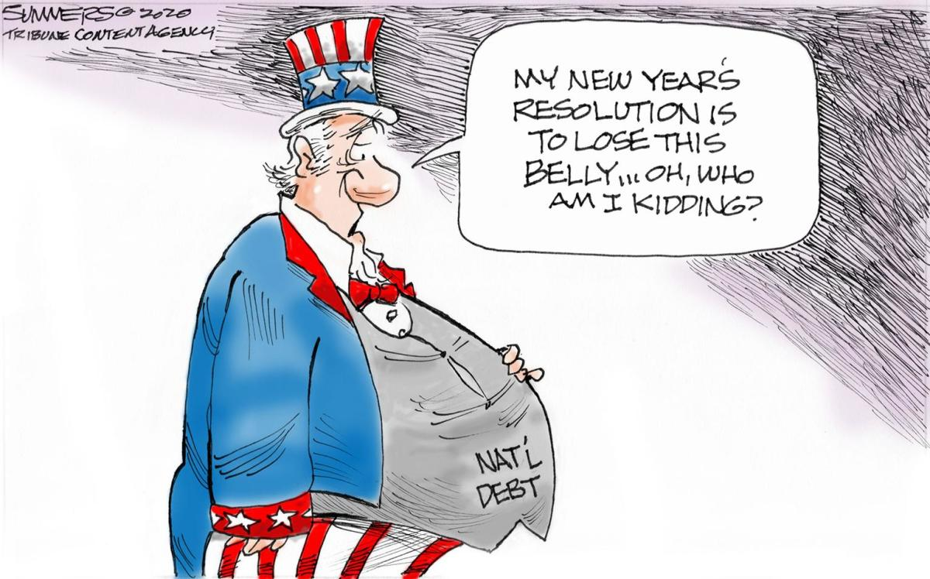

Slide 31
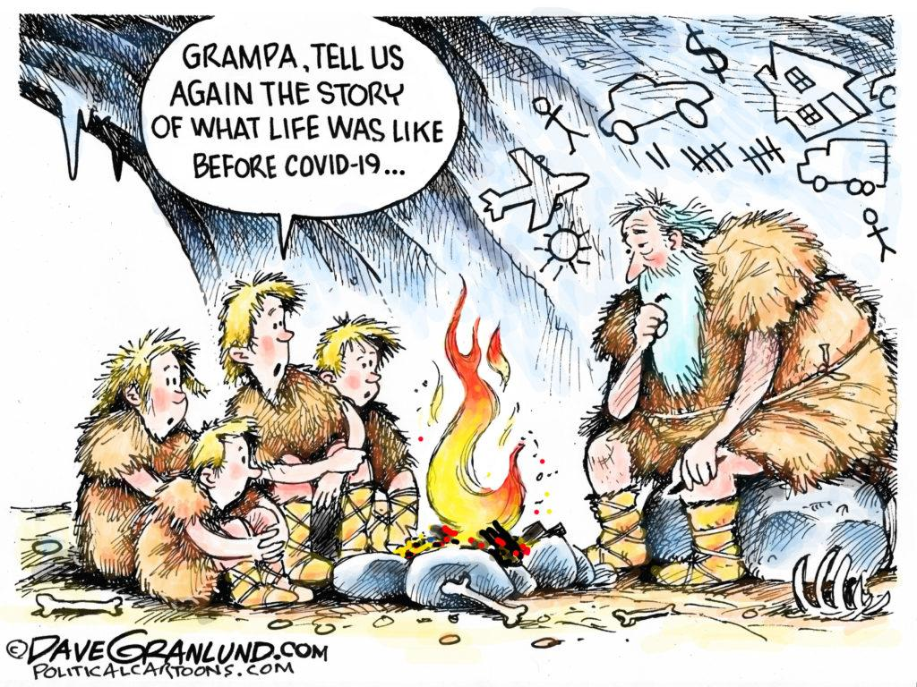

Slide 32
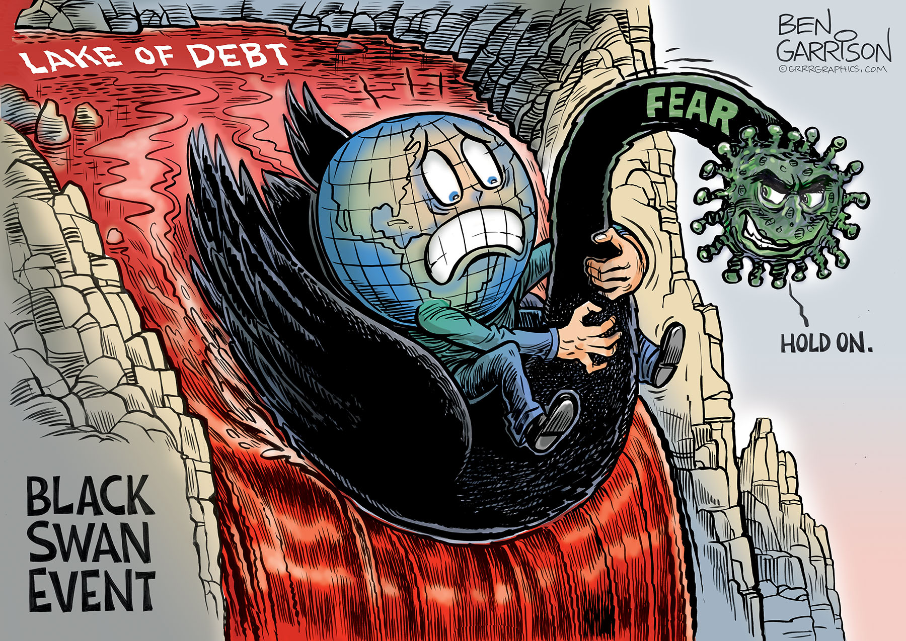

Slide 33
Thoughts of leading economists…
Costs are enormous, but we are doing the right thing!
Bipartisan support
Fiscal policy concerns:
  Are direct cash payments making it into the hands of those most in need?
  Payments to large corporations
  Technical issues with PPP
  Enough for medical care?
Capacity to borrow – treasury bonds attractive

Slide 34
Final Thoughts
In such a polarized country, why has there been bipartisan support of stimulus packages to support the economy at this time?
What are the potential costs and benefits associated with increasing the debt?

Slide 35


Slide 36

CEE Affiliates
https://www.councilforeconed.org/resources/local-affiliates/

Slide 37
Thank You to Our Sponsors!

Slide 38
Covid-19 and the National Debt
Presented by Amanda Stiglbauer
Blythewood High School, Blythewood, SC
June 21, 2020
Amanda.Stiglbauer@moore.sc.edu

