Slide 1
The American Banking System
Presented by
Date
Professional Email
Matthew Gherman
7/23/20
mgherman@schools.nyc.gov
Edward R. Murrow High School

Slide 2
EconEdLink Membership
You can now access CEE’s professional development webinars directly on EconEdLink.org! To receive these new professional development benefits, become an EconEdLink member. As a member, you will now be able to:
Automatically receive a professional development certificate via e-mail within 24 hours after viewing any webinar for a minimum of 45 minutes
Register for upcoming webinars with a simple one-click process
Easily download presentations, lesson plan materials, and activities for each webinar
Search and view all webinars at your convenience
Save webinars to your EconEdLink dashboard for easy access to the event
You may access our new Professional Development page here

Slide 3
Professional Development Certificate
To earn your professional development certificate for this webinar, you must:
Watch a minimum of 45-minutes and you will automatically receive a professional development certificate via e-mail within 24 hours.
Accessing resources:
You can now easily download presentations, lesson plan materials, and activities for each webinar from EconEdLink.org/professional-development/

Slide 4
Agenda
Importance of banks to an economy
Evolution of the American Banking System and Money
The Federal Reserve and its powers
How has the Fed done?

Slide 5
Objectives
Understand the history and evolution of the American Banking System
Understand why banks are integral to an industrialized and capitalist society and economy
Materials for Students
Evaluate: How has the Federal Reserve done in the face of economic crisis?

Slide 6
National Standards
20.7 Monetary policies are decisions by the Federal reserve System that lead to changes in the supply of money, short term interest rates, and the availability of credit. Changes in the growth rate of the money supply can influence overall levels of spending, employment, and prices in the economy by inducing changes in the levels of personal and business investment spending.
20.8. the Federal reserve System’s major monetary policy tool is open market purchases or sales of government securities, which affects the money supply and short-term interest rates. other policy tools used by the Federal reserve System include making loans to banks (and charging a rate of interest called the discount rate). in emergency situations, the Federal reserve may make loans to other institutions. the Federal reserve can also influence monetary conditions by changing depository institutions’ reserve requirements.

Slide 7
State Standards
12.E3d A degree of regulation, oversight, or government control is necessary in some markets to ensure free and fair competition and to limit unintended consequences of American capitalism. Government attempts to protect the worker, ensure property rights, and to regulate the marketplace, as well as to promote income equality and social mobility, have had varied results.
12.E4c The Federal Reserve is the government institution responsible for managing the nation’s monetary policy, including regulating the amount of money in circulation and interest rates.

Slide 8
Introduction to Banking
Motivation for students regardless of lesson:
  Why do people put their money in the bank?
    Introduction discussions to interest rates and safety
    Introduction to different types of bank accounts and their merits: checking, savings, certificate of deposit, money market
    Why do banks want us to put our money in them?
    Activity: Shopping for a bank worksheet. Compare and contrast the ways to put your money in 2-3 different banks

Slide 9
Keywords
Deposit - Amount of money put into a bank (M1 or M2).
Required Reserves - Amount the FED forces banks to keep as cash reserves on hand and in their vaults.
Excess Reserves - Amount banks can lend out after their required reserves are kept aside.
Federal Funds Rate - The rate in which banks lend money to each other (changes when the FED changes monetary policy -- affected by the change in interest rates).
Assets: Anything owned by the bank or owed to the bank is an asset of the bank. Cash on reserve is an asset and so are loans made to citizens.
Liability: Anything owned by depositors or lenders to the bank is a liability. Checking deposits or loans made to the bank are liabilities to the bank.
*A bank’s liabilities cannot exceed its assets (Balance Sheet)

Slide 10
Money Multiplier and the balance sheet
Why banks are so important to an economy

Slide 11
Money Multiplier
Step 1: Mike takes $1000 from under his mattress, deposits it at a Chase Bank, and opens a checking account. If the required reserves rate is 10%, the bank must put $100 in required reserves, but the remaining $900 are excess reserves and can be either kept on reserve or lent
Assets | Liabilities
Required Reserves: $100 | Checking Deposits: $1,000
Excess Reserves: $900
Total Assets: $1,000 | Total Liabilities: $1,000

Slide 12
Step 2: The Chase bank lends all $900 in excess reserves to Thomas, a local farmer
Assets | Liabilities
Required Reserves: $100 | Checking Deposits: $1,000
Excess Reserves: $0
Loans: $900
Total Assets: $1,000 | Total Liabilities: $1,000

Slide 13
Step 3: Thomas uses his $900 at Tractor Supply, which has a checking account at the Chase Bank. Checking deposits have now increased by $900 and this is new money. The Chase Bank must keep $90 as required reserves and there is now $810 of excess reserves
Assets | Liabilities
Required Reserves: $190 | Checking Deposits: $1,900
Excess Reserves: $810
Loans: $900
Total Assets: $1,900 | Total Liabilities: $1,900

Slide 14
Step #4: The Chase Bank makes a loan to James, who is looking to buy some furniture. James spends $810 dollars at Furniture Factory, which also banks with the Chase Bank, increasing checking deposits by $810. The Chase Bank must keep $81 in required reserves and there are now $729 in excess reserves
Assets | Liabilities
Required Reserves: $271 | Checking Deposits: $2,710
Excess Reserves: $729
Loans: $1,710
Total Assets: $2,710 | Total Liabilities: $2,710

Slide 15
Evolution of the Federal Reserve System

Slide 16
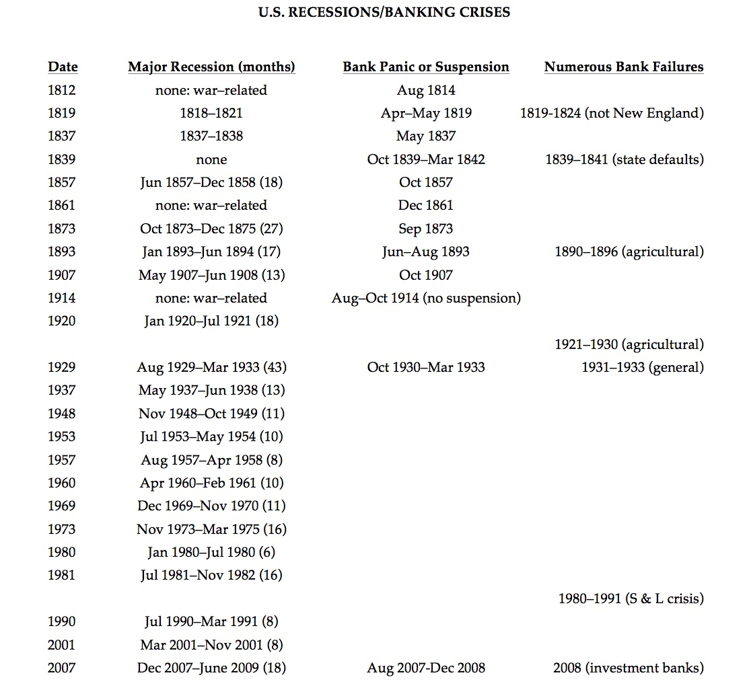
Banks and Economic Crisis

Slide 17
Start of National Banking
Post-Revolutionary War
Money was “worthless as a continental”
States had their own individual currencies
Alexander Hamilton sees America as an industrial nation which requires a strong banking system

Slide 18
The BUS
  Creates Bank of United States (BUS) plan after the Bank of England
    Have branches in every major city throughout the land
    Issue money (bank notes) that would be equally acceptable in all parts of the nation and be redeemable in gold and silver
    Help in the creation of new money through borrowing
    Loan money to the government when needed
    Serve as a place for the government to deposit its money
    Must buy stock in the bank
    Issue government bonds
    Board of directors (25) chosen by shareholders, government and bank President

Slide 19
Hamilton
Jefferson
A restrictive interpretation of the word “necessary” is also contrary to this sound maxim of construction: namely that the powers contained in a Constitution ought to be construed liberally in advancement of the public good. The means by which national exigencies are to be provided for, national prosperity promoted, are of such infinite variety, extent, and complexity, that there must o necessity be a great latitude of choice in the selection and application of these means…
If the end (purpose of law) be clearly comprehended within any of the specific powers, and if the measure have an obvious relation to the end, and is not forbidden by any particular provision of the Constitution, it may be safely deemed to come within the compass of national authority.
I consider the foundation of the Constitution that “all powers not delegated to the United States, nor prohibited by it to the States, are reserved to the States, or to the people” (10th Amendment). To take a single step beyond the boundaries that are specifically drawn around the powers of Congress is to take possession of a boundless field of power, no longer susceptible of any definition.
It has been much urged that a bank will give great convenience in the collection of taxes…yet the Constitution allows only the means which are “necessary” not those which are merely “convenient”…there is not one (power) which ingenuity may torture into convenience, in some instance or other, to someone of so long a list of enumerated powers. It would swallow up all the delegated powers, and reduce the whole to one power…Therefore it was that the Constitution restrained them to the necessary means; that is to say, to those means without which the grant of the power would be nugatory (useless).

Slide 20
Andrew Jackson and the 2nd BUS
“The powers of the national bank are not only unnecessary, but they are also dangerous to the government and to the country. When the bank was created, it set up a monopoly that let one small group in society gain most of the benefits. If the benefits had been shared equally, then it would have been a benefit for society, but because it helped the rich more than the poor, it is against democracy.” – Andrew Jackson
“There were three main arguments made by Jackson against the bank. One was economic, another was political, and the third was social. The third reason was to keep a small group of wealthy citizens from taking advantage of the common people.” -- Historian Arthur M. Schlesinger (1945)

Slide 21
The Bank War and the Panic of 1837
Andrew Jackson believed the bank hurt the American Republic because:
It concentrated the nation's money into one business controlled by one elite group
It gave cheaper and better loans to Congressmen than ordinary Americans; thus having too much control over members of Congress
It favored businessmen from the Northeast over farmers from the Southern and Western states
The bank was in charge of receiving Federal tax money and then used this tax money to give its owners and investors profit and to take advantage of state banks
Jackson vetoed the renewal of the Charter (contract) of the BUS and it went out of business – each state now had its own main banks instead. However, this led to lots of complications and eventually caused The Panic of 1837 – where local banks closed costing many people their savings, bankrupting hundreds of businesses and put 33% of the population of out of work

Slide 22
Banking with no true National Bank
All banks were either chartered by the various states or given permission to operate without a charter by the national government “free banks”
No banks were allowed to branch across state lines, and some states prohibited branching altogether
This prevented a natural system of nationwide clearinghouses (3rd party financial institutions) from developing to exchange banknotes and later, deposits
Banknote reporters tried to keep the public informed about the value of these various notes, but some fraudulent issuers were able to take advantage of the lapse of time until this information was disseminated
Pre-Civil War money supply, which had involved thousands of different varieties of paper money issued by local banks, rampant counterfeiting, chronic uncertainty about the value of paper money, and, as a result, difficulty conducting private business

Slide 23
National Bank Act – Pre-Cursor to Fed – 1863 and Amdended 1864
The Act established the Office of the Comptroller of the Currency (OCC), charged with responsibility for organizing and administering a system of nationally chartered banks and a uniform national currency
Short Term Goal = Generate Cash. Desperately needed to finance and fight the Civil War. Early “National Banks” -- After prospective national bank organizers submitted a business plan and had it approved by the OCC, they were required to purchase interest-bearing U.S. government bonds in an amount equal to one-third of their paid-in capital. Millions of much-needed dollars flowed into the Treasury in this manner
Long Term Goal = New National Currency. Purchased bonds were to be deposited with the Treasury, where they were held as security for a new kind of paper money, “The Green Back.” Bearing the name of the issuing national bank and the signatures of its officers, these notes were otherwise identical in design, size, and coloration. Anyone holding a national bank note could present it for redemption in, gold or silver coin, at the issuing bank or at reserve banks around the country. If, for whatever reason, the issuing bank was unable to meet the demand for cash redemption, the system was set up so that the government could sell the bank’s bonds and pay off the noteholders directly

Slide 24
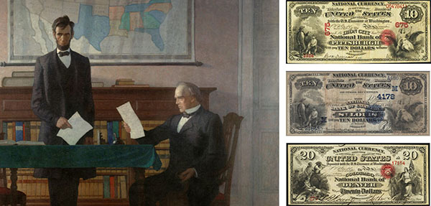

Slide 25
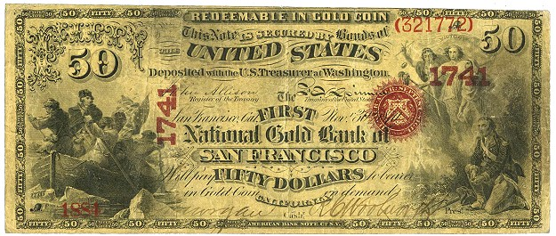

Slide 26
Lincoln and Banking
"The [National] Bank was permitted to and did actually loan [public revenues] out to individuals, and hence the large amount of money annually collected for revenue purposes, which by any other plan would have been idle a great portion of time, was kept almost constantly in circulation. Any person ... will reflect, that money is only valuable while in circulation, [and] any device which will keep the government revenues, in constant circulation, instead of being locked up in idleness, is no inconsiderable advantage.
"The national banking system is proving to be acceptable to capitalists and to the people ... That the government and the people will derive great benefit from this change in the banking systems of the country can hardly be questioned. The national system will create a reliable and permanent influence in support of the national credit and protect the people against losses in the use of paper money."

Slide 27
1907 Panic and the Aldrich-Vreeland Act of 1908
Stock market lost half its value (due to heavy shorting stocks)
The economy fell into recession
In the early 1900s, the United States had about 7,000 independently owned banks that were all vulnerable to depression, because there was no back-up plan in place. Severe bank runs and loan calls called bank failures in many of these banks
National Bank of North America collapsed
Sparked, apparently, by a decision by a few New York banks to retract loans but soon spread nationwide
JP Morgan, who sorted the problem out by organizing money transfers between the banks, setting up international credit lines, and buying up cheap shares in fundamentally healthy outfits. Morgan goes to John D. Rockefeller to help him finance these credit lines

Slide 28
Aldrich-Vreeland Act of 1908
The legislation allowed national banks to issue notes on a wider range of securities than previously allowed
In addition to federal government bonds, the Aldrich-Vreeland allowed banks to use the bonds of states, cities, and counties along with commercial paper
The effect of that liberalization of policy was to put more money into circulation
National Monetary Commission: create a plan to prevent it from ever happening again

Slide 29
Federal Reserve Act
House Committee on Banking and Finance presented President Woodrow Wilson with what would become, with some modifications, the Federal Reserve Act
December 23, 1913: President Wilson signed the Federal Reserve Act into law
American compromise — a decentralized central bank that balanced the competing interests of private banks and populist sentiment (not too similar to BUS), farmers interests, “money trust” or no “money trust,” bankers’ interests, regulator of money supply, banker’s bank

Slide 30
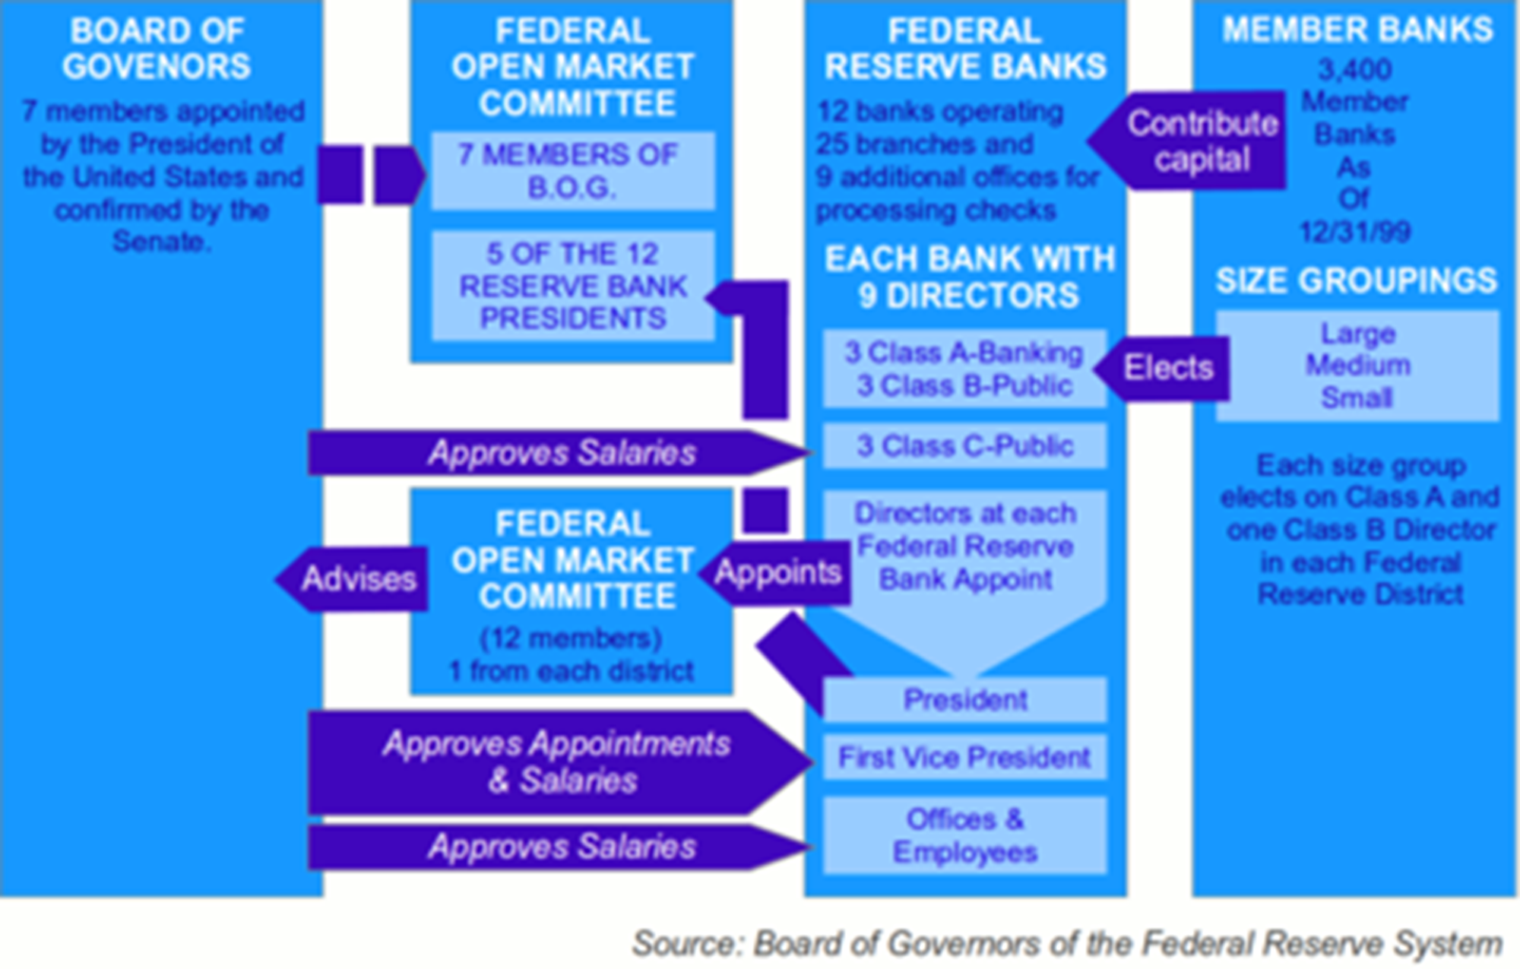

Slide 31
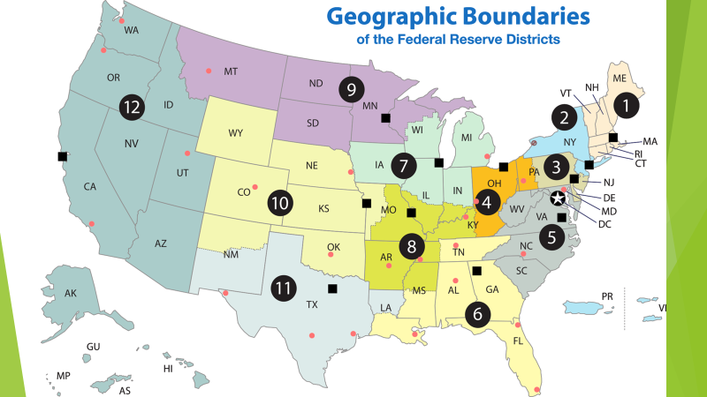

Slide 32
Main Functions of the Fed
Conducts the nation’s monetary policy to promote maximum employment, stable prices, and moderate long-term interest rates in the U.S. economy
Promotes the stability of the financial system and seeks to minimize and contain systemic risks through active monitoring and engagement in the U.S. and abroad
Promotes the safety and soundness of individual financial institutions and monitors their impact on the financial system as a whole
Fosters payment and settlement system safety and efficiency through services to the banking industry and the U.S. government that facilitate U.S.-dollar transactions and payments
Promotes consumer protection and community development through consumer-focused supervision and examination, research and analysis of emerging consumer issues and trends, community economic development activities, and the administration of consumer laws and regulations

Slide 33
Breakdown of the Fed
https://www.federalreserve.gov/aboutthefed/pf.htm

Slide 34
Monetary Policy: Controlling the nation’s money supply (m1 and m2)
1) Required Reserve Ratio (RRR). The Required Reserve Ratio is the percentage of required reserves the banks must keep in their vaults.
If the Federal Reserve changes the RRR, then banks are forced to either keep more money aside (in terms of vault cash at the bank or reserve accounts at the Federal Reserve Bank) or are allowed to keep less (and lend out more). The left over reserves that banks are allowed to lend are called excess reserves. The change in excess reserves increases or decreases the money supply because this money is now liquid and able to be circulated

Slide 35
Monetary Policy: Controlling the nation’s money supply (m1 and m2)
2) Discount Rate. This is interest rate at which the FED lends money to banks. This can either encourage or discourage banks to borrow money from the FED, which will increase or decrease the money supply, since this will affect the banks’ willingness and ability to loan money (putting it in circulation)

Slide 36
Monetary Policy: Controlling the nation’s money supply (m1 and m2)
3) Open Market Operations - This is the main tool the FED uses because it influences monetary policy the quickest. The FED buys and sells government securities like bonds and treasury bills or notes to banks to increase or decrease their excess reserves. If the FED wants to increase their excess reserves (and increase the money supply), they will buy bonds from the banks, giving the banks money in exchange for their securities
If the Fed wants to decrease the excess reserves (and decrease the money supply), they will sell bonds to the banks, which will take money out of the banks
*hint: Buying Bonds = Bigger Bucks, Selling Bonds = Smaller Bucks

Slide 37
Effects of All 3
These mechanisms will affect the money supply, interest rates and money demanded
Also changes the Federal Funds Rate -- the rate that banks lend money to each other
When monetary policy is expansionary, the money supply increases, decreasing interest rates (banks will be more willing to lend money; thus lowering their interest rates) and increasing the demand for money by the public, so banks will decrease their Federal Funds Rate to each other (therefore also increasing the demand for money and investment)
When monetary policy is contractionary, the money supply decreases, which increases the interest rate (since banks are less willing to loan money they will raise interest rates), decreasing the demand for money by the public, which also increases the Federal Funds rate (which further decreases money supply and demand for money and investment)

Slide 38
Tool | Description | To Increase Money Supply (during recession) | To Decrease Money Supply (during inflation)
Change Reserve Requirement Ratio (RRR) | Change the percentage of each deposit that banks must hold aside. | Lower the reserve requirement ratio. | Raise the reserve requirement
Change the Discount Rate | Change the rate of interest the FED charges on bank borrowings | Lower the discount rate | Raise the discount rate
Open Market Operation (most used) | Buy or sell government securities in the secondary market. | Buy government securities | Sell government securities

Slide 39
Money Multiplier Formula
The Money Multiplier (also known as the deposit expansion multiplier) = 1/required reserve ratio.
The change in the money supply = money multiplier x change in excess bank reserves.
So, if the required reserve ratio was 10%, the money multiplier would be 10
Then, if open market operations led to an increase in bank reserves by $50 million dollars, the actual change in the money supply would be $500 million dollars.

Slide 40
So, How Has the Fed Done?

Slide 41
WWI
World War I: By using the Fed as a bankers’ bank and now a stable form of currency (Federal Reserve Notes), the United States aided the flow of trade goods to Europe, indirectly helping to finance the war until 1917, when the United States officially declared war on Germany and financing our own war effort became paramount. The Federal Reserve helped to secure the financial system to borrow to finance the war

Slide 42
1920’s
1920’s: Large purchase of government securities via open market operations helped to move the economy out the 1921 recession. During the 1920s, the Fed began using open market operations as a monetary policy tool. During his tenure, Chairman Benjamin Armstrong also elevated the stature of the Fed by promoting relations with other central banks, especially the Bank of England.

Slide 43
The Great Depression
Federal Reserve Chairman Ben Bernake at Milton Friedman’s 90th birthday: “Let me end my talk by abusing slightly my status as an official representative of the Federal Reserve. I would like to say to Milton and Anna: Regarding the Great Depression. You're right, we did it. We're very sorry. But thanks to you, we won't do it again.”
Stock Market Crash, Poor Banking Practices and Collapse of Bank of America leads to Bank Run: 5,000 banks close through 1933 and 1/3 of the nation’s money supply is lost.
1933: ¼ Americans is unemployed with millions more underemployed. 1929-1933 Federal Reserve creates a contractionary monetary policy; exacerbating the Recession into a Depression
Utah Branch “Counting Slow” Story
Being tied to the Gold Standard made our Depression more severe; less liquidity and price adjustment

Slide 44
Why do the opposite?
1) Poor leadership: death of chairman Benjamin Armstrong (1st chair) in 1928
2) Fear of speculation: trying to use a tight monetary policy to slow down Wall Street Speculation. New Chairman Roy Young sees Federal Reserve goal to protect banking system, not monetary policy.
3) Fear of a run on U.S. gold by foreign powers and banks
4) Fear itself: many Fed officials wanted to hold onto dollars and gold fearing a run on each. Fed officials were also weary of Roosevelt’s new policies before he was inaugurated.
https://www.federalreserve.gov/BOARDDOCS/SPEECHES/2002/20021108

Slide 45
Depression Aftermath
Bank Holiday (1933)
FDIC + FOMC as separate entity with 14 year term limits
Employment Act: Added the goal of promising maximum employment to the list of the Fed’s responsibilities
Bank Holding Company Act (1956): Named the Fed as the regulator of bank holding companies owning more than one bank
Humphrey-Hawkins Act (1978): Required the Fed chairman to report to Congress twice annually on monetary policy goals and objectives.
Treasury-Fed Accord: This eliminated the obligation of the Fed to monetize the debt of the Treasury (buying bonds from the government) at a fixed rate and became essential to the independence of central banking and how monetary policy is pursued by the Federal Reserve today.

Slide 46
Fighting Stagflation: Chairman Paul Volkner raises interest rates to slow down inflation while President Reagan’s tax cuts decrease inflation
Chairman Alan Greenspan: Throughout the 1990s, the Fed used monetary policy on a number of occasions including the credit crunch of the early 1990s and the Russian default on government securities to keep potential financial problems from adversely affecting the real economy. The decade was marked by generally declining inflation and the longest peacetime economic expansion in our country’s history.
9/11: The Fed issued a short statement reminiscent of its announcement in 1987: “The Federal Reserve System is open and operating. The discount window is available to meet liquidity needs.” In the days that followed, the Fed lowered interest rates and loaned more than $45 billion to financial institutions in order to provide stability to the U.S. economy. By the end of September, Fed lending had returned to pre-September 11 levels and a potential liquidity crunch had been averted. The Fed played the pivotal role in dampening the effects of the September 11 attacks on U.S. financial markets.

Slide 47
2007-2010 Housing Crisis
https://www.youtube.com/watch?v=N9YLta5Tr2A

Slide 48
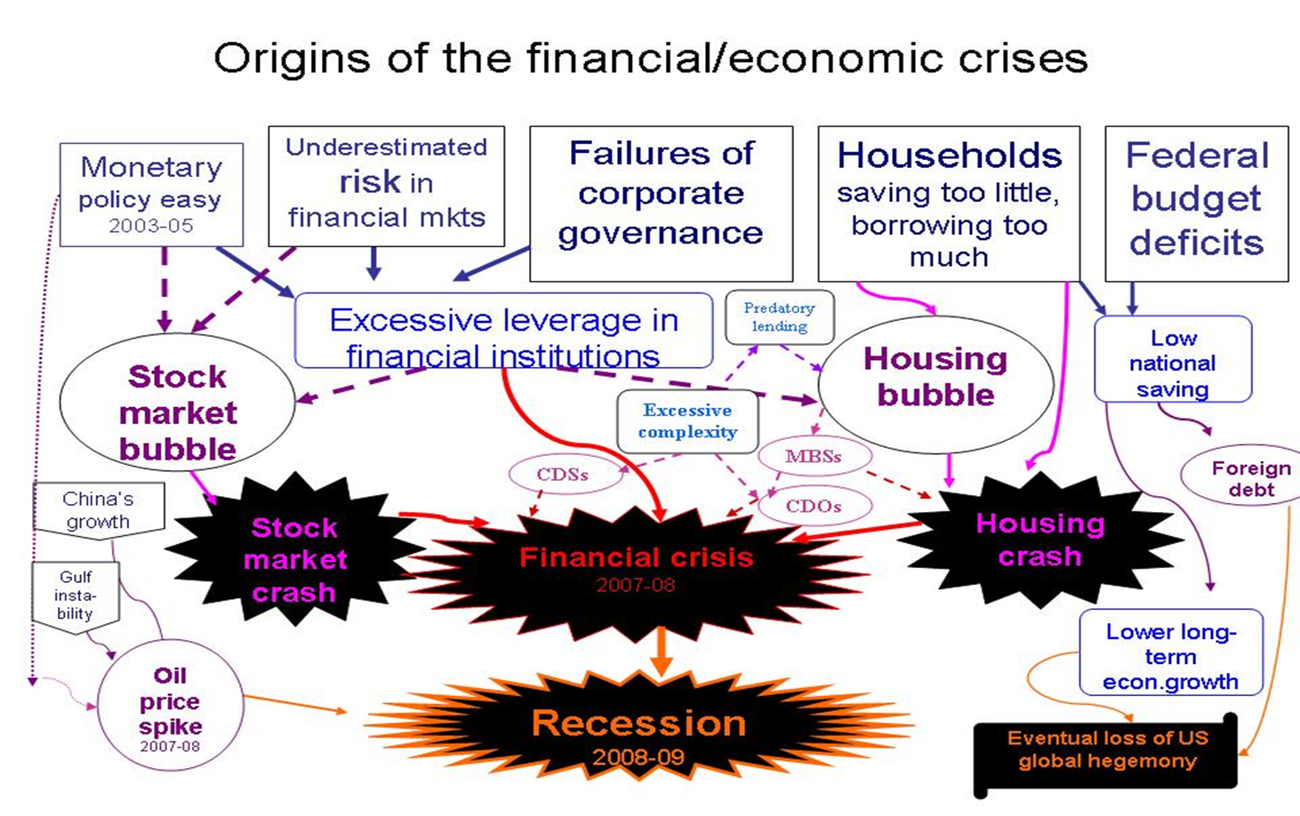

Slide 49
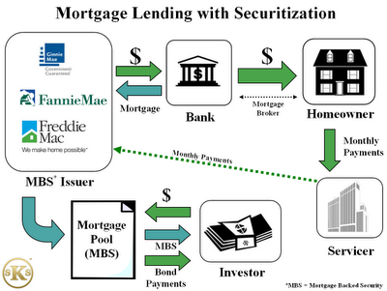

Slide 50
Should the Federal Reserve be blamed for 2007?
YES
NO
  Historically low interest rates for extended periods of time
  Long term expansionary policies; ultimately printing money and over-expanding credit
  Not reigning in financial institutions (ie – Citi Bank?)
  De-regulation of Banking System under Alan Greenspan and Ben Bernanke
  “Cavalier” attitude about no future recession
  Fair Housing Act (1995)
  Failure of Congress to reign in Fannie Mae and Freddy Mac
  Greed of individual banks and financial institutions: predatory lending, toxic mortgages, MBSs

Slide 51
Fed’s Response to the Great Recession
Federal Reserve expanded its own collateralized lending to financial institutions to ensure that they had access to the critical funding needed for day-to-day operations
March 2008, the Federal Reserve created two programs to provide short-term secured loans to banks to buy other banks’ assets (for example Chase receiving loans to buy Bear Sterns’ assets)
Provided secured loans to the giant insurance company American International Group (AIG) because of its central role guaranteeing financial instruments

Slide 52
Response Cont’d
Unprecedented review of the financial condition of the 19 largest U.S. banks
This included a "stress test" that measured how well these banks could weather a bad economy over the next two years
Banks that didn't have enough of a capital cushion to protect them from loan losses under the most adverse economic scenario were required to raise new money from the private sector or accept federal government funds from the Troubled Asset Relief Program (TARP I and TARP II) under Presidents George W. Bush and Barack Obama

Slide 53
Response Cont’d
Federal Open Market Committee, slashed its target for the federal funds rate to nearly 0
It purchased $300 billion in longer-term Treasury securities, which are used as benchmarks for a variety of longer-term interest rates, such as corporate bonds and fixed-rate mortgages
To support the housing market, the Federal Reserve authorized the purchase of $1.25 trillion in mortgage-backed securities guaranteed by agencies such as Freddie Mac and Fannie Mae and about $175 billion of mortgage agency longer-term debt. These Federal Reserve purchases have reduced mortgage interest rates, making home purchases more affordable
Debt Monetization: Government sells bonds to raise money for government debt. Treasury Department prints money so Federal Reserve can buy bonds back from secondary bond market, so this way the Federal Reserve owns the government debt

Slide 54
Response to Coronavirus
1) Targets nominal and federal funds interest rates to 0%
2) Emergency credit facilities
3) Scaling back banking regulations, oversight, bank capital requirements
4) New York Fed Buys Commercial Mortgage-Backed Securities
5) Currently over 1.5 Trillion…can go to 4 Trillion in lending and liquidity

Slide 55
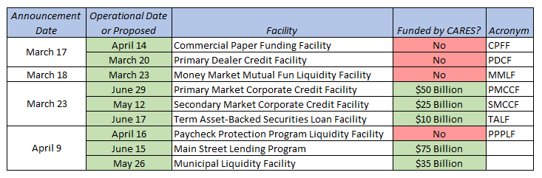
Emergency Credit Facilities

Slide 56
Response to Coronavirus
Great Timeline: https://www.americanactionforum.org/insight/timeline-the-federal-reserve-responds-to-the-threat-of-coronavirus/
https://www.brookings.edu/research/fed-response-to-covid19/

Slide 57
Assessment Questions
Evaluate the Constitutional Arguments of Hamilton, Jefferson and Jackson around the Bank of the United States and evaluate the impact of those arguments.
To what extent should the Great Depression be seen as a failure of laissez-faire capitalism or as a failure of government and government institutions?
Explain in your own words the process and importance of the money multiplier.
To what extent should the Federal Reserve use monetary policy to correct and adjust the economy?
How might actions of the Federal Reserve affect the everyday personal finance decisions of individuals?
Choose an economic crisis in American History since the creation of the Federal Reserve and evaluate how the Federal Reserve’s actions handled that crisis.

Slide 58
References
https://www.occ.treas.gov/about/who-we-are/history/founding-occ-national-bank-system/in-his-own-words-abraham-lincoln-on-banking.html
https://www.dhakatribune.com/business/2019/02/07/a-history-of-banking
https://www.federalreservehistory.org/essays/gold_convertibility_ends
https://fee.org/articles/banking-before-the-federal-reserve-the-us-and-canada-compared/
https://www.economist.com/news/essays/21600451-finance-not-merely-prone-crises-it-shaped-them-five-historical-crises-show-how-aspects-today-s-fina
https://www0.gsb.columbia.edu/mygsb/faculty/research/pubfiles/5416/banking%20crises.pdf

Slide 59
Resources
https://www.investopedia.com/terms/c/clearinghouse.asp
https://www.kansascityfed.org/aboutus/federalreservesystem
https://www.federalreserveeducation.org/about-the-fed/history
https://www.federalreserve.gov/BOARDDOCS/SPEECHES/2002/20021108/
https://www.forbes.com/sites/richardsalsman/2011/07/17/how-bernankes-fed-triggered-the-great-recession/#3c32f5c61d93

Slide 60

CEE Affiliates
https://www.councilforeconed.org/resources/local-affiliates/

