Slide 1
Business Cycles: Recession vs. Depression Macroeconomics 302 Presented by Tawni Hunt Ferrarini, PhD July 9, 2020 Tferrarini@Lindenwood.edu * Tawni.org

Slide 2
EconEdLink Membership
You can now access CEE’s professional development webinars directly on EconEdLink.org! To receive these new professional development benefits, become an EconEdLink member. As a member, you will now be able to:
Automatically receive a professional development certificate via e-mail within 24 hours after viewing any webinar for a minimum of 45 minutes
Register for upcoming webinars with a simple one-click process
Easily download presentations, lesson plan materials, and activities for each webinar
Search and view all webinars at your convenience
Save webinars to your EconEdLink dashboard for easy access to the event
You may access our new Professional Development page here

Slide 3
Professional Development Certificate
To earn your professional development certificate for this webinar, you must:
Watch a minimum of 45-minutes and you will automatically receive a professional development certificate via e-mail within 24 hours.
Accessing resources:
You can now easily download presentations, lesson plan materials, and activities for each webinar from EconEdLink.org/professional-development/

Slide 4
Agenda
Welcome
Macroeconomics objectives
Six online practices for good teaching applied to economics
Deep dive into macroeconomic recessions and depressions
Review
Conclusion and references
Thanks to you and our sponsors

Slide 5
Bell Ringer
Are we coming out of a recession? Yes * No * I Don’t Know (Reply in chat box)
SEE BITMOJI. TAKE ACTION!!!!

Slide 6
Macro Objectives
Identify the last key recessions in the U.S.
Define a business cycle and describe the interplay of key economic indicators
Compare and contrast a recession and a depression

Slide 7
Good Online Teaching Practices
peardeck.com (Level 1, $0)

Slide 8
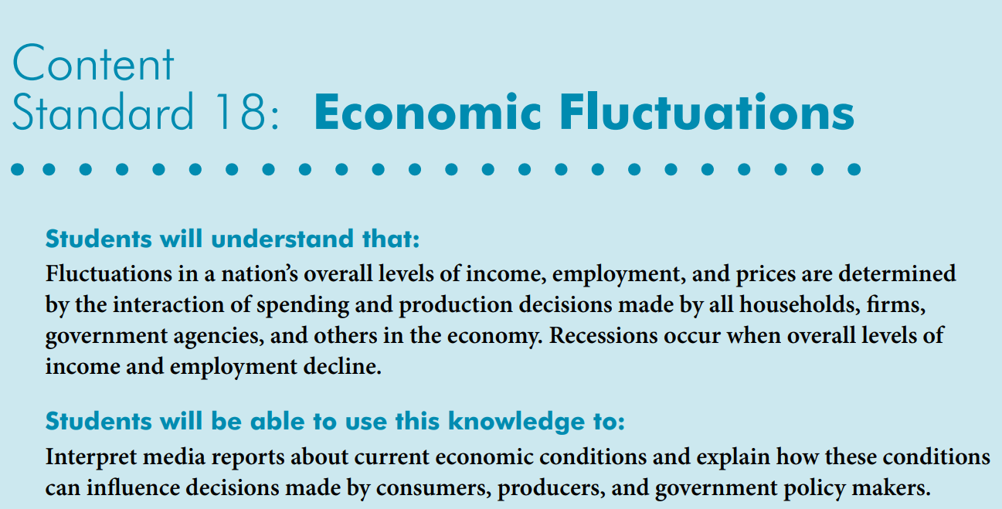
Voluntary National Content Standards in Economics

Slide 9
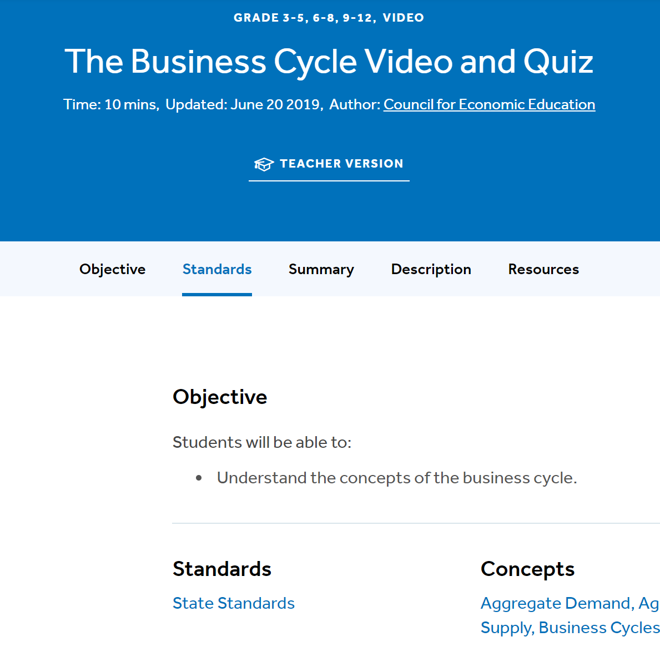
State Standards
Connect to regional and state standards at EconEdLink.org
Search for “business cycles”
Choose a lesson
Click on State Standards
NYSed.gov

Slide 10
Active Learning
You will through five activities by:
Identifying key recessions in U.S. history
Investigating the relationships between key macroeconomic indicators
Identifying links between them
Describing a recession and explain how it differs from a depression
Placing the U.S. economy on the business cycle

Slide 11
Drag and Drop
Name | Period | Duration
COVID | 02/2020 – | TBD
Great Recession | 12/2007–06/ 2009 | (1y/6m)
Back-2-Back Recessions | 01/1980–07/198 07/1981–11/ 1982 0 | (6m) and (1y/4m)
Stagflation | 11/1973–03/1975 | (1y/4m)
Postwar Economy | 02/1945–10/1945 | (8m)
Great Depression | 08/1929–03/1933 | (3y/7m)

Slide 12
Drag and Drop
Name | Period | Duration
COVID | 02/2020 – | TBD
Great Recession | 12/2007–06/ 2009 | (1y/6m)
Back-2-Back Recessions | 01/1980–07/198 07/1981–11/ 1982 0 | (6m) and (1y/4m)
Stagflation | 11/1973–03/1975 | (1y/4m)
Postwar Economy | 02/1945–10/1945 | (8m)
Great Depression | 08/1929–03/1933 | (3y/7m)

Slide 13
Choice
Period | GDP decline (peak to trough) | Unemployment | CPI | Stock Mkt
COVID 02/2020–TBD
Great Recession 12/2007–06/2009 (1y/6m)
Back-2-Back Recessions 01/1980–07/1980 (6m) and 07/1981–11/ 1982 (1y/4m)
Stagflation 11/1973–03/1975 (1y/4m)
Postwar Economy 02/1945–10/1945 (8m)
Great Depression 08/1929–03/1933 (3y/7m)
During a recession what happens to production (GDP), employment, and unemployment?

Slide 14
Choice
Period | GDP decline (peak to trough) | Unemployment
COVID 02/2020–TBD
Great Recession 12/2007–06/ 2009 (1y/6m) | -05% | +10%
Back-2-Back Recessions 01/1980–07/1980 (6m) and 07/1981–11/ 1982 (1y/4m) | -02% -03% | +08% +11%
Stagflation 11/1973–03/1975 (1y/4m) | -03% | +09%
Postwar Economy 02/1945–10/1945 (8m) | -13% | +05%
Great Depression 08/1929–03/1933 (3y/7m) | −27% | +21%
During a recession what happens to production (GDP) and employment decline while unemployment rises.

Slide 15
Price Levels
Period | GDP decline (peak to trough) | Unemployment | Consumer Price Level (CPI)
COVID 02/2020 –TBD
Great Recession 12/2007–06/2009 (1y/6m) | -05% | +10%
Back-2-Back Recessions 01/1980–07/1980 (6m) and 07/1981–11/ 1982 (1y/4m) | -02% -03% | +08% +11%
Stagflation 11/1973–03/1975 (1y/4m) | -03% | +09%
Postwar Economy 02/1945–10/1945 (8m) | -13% | +05%
Great Depression 08/1929–03/1933 (3y/7m) | −27% | +21%
During a recession what happens to price levels?

Slide 16
Let’s Investigate
Look at the “Inflation Rates” using historic data.
Calculate in/deflation rates for the year and recessionary period.
Summarize our findings.
Draw a conclusion.

Slide 17
Inflation Rates from Price Levels (CPI)
Citation: "Graphing Various Historical Economic Series," MeasuringWorth, 2020. URL: www.measuringworth.com/graphs

Slide 18
Inflation Rates from Price Levels (CPI)
Calculate
Citation: "Graphing Various Historical Economic Series," MeasuringWorth, 2020. www.measuringworth.com/graphs
Calculate Rate of In/Deflation by year or period
Do the math
Use a calculator
Calculate Rate of In/Deflation [CPI(t)-CPI(t-1)]/CPI(t-1)*100, %

Slide 19
Inflation Rates from Price Levels (CPI)
Calculate
Calculate Rate of In/Deflation [CPI(t)-CPI(t-1)]/CPI(t-1)*100, %
Calculate Rate of In/Deflation by year or period
Do the math
Use a calculator 1929-30
Use a calculator 1929-33
Citation: "Graphing Various Historical Economic Series," MeasuringWorth, 2020. URL: www.measuringworth.com/graphs

Slide 20
Price Levels
Period | GDP decline (peak to trough) | Unemployment | Consumer Price Level (CPI) | Stock Mkt
COVID 02/2020 –TBD
Great Recession 12/2007–06/2009 (1y/6m) | -05% | +10% | Moderate
Back-2-Back Recessions 01/1980–07/1980 (6m) and 07/1981–11/ 1982 (1y/4m) | -02% -03% | +08% +11% | Moderate
Stagflation 11/1973–03/1975 (1y/4m) | -03% | +09% | Inflation 1973 44CPI – 1975 55CPI
Postwar Economy 02/1945–10/1945 (8m) | -13% | +05% | Relatively constant
Great Depression 08/1929–03/1933 (3y/7m) | −27% | +21% | Deflation (Students insert calculations here.)

Slide 21
Price Levels
Period | GDP decline (peak to trough) | Unemployment | Consumer Price Level (CPI) | Stock Mkt
COVID 02/2020 –TBD
Great Recession 12/2007–06/2009 (1y/6m) | -05% | +10% | Moderate
Back-2-Back Recessions 01/1980–07/1980 (6m) and 07/1981–11/ 1982 (1y/4m) | -02% -03% | +08% +11% | Moderate
Stagflation 11/1973–03/1975 (1y/4m) | -03% | +09% | Inflation 1973 44CPI -1975 55CPI
Postwar Economy 02/1945–10/1945 (8m) | -13% | +05% | Relatively constant
Great Depression 08/1929–03/1933 (3y/7m) | −27% | +21% | Deflation
During a recession what happens to price levels depends on forces and causes.

Slide 22
Stock Markets
Period | GDP decline (peak to trough) | Unemployment | Consumer Price Level (CPI) | Stock Mkt
COVID 02/2020 –TBD
Great Recession 12/2007–06/2009 (1y/6m) | -05% | +10% | Moderate
Back-2-Back Recessions 01/1980–07/1980 (6m) and 07/1981–11/ 1982 (1y/4m) | -02% -03% | +08% +11% | Moderate
Stagflation 11/1973–03/1975 (1y/4m) | -03% | +09% | Inflation 1973 44CPI – 1975 55CPI
Postwar Economy 02/1945–10/1945 (8m) | -13% | +05% | Relatively constant
Great Depression 08/1929–03/1933 (3y/7m) | −27% | +21% | Deflation (Students insert calculations here.)

Slide 23
Things get involved.
Huge data sets
DJIA from 1885 on
NASDAQ 1971 on
S&P500, 1957 on

Slide 24
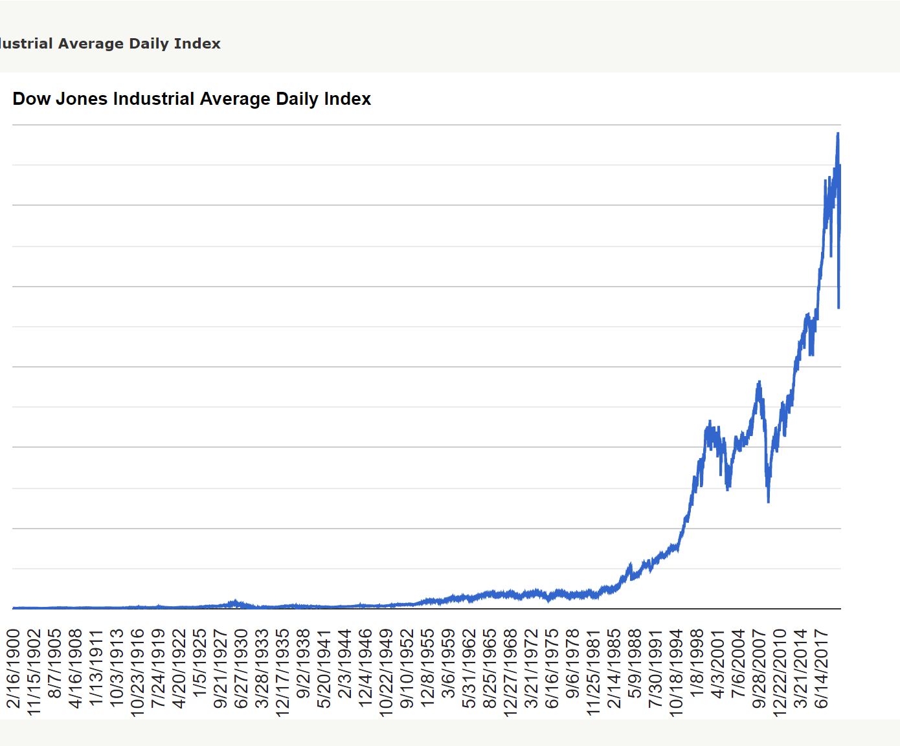
Stock Market

Slide 25
Visuals
Stagflation 11/1973-03/1975
Students fill in table…

Slide 26
Depression?
Period | GDP decline (peak to trough) | Unemployment | Consumer Price Level (CPI) | Stock Mkt
COVID 02/2020 –TBD | TBD | TBD | TBD, holding their own to date | TBD, holding for well- diversified portfolios
Great Recession 12/2007–06/2009 (1y/6m) | -05% | +10% | Moderate | Plummeted but moved upward in a relatively short period
 |  |  | Inflation 1973 44CPI – 1975 55CPI
 |  |  | Relatively constant
Great Depression 08/1929–03/1933 (3y/7m) | −27% | +21% | Deflation (Students insert calculations here.) | Plummeted for extended period
What turns a recession into a depression?

Slide 27
Turning Outward
Moving from the classroom to the world beyond…
What does the NBER say? (Visit the website)
What do local businesspeople say? (Host a video chat)
What do the regional experts report? (Link to a speech and ask to answer questions with short responses)

Slide 28
Business Cycle
“Business cycles are recurrent expansions and contractions that are common to large parts of the economy. The National Bureau of Economic Research (NBER)—the private organization that is the de facto arbiter of U.S. business cycle dating—defines a recession as “a significant decline in economic activity spread across the economy, lasting more than a few months, normally visible in real GDP, real income, employment, industrial production, and wholesale-retail sales.”
Philadelphia FED

Slide 29
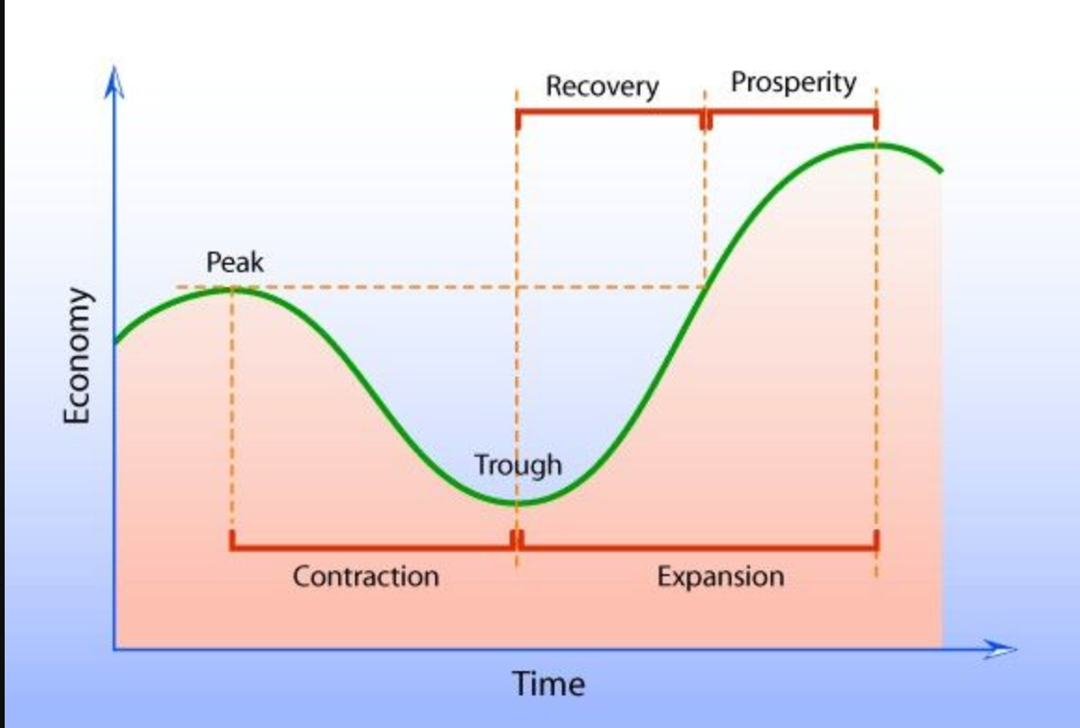
Business Cycle
Citation: https://www.pinterest.com/pin/570549846513119766/ (Seeking permission to use from Mindlever Education.)

Slide 30
Summative Assessment
Citation: Ferrarini, Tawni. 2020. Economics of Business Cycles at https://h5p.org/node/951353

Slide 31
U.S. Economy Today?
Real GDP
Real income
Employment
Industrial production
Wholesale-retail sales

Slide 32
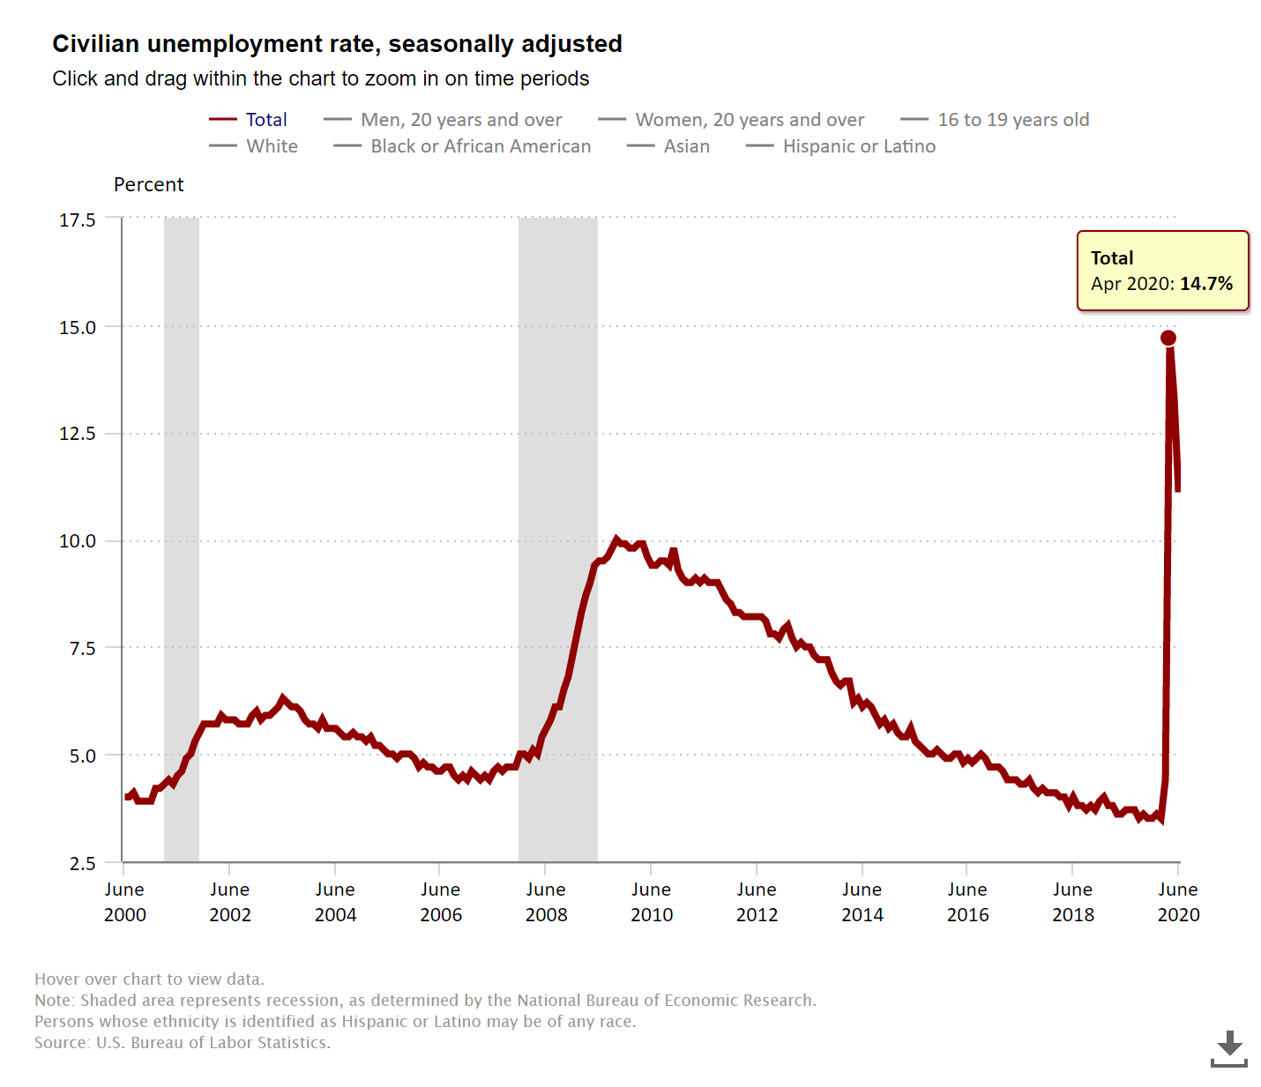
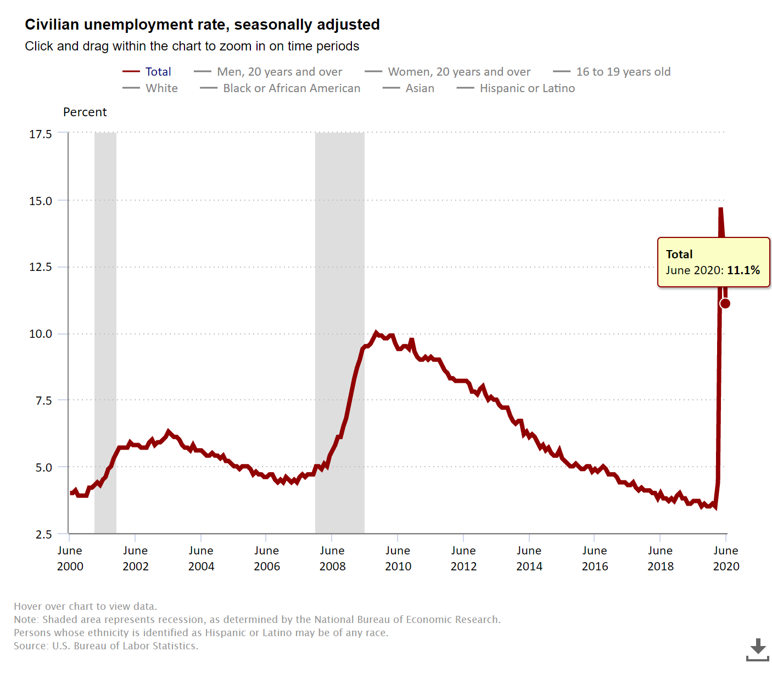
Before we leave
The recent drop in the rate of unemployment from 14.76% in April down to 11.1% in June
The unemployment rate for the class (undergraduate or hands-on activity for high school and anonymous survey participants)

Slide 33
Wrapping Up
Covered our objectives
Applied our good teaching practices
Investigated four key U.S. recessions and the Great Depression
Each recession is unique, with the Great Depression being the longest and most intense
To learn more about them, explore the competing theories about the causes and consequences

Slide 34
References
Audio The Business Cycle - The Economic Lowdown Podcast Series, Episode 18 (08:48)
Interactives (Virtual classroom activities, preparatory interactives, or follow-up reinforcements) Economics of the Business Cycle H5P Interactive ** EconEdLink Resources Business Cycle Video and Quiz ** EconEdLink AP Macro An Introduction to Business Cycles and Macroeconomic Indicators
Learning Activity Suggestions Short Essay Assignment Summarizing the Controversies on What Causes Booms and Busts ** Case Study – Compare and Contrast Great Recession and Great Depression
Videos Intro to Business Fluctuations @ Marginal Revolution University (02:58) ** The Business Cycle @ Kahn Academy (11:15)
Visuals and Data BLS.gov (Current) ** FRED St. Louis, FED (Current) ** MeasuringWorth.com (Historic Data)

Slide 35
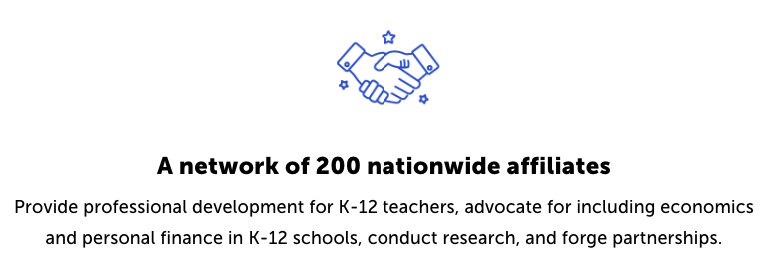
CEE Affiliates
https://www.councilforeconed.org/resources/local-affiliates/

Slide 36
Business Cycles: Recession vs. Depression Macroeconomics 302 Please stay in touch Tawni Hunt Ferrarini, PhD July 09, 2020 Tferrarini@Lindenwood.edu * Tawni.org

Slide 37
Thank You to Our Sponsors!

