Slide 1
Fiscal Policy, Deficit and Debt
Presented by
Matthew Gherman
July 16, 2020 mgherman@schools.nyc.gov

Slide 2
EconEdLink Membership
You can now access CEE’s professional development webinars directly on EconEdLink.org! To receive these new professional development benefits, become an EconEdLink member. As a member, you will now be able to:
Automatically receive a professional development certificate via e-mail within 24 hours after viewing any webinar for a minimum of 45 minutes
Register for upcoming webinars with a simple one-click process
Easily download presentations, lesson plan materials, and activities for each webinar
Search and view all webinars at your convenience
Save webinars to your EconEdLink dashboard for easy access to the event
You may access our new Professional Development page here

Slide 3
Professional Development Certificate
To earn your professional development certificate for this webinar, you must:
Watch a minimum of 45-minutes and you will automatically receive a professional development certificate via e-mail within 24 hours.
Accessing resources:
You can now easily download presentations, lesson plan materials, and activities for each webinar from EconEdLink.org/professional-development/

Slide 4
Agenda
Today we will be going through how to teach Fiscal Policy, the origins and theory of Keynesian Fiscal Policy, the effects of Deficit, Debt and Crowding Out.

Slide 5
Objectives
Introduction and Student Discussion start to Fiscal Policy
Keynesian Economics
Deficit, Debt and Crowding Out
History of Fiscal Policies
Interpretation of Keynes
Handouts and Videos

Slide 6
National Standards
20.1: Fiscal policies are decisions to change spending and taxation levels by the federal government. as fiscal policies, these decisions are adopted to influence national levels of output, employment, and prices
20.2: in the short run, increasing federal spending and/ or reducing taxes can promote more employment and output, but these polices also put upward pressure on the price level and interest rates. decreased federal spending and/or increased taxes tend to lower price levels and interest rates, but they reduce employment and output levels in the short run.
20.4. the federal government’s annual budget is balanced when its revenues from taxes (and other sources) equal its expenditures. the government runs a budget deficit when its expenditures exceed its revenues. the government runs a surplus when its revenues exceed its expenditures

Slide 7
State Standards
12.E4a Policy makers establish economic goals related to economic indicators, including the Gross National Product (GNP), Gross Domestic Product (GDP), Consumer Price Index (CPI), employment and interest rates, and aggregate supply and demand.
12.E4b The president and Congress determine fiscal policy by establishing the level of spending and taxing in the annual budget. Some tax programs are designed to provide incentives to individuals and businesses that influence private sector spending, saving, and investment.

Slide 8
Fiscal Policy Motivation
To understand the idea of using tax money, need to understand our role and personal finance in taxes
Tax Forms: W2, W4, 1040 and 1099?
What is each one, what is it’s importance?
Activity: https://apps.irs.gov/app/understandingTaxes/student/simulations.jsp

Slide 9
Fiscal Policy
Simplest form: Congress’s ability to spend and tax (bills start at House of Representatives, go to Senate, go to President)

Slide 10
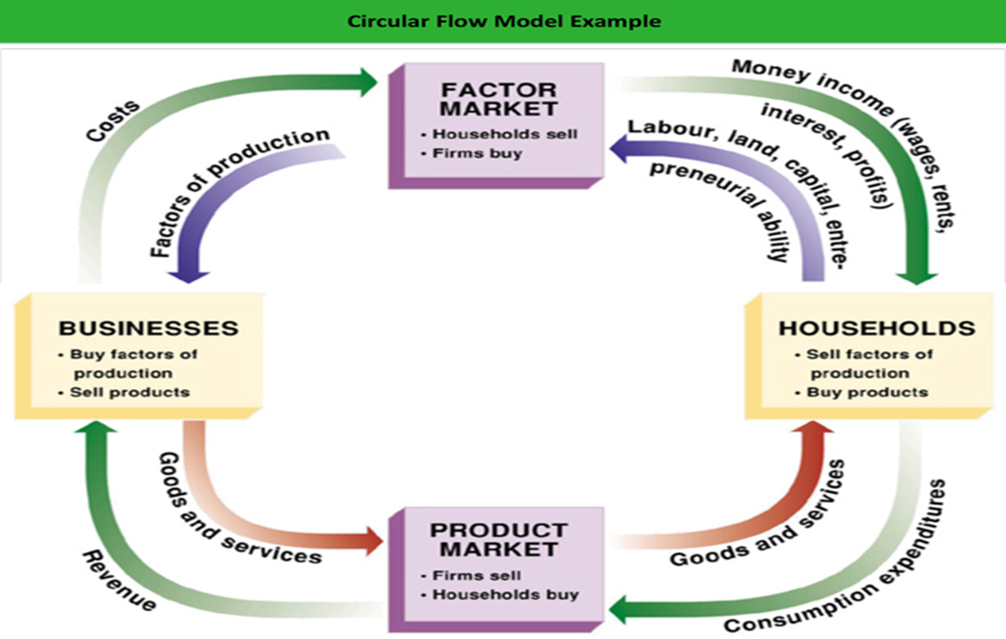
The Circular Flow Model and
Republicans vs. Democrats on Fiscal Policy

Slide 11

Republicans Flow starts here
Democrats Flow Starts Here

Slide 12
Keynesian Economics
https://www.youtube.com/watch?v=Kod1nIxteWQ
Lewis Black explains how public works projects work

Slide 13
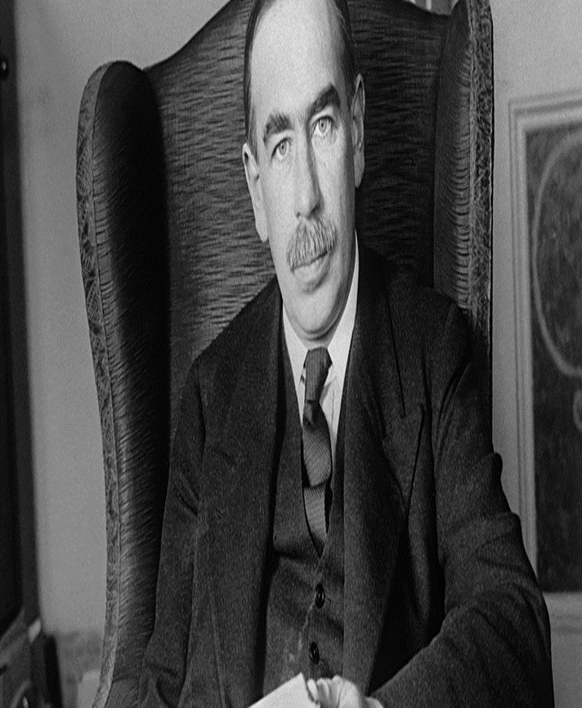
John Maynard Keynes
1883-1946
British economist
Most influential writing, The General Theory and The End of Laissez-Faire
New models of full employment, income, wages, interest and spending, investment
Will revolutionize the relationship between the role of government and the economy
Founder of modern macroeconomics
“We are all Keynesians now”
– Milton Friedman

Slide 14
Historical Circumstances
The Great Depression
World-Wide Economic Crisis on heels of great laissez-faire “Roaring ‘20’s of United States,” economic revival in England and France, miracle of the Reitenmarch in Germany
Unlike depression of 1920-1921, deeper, greater unemployment and worsening

Slide 15
Key Words
Aggregate Demand: Total Spending in the economy: consumer spending, investment spending (on capital resources), government spending and net exports (C+I+G+Nx)
Aggregate Supply: Total spending by businesses on production
LRAS: long run aggregate supply
Full Employment of Economic Resources (where an economy should be)

Slide 16
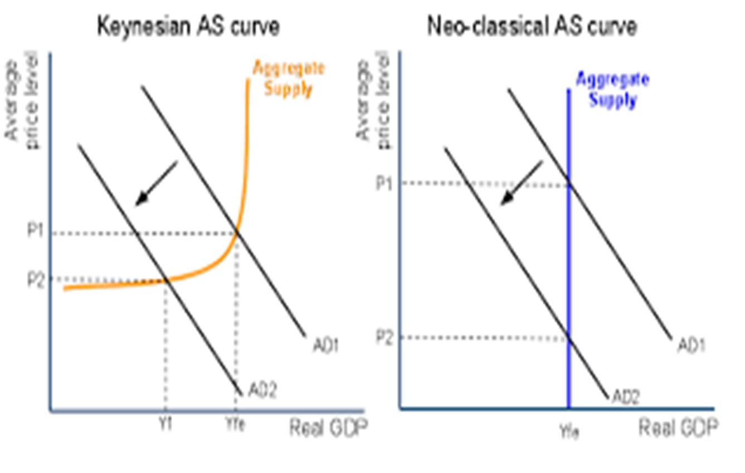
Revisualizing what an economy looks like…

Slide 17
Model 1: Classical Model
Jean Baptiste Say: Supply creates its own demand
When products are created, the wage to buy those products is also created
Production will respond to changes in price level and changes in inventory
Inventory, wages and input costs adjust to change in prices
Lower prices will drive down input costs, which will result in lower wages and allow businesses to produce more

Slide 18
Keynes Theory
Problem that Great Depression illustrates: 4 years into depression; prices are at lowest; no increase in production.
Great Depression: 1920’s already experienced maximum investment spending…all of this capital was still there in 1929, so businesses would not have incentive to do more investment spending
Recessions are caused by a decrease in Consumer Spending and a decrease in Aggregate Demand
Classical model is incorrect: Aggregate Supply is upward slopping; reflecting that price = profit and the ability to break even
Input costs are sticky (wages, rent, insurance, etc.), so don’t change with the price level
Businesses will decrease production as price level decreases

Slide 19
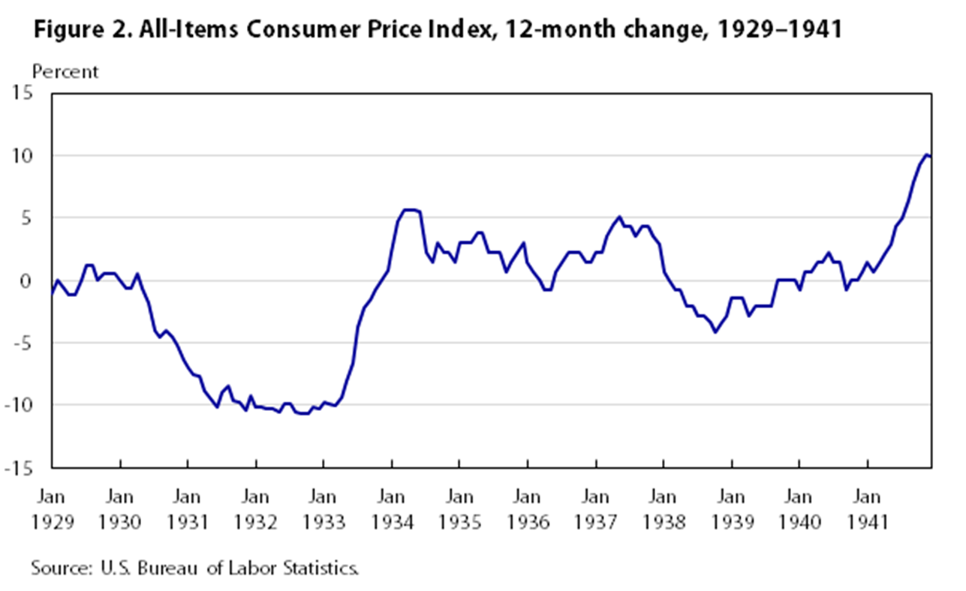

Slide 20
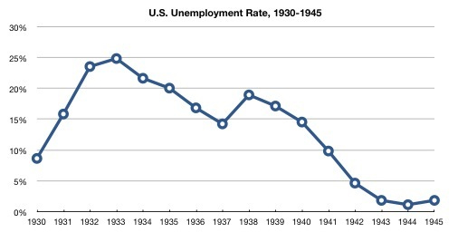

Slide 21
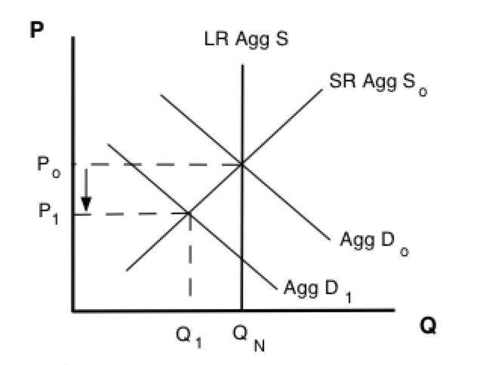
Keynesian Recessionary Graph

Slide 22
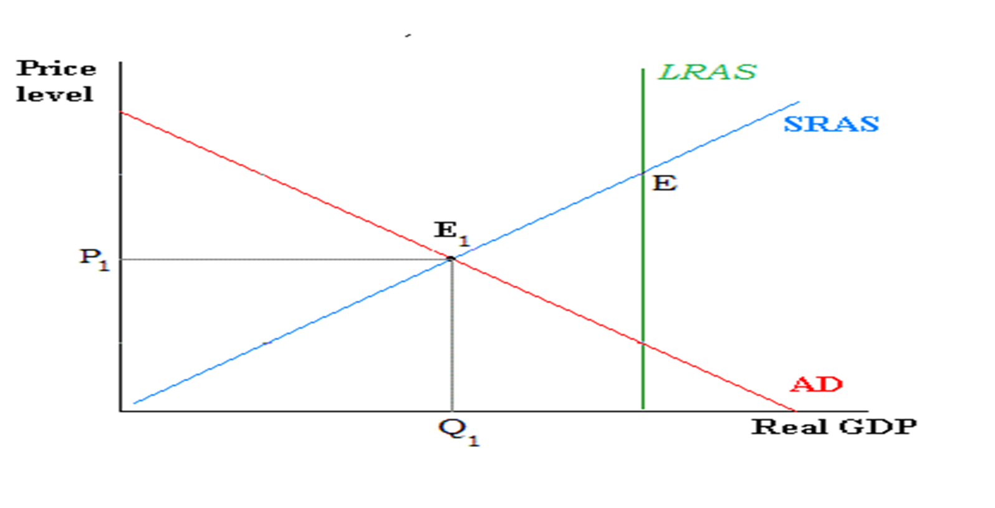
Recessionary Gap

Slide 23
“Many of the greatest economic evils of our time are the fruits of risk, uncertainty, and ignorance. It is because particular individuals, fortunate in situation or in abilities, are able to take advantage of uncertainty and ignorance, and also because for the same reason big business is often a lottery, that great inequalities of wealth come about; and these same factors are also the cause of the unemployment of labour, or the disappointment of reasonable business expectations, and of the impairment of efficiency and production. Yet the cure lies outside the operations of individuals; it may even be to the interest of individuals to aggravate the disease.”
-- John Maynard Keynes, The End of Laissez-Faire, 1926

Slide 24
"To dig holes in the ground, paid for out of savings, will increase, not only employment, but the real national dividend of useful goods and services. It is not reasonable, however, that a sensible community should be content to remain dependent on such fortuitous and often wasteful mitigations when once we understand the influences upon which effective demand depends.”
-- Keynes, The General Theory

Slide 25
“The outstanding faults of the economic society in which we live are its failure to provide for full employment and its arbitrary and inequitable distribution of wealth and income.”
    – Keynes, The General Theory

Slide 26
Keynes: How should a government respond?
Government can’t trust the “animalistic spirit” of business
Government needs to use its powers of taxes and spending to improve consumer spending (changing disposable income)
As incomes change, people spend a portion of that income (marginal propensity to consume)
This has a multiplier effect

Slide 27

Multiplier Effect

Slide 28
Multiplier Effect
Initial spending keeps becoming another person’s income
That person’s income becomes spending
Which becomes another person’s income
Initial change in government spending has a multiplied effect on Aggregate Demand and Total GDP
Can Deficit Spend but can deficit spend responsibly?
Know the Recessionary Gap; know the MPC; know the amount to spend

Slide 29
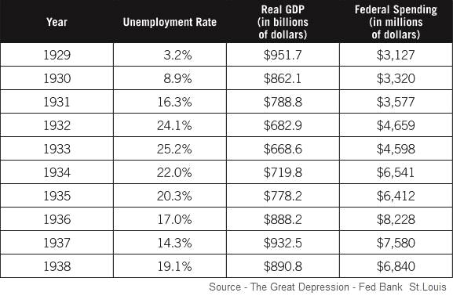

Slide 30
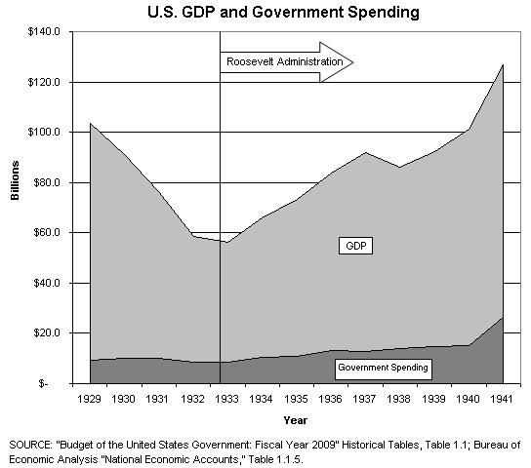

Slide 31
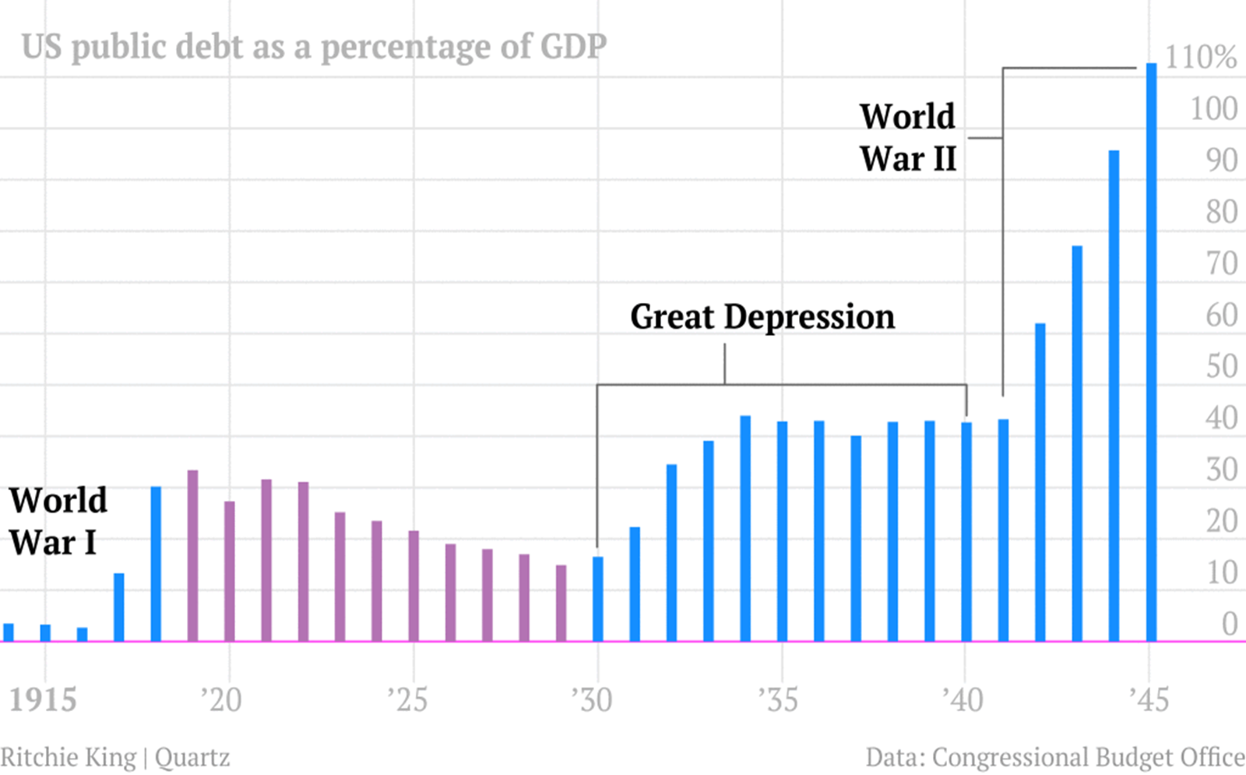

Slide 32
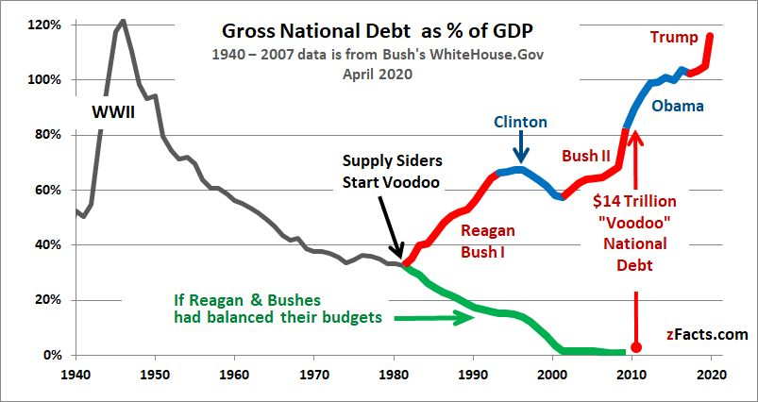
US Debt Clock

Slide 33

Deficit vs. Debt
https://www.marketplace.org/2018/02/16/what-it-means-worry-about-national-debt/
Deficit = water coming into bath from faucet.
Debt = water filling in the tub.

Slide 34
Debt and
“Crowding Out”
https://www.youtube.com/watch?v=0PJsa_WpsuA
Motivation: As you are watching the video, why can too much personal finance debt be bad?
Transition: Personal Finance to Macro Economy and Crowding Out handout.

Slide 35
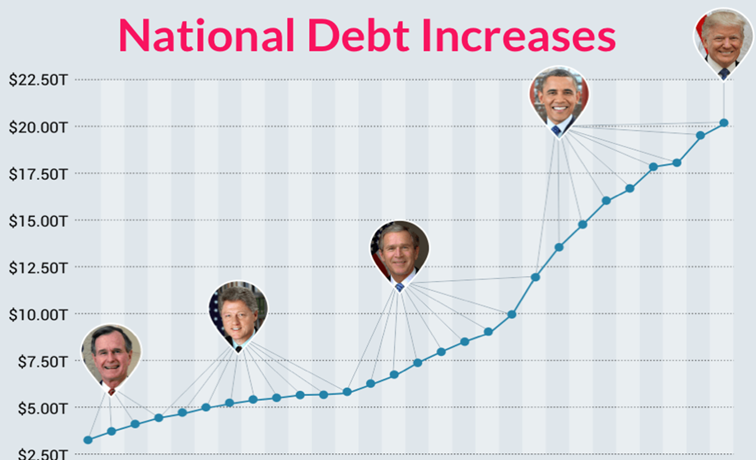

Slide 36
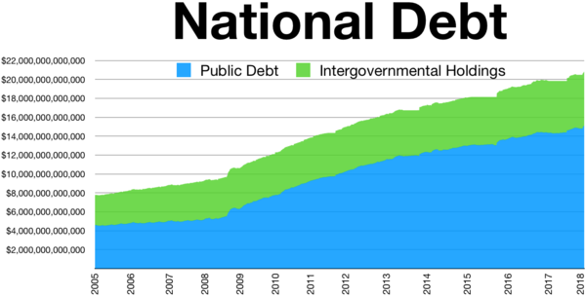

Slide 37
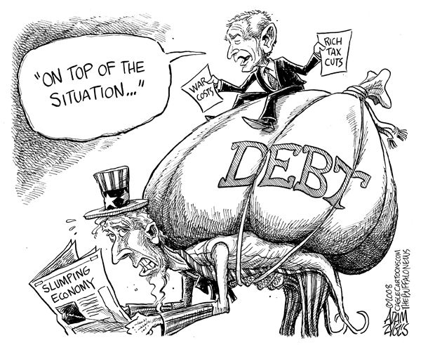

Slide 38
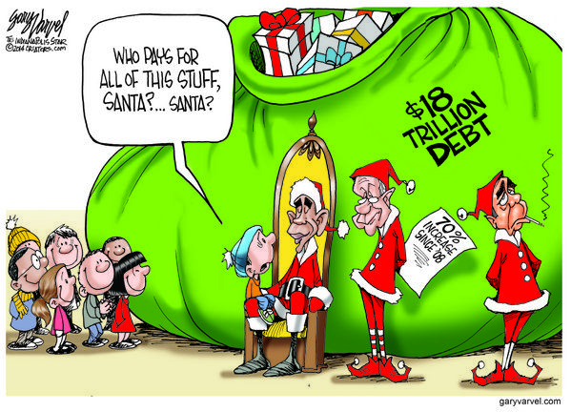

Slide 39
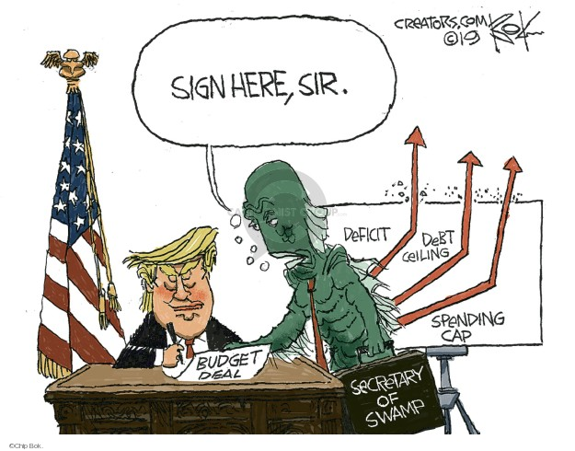

Slide 40
Keynes vs. the Keynesians
Pseudo-Keynesian Policy:
Full Employment via Demand Expansion
Full Growth Objective and government regulation
Reduced price-stability objective

Slide 41
What Did Keynes Really Think?
Excerpts from Keynes’ later articles:
“Successful Economies are not government run”
“What a ticklish business it is to maintain stability”
“Boom, not a slump is the right time for austerity, caution and taxes”
“A decrease in taxes is best for general welfare, use interest rate to stimulate long term investment.”

Slide 42
“Three years ago it was important to use public policy to increase investment. It may soon be equally important to retard certain types of investment…Just as it was advisable for the government to incur debt during the slump, so for the same reasons it is now advisable that they should incline to the opposite policy…that they should postpone whatever new enterprises can be reasonably held back…I believe that we are approaching, or have reached, the point where there is not much advantage to applying a further general stimulus at the center.”
---- Keynes on Constant Planning, 1937

Slide 43
“On the other hand, even wise and necessary Reform may, in some respects, impede and complicate Recovery. For it will upset the confidence of the business world and weaken their existing motives to action, before you have had time to put other motives in their place. It may overtask your bureaucratic machine, which the traditional individualism of the United States and the old “spoils system” have left none too strong. And it will confuse the thought and aim of yourself and your administration by giving you too much to think about all at once.”
-- Excerpts from Keynes to FDR, 1933

Slide 44
“I do not mean to impugn the social justice and social expediency of the redistribution of incomes aimed at by N.I.R.A. and by the various schemes for agricultural restriction. The latter, in particular, I should strongly support in principle. But too much emphasis on the remedial value of a higher price-level as an object in itself may lead to serious misapprehension as to the part which prices can play in the technique of recovery. The stimulation of output by increasing aggregate purchasing power is the right way to get prices up; and not the other way round.”
---- Keynes to FDR

Slide 45
Keynes to FDR, 1938
The recovery was mainly due to the following factors:
the solution of the credit and insolvency problems, and the establishment of easy short-term money
(ii)the creation of an adequate system of relief for the unemployed
(iii) the public works and other investments aided by Government funds or guarantees
(iv) investment in the instrumental goods required to supply the increased demand for consumption goods
(v)the momentum of the recovery thus initiated.

Slide 46
Keynesian Revival and the Great Recession
Paul Krugman released his book The Return of Depression Economics and the Crisis of 2008
https://krugman.blogs.nytimes.com/2015/06/06/why-am-i-a-keynesian/

Slide 47
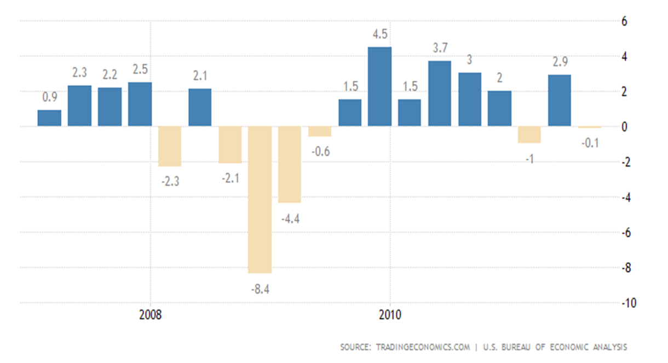
RGDP Growth Rate Great Recession

Slide 48
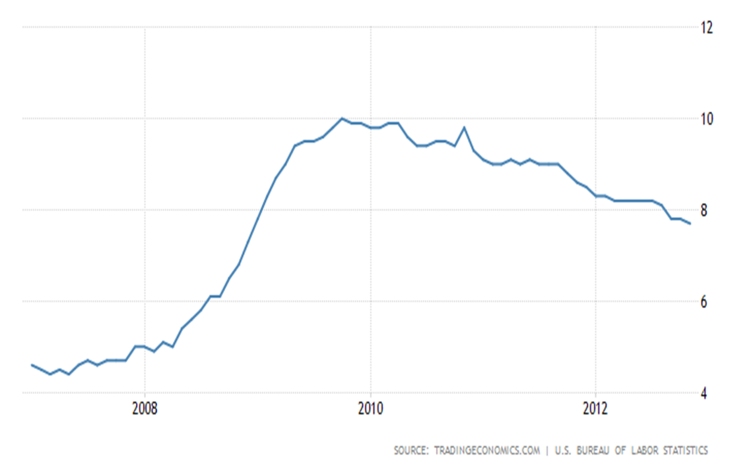
Great Recession Unemployment

Slide 49
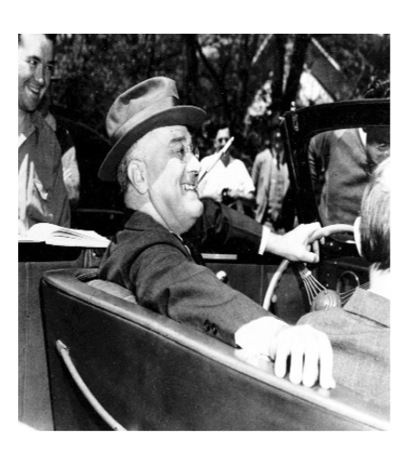
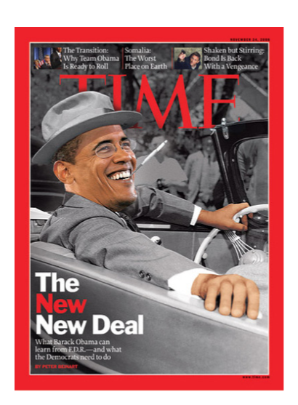
FDR Original
Recreation with Obama

Slide 50
Response to the Great Recession
President George W. Bush
President Barack Obama
TARP $700 Billion bailout to banking system including buying bank stock and toxic assets.
$168 Billion Economic Stimulus Act
$13 Billion in Stimulus Checks
TARP II: Remaining $400 billion of 2008 TARP
$720 billion in spending
$288 billion tax decrease
$224 billion in extended unemployment benefits (up to 99 weeks)
$275 billion in federal contracts, grants, and loans
Stimulus II: $154 Billion Dollar jobs bill and $15 Billion Dollar tax cut

Slide 51
TARP
Approximately $250 billion was committed in programs to stabilize banking institutions ($5 billion of which was ultimately cancelled).
Treasury invested approximately $245 billion across five distinct bank programs. Each of these programs was established to accomplish different goals as part of the overall effort to stabilize America's banking system.
Approximately $27 billion was committed through programs to restart credit markets.
Approximately $82 billion was committed to stabilize the U.S. auto industry ($2 billion of which was ultimately cancelled).
Approximately $70 billion was committed to stabilize American International Group (AIG) ($2 billion of which was ultimately cancelled).
Approximately $46 billion was committed for programs to help struggling families avoid foreclosure, with these expenditures being made over time.

Slide 52
Total Debt Added
President Bush
President Obama
Bush's deficits were $3.3 trillion, an increase of 57%
President Bush's last budget, for FY 2009, started out with a $407 billion deficit. Congress approved $350 billion to fund TARP
Total Debt Added: $5.8 trillion
Obama's total deficits were $6.9 trillion, also a 57% increase.
Economic Stimulus Plan adds $253 deficit to FY 2009 That added $253 billion in FY 2009.
As a result, the FY 2009 budget deficit was $1.4 trillion. This was the largest budget deficit in U.S. history.
FY 2010 budget deficit: $1.294
FY 2011 deficit topped that at $1.3 trillion
As the economy improved, each year's deficit was lower.
Total Debt Added: $9.6 Trillion

Slide 53
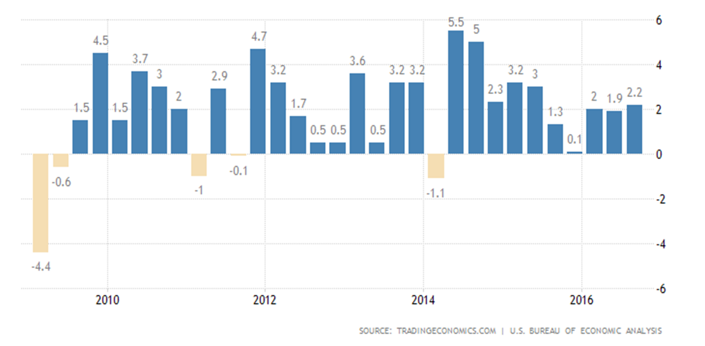
RGDP Growth Rate

Slide 54
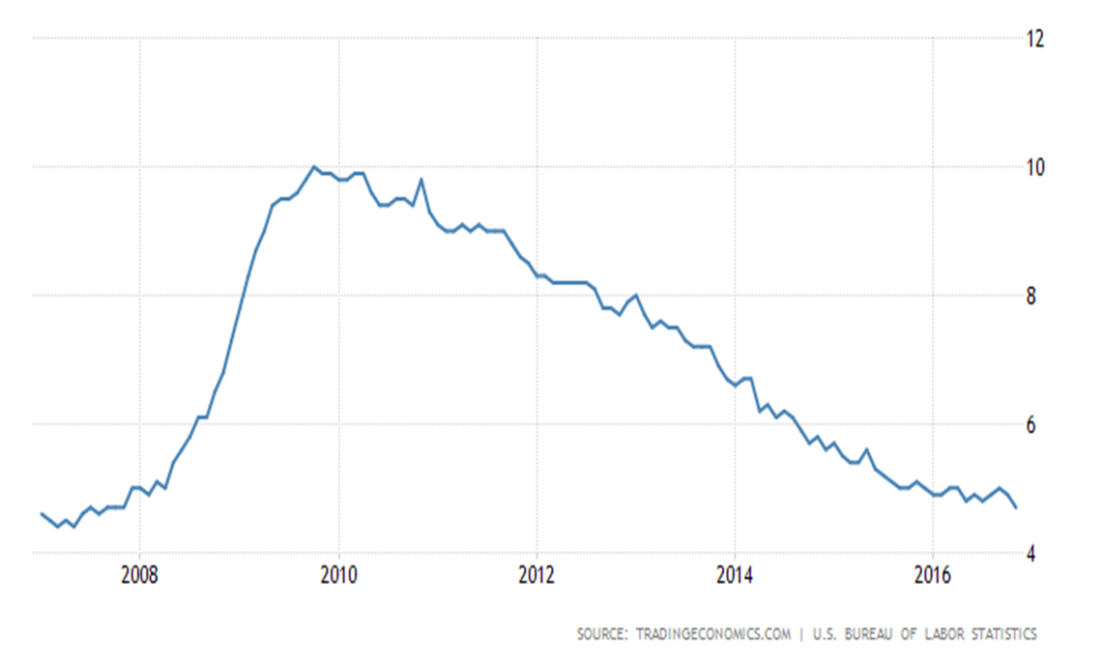
Unemployment Rate

Slide 55
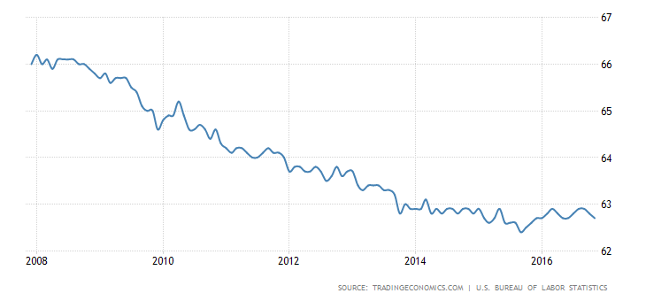
Labor Force Participation Rate

Slide 56
President Trump Response to Coronavirus
The Families First Coronavirus Aid Package, Payment Protection Program and Health Care Enhancement Act, National Emergency Declarations and Stafford Act, Coronavirus, Aid, Relief and Economic Security (CARES) Act: $2.5 Trillion
Federal Reserve Increased Liquidity Programs: $4 Trillion
https://www.washingtonpost.com/business/2020/04/15/coronavirus-economy-6-trillion/
https://www.npr.org/2020/03/19/818322136/heres-what-is-in-the-families-first-coronavirus-aid-package-trump-approved
https://www.ncsl.org/research/fiscal-policy/state-fiscal-responses-to-covid-19.aspx#:~:text=President%20Donald%20Trump%20declared%20a,response%20to%20the%20coronavirus%20epidemic.&text=The%20relief%20package%20allocates%20an,package%20in%20modern%20American%20history.

Slide 57
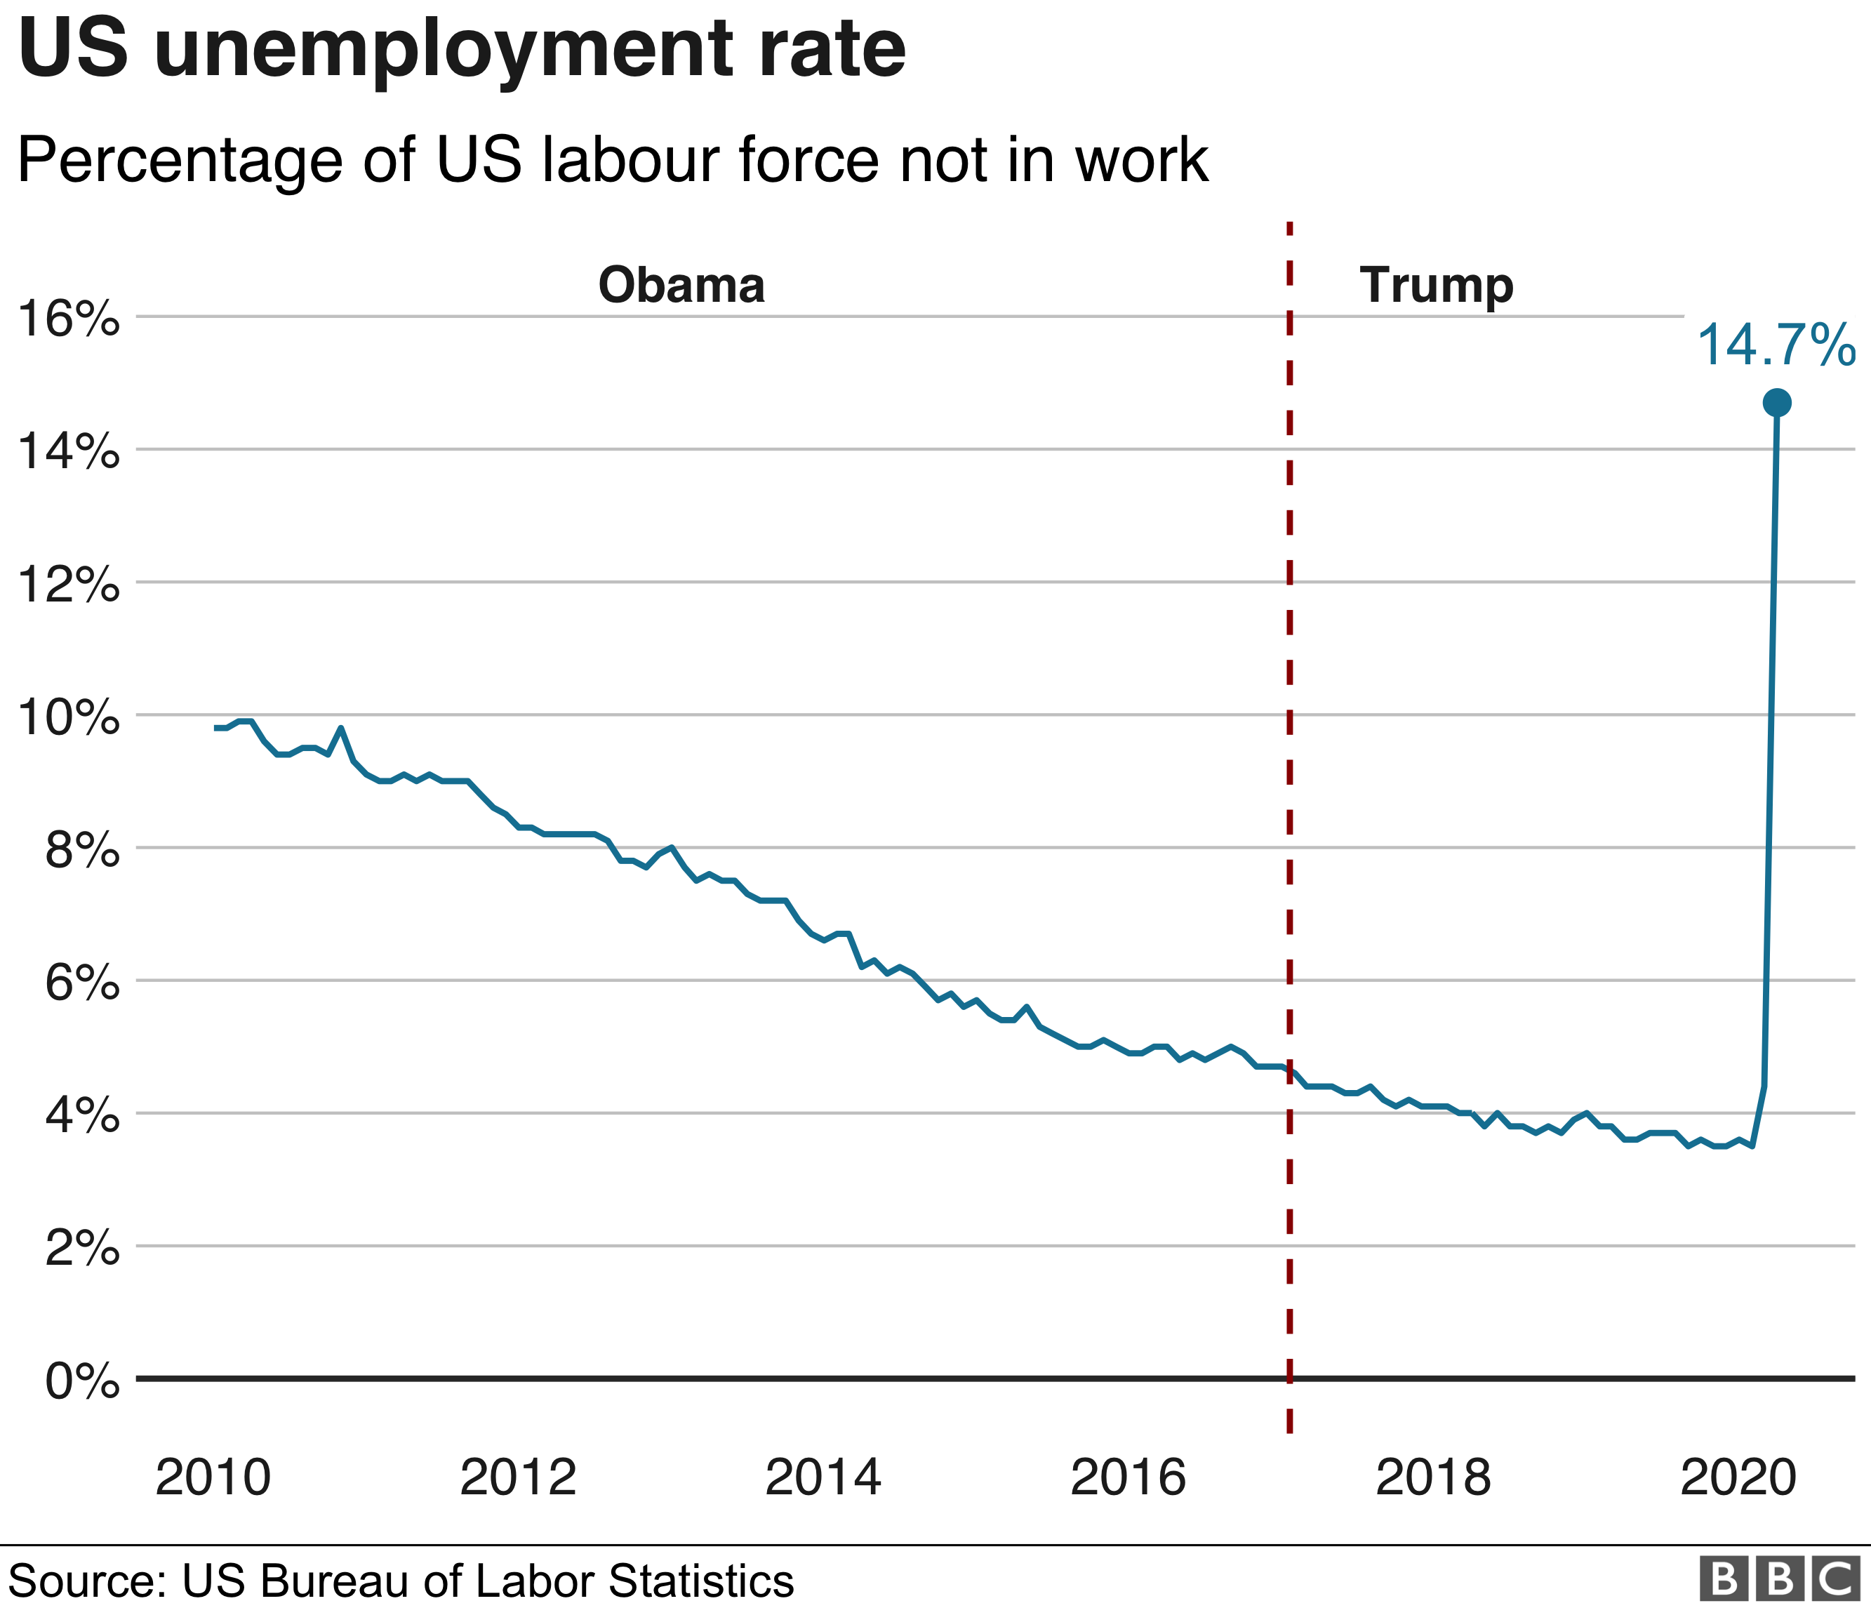

Slide 58
Assessment Questions
  To what extent are the current economic circumstances, impacts and responses more similar or different to:
    Great Depression?
    Great Recession?
    Compare/Contrast Economic Responses of President Roosevelt, President Obama and President Trump to the economic crises. To what extent are they more similar/different?
    How would you rate each’s handling of their economic situation? Explain.
    History of Stimulus Payments

Slide 59
More Assessment Questions
Explain the difference between the concepts of government deficits and government debt?
Explain what will happen to both the size of the government’s deficit and to its stock of debt if borrowing begins to decline.
Can the stock of government debt fall if the government continues to borrow? Can the ratio of the stock of government debt fall relative to GDP (i.e. Debt/GDP), if government continues to borrow?
With examples, explain the differences between the government’s current and investment (capital) expenditures.
What are the economic arguments for trying to cut the deficit quickly or more slowly?

Slide 60
Assessment Questions – AP Style
The economy is experiencing a recession.
  1) Draw the situation on an AS/AD graph.
2) What type of policy should the government take to correct this?
3) Based on your answer for #2, draw what happens in market for loanable funds graph.
4) Based on your answer to #3, explain what happens to:
a) Real interest rates
b) Investment spending
c) Aggregate Demand
5) In order to balance in the interest rates, what policy should the Fed take?
6) Based on your answer to #5, draw the Fed’s policy on a Money Market Graph
7) On a separate Market for Loanable Funds Graph from #3, draw the effects of the Fed’s actions.
6) From this exercise, why is it important that the Government and Federal Reserve System work together?

Slide 61
References
https://www.ncsl.org/research/fiscal-policy/state-fiscal-responses-to-covid-19.aspx#:~:text=President%20Donald%20Trump%20declared%20a,response%20to%20the%20coronavirus%20epidemic.&text=The%20relief%20package%20allocates%20an,package%20in%20modern%20American%20history.
http://evonomics.com/new-keynesian-economics-betrays-keynes/
http://www.la.utexas.edu/users/hcleaver/368/368KeynesOpenLetFDRtable.pdf
http://www.iea.org.uk/sites/default/files/publications/files/KEYNES%20VERSUS%20THE%20KEYNESIANS.pdf
https://delong.typepad.com/egregious_moderation/2008/12/john-maynard-ke.html
http://www.panarchy.org/keynes/laissezfaire.1926.html
https://noahpinionblog.blogspot.com/2015/06/economic-arguments-as-stalking-horses.html

Slide 62
References
https://krugman.blogs.nytimes.com/2015/06/06/why-am-i-a-keynesian/
https://www.forbes.com/sites/modeledbehavior/2015/06/06/macro-ideology/#473a352a15c7
https://www.thebalance.com/bush-economic-stimulus-package-3305782
https://www.thebalance.com/what-was-obama-s-stimulus-package-3305625
https://www.treasury.gov/initiatives/financial-stability/Pages/default.aspx

Slide 63

CEE Affiliates
https://www.councilforeconed.org/resources/local-affiliates/

Slide 64
Thank You to Our Sponsors!

