Slide 1
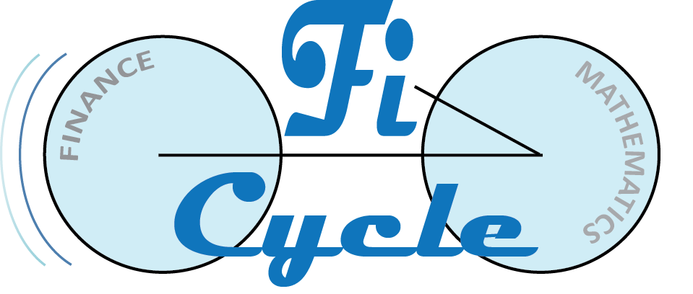
Compound Interest and Your Financial Life Cycle
Presented by
Thursday, June 18th, 2020
Philip Dituri, Ph.D.
Director of Education, FiCycle
phil@ficycle.org
Jack Marley-Payne, Ph.D.
Director of Research, FiCycle
jack@ficycle.org

Slide 2
Warm Up
1. As a recent graduate who has just finished college, moved into his own place and started a new job, what are Eduardo’s sources of income?
2. As a recent graduate who has just finished college, moved into his own place and started a new job, what do you suspect are some of Eduardo’s biggest expenses?
3. We can think of your life as being broken into five categories:
1. Education
2. Early Career
3. Family
4. Late Career
5. Retirement
If you had to place Eduardo into one of the above 5 categories, in which category would you place him and why?
Meet Eduardo. Eduardo has just graduated college. In college, he earned a degree in computer science and he has just started a job maintaining the website for a local business.

Slide 3
EconEdLink Membership
You can now access CEE’s professional development webinars directly on EconEdLink.org! To receive these new professional development benefits, become an EconEdLink member. As a member, you will now be able to:
Automatically receive a professional development certificate via e-mail within 24 hours after viewing any webinar for a minimum of 45 minutes
Register for upcoming webinars with a simple one-click process
Easily download presentations, lesson plan materials, and activities for each webinar
Search and view all webinars at your convenience
Save webinars to your EconEdLink dashboard for easy access to the event
You may access our new Professional Development page here

Slide 4
Professional Development Certificate
To earn your professional development certificate for this webinar, you must:
Watch a minimum of 45-minutes and you will automatically receive a professional development certificate via e-mail within 24 hours.
Accessing resources:
You can now easily download presentations, lesson plan materials, and activities for each webinar from EconEdLink.org/professional-development/

Slide 5
Checking in: Padlet
Before we dive in, let’s check in!
How are you feeling about
remote learning?
https://tinyurl.com/y8obqesh

Slide 6
Compound Interest and Your Financial Life Cycle
Learn about the concept of the financial life cycle – how our financial needs and means vary at different stages of life, and how this shapes decision making – along with activities to introduce these ideas to students. This provides a fresh approach to teaching both compound interest and exponents, one that allows students to critically analyze decisions regarding borrowing and investment and find an authentic application of mathematics

Slide 7
Compound Interest and Your Financial Life Cycle
Learn about the concept of the financial life cycle – how our financial needs and means vary at different stages of life, and how this shapes decision making – along with a full lesson to introduce these ideas to students.
This provides a fresh approach to teaching both compound interest and exponents, one that allows students to critically analyze decisions regarding borrowing and investment and find an authentic application of mathematics.

Slide 8
Objectives
Understand the Financial Life Cycle and how it necessitates the study of compound interest.
Share a way to easily deliver content remotely using a free & widely used learning management system (LMS), Google Classroom.
Demonstrate a way to teach compound interest through the lens of personal finance, instead of as an application of it.
Traditional personal finance instruction focuses on which formula to apply, our approach focuses on the underlying conceptual knowledge and the mathematics that drives decision making.

Slide 9
Objectives
Student
for our lesson
Students will be able to calculate the future value of an investment given the present value and interest rate.
Students will be able to calculate the present value of an investment given the future value and discounting rate.
Students will be able to determine their personal discounting rate, given a scenario.
Students will understand the role of transferring wealth in navigating their financial life cycle, and how the time-value of money influences this process.

Slide 10

Introductions
Has taught and inspired educators and children for over 20 years
Served as a Visiting Professor at Fordham University
Served as a public school teacher, instructional coach, and chairperson of the mathematics department at New Design HS in lower Manhattan for over 13 years
Three-time Math for America Master Teacher
B.A. in Mathematics from NYU
Ph.D. in Mathematics Education from Columbia University
Philip Dituri, Ph.D.
Director of Education, FiCycle
phil@ficycle.org

Slide 11

Introductions
Researches issues in education, finance and mathematics, and creates materials for teaching and understanding these topics
Undergraduate degree in Mathematics and Philosophy from University of Oxford
Ph.D. from MIT focused on understanding knowledge in light of psychological discoveries regarding our limited rationality
Taught undergraduate classes in philosophy and mathematics
Jack Marley-Payne, Ph.D.
Director of Research, FiCycle
jack@ficycle.org

Slide 12
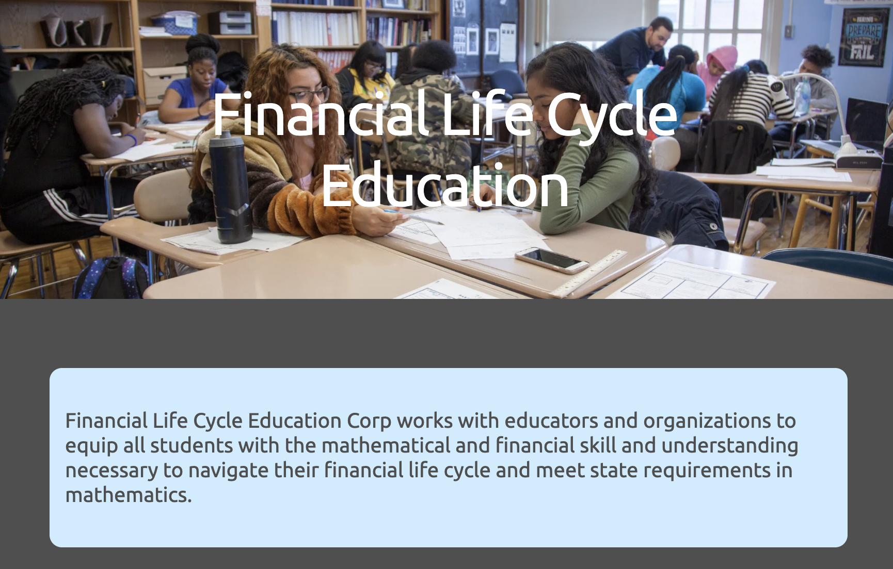

Slide 13
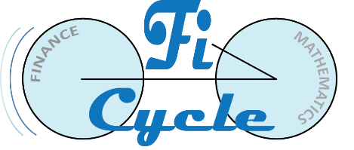
Introductions
FiCycle provides a theoretically grounded introduction to finance for High School Students:
It is a mathematics course at the Algebra 2 level.
It navigates the financial calculations and decisions a person must make over the course of a lifetime (the financial lifecycle of an individual).
The course unifies the material around two key principles: transferring consumption across time and managing uncertainty.
It also presents the mathematical concepts underlying these principles in a systematic manner.

Slide 14
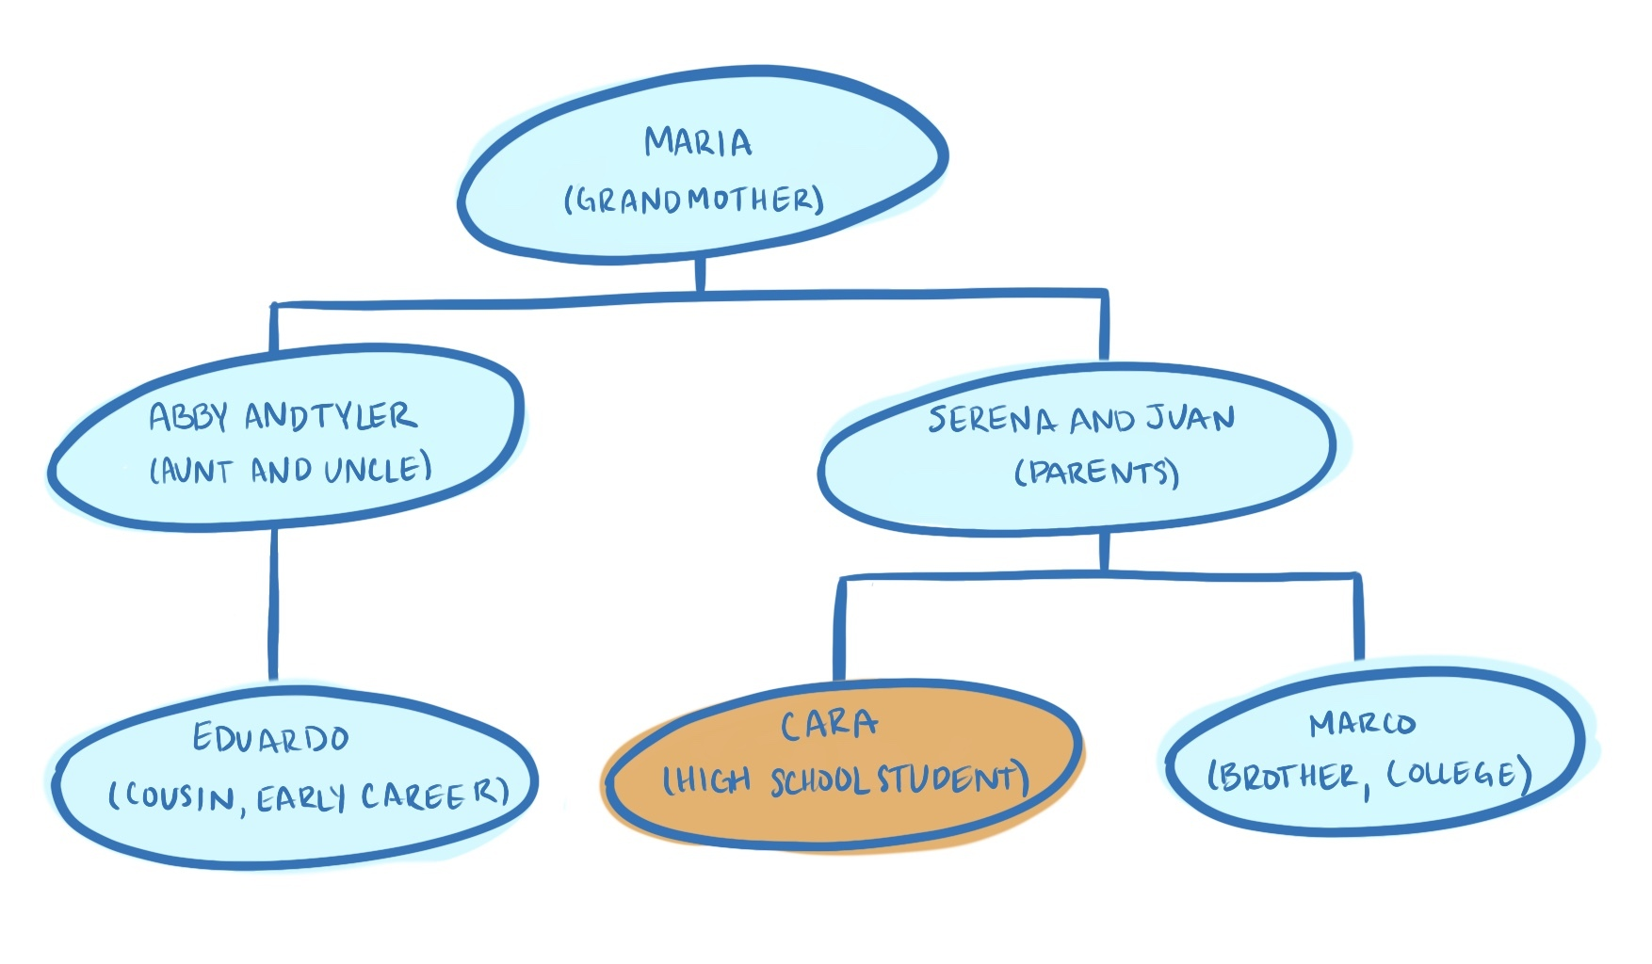
Introductions

Slide 15
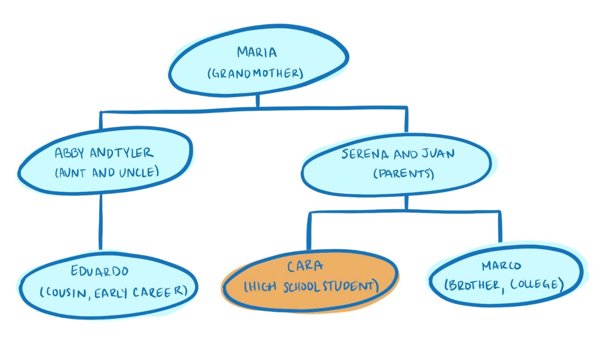
Life Cycle Stages
Using the different members of Cara’s family as a model, we can divide a person’s life into various stages, with each family member being representative of a stage:
Education (Marco)
Early Career (Eduardo)
Family (Serena and Juan)
Late Career (Abby and Tyler)
Retirement (Maria)

Slide 16
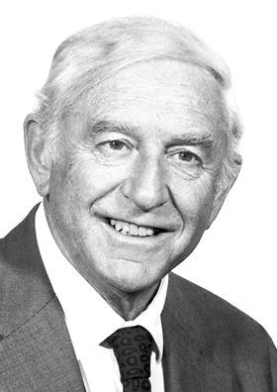
Life Cycle Hypothesis of Saving (LCH)
This idea was the basis for a Nobel Prize for Franco Modigliani:
        “Utility Analysis and the Consumption Function: an Interpretation of Cross Section Data” (Modigliani and Brumberg [1954])
        “Utility Analysis and the Aggregate Consumption Function: an attempt at Integration” (Modigliani and Brumberg [1979])
        See Franco Modigliani, LIFE CYCLE, INDIVIDUAL THRIFT AND THE WEALTH OF NATIONS
        http://www.nobelprize.org/nobel_prizes/economics/laureates/1985/modigliani-lecture.pdf

Slide 17
LCH: Transferring Wealth

Slide 18
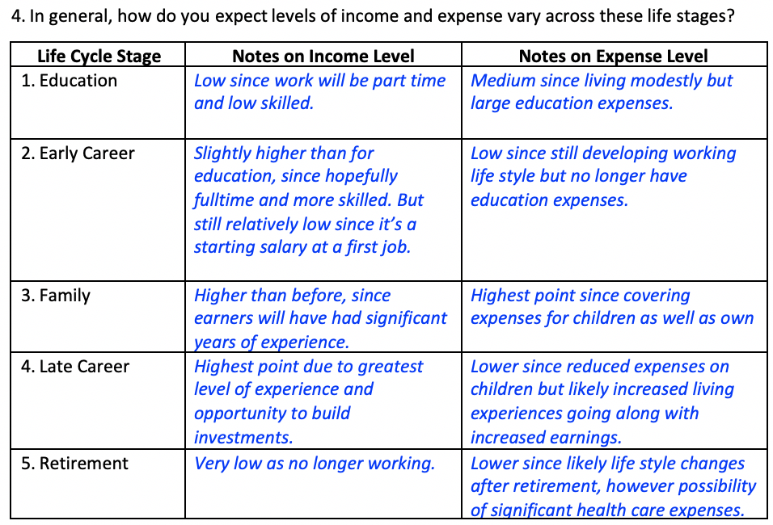
LCH: Transferring Wealth

Slide 19
LCH: Transferring Wealth

Slide 20
Warm Up
1. As a recent graduate who has just finished college, moved into his own place and started a new job, what are Eduardo’s sources of income?
2. As a recent graduate who has just finished college, moved into his own place and started a new job, what do you suspect are some of Eduardo’s biggest expenses?
3. We can think of your life as being broken into five categories:
1. Education
2. Early Career
3. Family
4. Late Career
5. Retirement
If you had to place Eduardo into one of the above 5 categories, in which category would you place him and why?
Meet Eduardo. Eduardo has just graduated college. In college, he earned a degree in computer science and he has just started a job maintaining the website for a local business.

Slide 21
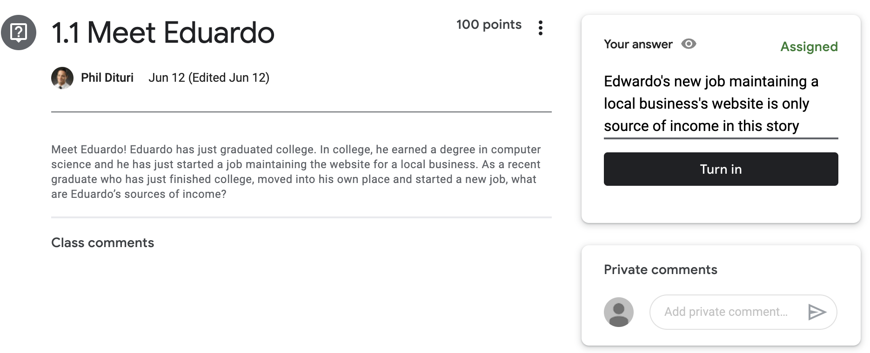
Google Classroom
Class code: keen5ve
https://classroom.google.com/

Slide 22
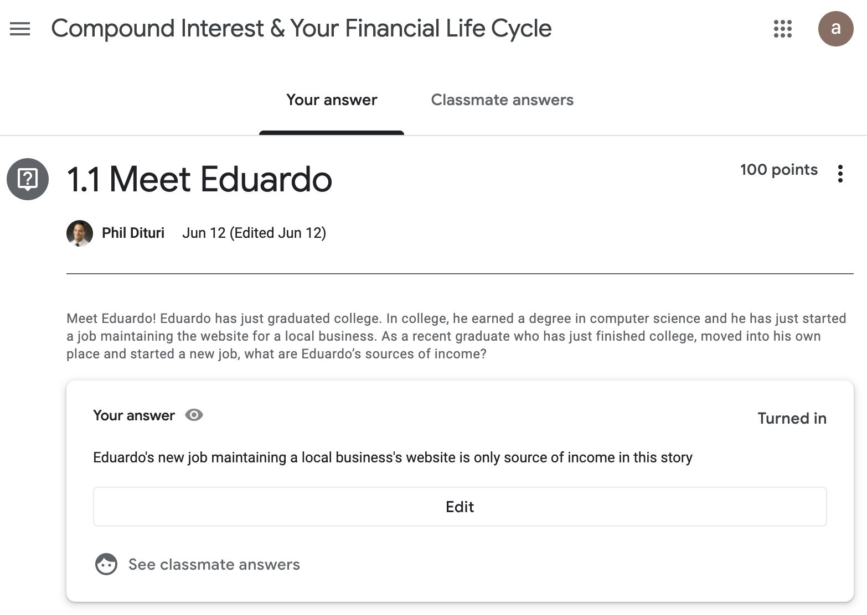

Slide 23
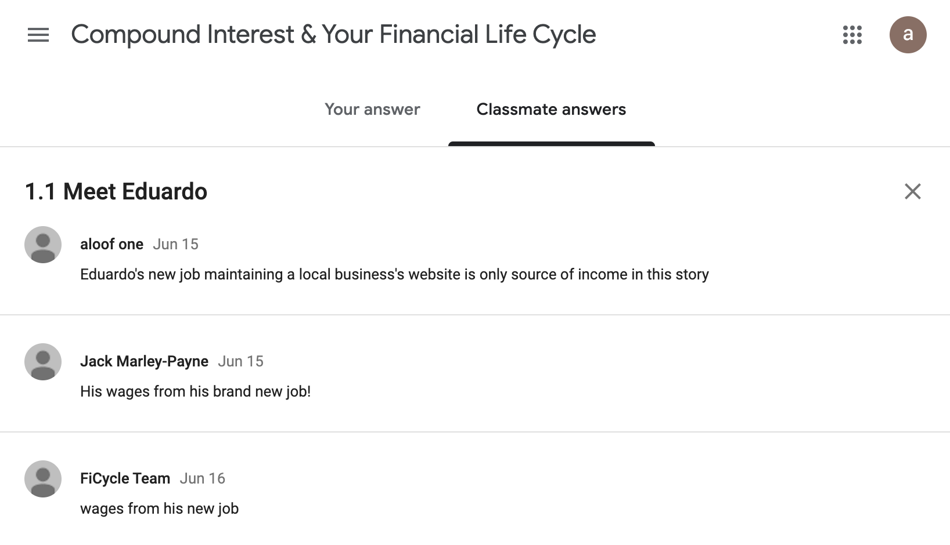

Slide 24
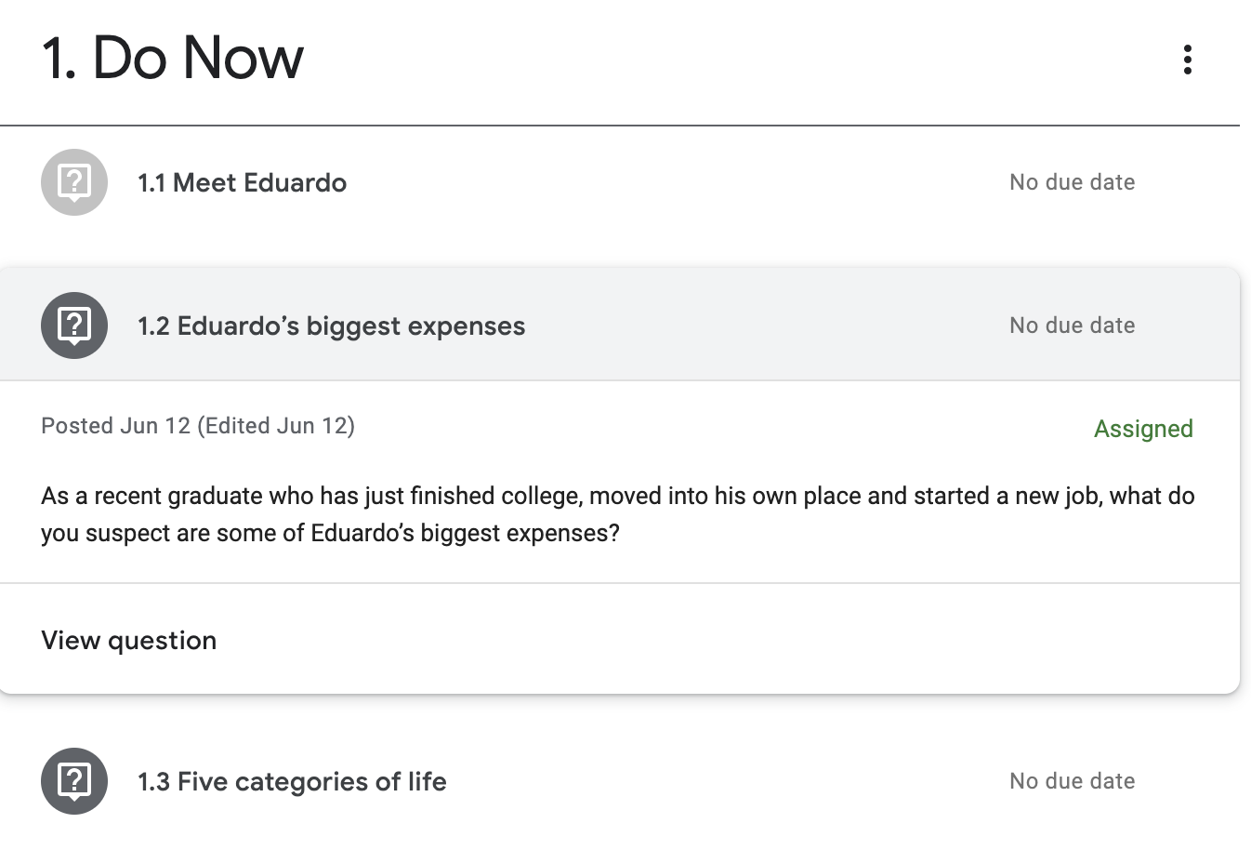

Slide 25
Structure
Often, the best educational experiences involve both Synchronous and Asynchronous instruction:
Asynchronous Time: students engaging in an activity on their own at their own pace over the course of a period of time
Examples: Homework, Projects, Online learning modules, Khan Academy
Synchronous Time: students engaging in an activity at the same time
Examples: Activities in class, Meeting with all students over zoom, Groupwork

Slide 26
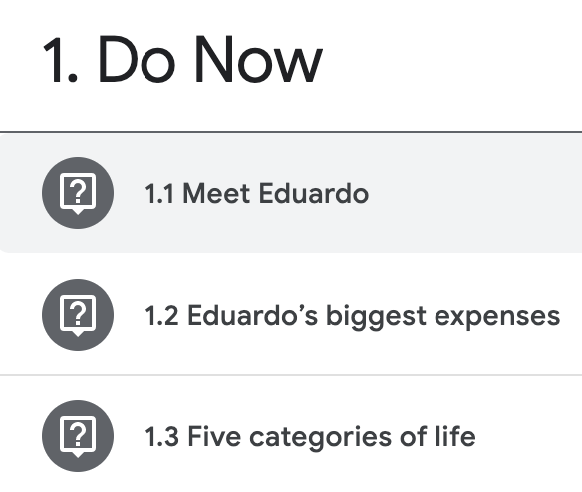
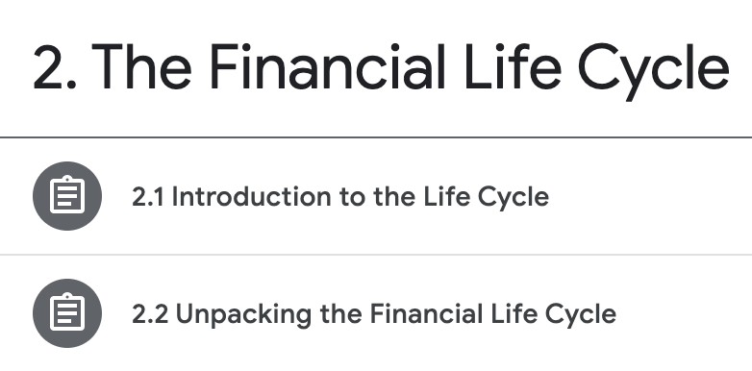
Structure

Slide 27
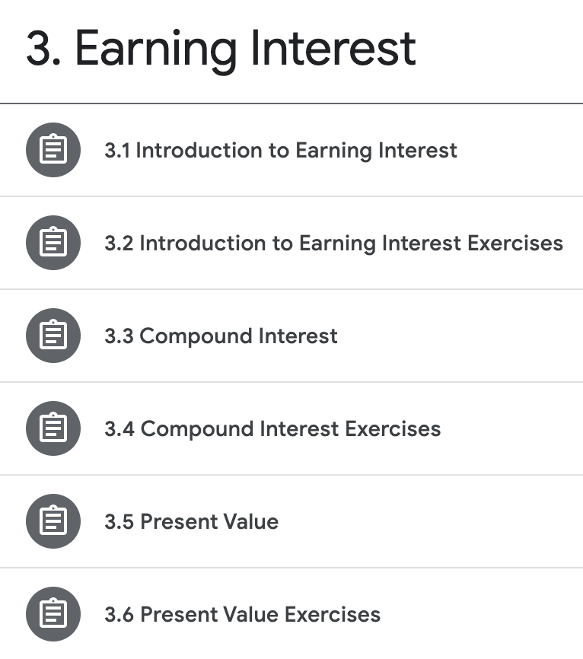
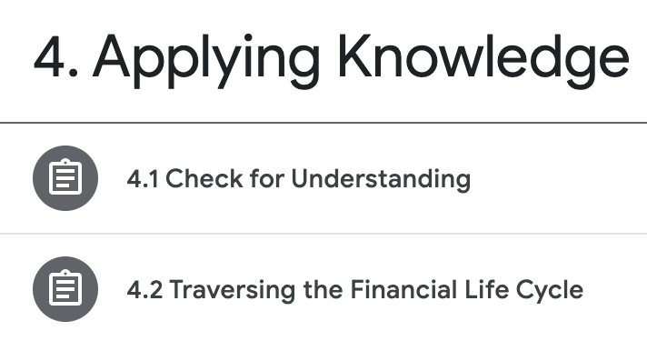
Structure

Slide 28
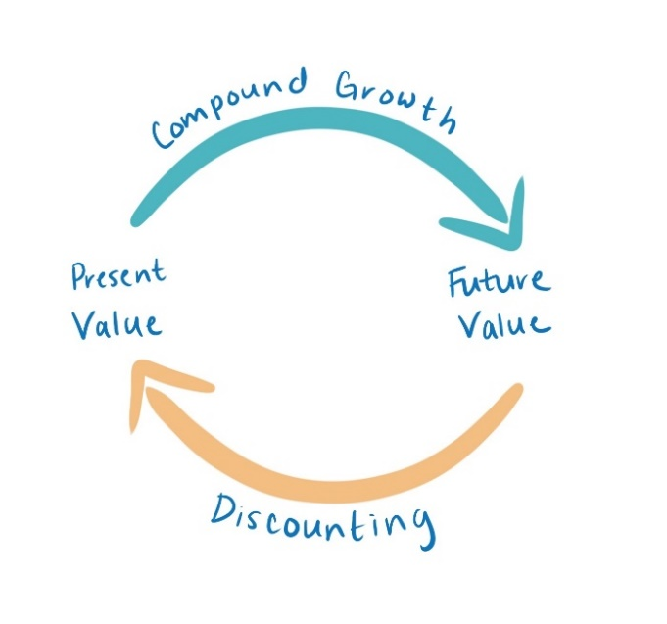
Structure
We believe it’s important to include instruction on Present Value, even in normal compulsory mathematics education, and as we will see, any study of the Financial Life Cycle necessitates it.

Slide 29
Learning Management Systems
Google Classroom
Canvas
Blackboard
Schoology
Edmodo

Slide 30
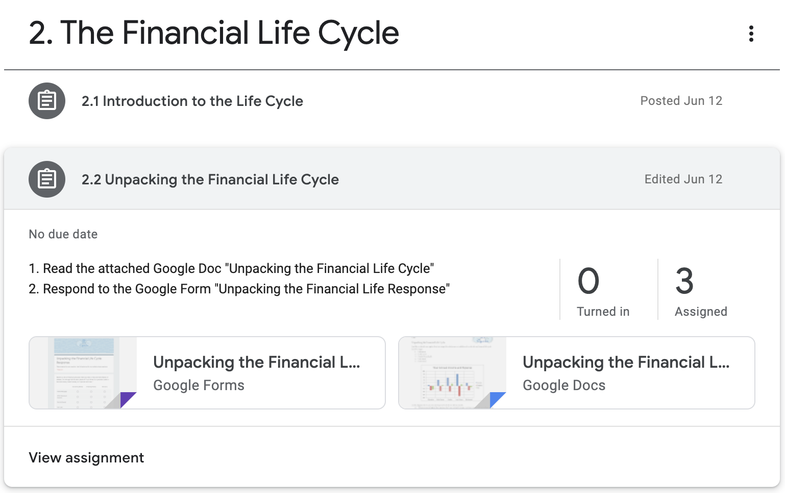
Modules

Slide 31
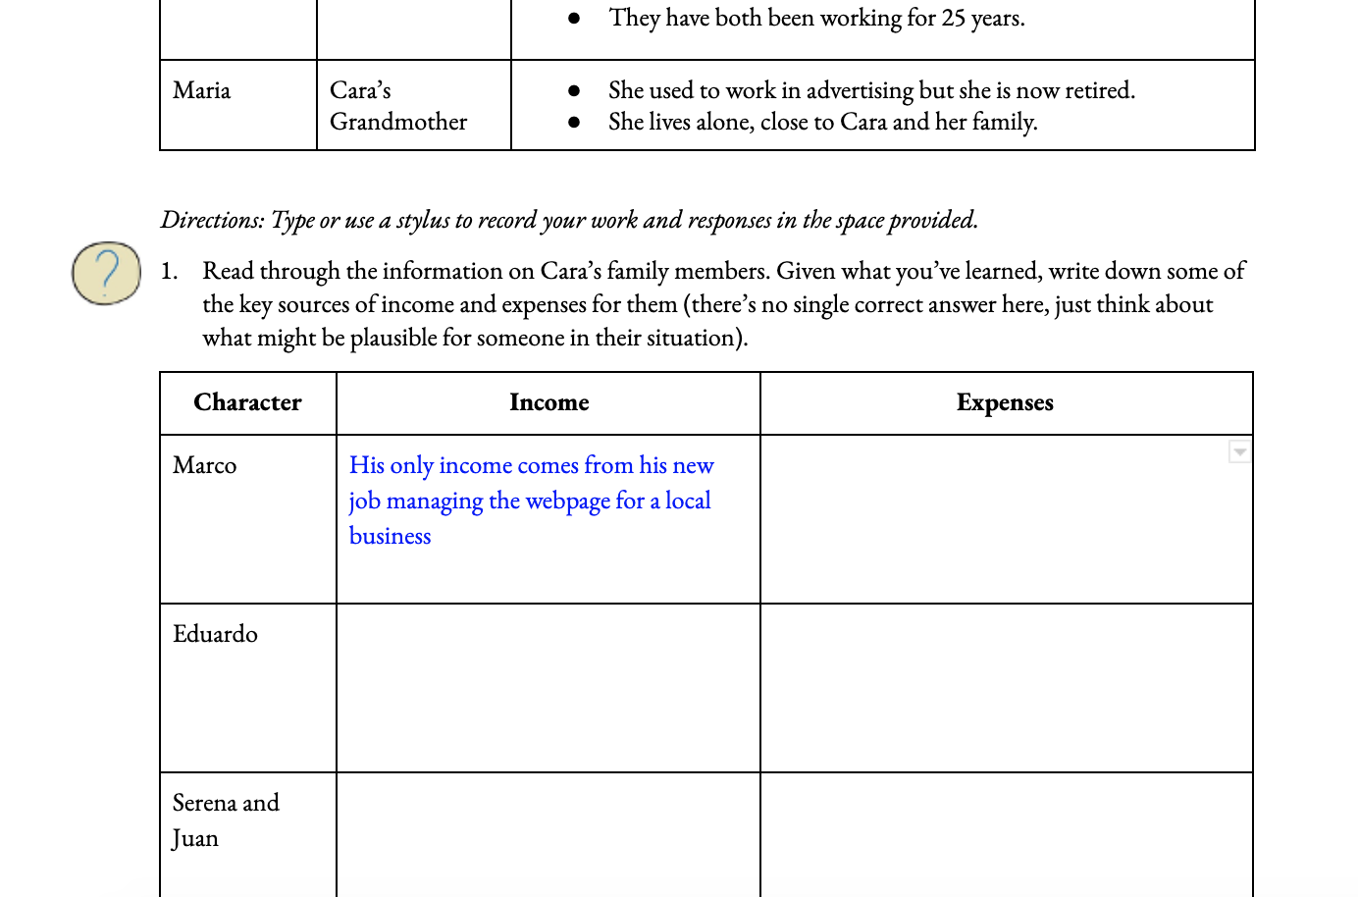
Textbooks, Workbooks & Notes

Slide 32
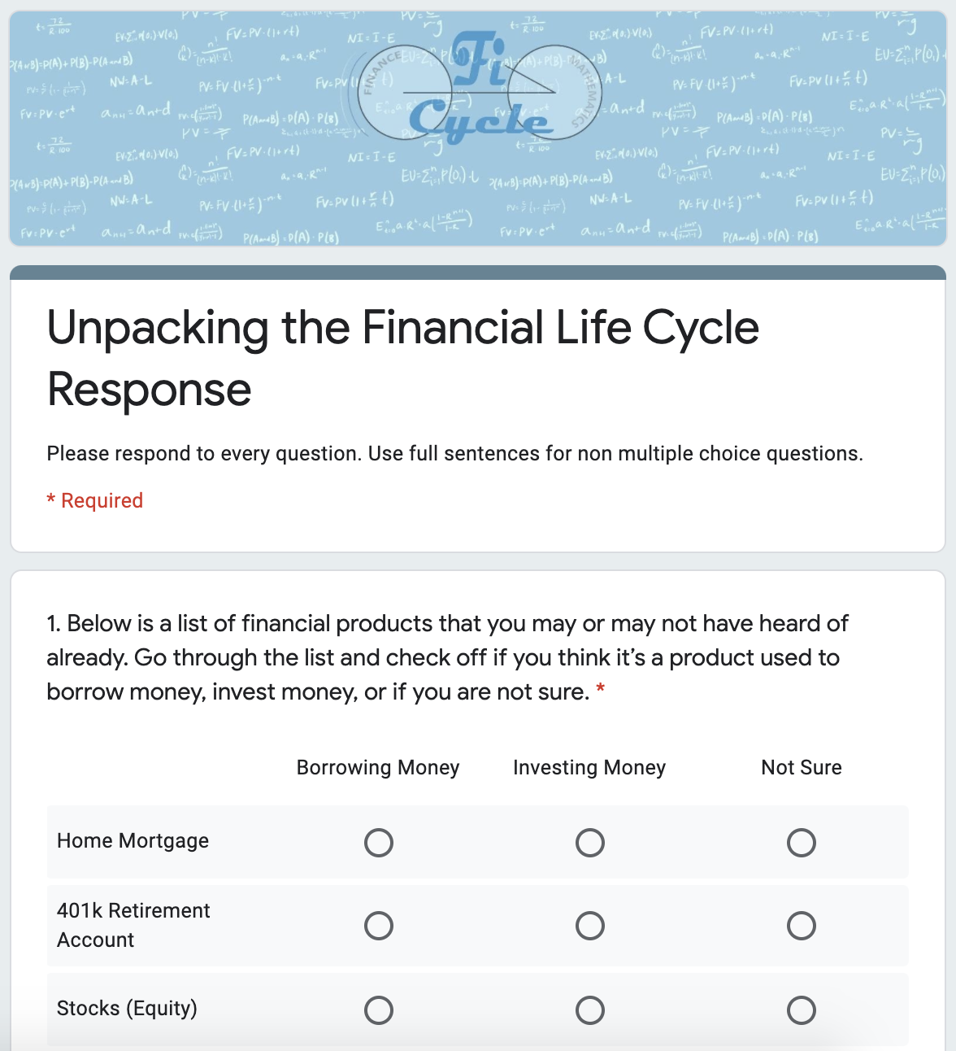
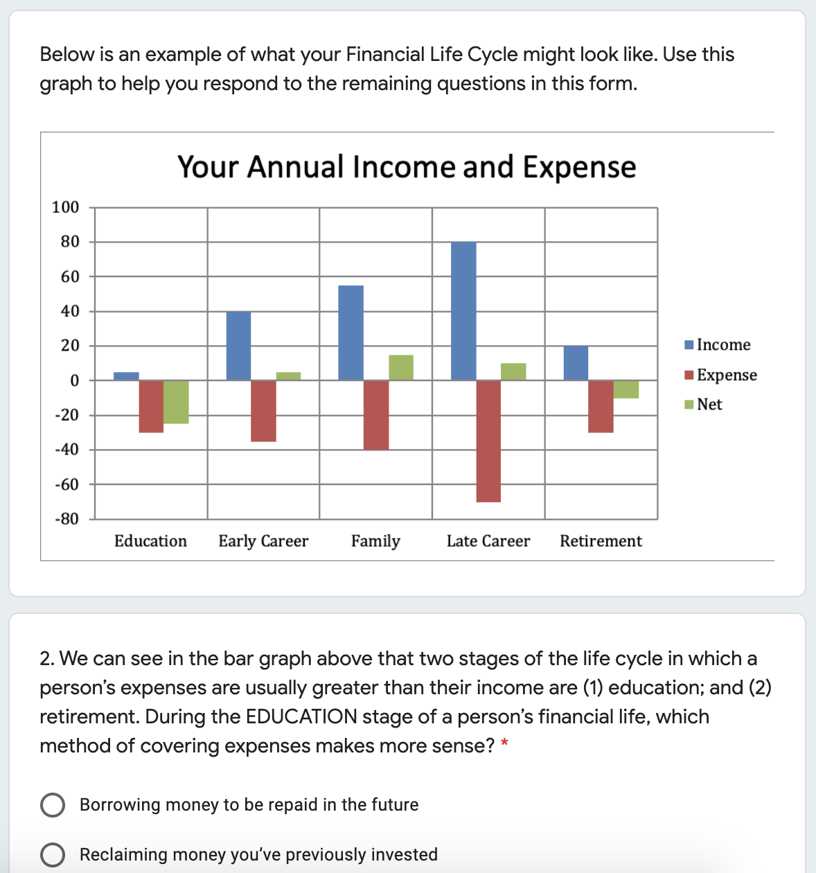
Google Forms

Slide 33
Question Design
Multiple choice
Students get immediate feedback
Limited to certain kinds of questions
Easy Grading
Issues related to giving answer options
Open-ended
Students need to wait for feedback
Can ask a broader scope of questions
More grading
Avoids issues related to giving answer options

Slide 34
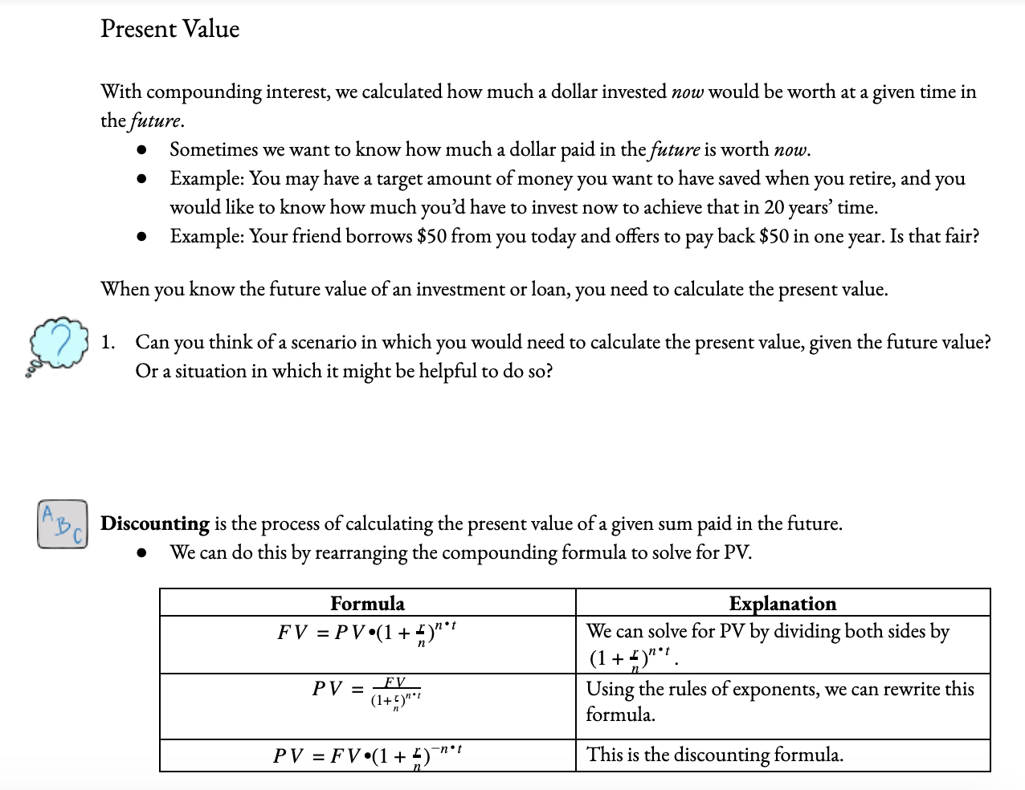

Slide 35
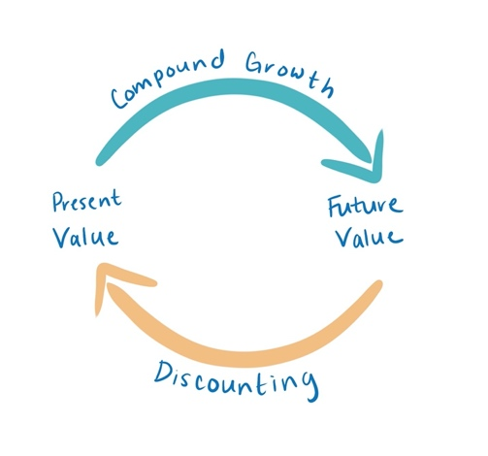
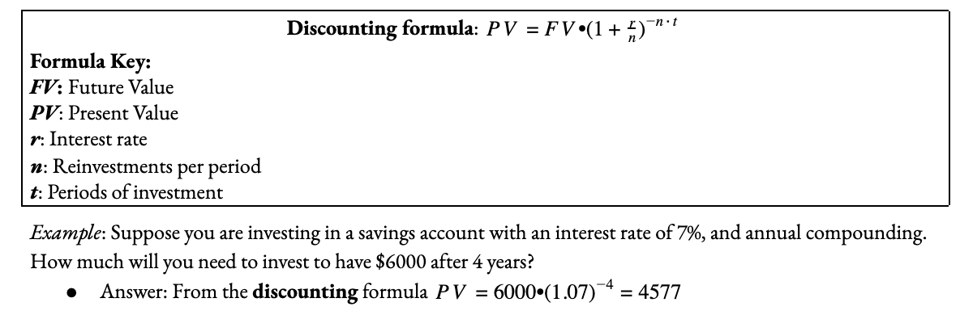
Present Value:
Discounting Formula

Slide 36
Present Value:
Personal Discounting Rate
Identifying Personal Discounting Rate
Interest rates are given
Individuals need to determine their personal discounting rate
Example:
You have a savings account with an interest rate of 0.7%, investments with an interest rate of 6.2%, and $3000 of credit card debt with an interest rate of 24%. What is the present value of $390 received in seven years?

Slide 37
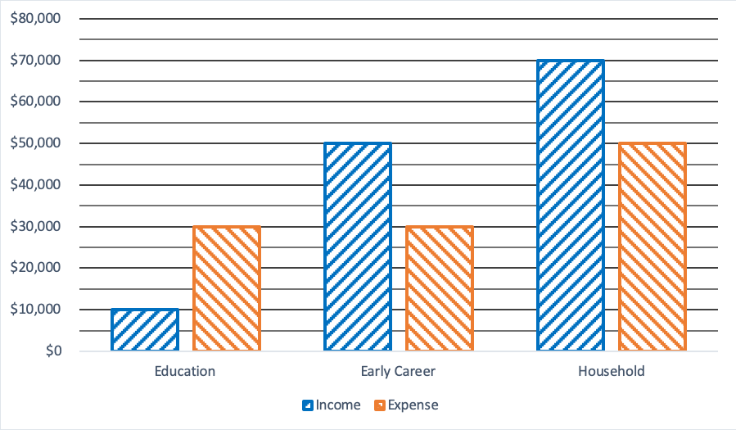
Traversing the Financial Life Cycle

Slide 38
Eduardo’s Financial Life Cycle
How much does Eduardo need to borrow
to cover his education expenses, given
his education income level?
How much does Eduardo have available to repay education loans at both early career and household phases?
Assume each life cycle phase is 10 years apart from the next and that Eduardo’s student loans have a 5% interest rate. What is the present value of Eduardo’s surplus early career income if Eduardo transfers it to the education stage?
How much of Eduardo’s surplus household-phase income is required to completely meet his education expenses, assuming all his surplus early-career income, the amount you calculated in the last question, also goes towards this?

Slide 39
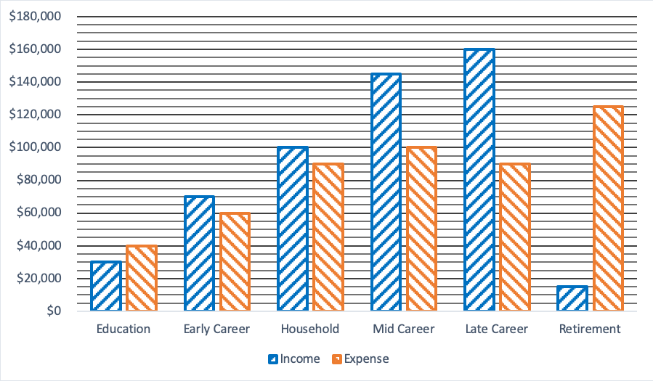
Traversing the Financial Life Cycle

Slide 40
Abby and Tyler’s Financial Life Cycle
Assume that each stage is 10 years apart and that loans have a 5% interest rate while investments have an 8% rate. Abby and Tyler want to use only 50% of their surplus income for covering education expenses, starting with early career and continuing until they are completely covered. Calculate the present value of each surplus in turn and explain at what stage the expenses will have been covered.
Abby and Tyler use the remainder of their income surplus to invest for retirement. What is the future value of each of these investments?

Slide 41
Synchronous Time
Check in with students (Shared bulletin board)
Provide students an opportunity to check and revise work from asynchronous session in small groups (breakout groups)
Provide teacher feedback and field questions
Allow students to collaborate to generate test items in groups
Provide an exit slip: a selection of test items from the student generated problems

Slide 42
Overview
Start with stories and scenarios that allow students to identify with, contextualize and interact with these financial concepts in a low stakes environment
Mathematics is motivated by real world and realistic scenarios
Financial Life Cycle provides the necessary framework to both understand and navigate our our financial lives – and compound interest is the tool we need to do that

Slide 43
Overview
All the materials we shared today are freely available to you for use in your classroom or community.
Download a full set of materials for in school instruction on our webpage:
https://ficycle.org/lessons/
We are happy to share our Google Classroom from today with you for use in your own class if if you email us at info@ficycle.org

Slide 44

CEE Affiliates
https://www.councilforeconed.org/resources/local-affiliates/

