Slide 1
Microeconomics 201: Equilibrium, Goods and Services & Supply and Demand Presented by Amanda Stiglbauer Blythewood High School, SC June 2, 2020 Amanda.Stiglbauer@moore.sc.edu

Slide 2
EconEdLink Membership
You can now access CEE’s professional development webinars directly on EconEdLink.org! To receive these new professional development benefits, become an EconEdLink member. As a member, you will now be able to:
Automatically receive a professional development certificate via e-mail within 24 hours after viewing any webinar for a minimum of 45 minutes
Register for upcoming webinars with a simple one-click process
Easily download presentations, lesson plan materials, and activities for each webinar
Search and view all webinars at your convenience
Save webinars to your EconEdLink dashboard for easy access to the event
You may access our new Professional Development page here

Slide 3
Professional Development Certificate
To earn your professional development certificate for this webinar, you must:
Watch a minimum of 45-minutes and you will automatically receive a professional development certificate via e-mail within 24 hours.
Accessing resources:
You can now easily download presentations, lesson plan materials, and activities for each webinar from EconEdLink.org/professional-development/

Slide 4
Agenda
Roll Call! Collaboration Board
Interactive Ways to Teach Demand & Supply
High tech and low tech!
Demand or Supply?
Equilibrium
Market Simulations and Sidewalk Chalk

Slide 5
Objectives
I can:
Distinguish between a change in quantity demanded and supplied and and change in overall demand or supply.
Explain how price is determined in a market using interactive simulations.

Slide 6
National Standards
Standard 7:
A market exists when buyers and sellers interact. This interaction determines market prices and thereby allocates scarce goods and services.

Slide 7
Demand Auction
How much would you be willing to pay for a bag filled with treats? (you must have money with you)
Write down your “bid” on a slip of paper.
Highest bidder wins!

Slide 8
DEMAND
DEMAND: The WILLINGNESS
and ABILITY to buy a product at a given price.
THE LAW OF DEMAND: The quantity demanded of a product varies INVERSELY with its price.
_
_
_
_
_ _ _ _ _
$2.00
$1.75
$1.50
$1.25
$1.00
$ .75
$ .50
$ .25
$ .00
D
P
+ + + + + + + + + +
1 2 3 4 5 6 7 8 9
Q

Slide 9
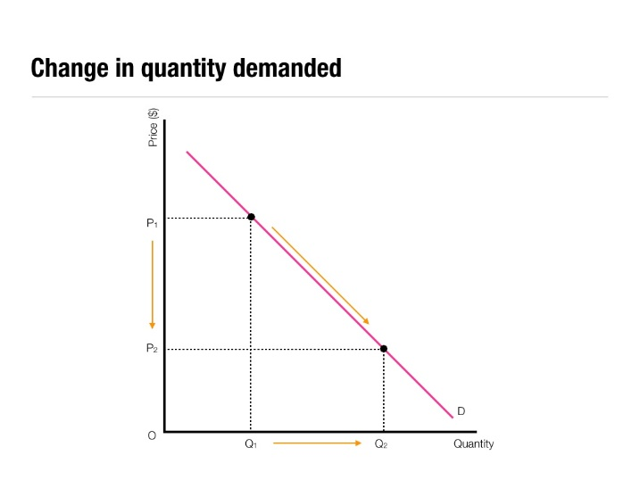
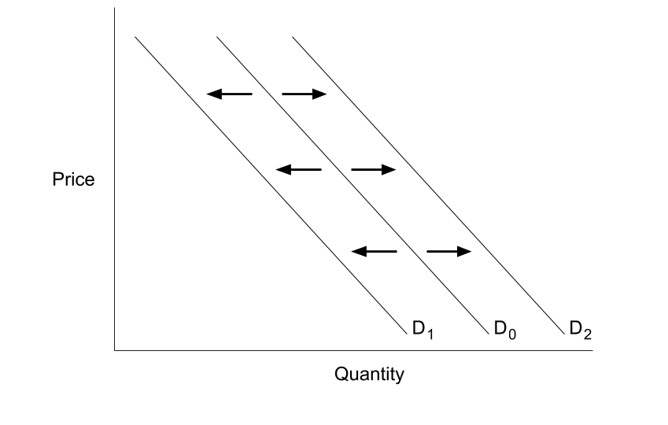
Changes in QUANTITY Demanded and Demand
Quantity Demanded
Change in Demand
caused by an outside factor, such as:
Tastes, Income, Market Size, Expectations, Related Goods (TIMER)
shifts to a NEW demand curve (to the left or right)
Only a change in PRICE can alter
Movement along the SAME demand curve

Slide 10
Concept Building
What would happen to the price and quantity of sunblock if summer suddenly became winter?
https://www.youtube.com/watch?v=y_w105aWPNY

Slide 11
Price of Chocolate
Demand Schedule
Price | Quantity Demanded
$5 | 10
$4 | 20
$3 | 30
$2 | 50
$1 | 80
$5
4
3
2
1
Demand
10 20 30 40 50 60 70 80
Quantity of Chocolate
Q

Slide 12
Change in Demand
Price of Chocolate
Demand Schedule
$5
4
3
2
1
Price | Quantity Demanded
$5 | 10 0
$4 | 20 5
$3 | 30 20
$2 | 50 30
$1 | 80 60
Demand
10 20 30 40 50 60 70 80
Quantity of Chocolate
Q

Slide 13
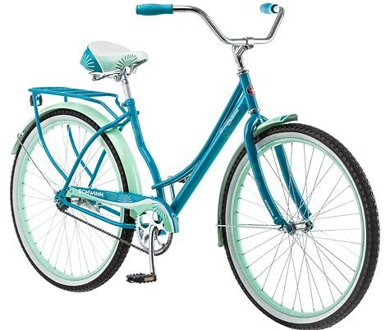
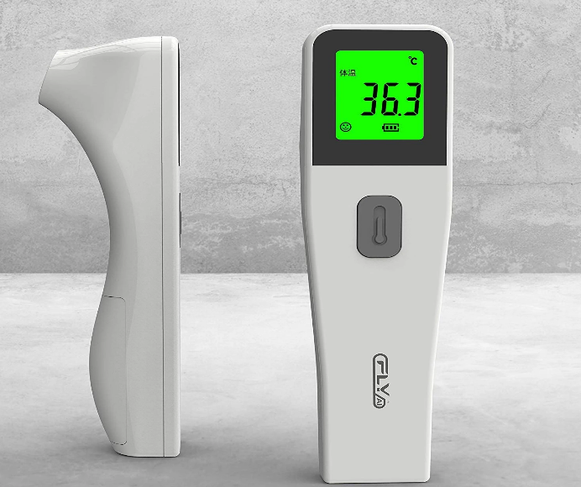
Coronavirus & Demand

Slide 14
Other Interactive Ways to Teach Demand
High Tech Options
Cartoons
News Headlines
Teacher or student led
Low Tech Options
Carpet Graphs
Class Barometer

Slide 15
Demand News Headlines
Demand is ever present in the news and world around us! Using the internet and your favorite news source, find five news articles whose titles demonstrate a change in demand (SHIFT).
Indicate the product.
Copy and paste the link and show the change on a graph on demand.
Be sure to list the determinant of demand!

Slide 16
Demand Cartoons
Go to cartoonstock.com or any other political cartoon site.
Find cartoons that illustrate THREE (different) determinants of demand (you should have a total of three cartoons, one for each determinant).
Copy and paste the cartoon to a Google Slides presentation (one slide per cartoon).
Show which determinant shifts the demand curve and tell what the product is.
Draw graph to show how the demand curve shifts.
Presentation should be three slides total (one slide for each cartoon, graph, explanation).
Here are some examples….. (Your product should look very similar to this).

Slide 17
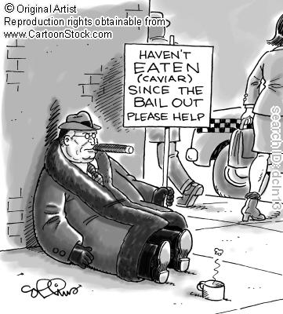
Determinant: Income
Product: Caviar
P
D₂
D₁
Q

Slide 18
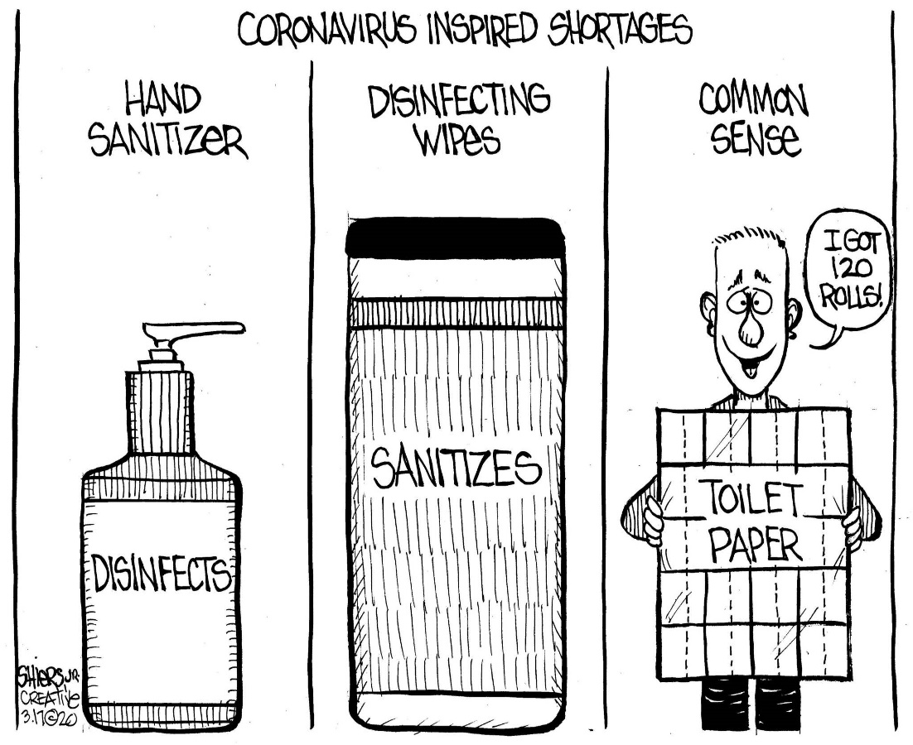
Products: Disinfectants & TP
Determinant: Expectations
P
D₁
D₂
Q

Slide 19
SUPPLY
S
THE LAW OF SUPPLY: quantity Supplied of a Product Varies Directly with Its Price.
SUPPLY: The Willingness and Ability to Supply a Product at a Given Price.
P
Q

Slide 20
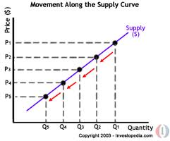
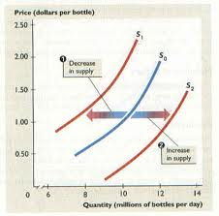
Changes in QUANTITY Supplied and Supply
Quantity Supplied
Only a change in PRICE can alter
Movement along the SAME supply curve
Supply
-outside factors such as: Government tools, Other goods, Input prices, Competition, Expectations, & Technology (GO ICE-T)
-shifts to a NEW supply curve (to the left or right)

Slide 21
Supply Foldable
Today, we will create beautiful foldables to help us apply the determinants of supply to the world around us.
Think of a product you like or would like to produce.
Create two examples for each respective determinant—one example that will increase supply for that good/service and one that will cause supply to decrease for that good/service.
Create your flaps creatively to represent your product.

Slide 22
Chocopalypse?
While watching the video, pick out some factors that impact demand and supply for chocolate and place them on the collaboration board. Be specific about if the factor impacted demand or supply!
https://www.youtube.com/watch?v=6ZKWrGIG9UU

Slide 23
Market Simulations
The Handshake Market
The Bread Market
Pearl Exchange

Slide 24
Buyers: Black Cards
Buyers want to pay the lowest price possible.
The amount the are willing and able to pay is determined by the number on the black cards.
After you make a transaction, return your card and randomly pick a new one.
Buy as many handshakes as you can in each round.

Slide 25
Sellers: Red Cards
Sellers want to get the highest price possible.
How much they are willing and able to sell handshakes for is determined by the numbers on the red cards.
After you make a transaction, return your card, randomly pick a new one, and report the transaction price.
Sell as many handshakes as you can in each round.

Slide 26
Rules
Randomly pick ONE card at a time.
You must pick a different card after each transaction.
Buy and sell to different people.
If you want a new card, you must leave the market.
Sellers = RED; Buyers = BLACK
Leaving the Market: To leave the market a buyer or seller must sit down in their chair for 20 seconds and then hit the “leave the market sign.” Write “left the market” on your score sheet.

Slide 27
Score
Your goal is to have the highest score. Keep track on your score sheet.
Example for Buyer: If your card is a 7 and you negotiate a price of 5, your score is 2.
Example for Seller: If your card is a 4 and you negotiate a price of 5, your score is 1.
If the transaction price is equal, your score is 0.
You cannot buy or sell your handshakes for a loss. If you are having a hard time, leave the market.

Slide 28
Rounds
Round 1: Unregulated competitive market.
Round 2: The government sets a price ceiling on handshakes at $3.
Round 3: The price ceiling is removed, but the price of a substitute (high fives from the teacher) has fallen from $10 to $3.

Slide 30
Assessment Questions
What is the most likely effect this news headline will have on the oil market?
a) price will decrease
b) price will increase
c) demand will increase
d) demand will decrease

Slide 31
Assessment Questions
2. What sort of relationship is there between demand and price of a good?
a) inflated
b) inverse
c) direct
d) disproportionate

Slide 32
Assessment Questions
3. Changes in the demand of a good result from which of the following? a) changes in market size
b) changes in technology
c) change in the price of the good
d) price changes of resources

Slide 33
Assessment Questions
4. If the demand for a product stays the same, and the supply decreases, then what would be the result?
a) The new equilibrium price would be higher.
b) The new equilibrium price would be lower.
c) The equilibrium price would be the same.
d) There would be no equilibrium price.

Slide 34
Assessment Questions
5. Which of the following is NOT a supply shifter (determinant)?
a) technology
b) government tools (taxes/subsides)
c) market size/population
d) number of sellers/competition

Slide 35
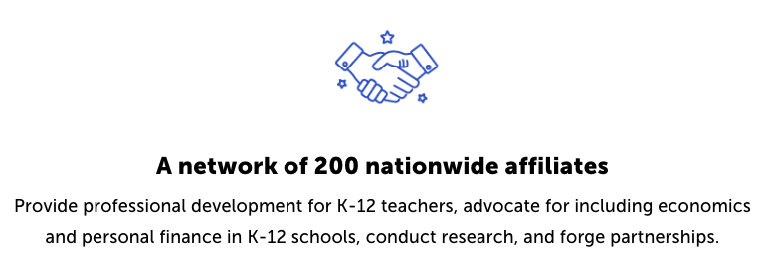
CEE Affiliates
https://www.councilforeconed.org/resources/local-affiliates/

