Slide 1
Teaching Microeconomics with Games & Simulations Presented by:
Alex Lamon, CEE Master Teacher
@AlexMLamon 10/15/19
Notes:
About me

Slide 2
Agenda
Today’s Goal: Showcase games and simulations, with best practice usage, for your CP or AP Economics classroom.
Teachers will leave today with new games they can implement in their classrooms, understanding some of the pitfalls and peaks of these games as learning tools.
Notes:
evolution of trust, monopoly, oilgarchy, epipen, bakery

Slide 3
Evolution of Trust
Topic: Game Theory
Background and context

Slide 4
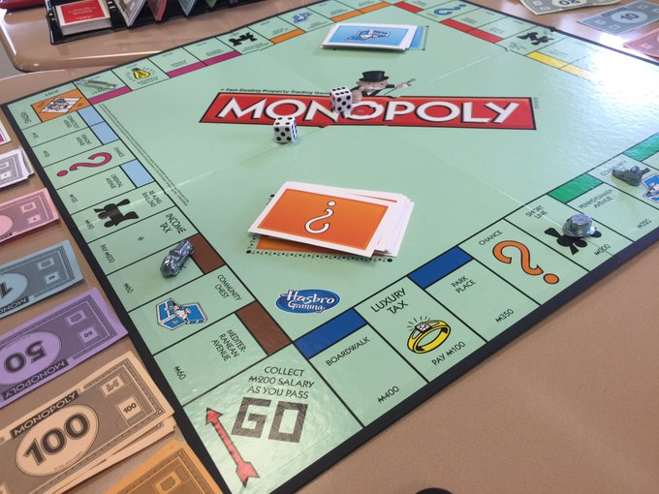
Monopoly (Modified)
Topic: Market Structures
Record keeping

Slide 5
Oilgarchy
Topic: Externalities
Student's Example

Slide 6
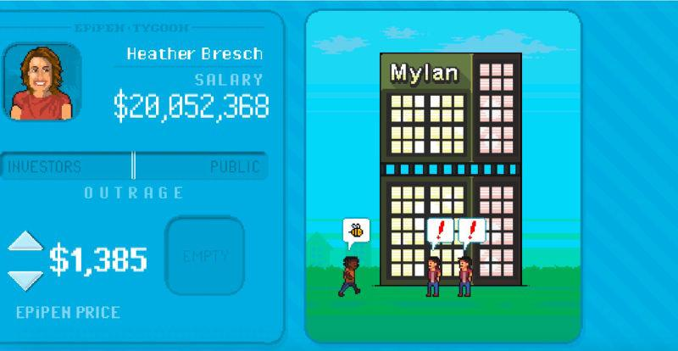
EpiPen Tycoon
Topic: Elasticity, Healthcare
Video example

Slide 7
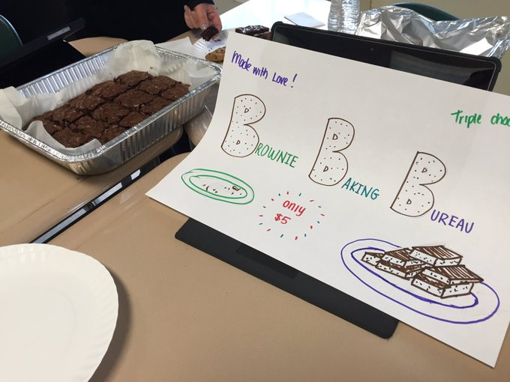
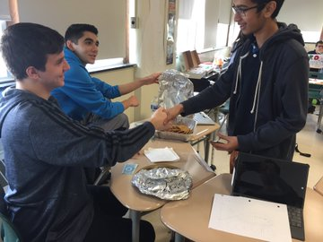
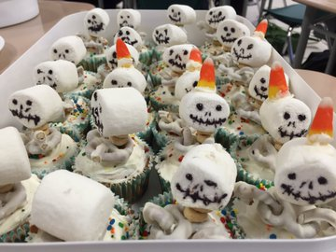
Cost Curves at a Bakery
Topic: Cost Curves, Profit
Overview / Directions
Profit Record
Credit: @RHS_APecon

Slide 8
Summing Up
These games are tools to introduce or enhance understanding
Present them meaningfully, with a clear goal and purpose
Provide opportunity for all students to reflect

Slide 9
I Love Econ!
Thank you! Feel free to connect:
lamonteach@gmail.com
@AlexMLamon

