Slide 1
Module 2: Money Management
July 16, 2019
Doug Kramer

Slide 2
Brief Bio
Social Studies teacher at Herricks High School, in New Hyde Park, NY since 2001.
Before teaching I was Vice President of Portfolio Acquisitions and Regional Manager for Arbor Commercial Mortgage.
2017 Alfred P. Sloan Foundation Teacher Champion Award
Gold Star Teacher Award from the Financial Literacy Certification Program (2009 -2018)
Helped develop the Career and Financial Management Resource Guide for the NYS Career and Management Curriculum Framework.
Co-Advisor of Euro Challenge and Fed Challenge Economic Competition Teams
Presenter at the 56th Annual Financial Literacy and Economic Education Conference

Slide 3
Key Ideas
Understanding what money is.
Money’s role in our economy.
Benefits of money (the obvious is not always obvious).
The role of the financial industry.
Banking
Checking Accounts
Savings Accounts
Note: Shaded pictures have links

Slide 4
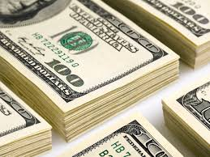
What is Money?
Answer: Anything we use to buy and sell goods and services with. However…
To be money (if you ask a banker or economist) it must be a:
Medium of Exchange
Unit of Account
Store of Value

Slide 5
What is Money?
Medium of Exchange: Facilitates the sale/purchase [exchange] of goods and services between parties. Must have a standard value.
i.e. currency
Different than Barter
Why Money? {Philadelphia Fed}
Easier than Coincidence of Wants

Slide 6
What is Money?
Unit of Account: Measurement of value, can be used to value goods and services, record debts, etc.
Quantifies value
i.e. How much does that cost?

Slide 7
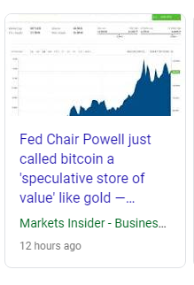
What is Money?
Store of Value: When an asset can be saved, retrieved, exchanged at a later time and be predictably useful when retrieved.
i.e. It retains its purchasing power in the future.
Vs Speculation

Slide 8
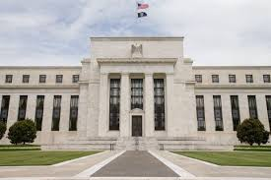
Financial Service Providers
The Federal Reserve Bank [aka The FED]
The US’s central bank. The Fed’s main functions are:
Monetary Policy [interest rates]
Supervising and Regulating US Financial Institutions
Payment & Settlement Systems
Check Clearing
Fed Wire
Brief Fed Videos of Each Function
Overview of What it Does (better)
Lesson Kit

Slide 9
Financial Service Providers
Inside the Fed [The Federal Reserve Bank]
What are the three major responsibilities of the Federal Reserve Bank?
What happens to counterfeit bills?
What happens to bills that are worn out?
What role did the Fed play after Hurricane Andrew?

Slide 10
Financial Service Providers
Inside the Fed [The Federal Reserve Bank]
Monetary Policy:
“…basically it means trying to keep stable to avoid .”
“…as the country’s central bank, the Fed manages monetary policy, meaning it actually changes the size of the nation’s .”
What happens when interest rates rise too much?
Note: I would skip the part about bank examining

Slide 11
Financial Service Providers
Monetary Policy
Fed’s mandate is to:
maximize employment [unemployment rate]
maintain stable prices [inflation rate]
maintain moderate long term interest rates [Fed Funds Rate]
It does this by adjusting the money [hence the name monetary policy] supply.
Note: The Fed creates money, the US Mint [under the treasury] makes our currency. Simple, short videos of a mint in action.

Slide 12
Financial Service Providers
Banks
Financial intermediaries of the economy. Take deposits (surplus of money) and lend to borrowers (deficit of money). They make a profit by charging for services at a higher rate than paid out for deposits.
Services:
Checking
ATM’s
Cashier Checks
Saving
Loans
Credit Cards
Safe Deposit Boxes

Slide 13
Financial Service Providers
Banks
Checking Accounts
Manual vs Electronic

Slide 14
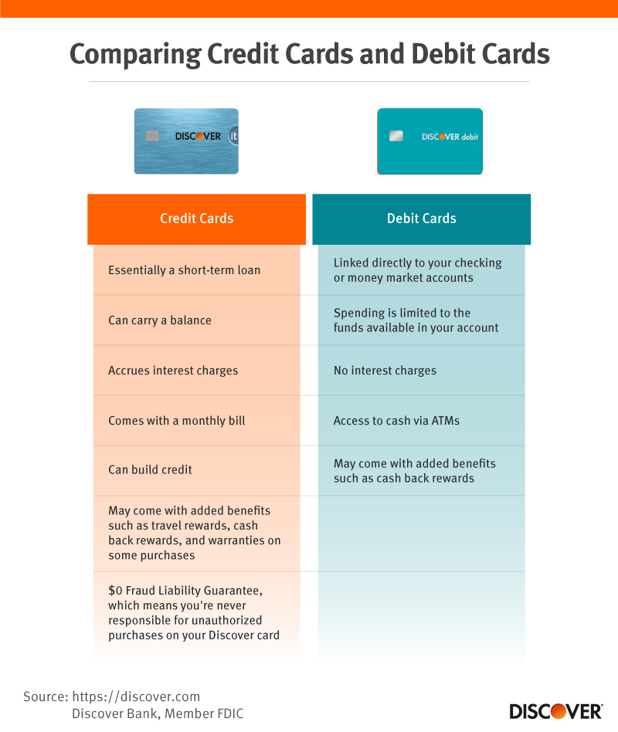
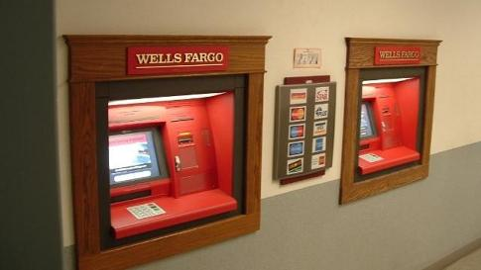
Financial Service Providers
Banks
Checking Accounts
Debit card vs ATM card
Debit / ATM vs Credit

Slide 15
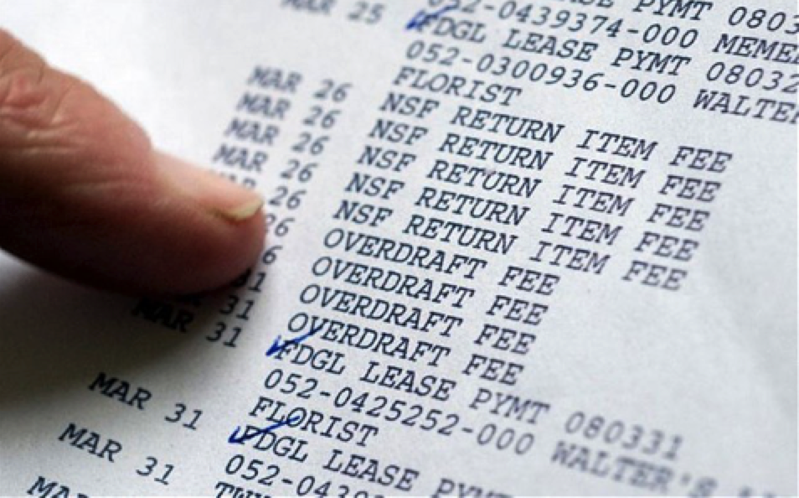
Financial Service Providers
Banks
Checking Accounts
Overdraft
Fees

Slide 16
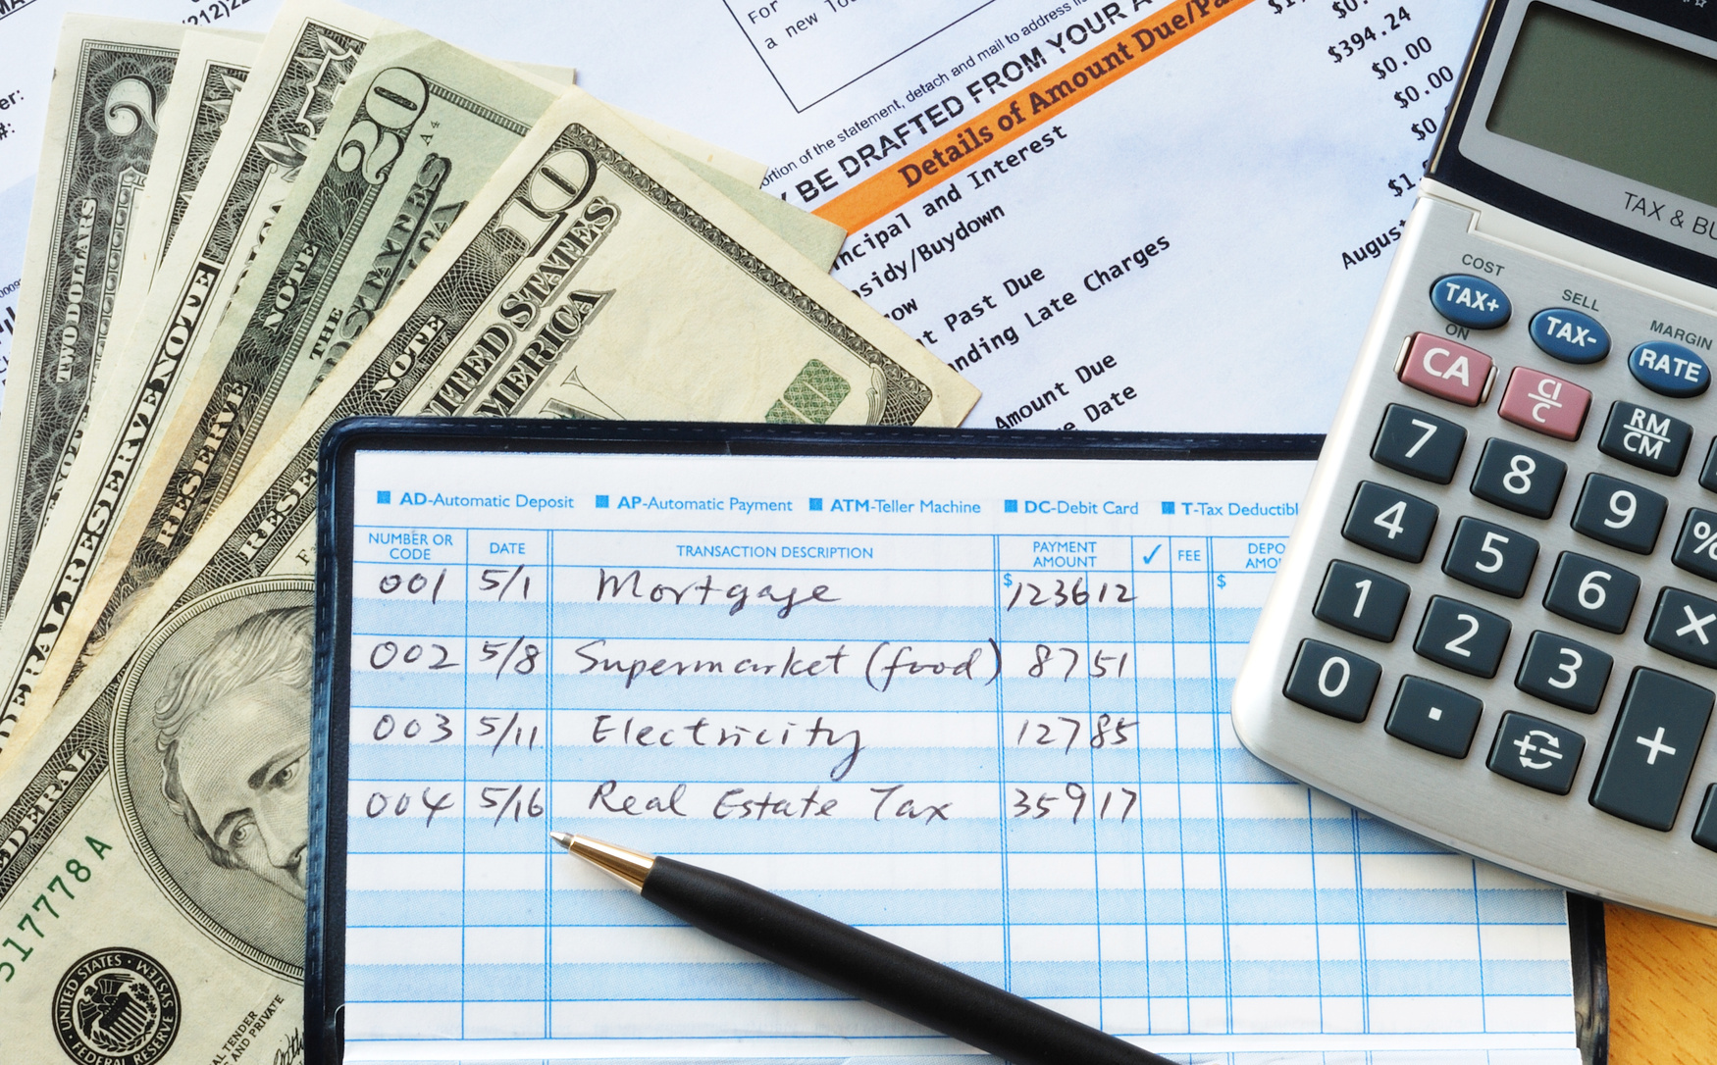
Financial Service Providers
Banks
Checking Accounts
How do I maintain records?
Balancing a checkbook

Slide 17
Financial Service Providers
Banks
Lesson Ideas
Checking Accounts
How do I maintain records?
Balancing a checkbook

Slide 18
Financial Service Providers
Banks
Lesson Ideas
Checking Accounts
Comparing services
Understanding debit cards
Balancing a checkbook

Slide 19
Financial Service Providers
Banks
Savings Accounts
Why?
Emergency Fund
Temporary home
Emergency Fund Requirements
Safe
Liquid
Interest

Slide 20
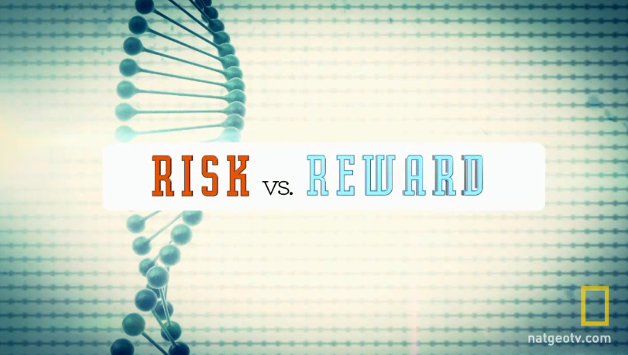
Financial Service Providers
Banks
Savings Accounts
Types
Passbook
Basic Savings
Money Market
CD’s
Risk vs Reward
Interest

Slide 21
Resources
www.econedlink.org
https://www.chicagofed.org/education/econ-classroom/what-we-do-lesson-plan-kit
https://www.philadelphiafed.org/-/media/education/teachers/lesson-plans/MoneyGrades6-8.pdf
https://www.incharge.org/financial-literacy/resources-for-teachers/high-school/
http://wowzone.tdbank.com/wowzone/lessons/Gr9-12Lesson2.pdf

Slide 22
Thank you!
If you have any questions, feel free to contact me @
Dougkramer1@gmail.com

