Slide 1
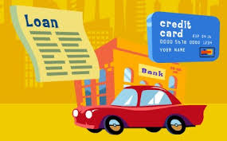

Career and Financial Management Framework Webinar: Insurance (FM.7)
Date: August 21, 2019
Presenter: Kenneth Mengani

Slide 2

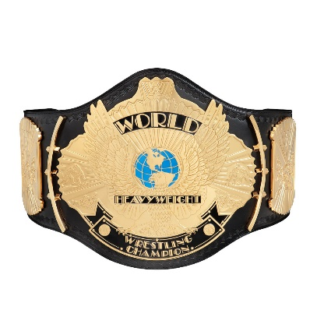

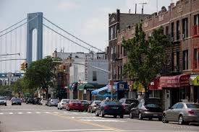

Who am I?
Social Studies Teacher at World Journalism Preparatory School in Queens, New York (a 6-12 school)
Teaching since Fall of 2003
Currently teach AP Macroeconomics, 12 Grade Participation in Government and Economics and 8th Grade US History
Career Highlights: 2009 CEE McGraw Hill “Teaching Champion”; graduate of University of Delaware’s MAEE Program (highly recommended!); workshop facilitator for CEE; textbook and curriculum consultant
Born and raised in Brooklyn NY (so please excuse any peculiar inflection)

Slide 3
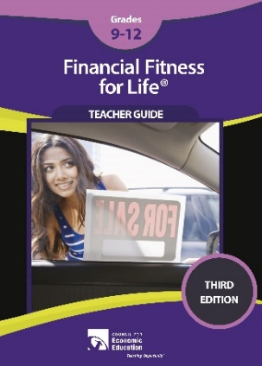


Our Agenda:
Review of NYS Career and Financial Management Curriculum Standards (Insurance)
Lesson 10: Managing Risk (Financial Fitness for Life 3rd Edition)
  Exercise 10.1: Choices and Risk
  *Econedlink Insurance Video and Kahoot Quiz
  Exercise 10.2: Types of Insurance
  Exercise 10.3: What Insurance do We Need
  *Exercise 10.2B: The Big Risk (from 2nd Edition)
Lesson 2.6.5: Types of Insurance (University of Arizona’s Take Charge Today Curriculum)
  Types of Insurance Match Game
  Damon Goes To The Hospital
Review and Closing
www.councilforeconed.org

Slide 4
Our Learning Objectives:
Review NYS CFM Standards (What should I be teaching?!)
Introduce and demonstrate several CEE teaching resources pertaining to key topics (How can I teach it?!)
Share pedagogical approaches that will make teaching more fun, engaging and improve student learning outcomes (How can I teach it better?!)
www.councilforeconed.org

Slide 5
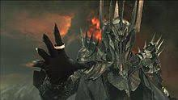
Challenge Slide 1!
Please use the polling feature to answer the following question:
What is the most important reason you are viewing this webinar?
  Learn more about NYS CFM Standards
  Explore new/different ways to teach the topic
  Expand my own knowledge of the topic
  I need credit to maintain my professional license/certification
www.councilforeconed.org

Slide 6
FM7: Insurance
Essential Question: How can insurance minimize financial risk and protect people?
Risk Management: Identify and explain risk, risk management, shared risk, the costs and benefits of insurance and the consequences of not carrying insurance
Purchasing Insurance: Compare insurance companies and insurance brokers; determine insurance needs, decide what is affordable, and compare costs; define insurance terms such as premium, coverage, deductible, and claim
Types of Insurance: Explain purpose and types of vehicle, health, life and property insurance
Other insurance products: travel, electronic device, disability, long-term care
www.councilforeconed.org

Slide 7
Lesson 10: Managing Risk
How does insurance protect us from risk?
Type and Timing: (Reading, Video, Kahoot, Simulation, case study, 90 minutes+)
Standards (NSFL G12 6.4; CCLS: CCRA.R10; W9-10.9; W11-12.9; L.9-10.6; L11-12.6; RH.9-10.4)
SWBAT:
  Identify key types of insurance such as health, auto, homeowner’s, renter’s, life and disability
  Explain the costs and benefits of purchasing key types of insurance
www.councilforeconed.org

Slide 8
Lesson 10: Managing Risk
Sequence:
  Exercise 10.1: reading exercise that introduces the concept of insurance
  *Econedlink Insurance Video: more technical explanation of insurance and introduction on types of insurance (followed by included Kahoot quiz)
  Exercise 10.2: Table outlining the types of insurance and examples of coverage
  *Types of Insurance Match Game
  Exercise 10.3: What Insurance Do We Need
  *Damon Goes to the Hospital Case Study
  Exercise 10.2B: The Big Risk Simulation Game
www.councilforeconed.org

Slide 9
Lesson 10: Managing Risk
Opening Discussion Questions: What do you know about insurance? How would you define the word risk?
  Chart/record student responses; possible review of previous lesson
  Responses might trend toward protecting a car, covering medical expenses, life insurance
Introduce Exercise 10.1
  Exercise can be read as a class or individually; questions can be answered in writing or via class discussion
www.councilforeconed.org

Slide 10
Exercise 10.1: Choices and Risk
www.councilforeconed.org

Slide 11
*Econedlink Video and Kahoot Quiz
This video provides a more technical explanation of insurance and can be used either instead of, or as a supplement to, Exercise 10.1
https://www.econedlink.org/resources/insurance-video-and-quiz/
It includes a Kahoot Quiz as a follow up activity.
www.councilforeconed.org

Slide 12
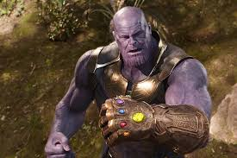
Challenge Slide 2!
Please use the polling feature to answer the following question:
Determining the risk associated with a particular group or activity is called
  Discounting
  Underwriting
  Forecasting
  Risk determination
www.councilforeconed.org

Slide 13
Exercise 10.2: Types of Insurance
www.councilforeconed.org

Slide 14
Exercise 10.2: Types of Insurance
www.councilforeconed.org

Slide 15
Exercise 10.2: Types of Insurance
www.councilforeconed.org

Slide 16
Exercise 10.2: Types of Insurance
www.councilforeconed.org

Slide 17
Exercise 10.2: Types of Insurance
www.councilforeconed.org

Slide 18
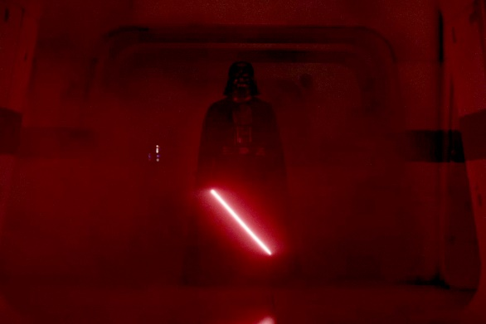
Challenge Slide 3!
Please use the polling feature to answer the following question:
When considering purchasing renter’s insurance, a person should know that the
  premium is based on the tenant’s income.
  landlord’s insurance pays the tenant for any personal property losses.
  purpose is to cover monetary losses related to fire, theft, and personal injury.
  landlord must approve any insurance policy the renter intends to buy.
www.councilforeconed.org

Slide 19
*Types of Insurance Match Game
This game comes from the University of Arizona’s Take Charge Today Curriculum; it can be used as a supplement to Exercise 10.2
Print and prepare 10 Types of Insurance Cards and 16 Insurance Event Cards (duplicate event cards or create your own to supplement deck).
Choose ten students to represent the insurance companies (they can be identified by nametags, armbands, buttons, etc.); remaining students will represent claimants and receive event cards.
Claimant students will have 5 minutes to match themselves up with the correct type of insurance company student
For every correct match, students will receive a piece of candy (or other reward).
www.councilforeconed.org

Slide 23
Exercise 10.3: What Insurance Do We Need?
As a concluding activity students complete Exercise 10.3, a case study of Wyn and Kim.
Students will advise the couple on what types of insurance they should buy given a budget of $3000.
They will also be asked to explain why the couple should buy these types of insurance.
www.councilforeconed.org

Slide 24
www.councilforeconed.org

Slide 25
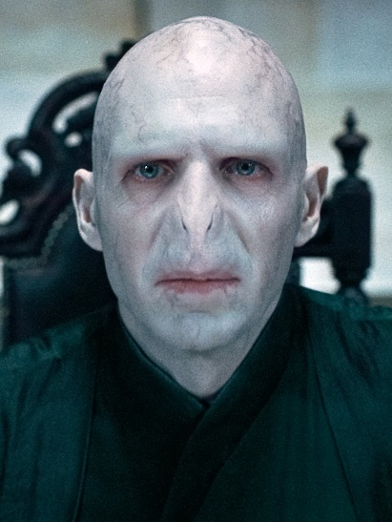
Challenge Slide 4!
Please use the polling feature to answer the following question:
What insurance do you think is the most important insurance they should buy?
  Renter’s Insurance
  Car Insurance
  Health Insurance
  Disability Insurance
www.councilforeconed.org

Slide 26
Damon Goes To The Hospital Activity
This game comes from the University of Arizona’s Take Charge Today Curriculum; it can be used instead of, or as a supplement to, Exercise 10.3.
Students read about Damon who visits the emergency room with appendicitis and learn how much not having health insurance could have cost his family!
www.councilforeconed.org

Slide 27
Damon Goes To The Hospital Activity
Cost of appendicitis without health insurance: $55,543
Cost of appendicitis with health insurance: $7,200 (premiums) + $5,543 (deductibles and co-insurance) = $12,743
Difference of $42,800!
www.councilforeconed.org

Slide 28
Exercise 10.2B: The Big Risk
Can be used instead of, or as a supplement to, Exercise 10.3
Simulation comes from 2nd Edition of FFL, excellent at directly illustrating the financial impact of having or not having insurance, also A LOT of fun
Students can work individually or be broken into groups; groups are better for facilitating conversation and calculations can be farmed out
www.councilforeconed.org

Slide 29
Exercise 10.2B: The Big Risk
Procedure:
Each student receives a copy of 10.2B and each group receives a 12-sided die (or cards with the numbers 1-12)
Students then decide what insurance policies to buy with a maximum budget of $2,900
Groups then roll the die 5 times (or draw five cards) and record the result; each roll (draw) triggers “events” for that year
Based on events triggered, students then calculate their financial losses against an uninsured person facing the same events
www.councilforeconed.org

Slide 32
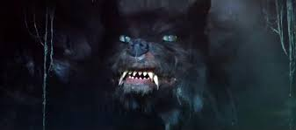
Challenge Slide 5!
Please use the polling feature to answer the following question:
In this scenario, which insurance would you most likely forego?
  Jewelry Insurance: ($60 premium; $3,400 loss; 1 in 12 odds; 0$ Deductible)
  Rare Coin Insurance: ($200 premium; $1,000 loss; 1 in 12 odds; 0$ Deductible)
  Renter’s Insurance: ($240 premium; $2,800 loss; 1 in 12 odds; 250$ Deductible)
  Life Insurance: ($300 premium; $300,000 loss; 1 in 144 odds; 0$ Deductible)
www.councilforeconed.org

Slide 33
Exercise 10.2B: The Big Risk
Roll/Card | Year | Premiums | D/C | Uninsured Costs | Total Costs
9 | 1 U | N/A | $0 | $2800 (Property) + $5000 (Auto) + $1200 (Health) + $14400 (Disability) | $23,400
12 | 2 U | N/A | $0 | $5000 + $1200 + $14400 | $20,600
5 | 3 U | N/A | $0 | $5000 + $1200 | $6,200
3 | 4 U | N/A | $0 | $1200 | $1,200
9 | 5 U | N/A | $0 | $2800+$5000+ $1,200+$14,400 | $23,400
 |  |  |  | Grand Total: | $74,800
www.councilforeconed.org

Slide 34
Exercise 10.2B: The Big Risk
Roll | Y | Premiums | D/C | Uninsured Costs | Total Costs
9 | 1 I | $240 (Renter’s) + $1200 (Auto) + $750 (Health) + $700 (Disability) | $250 (Renter’s) +$250 (Auto) +$25 (Health) | $0 | $3,415
12 | 2 I | $2890 | $250+$25 | $0 | $3,165
5 | 3 I | $2890 | $250+$25 | $0 | $3,165
3 | 4 I | $2890 | $25 | $0 | $2,915
9 | 5 I | $2890 | $250+$250+$25 | $0 | $3,415
 |  |  |  | Grand Total: | $16,075
www.councilforeconed.org

Slide 35
Exercise 10.2B: The Big Risk
Based on our simulation:
Uninsured Costs: $74,800
Insured Costs: $16,075
Difference of $58,725 → it pays to have insurance!
Be aware that groups may a roll sequence where the uninsured spends less; also the dreaded “double 12” roll is possible—both are great opportunities for conversation!
www.councilforeconed.org

Slide 36
Lesson 10: Managing Risk
Closing/Assessment:
  Debrief from Exercise 10.3, Damon Goes to the Hospital or Exercise 10.2B
  Class discussion and/or exit ticket: Why should you buy insurance? What types of insurance are most important?
Ideas for extending and/or scaffolding:
  Econedlink lessons: “Break a Leg” Lesson; Making Sen$e Videos
  For advanced students: have individual students or groups research and present on different types of insurance
  For struggling students: complete reading exercises together; use more close ended questions; use fewer rounds in Exercise 10.2B or complete as a whole class
www.councilforeconed.org

Slide 37
What did we learn today?
Reviewed NYS CFM Curriculum Standards (Insurance)
Explored Activities/Resources:
  10.1: Choices and Risk
  *Econedlink Insurance Video and Kahoot Quiz
  Exercise 10.2: Types of Insurance
  *Types of Insurance Match Game
  Exercise 10.3: What Insurance do We Need
  *Damon Goes To The Hospital
  *Exercise 10.2B: The Big Risk (from 2nd Edition)
www.councilforeconed.org

Slide 38
What did we learn today?
In using these activities with our students they will:
  Explain how insurance works
  Evaluate key types of insurance such as health, auto, homeowners, renter’s life and disability
  Assess the costs of benefits of purchasing different types of insurance
www.councilforeconed.org

Slide 39
Resources Used
CEE’s Financial Fitness for Life (3rd Edition)
  https://www.econedlink.org/resources/collection/fffl-9-12/
University of Arizona’s Take Charge Today Curriculum
  https://takechargetoday.arizona.edu/
www.councilforeconed.org

Slide 40

And now . . . the end!
This concludes the webinar!
Please feel free to e-mail me any questions you may have!
Thank you for your attention! ☺
My contact info
  Kenneth Mengani; kenneth.mengani@wjps.org
  World Journalism Preparatory School
  34-65 192nd Street, Flushing, NY 11358
  Phone: (718) 461-2219 | Fax: (718) 461-2633

