Slide 1
Consumer Options and Protections
How risky are you?
July 31, 2019
Zaileen Washington

Slide 2
Zaileen Washington - Bio
I have taught the following courses: ecommerce, retailing, marketing, entrepreneurship, career and financial management and computer applications coursework
My degreed background is in management, education, and educational administration
I am a CUNY alumnus and formerly an instructor with the College Now Program

Slide 3
Agenda
Unit: FM.6 Consumer Options and Protections
This unit covers the responsibilities that come with being a consumer and the concept of consumer protection. Students will gain insight into laws governing consumer rights and areas for which they must assume responsibility.
New York State Career and Financial Management Curriculum Framework
Preliminary Release June 2018

Slide 4
Learning Objectives for this webinar
Students will be able to examine their rights as a consumer
Students will be able to discern who has their best consumer interest in mind
Students will be able to evaluate their risk options
Students will be able to calculate their risk relating to cost

Slide 5
Before you buy…
Caveat emptor (Latin: “let the buyer beware”)
In the law of commercial transactions it is the principle that the buyer purchases at his own risk in the absence of an express warranty in the contract. (Britannica)
Look out for…
“as is”
“no returns”

Slide 6
Consumer Protections
FTC (Federal Trade Commission)
Protecting consumers and Promoting good business
File lawsuit
Publish decisions
Develop policy
Educate the public

Slide 7
Consumer Protections
(NYS) Attorney General’s Office
The Bureau of Consumer Frauds and Protection, part of the Economic Justice Division, prosecutes businesses and individuals engaged in fraudulent, misleading, deceptive or illegal trade practices.
They conduct studies and write reports about emerging consumer issues.

Slide 8
Consumer Protections
BBB (Better Business Bureau)
“An ethical marketplace where sellers and buyers trust each other”
Private non-profit
Independent state offices
  File a complaint
  Leave a review

Slide 9
Consumer Protections
Small Claims Court
(New York City and Long Island) $5000 or less
You do not need an attorney but you may use one (the other side can as well). In this court you can only sue for a tangible issue/value
Average per hour rate for a NY lawyer is no less than $300hr

Slide 10
Consumer Protections
Fed Functions: Consumer Protection and Community Development
The Federal Reserve advances supervision, community reinvestment, and research to increase understanding of the impacts of financial services policies and practices on consumers and communities.
What is the Federal Reserve?…it is the central banking system

Slide 11
Consumer Responsibilities
The New York City Consumer Protection Law forbids all "deceptive or unconscionable trade practices in the sale, lease, rental, or loan, or in the offering for sale, lease, rental, or loan of any consumer goods and services, or in the collection of consumer debts." Under the Consumer Protection Law (commonly referred to as CPL), the Department of Consumer Affairs has authority to adopt rules prohibiting practices it defines as deceptive or unconscionable. (www.nyc.gov)
Educate yourself
Read information regarding good/service/transaction
This includes reading through the fine print before you ‘agree’*
NYC Department of Consumer Affairs (DCA)
Licensing Center
42 Broadway, Lobby
New York, NY 10004
For further assistance, please call 311 and ask for: the Consumer Protection Law
Website: http://www.nyc.gov/consumers
*terms and conditions" may be deemed an illusory contract and unenforceable

Slide 12
Consumer Profile
Risk Management

Slide 13

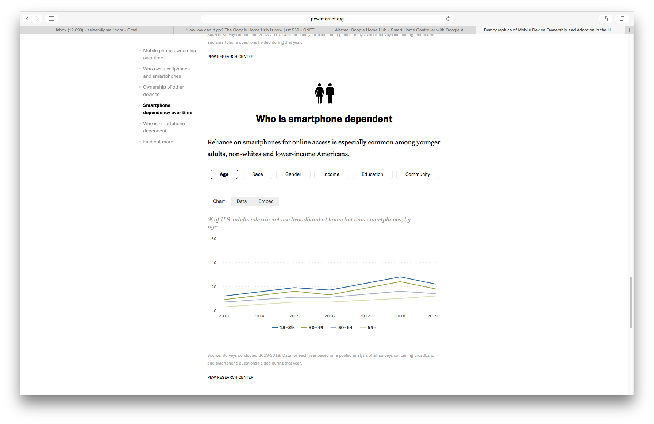
What is the most expensive item on your person at this very moment?
Contemporary Scenario

Slide 14



Risk Management Tolerance - Consumer Behaviors
Types
Avoidance don’t buy
Reduction secure and keep safe
Acceptance I’ll take my chances
Share…
Someone else will share the cost of the loss

Slide 15
Warranty types and cost:
Warranty* (retailer)
  A written guarantee to repair or replace product/service during a specified period of time if proven defective
Extended warranty (retailer)
  A prolonged warranty offered to consumer at a price. It can be also known as a service agreement
Third-party warranty (independent service)
  This type of warranty is fulfilled by another company other than original vendor. It is similar to a service agreement but often may not include manufacturer branded parts or original vendor service persons
  *expressed warranty – written statement promising repair
  vs Implied warranty – basic duty to meet expectations of use

Slide 16
Who? Consumer Protections
Retailer (cellphone)
Apple
The Apple Limited Warranty covers your iPhone and Apple-branded accessories against manufacturing defects for one year from the date you bought your product. The Apple Limited Warranty is in addition to rights provided by consumer law.
Samsung
This limited warranty begins on the original date of purchase, and is valid only on products purchased and used in the United States. To receive warranty service, the purchaser must contact Samsung for problem determination and service procedures.
Ebay
Walmart
SquareTrade All plans are continuous until cancelled. A $25-149 deductible applies per claim. Price comparisons based on smartphone protection for the following providers: SquareTrade Smartphone Protection Plan, Sprint Total Equipment Protection Plus, T-Mobile Premium Device Protection Plus, Verizon Total Mobile Protection, AT&T Mobile Protection Pack. Prices and terms are as of 08/01/2018 and may change. SquareTrade plans do not cover loss or theft. Refer to SquareTrade’s Terms & Conditions
-Protect any phone, any carrier, old or new
-Covers accidents like drops & spills
-Part of the Allstate family
-Continuous coverage follows when you upgrade phones

Slide 17
Shared Risk Exercise
Apple Care+ warranty
Screen damage $29 $29
Any other accidental damage $99 $99
Theft or loss Not available $199 for iPhone 8, iPhone 7, and iPhone 6s
$229 for iPhone XR, iPhone 8 Plus, iPhone 7 Plus, and iPhone 6s Plus
$269 for iPhone XS, iPhone XS Max, and iPhone X
SquareTrade warranty
Spills, drops, battery failure, yes yes
charging port failure, audio failure yes yes
Tech support no yes
Allstate Roadside Assistance no yes
Identify theft no yes
Incidents covered | AppleCare+ w/service fees | AppleCare+ with Theft and Loss Deductibles
Incidents covered | Smartphone protections w/deductible | Smartphone protections plus w/deductible

Slide 18
Activity
Cost/Benefit Analysis
Cost/Benefit worksheet calculations based on the average life of a cellphone (2 years)
An extension for students who maintain their cellphone for more than two years exist as a follow-up
Flow of lesson example

Slide 19
Activity – Cost/Benefit Analysis Worksheet

Slide 20
Extension – accounting for a longer life

Slide 21
Summary of Key Ideas
Consumer rights come with consumer responsibilities
Read before you buy/agree
Look for signage indicating policies (the law is on your side)
You have a right to refuse or amend the agreement before final acceptance
Evaluate the cost for today and the life of the purchase
A good buying decision is a good financial decision

Slide 22
Resources
CEE Resource
www.econedlink.org
  Video – Cost/Benefit Analysis https://www.econedlink.org/resources/decision-making-cost-benefit-analysis-video-and-quiz/
  Video – Consumer Credit Protection
  https://www.econedlink.org/resources/consumer-credit-protection/
URLs
  https://www.ngpf.org (Next Gen Personal Finance)
    ‘Question of the Day’ is a great way to launch a lesson
https://www.ftc.gov (FTC)
https://www.bbb.org (BBB)
https://ag.ny.gov/consumer-frauds/lemon-law (NYS Lemon Law)

Slide 23


Thank you!
contact information
zwashin@schools.nyc.gov or
bergtraumbusiness@gmail.com
Twitter thinking about it
Instagram not yet

