Slide 1
Taxation and the National Debt

Slide 2
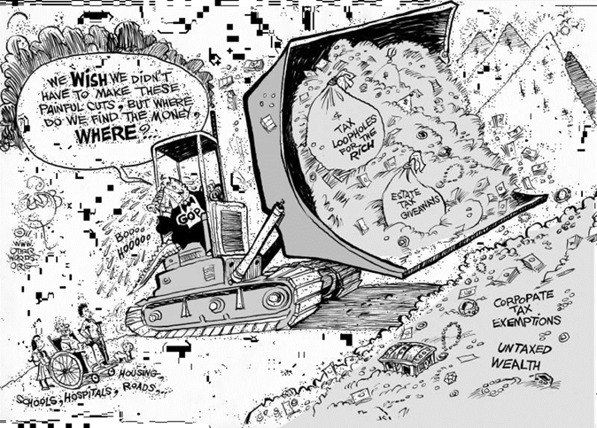
Notes:
Why does society need taxes? (Cartoon A)
[Student responses will vary but may include the need to fund essential public goods and services, the desire to balance the budget and avoid deficits and debt, and, based on the cartoon, some desire for equity or fairness by closing loopholes for the wealthy rather than cutting social programs for people who need them.]

Slide 3
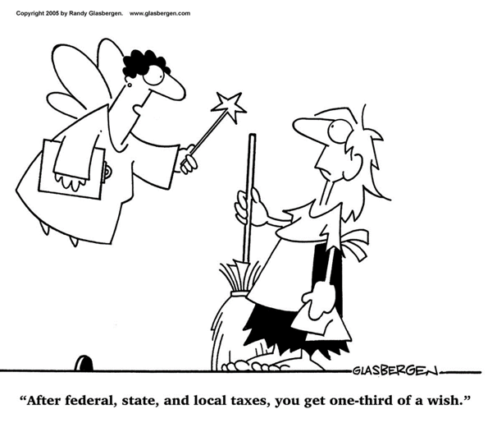

Slide 4
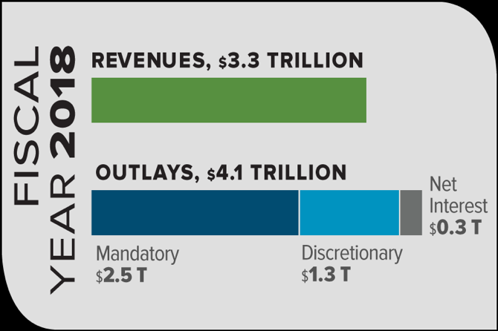
Notes:
Ask students how the government earns revenue (income taxes, corporate taxes, etc). In 2018, the Federal Government earned $3.3 trillion in revenue, but spent $4.1 trillion. What does this mean? (There was a federal deficit of around $800 billion). Ask students to brainstorm some ways this could be fixed. At least one of the suggestions should be to raise taxes.

Slide 5
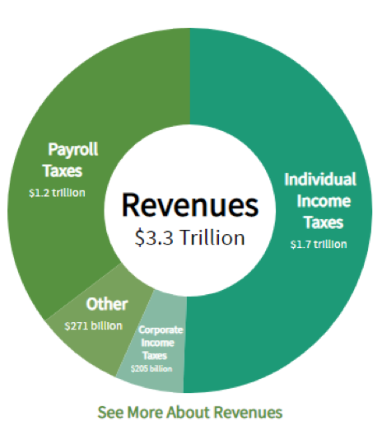
Notes:
Individual income taxes: Receipts from taxes on individual’s income, wages, dividends, and interest earned.
Corporate income taxes: Taxes on income made by corporations
Other: Excise taxes, estate taxes, remittances from the Federal Reserve, fees, fines, etc.
Payroll taxes: Taxes that fund specific social programs like Social Security and Medicare.
Discuss with students that if taxes are to be raised, there are a variety of taxes that can be raised. Each comes with its own costs/benefits.

