Slide 1
Andrew Jackson and the Veto of the Second National Bank

Slide 2
Andrew Jackson and the Veto of the Second National Bank March 7, 2018 Ted Opderbeck

Slide 3
Ted Opderbeck
Teacher at Waldwick High School 1996 - Present
Social Studies/Economics:
AP Economics
Honors Economics I and II
Introduction to Economics and Personal Finance
U.S. History I and II
Introduction to Law
Criminal Procedure
Coach varsity tennis and volleyball
Graduated from Gordon College in Wenham MA
Masters’ Degree in Teaching Montclair State University
Attended Seton Hall Law School
Enjoy photography, hiking, travelling, spending time with wife and two teenage children.

Slide 4
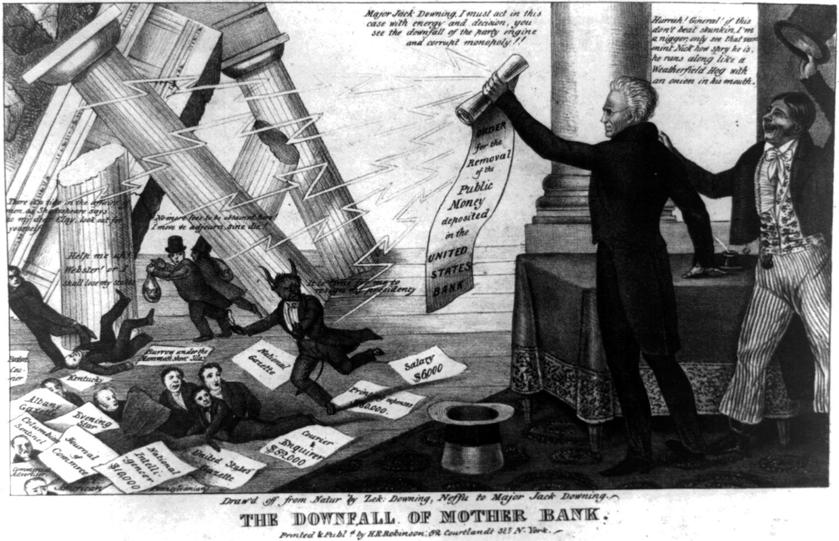
Agenda/ Objectives
Historical Context
EconEdLink Lesson
Further Applications

Slide 5
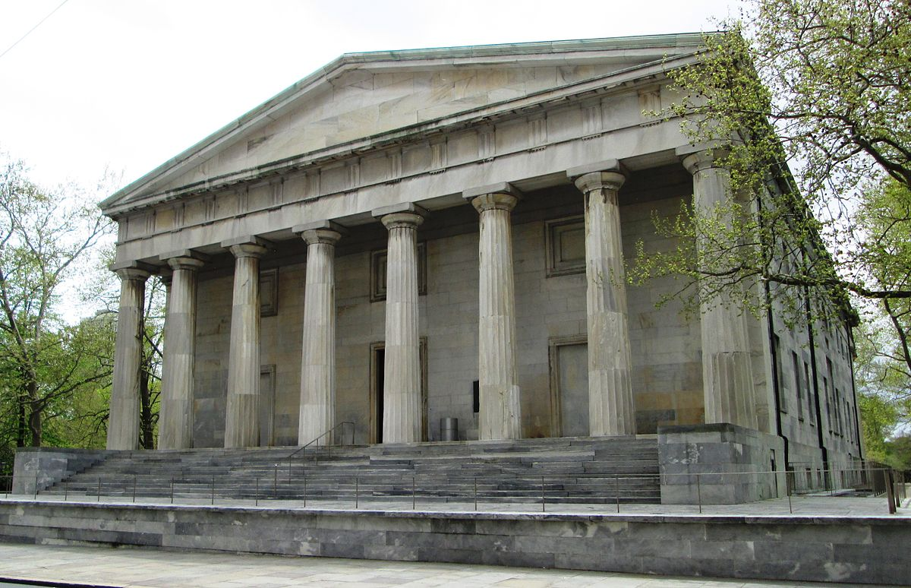
Objectives of the Lesson
Use historical evidence and critical thinking to appreciate the causal relationships and events leading up to Andrew Jackson’s veto.
Identify political, economic, and social arguments made by historical figures involved in the national bank debate.
Research and defend a political position on a historical economic issue.
Make connections to contemporary central banking issues.

Slide 6
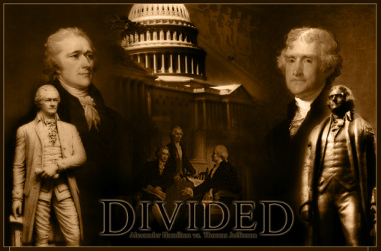
Historical Context
Two Early Views on a National Bank
Federalists
AntiFederalists

Slide 7
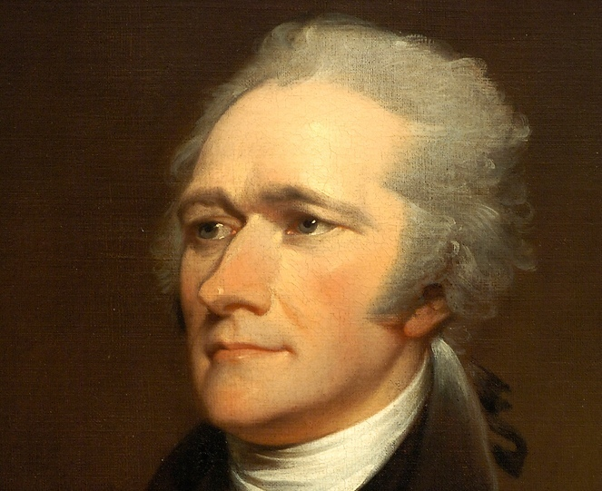
Historical Context
Federalists:
Led by Alexander Hamilton
Wanted a strong national bank
Functions: issue currency, manage the federal government’s budget, monitor private banks
Eventually assume state war debts
Believed a strong national bank would support industrial development

Slide 8
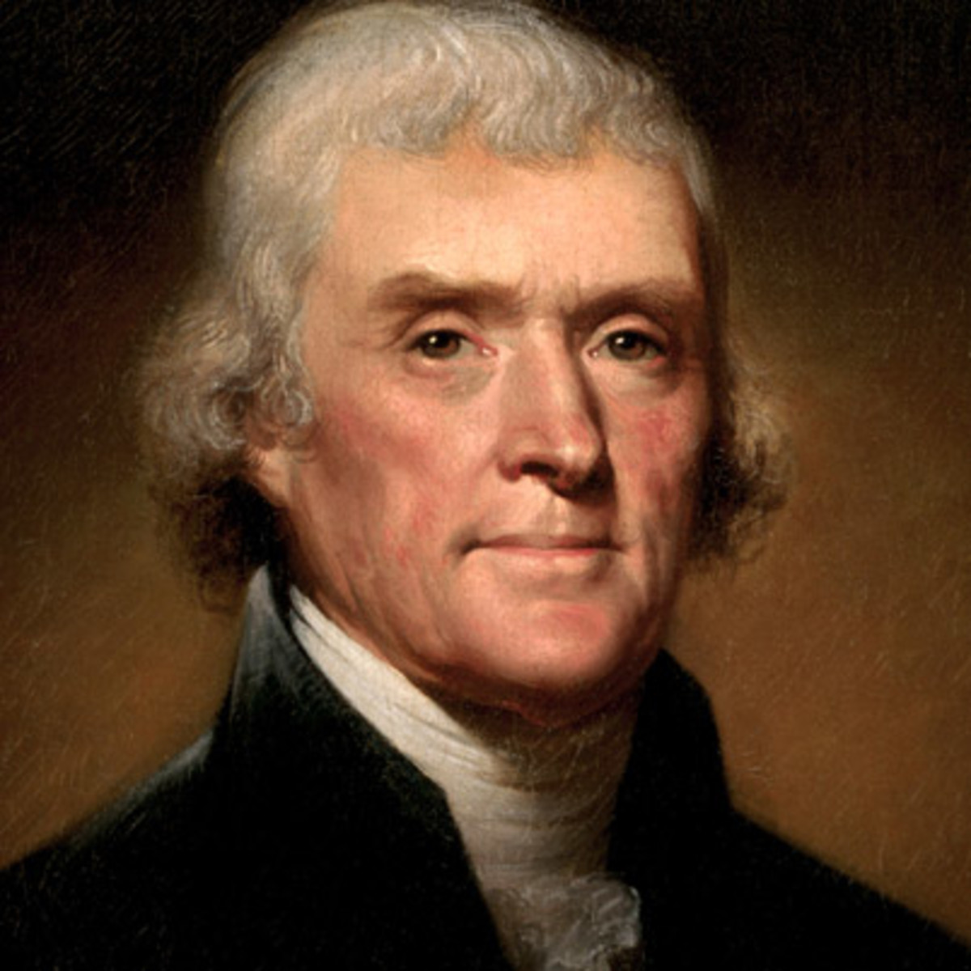
Historical Context (Continued)
Anti-federalists
Led by Thomas Jefferson
Favored a decentralized economic plan with more freedom for states.
Believed a national bank was an abuse of power by the federal government.
Desired an economy based on agriculture

Slide 9
Historical Context (Continued)
1791: First Bank of U.S. established with a 21 year charter
Hold tax money collected by the government
Borrow money in the public interest
Issue representative money backed by gold/silver
Monitor state-sponsored banks
1811 - 1816 - charter ran out - no national bank
Period of financial chaos
State banks issued currencies
Inflation as currencies lost worth
Bank runs and bank instability

Slide 10
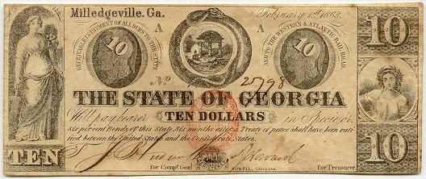
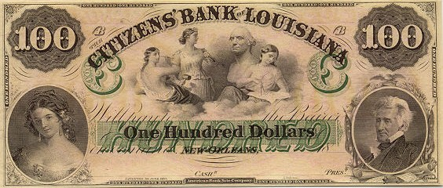
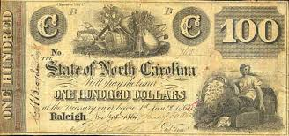
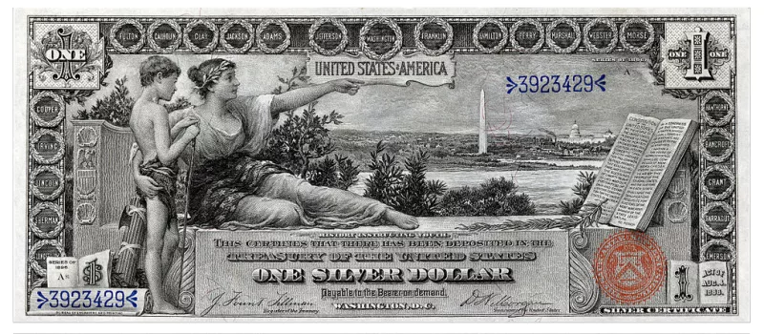
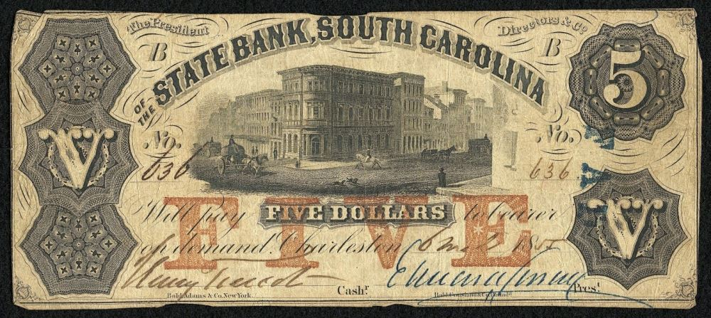
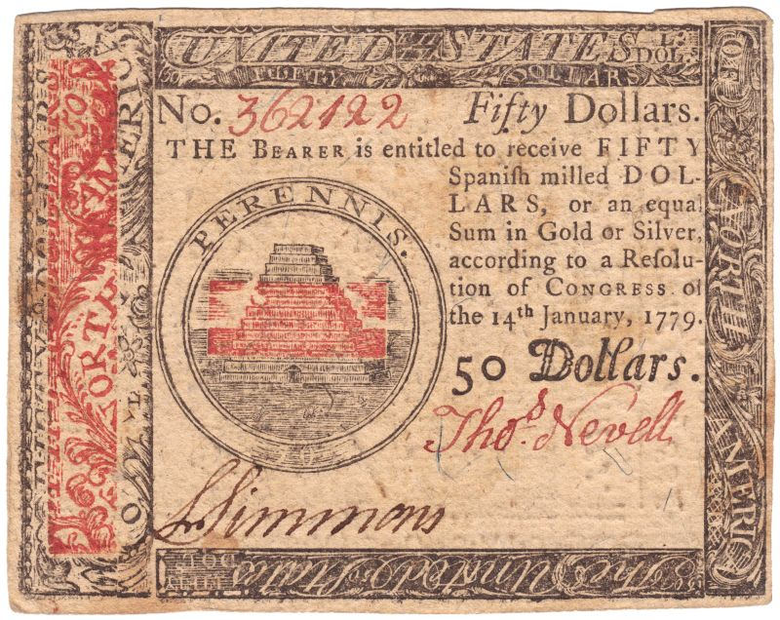
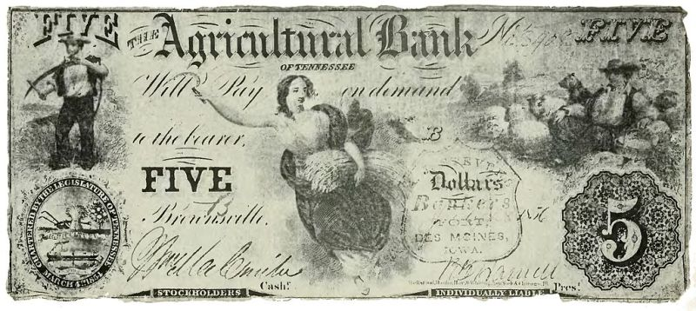

Slide 11
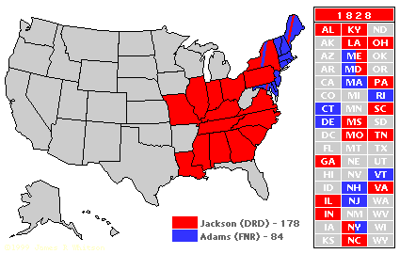
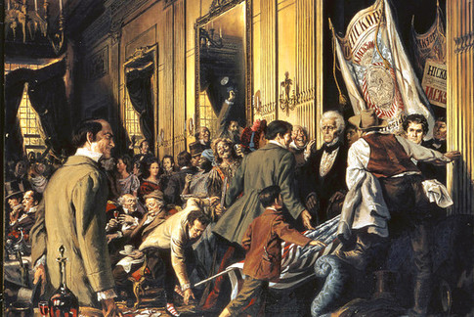
Historical Context (continued)
Congress renews charter for a Second National Bank for another 20 years.
Initially involved in questionable loaning practices and fraud.
Heavily invested in speculative land deals and set off a financial panic
1820’s - restored public confidence with better management.
1828 - Andrew Jackson wins Presidential election.
Strong opponent of the National Bank

Slide 12
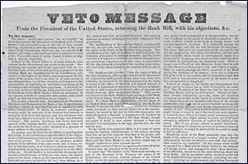
Historical Context (continued)
Jackson considered the bank to be an elitist institution that benefited the wealthy and as an undemocratic organization that did not serve the interests of the common man.
1832: The vote to recharter the bank passed both houses of congress but was vetoed by Jackson.
Debate was so fierce that the disagreement over the National Bank became known as “The Bank War”

Slide 13
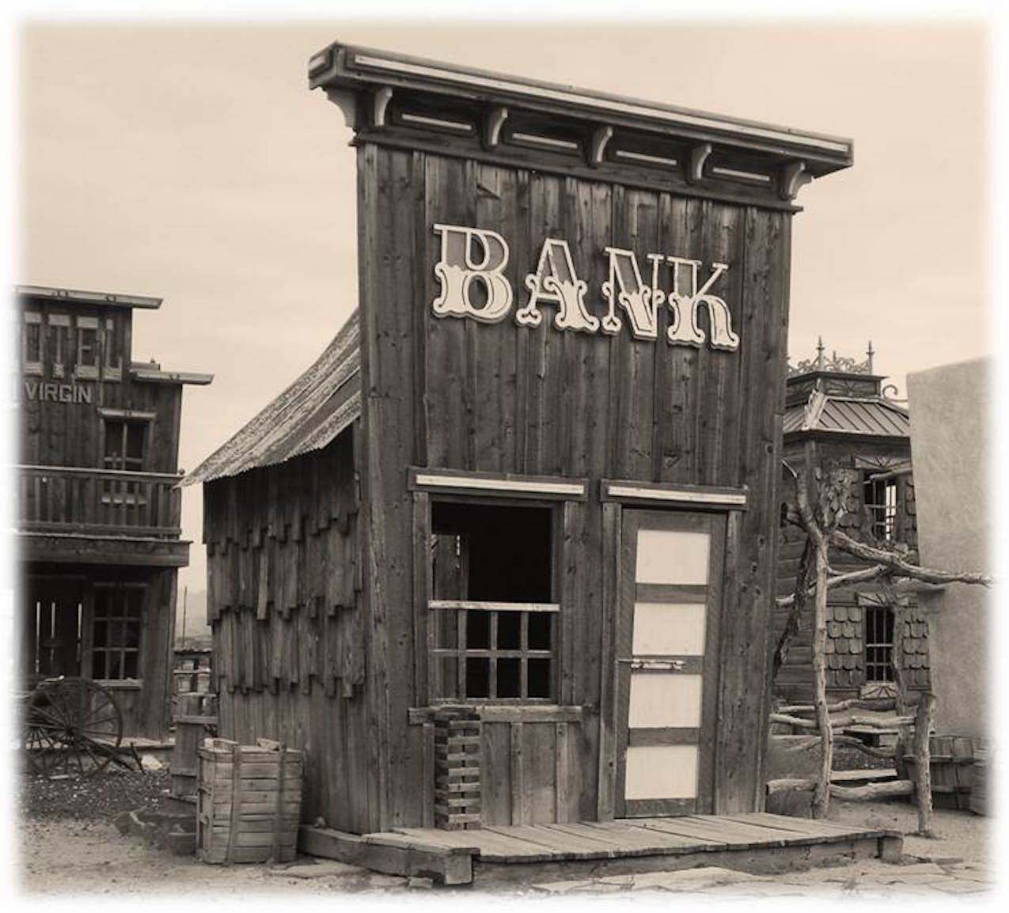
Further Historical Context
1833: Pres. Jackson removed all federal funds from the Second Bank, redistributing them to state banks (“pet banks”)
1836: the bank’s charter officially expired.
1837 - 1863: The “Wildcat Era”
Widespread bank runs/ panics
Over 8,000 currencies
“Wildcat” banks/ bank fraud

Slide 14
EconEdLink Lesson
https://www.econedlink.org/teacher-lesson/1305/President-Jackson-Veto-Second-National-Bank
Resource One - Introductory Set: Display the political cartoon, “King Andrew the First”
Discussion Questions: (Think - Pair - Share)
How is Andrew Jackson depicted?
Why is he shown in this way?
What is some of the imagery used and what might the artist be trying to convey?

Slide 15
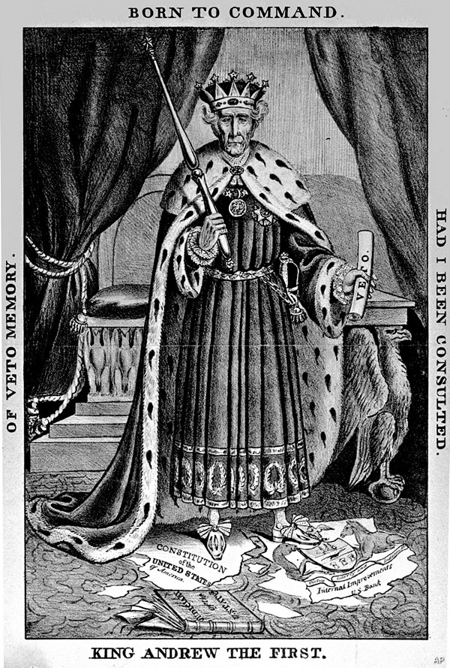

Slide 16
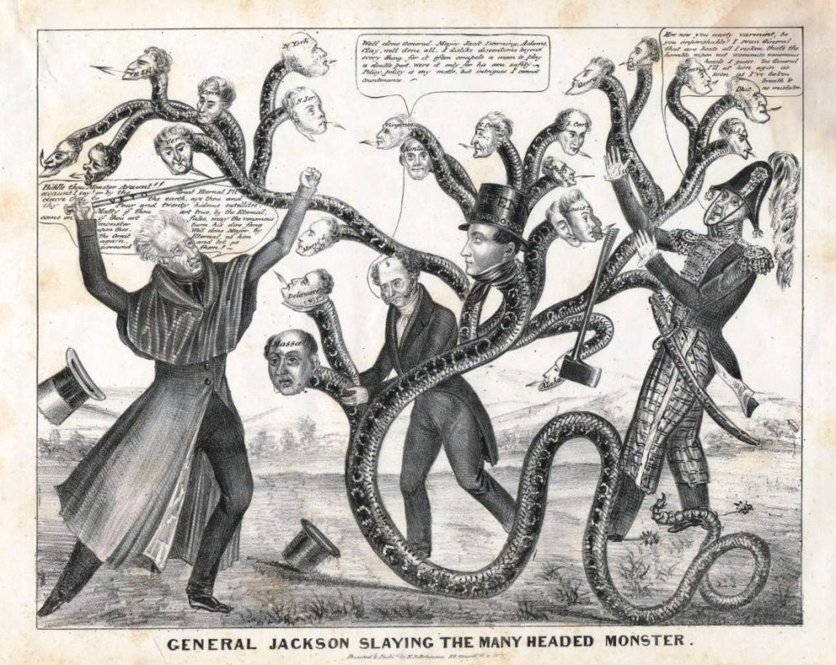

Slide 17
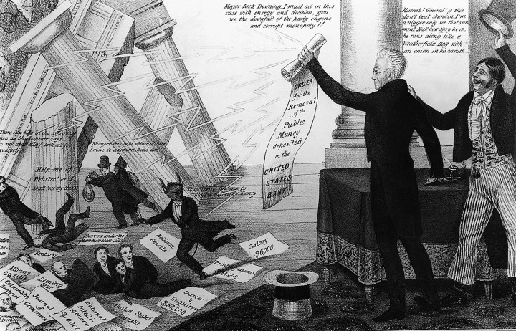

Slide 18
EconEdLink Lesson
Resource Two: Creating a Timeline
Variations for Different Learning Styles -
Kinesthetic - Have students stand in a spot on a virtual timeline
Interpersonal - Groups work together to find appropriate spot, then tape event on a timeline on the wall.
Analytical - Create a “cause and effect” timeline highlighting how one event led to and caused others.
Creative/Artistic - students draw a plot cartoon to show the proper sequence of events.
Technological - students create a digital timeline with images to portray the events sequentially.

Slide 19
EconEdLink Lesson
Follow Up Questions for Timeline Activity:
Who were the major players in the debate and what were some of their central arguments?
Do you think compromise would have been possible at this point?
Could President Jackson and Congress have reached a solution?

Slide 20
EconEdLink Lesson
Resource Three - Identifying the Main Arguments with Primary Sources
Document 1: Andrew Jackson’s Veto Message, July 10, 1832
Document 2: Speech by Senator Daniel Webster (Massachusetts)
Student groups:
Read and highlight the primary sources
Based on the sources, discuss what each man would say about the position statements presented at the end of the readings
Debate the positions

Slide 21
EconEdLink Lesson
Variations:
Provide roles (actual or fictional people who played a part in the national discussion). Students research the role and participate in a “town hall” meeting format.
Students conduct a Socratic “fishbowl” style discussion centered on whether the Second National Bank should be renewed or vetoed.
Students participate in a “value-line” activity in which they reflect on their own opinions and discuss within small groups of classmates.

Slide 22
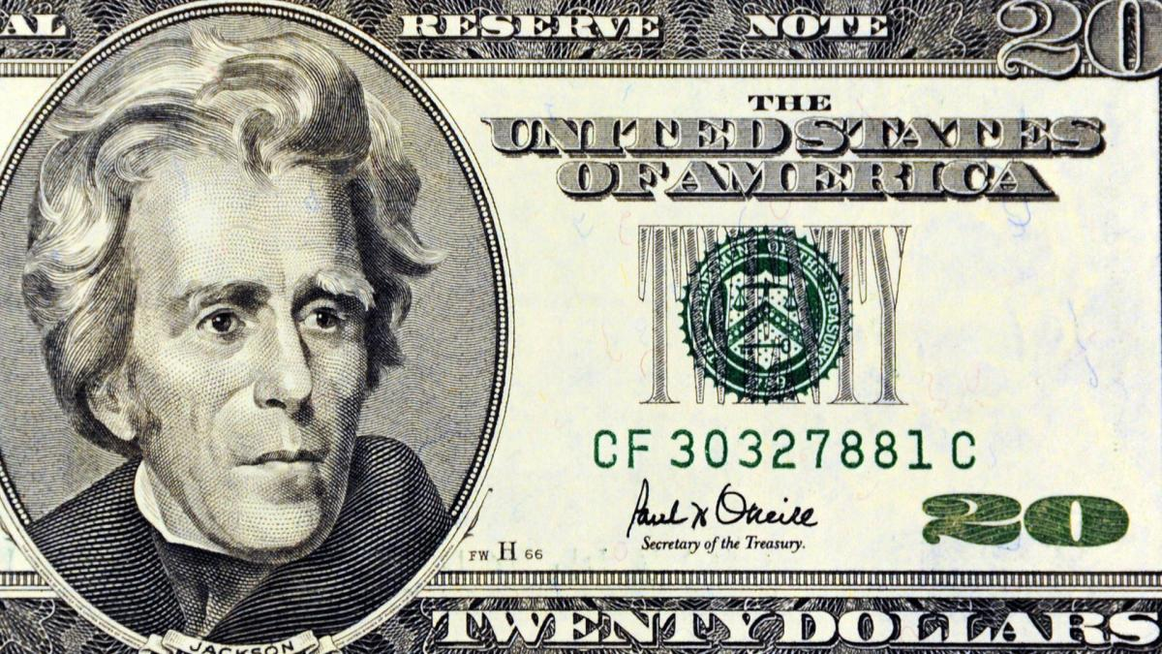
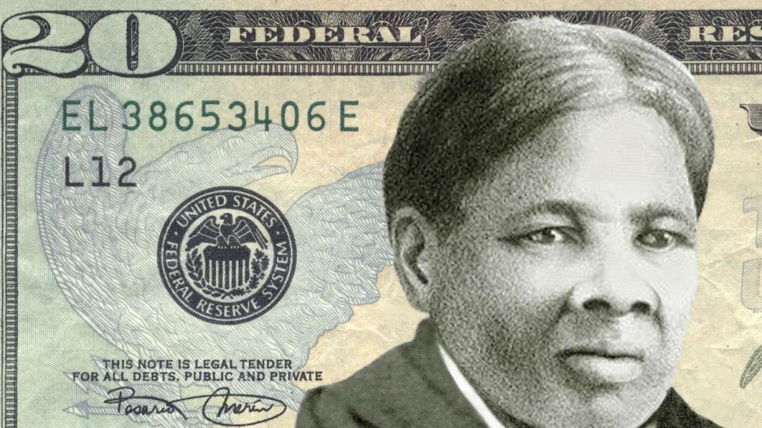
EconEdLink Lesson
Closure
Writing/ Reflection
Could a compromise have been reached?
Online poll - Google Form, Socrative, PollEverywhere

Slide 23
Connections to Today
Big Questions:
Does the Federal Reserve Bank Have Too Much Power?
Should the Fed be more transparent?
How independent should the Fed be?
How much power should the President have in regards to banking and the economy?
Do our modern financial institutions favor the wealthy?
How did failures in the banking system in the 2000’s lead to the Great Recession of 2008-09?

Slide 24
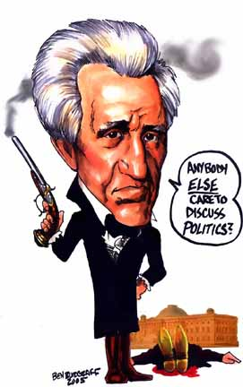

Slide 25
Any Questions?
Email:
opderbeckt@waldwickschools.org

