Slide 1
The History of Social Security
ESSENTIAL DILEMMA
Social Security Act of 1935: Did the creation of a federally administered old-age pension program support or threaten American values and traditions?

Slide 2
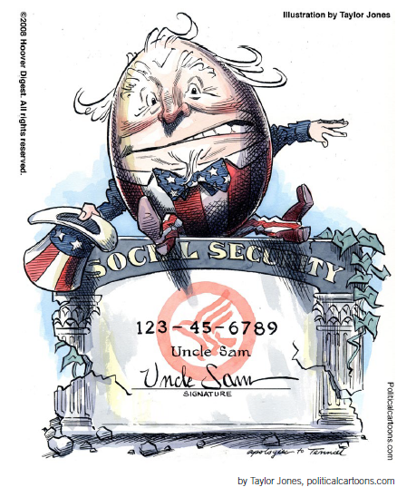
Social Security: Visualizing the Debate

Slide 3
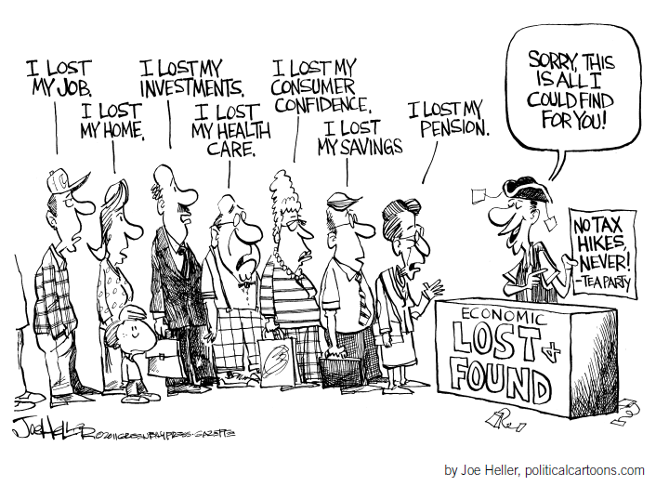
Social Security: Visualizing the Debate

Slide 4
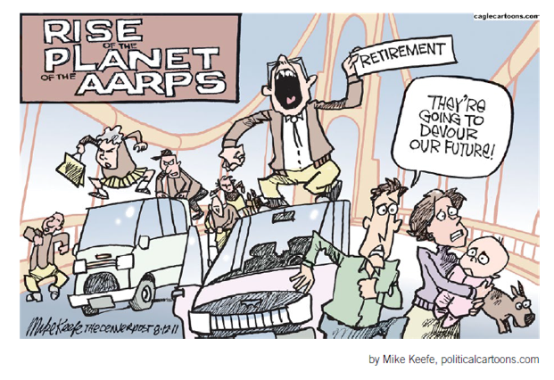
Social Security: Visualizing the Debate

Slide 5
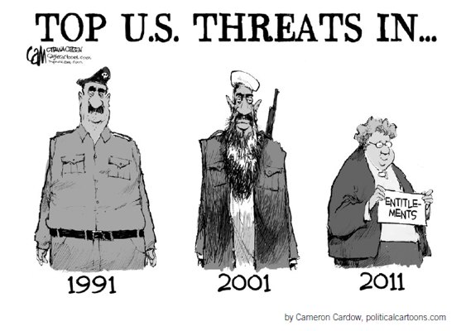
Social Security: Visualizing the Debate

Slide 6
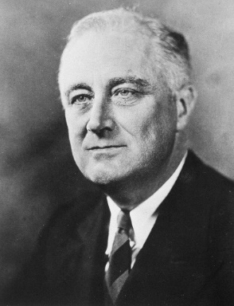
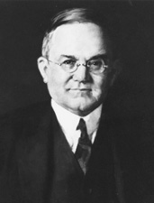
Conflicting Points of View
…security was attained in the earlier days through the interdependence of members of families upon each other and of the families within a small community upon each other. The complexities of great communities and of organized industry make less real these simple means of security. Therefore, we are compelled to employ the active interest of the Nation as a whole through government in order to encourage a greater security for each individual who composes it.
—President Franklin Roosevelt, Message to Congress, June 8, 1934 (Social Security Administration, n.d.e.)
I fear [Roosevelt’s Social Security policies] may end the progress of a great country and bring its people to the level of the average European… It will discourage and defeat the American trait of thrift. It will go a long way toward destroying American initiative and courage.
—Senator Daniel O. Hastings (R-DE), 1935 (Williams, 2011)

