Slide 1
National Security Goals, the Federal Budget and the National Debt
ESSENTIAL DILEMMA
Can the United States make a decision to reduce or modify spending on defense without jeopardizing the country's security goals?

Slide 2
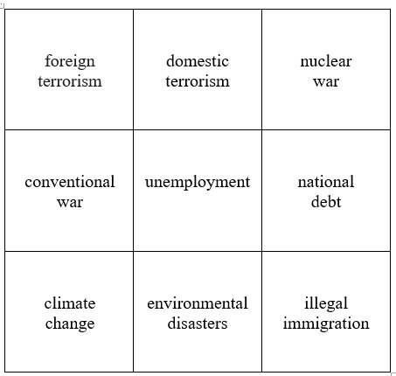
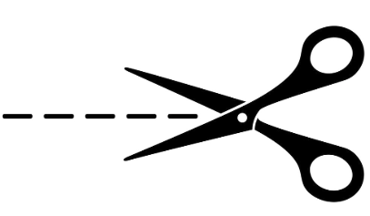
Greatest Threat to National Security
Directions: Cut this sheet into nine squares, and then rank-order the squares on your desk according from the one that is most concerning to you as a threat to national security down to the one you find least concerning.

Slide 3
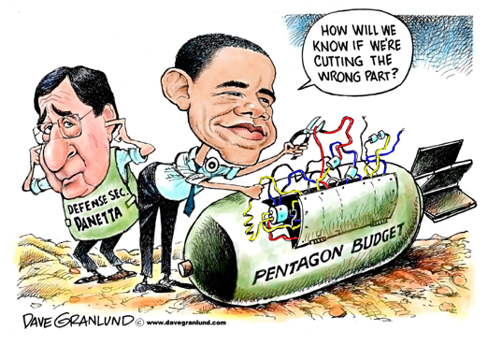
Pentagon Cuts

