Slide 1
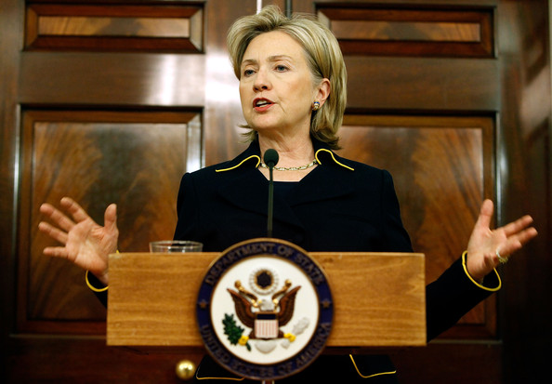
Extension Activity
I think that our rising debt level . . . poses a national security threat, and it poses a national security threat in two ways. It undermines our capacity to act in our own interest, and it does constrain us where constraint may be undesirable. And it also sends a message of weakness internationally.
—Former Secretary of State Hillary Clinton
(Council on Foreign Relations, 2010)

