Slide 1
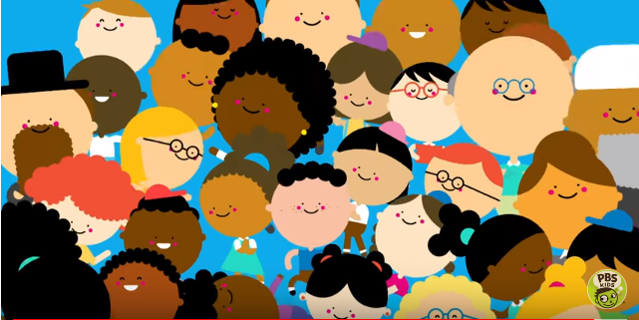
PBS Kids: You, Me & Community
Together We’re the Key

Slide 2
What does community mean to you?
What do you know about your community?

Slide 3
Who are some of the people in your community?
Police officers
Fire fighters
Teachers
Others?

Slide 4
What are some goods that businesses in your community provide?
What is a good?
Do you ever go shopping with your parents?
Can you think about any goods they may have bought?
Where did they buy them?
Can you name the businesses in your community that provide those goods?

Slide 5
What are some services that businesses in your community provide?
What is a service?
Have you ever had someone help you with your family car?
Can you name the businesses in your community that provide those services?

Slide 6
Can you think of places other than a business that provide services?
Do teachers provide a service?
Is a school a business?

Slide 7
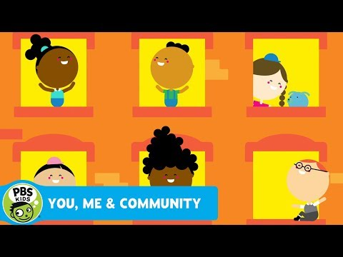
Let’s watch a video about communities!

Slide 8
You, Me, and Community
What were some businesses mentioned in the video?
Grocery store
Dry Cleaner
Music store
Bakery

Slide 9
You, Me, and Community
What were some goods provided in the video?
Groceries
Strudel. Do you know what a strudel is? What are some other things a baker could make?
Lemonade

Slide 10
You, Me, and Community
What were some services provided in the video?
Plumber fixing pipes
Construction worker making a building
Music lessons

Slide 11
The community in this video was a city. Have you ever designed a community!?
Let’s look at some ways cities can be designed.

