Slide 1
Josh Decides to Spend Personal Finance Economics K-2 Pocketwise

Slide 2
Josh and Mom are looking around the pet store. Josh is glad his father wanted him to visit the place and learn about the different costs of having a pet. There are many different and interesting pets to own. Josh never knew there were so many kinds of pets!

Slide 3
Mom likes the rabbits, and Josh stops to look at the hamster cages. One of the hamsters comes to the front of the cage and looks at Josh and then runs around and around. Josh decides that this is the pet for him. He wants a hamster – this hamster that seems to like him already.
“Well you sure seem to have made a friend,” the pet store clerk says. “You have come to the right place to pick out the perfect pet. Hamsters are a lot of fun. They are playful, but they require care, and you will have to be responsible for your hamster’s needs.”

Slide 4
“What does that hamster cost?” Josh asks, as he watches the cute hamster nibble at the food in the back of the cage.

Slide 5
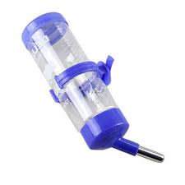
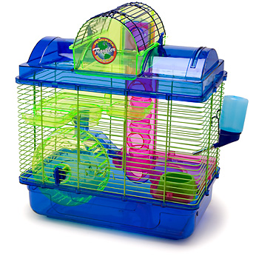
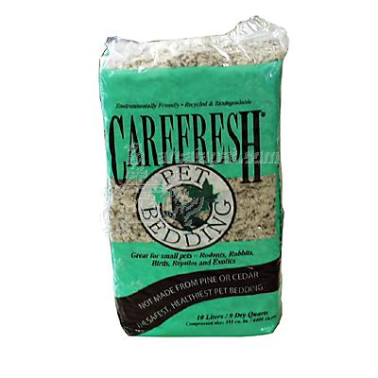
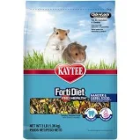
The clerk reaches in and picks up the hamster for Josh to hold. “This costs $5, but you will need to buy some supplies too. You should buy food, a water bottle, bedding and a cage unless your Mom will let it run around your room.”

Slide 6
Mom laughs and shakes her head. “We will definitely need a cage for your new pet, Josh. We don’t want a hamster on the loose.”
The pet store clerk writes down a list for Josh to see. “First, there is the cage for $11. The hamster food for one week costs fifty cents. The water bottle to hang in the cage is $3 and the bedding is $1.50. There are a lot of other things hamsters like to have but this list will get you started with your new pet,” the clerk explained.

Slide 7
Josh adds up the prices on the list. “I will need to spend twenty-one dollars for my hamster. That is a lot of money. I will use up all of my money if I buy this hamster. I can do lots of things with $21.”

Slide 8
“Yes, pets are expensive to own. You need to decide if you will be happy with your hamster once you have used your money,” the pet store clerk said.
“Let's go home and tell Dad what we learned about buying a hamster, Josh. Then if you choose to use your money for this cute hamster, you and Dad can pick it up tomorrow.”
Josh hands the hamster back to the clerk.

Slide 9
“I think this is a very special pet. Will you save this one for me until tomorrow?” asks Josh.
“Yes, I can hold it for you until tomorrow. Let me know what time you will be coming back. Thank you for shopping in our store. See you soon!” the clerk called to Josh and Mom as they closed the pet store door.

Slide 10
At home later, Josh shows Dad the list of costs for the hamster. “I have made my decision,” says Josh proudly. “I want that cute hamster I saw today at the pet store. I have enough money to pay for it. Nicholas and I will train our hamsters together. Maybe I can find a way to earn extra money to buy hamster toys and treats later.”
Josh can't wait for tomorrow to come. Tomorrow he will buy his hamster and bring it home.

Slide 11
Discussion Questions:
Where were Josh and his mother shopping? They went to a pet store.
What new friend does Josh make at the pet store? He met a hamster.
After Josh buys the hamster, what are some of the other things he will need to buy? A cage, food, a water bottle, bedding were other things that Josh would need.
What other things might Josh want for his hamster?

