Slide 1
Who are the most powerful people in the world?
Why?

Slide 2
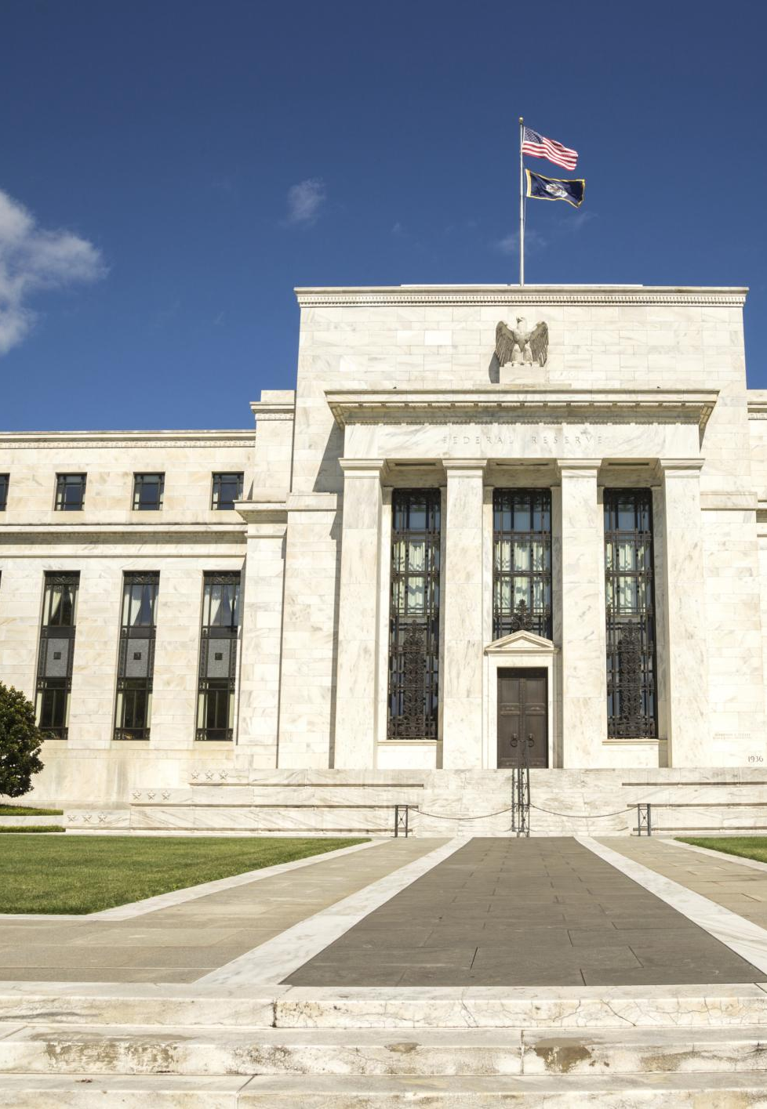
Who is the fed chair and how does one become “head of the fed”?
Fed was established in 1913 by the Federal
Reserve Act
  Outlines who is eligible to become chair
Member of the Board of Governors
Appointed by the President
Testifies before the Committee on Banking,
Housing, and Urban Affairs
Confirmed by Senate
Appointed to a four-year term (may serve multiple)
Currently Jerome “Jay” Powell

Slide 3
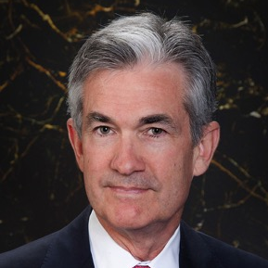
Who is Jay Powell?
Current Fed Chair, appointed by President Donald Trump
Took office February 5, 2018
Member of the Board of Governors since May 2012
Academic experience: AB in politics from Princeton University
(1975), law degree from Georgetown University (1979)
  First Fed Chair since Paul Volcker to not have a Ph.D. in Economics
Work Experience:
  Visiting scholar at the Bipartisan Policy Center in Washington, D.C.
  (focusing on federal and state fiscal issues)
  Assistant Secretary and Undersecretary of the Treasury under President George H.W. Bush
  Lawyer and Investment Banker in New York City
What do we know so far?
  It seems Jay Powell may be inclined to roll back some of the banking regulations
  that were implemented after the 2008 financial crisis.
  Under his leadership, the Fed has increased interest rates by .25% each quarter.
Notes:
The current chair, Jay Powell, is pictured, but the teacher can draw upon examples from previous chairs as well, as the background may be useful during the jigsaw portion of the lesson.

Slide 4
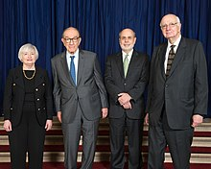
What exactly is the fed chair?
Official Title: Chair of the Board of
Governors of the Federal Reserve System
Public face of the Federal Reserve Bank
and the U.S. Economy
Charged with conducting monetary policy
that:
  Keeps inflation in check and promotes economic growth
  Guides Federal Open Market Committee, which guides policy on interest rates
  Supervises and regulates commercial banks
  Maintains financial stability
Important player in the international community of central banks
Notes:
Continue to discuss the role of the chair as the public face of the U.S. economy and the Federal Reserve Bank, important spokesperson in the international community of central bankers, and his/her role in conducting monetary policy and regulating the U.S. banking system.

Slide 5
How exactly does the fed chair influence monetary policy?
Tools of the Fed
Open Market Operations
Reserve Requirement
Discount Rate
Notes:
As the lesson progresses, examine the ways the Federal Reserve influences monetary policy--open market operations, changes in the reserve requirement and discount rate.

Slide 6
Why does this matter?
The Fed can stimulate the economy by:
decreasing reserve requirement,
decreasing discount rate, buying bonds
The Fed can rein in inflation by: increasing reserve requirement, increasing discount rate, selling bonds
Interest Rates
Aggregate demand
Interest Rates
Aggregate demand
Notes:
“Why Does it Matter?” to discuss how changes in the reserve requirement, discount rate, and open market operations influence aggregate demand and interest rates. When interest rates decline, this encourages the public to engage in more interest sensitive consumption. Lower interest rates prompt consumers and businesses to make more “big ticket” purchases, as the cost of borrowing declines. The Fed may choose to pursue this type of expansionary monetary policy when the economy is facing recession and unemployment in an effort to stimulate economic activity and increase aggregate demand. Conversely, the Fed may choose to increase interest rates when the economy is threatened with inflation or overheating. This is termed contractionary monetary policy, and can be accomplished by increasing the reserve requirement, increasing the discount rate, and selling bonds/securities. As interest rates rise and money is taken out of the economy, aggregate demand declines. In addition, consumers and businesses are less inclined to borrow money for interest sensitive purchases as interest rates rise.

Slide 7
Why are interest rates and aggregate demand important?
Notes:
Invite students to discuss why interest rates and aggregate demand are important in the U.S. economy.

Slide 8
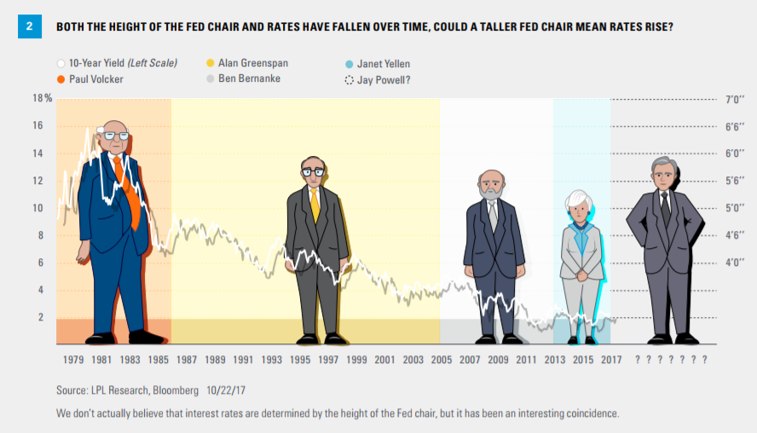
How much power can a fed chair wield?

Slide 9
Individual Activity
Compose a paragraph reflecting on the strengths and weaknesses of your assigned Fed Chair.
Questions to guide your writing:
In what ways did the Fed Chair exhibit his/her power?
What factors limited his/her power?
Did your Fed Chair make mostly positive or negative changes to the economy during his/her tenure?

Slide 10
Exit Ticket
In your opinion, which Fed Chair was most powerful? Why?
Do you believe the Fed Chair is one of the world’s most powerful people? Why or why not?

