Slide 1
Sports Economics:
To Build or Not to Build

Slide 2
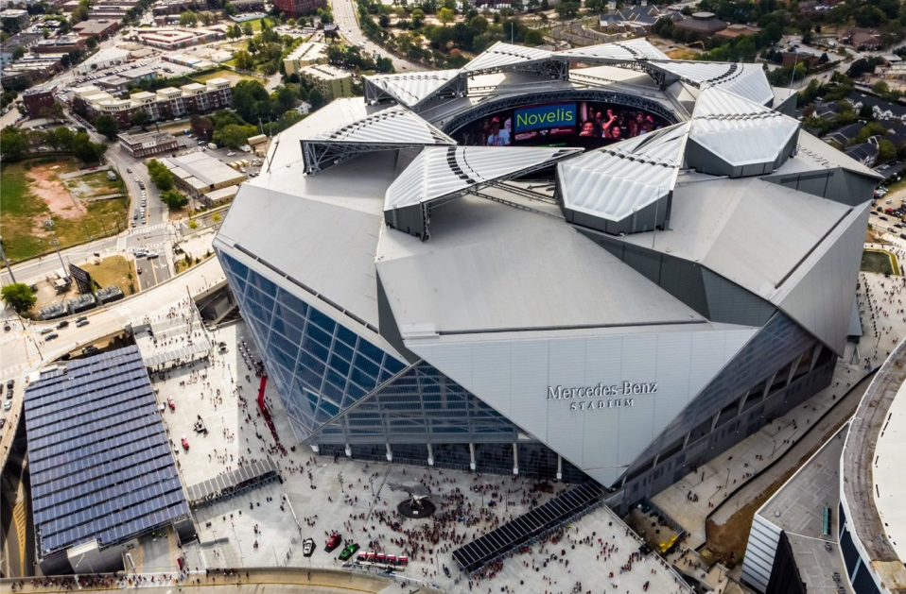
Visual 1
Mercedes-Benz Stadium

Slide 3
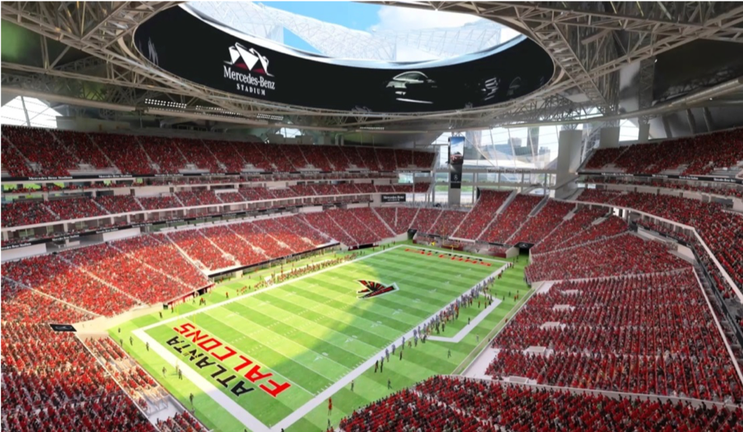
Visual 2
Mercedes-Benz Stadium

Slide 4
Visual 3
$1.6 Billion Dollars
Cost of Mercedes-Benz Stadium:
$1,600,000,000.00
For $1.6 Billion Dollars You Could G­­­et…
9,142,857 Air Jordan XXIIIs…OR
4,558,404 Beats Studio3 Wireless Headphones®…OR
1,231,716 Apple MacBook’s…OR
137,670 In-State Tuition for One Year at the University of Georgi­­­­a…OR
46,784 Tesla Model 3s…OR
5,918 Four Years of Student Tuition, Room, Board, Fees at Harvard…OR
160 Miles of Brand New Four-Lane Highway in an Urban Area in the United States…OR
45 Years of Lebron James’ 2018 Salary…OR
1 Mercedes-Benz Stadium

Slide 5
Visual 4
How Mercedes-Benz Stadium Was Funded
Atlanta Falcons:
$1.2 billion
(partly paid for with personal seat license sales)
National Football League Contribution:
$200 million
Atlanta’s Hotel-Motel Tax Revenues:
$200 million

