Slide 1
﻿Developing Your Human Capital
The Importance of Soft Skills

Slide 2
﻿Discussion Prompt
﻿You are invited by a potential employer to have coffee.
You have never met before, but the discussion will center on possibly hiring you for the job of your dreams.
What will you do to make the impression necessary to land the job?
Spend five minutes at your desk writing down the steps in preparation you would take and the skills and behaviors
you would exhibit during the interview.

Slide 3

﻿Labor Market
﻿Income for most people is determined by the market value of their labor, paid as wages and salaries.

Slide 4

﻿Personal Development
﻿People can increase
their income and job opportunities by choosing to acquire more education, work experience, and job skills.

Slide 5

﻿Human Capital
﻿This important economic term refers to the knowledge, skills, and health that individuals possess.

Slide 6

﻿Human Capital
﻿Developing human capital is a form of investing: investing in oneself.

Slide 7

﻿Human Capital / Opportunity Cost
﻿In devoting time, effort, and perhaps money to education, students give something up now in order to gain something of value in the future.

Slide 8
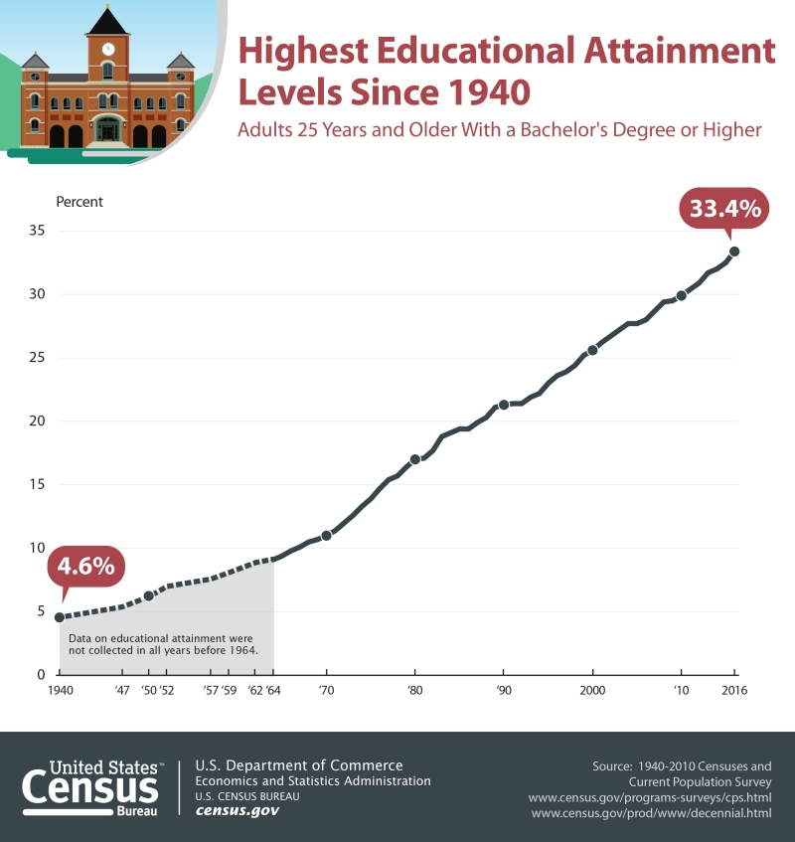
﻿Investing In Yourself
﻿Traditionally, it’s been believed that education is one of the safest and highest value investments around.

Slide 9
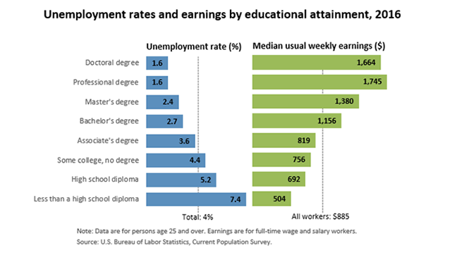
﻿Is More Education Worth The Cost?

Slide 10

﻿Human Capital
﻿Much emphasis is placed on developing the technical elements and specialist knowledge (Hard Skills)
Little attention is paid to developing intangible talents and intuition (Soft Skills)

Slide 11
﻿HARD SKILLS vs. SOFT SKILLS
﻿HARD SKILLS
﻿SOFT SKILLS
﻿Specific, teachable abilities that can be defined and measured
Often listed on a job applicant's cover letter and resume
Examples could include fluency in a 2nd language, software proficiency, machine operation ability
﻿Personality-oriented interpersonal skills, such as teamwork, flexibility, willingness to give extra and communication skills
They aren't learned through a defined instructional path; soft skills are often learned by trial and error.

Slide 12

﻿Seven Soft Skills Employers Seek
﻿Leadership Skills
Teamwork
Communication Skills
Problem Solving Skills
Work Ethic
Flexibility/Adaptability
Interpersonal Skills
﻿Because employers have an easier time teaching new hires hard skills, employers often look for job applicants with specific soft skills instead.

Slide 13
﻿Attributes Admired
﻿Intangible Skills Important To Employers
  ﻿Leadership 80.1%
  Ability to work in a team 78.9%
  Communication skills (written) 70.2%
  Problem-solving skills 70.2%
  Communication skills (verbal) 68.9%
  Strong work ethic 68.9%
  Initiative 65.8%
Source: Job Outlook 2016, a survey conducted by the National Association of Colleges and Employees (NACE)

Slide 14

﻿Key Soft Skills
﻿Leadership Skills:
cultivate relationships and build teams
Teamwork:
understand the value of joining forces
Communication Skills: Verbal, Non-Verbal, Aural, Written and Visual

Slide 15

﻿Key Soft Skills
﻿Problem Solving:
find answers and workable solutions, take on problems don’t avoid them
Work Ethic:
self-starter, punctual, meet deadlines, thorough, “go the extra mile”, be responsible

Slide 16

﻿Key Soft Skills
﻿Flexible/Adaptable:
“wear multiple hats”, respond to change well
Interpersonal Skills: maintain relationships, develop rapport, use diplomacy

